Slide 1
All In Praising God

Slide 2
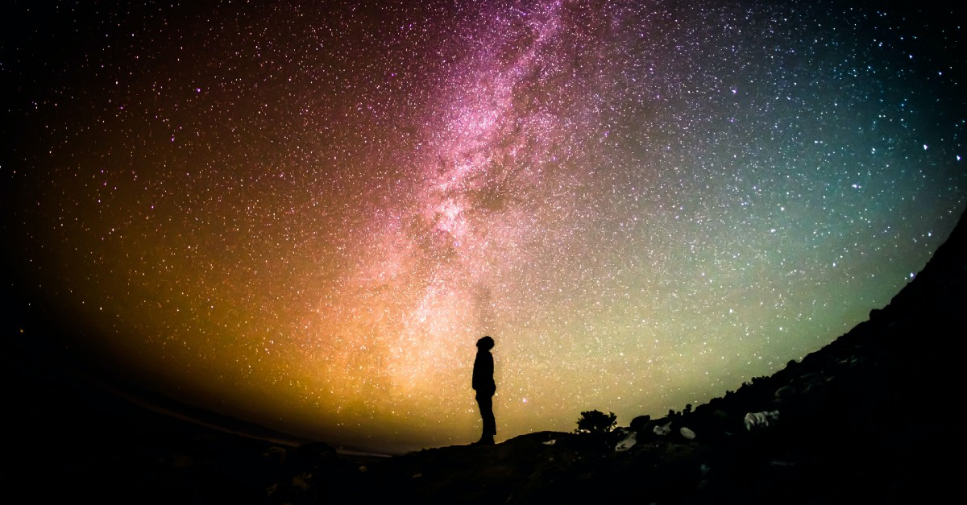
Psalm 19 The Heavens Declare the Glory of God!!!

Slide 3
Psalm 19:1-4
The heavens declare the glory of God; the skies proclaim the work of his hands.
Day after day they pour forth speech; night after night they reveal knowledge.
They have no speech, they use no words; no sound is heard from them.
Yet their voice goes out into all the earth; their words to the ends of the world.

Slide 4
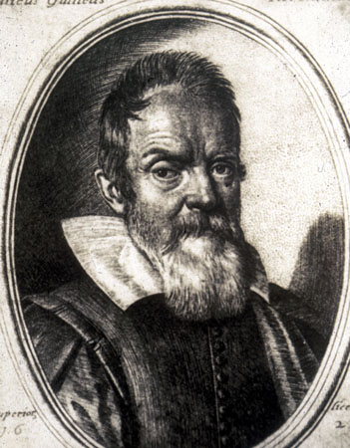
Galileo Galilei General Revelation
“The Bible was written to tell us how to go to heaven, not how the heavens go”
“For the Holy Bible and the phenomena of nature proceed alike from the divine Word, the former as the dictate of the Holy Spirit and the latter as the observant executor of God’s commands.”

Slide 5
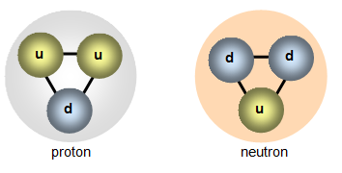
The Smallest Things Declare the Glory of God
Quark: 10⁻¹⁸ m

Slide 6
x 1,000,000

Slide 7
Electron 10⁻¹² m

Slide 8
x 10,000

Slide 9
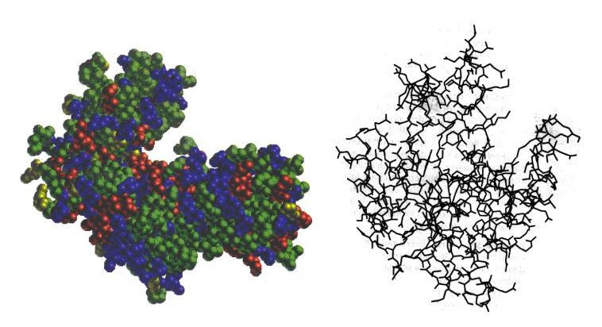
Protein Molecule 10⁻⁸ m

Slide 10
x 100,000

Slide 11
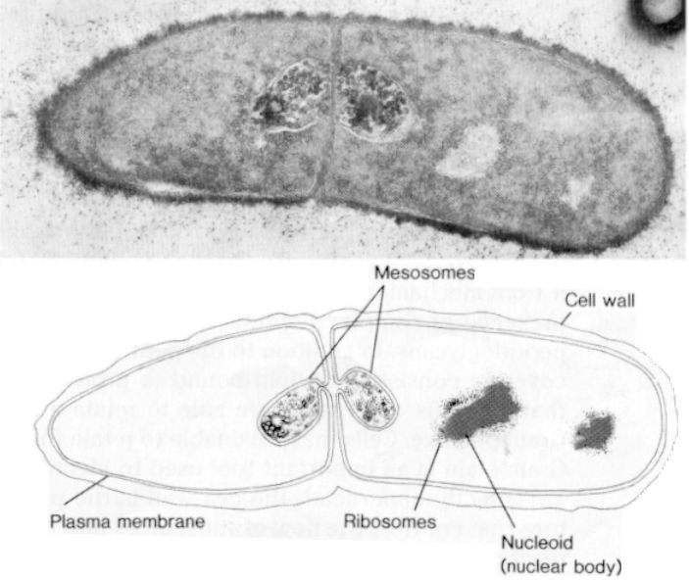
Cell 10⁻³ m

Slide 12
x 100,000

Slide 13
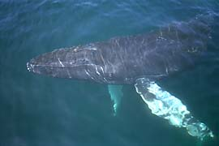
Blue Whale 10² m

Slide 14
x 100,000

Slide 15
The Earth 10⁷ m

Slide 16
x 100,000

Slide 17
The Solar System 10¹² m

Slide 18
x 10,000,000

Slide 19
The Andromeda Galaxy 10²¹ m

Slide 20
x 10,000

Slide 21
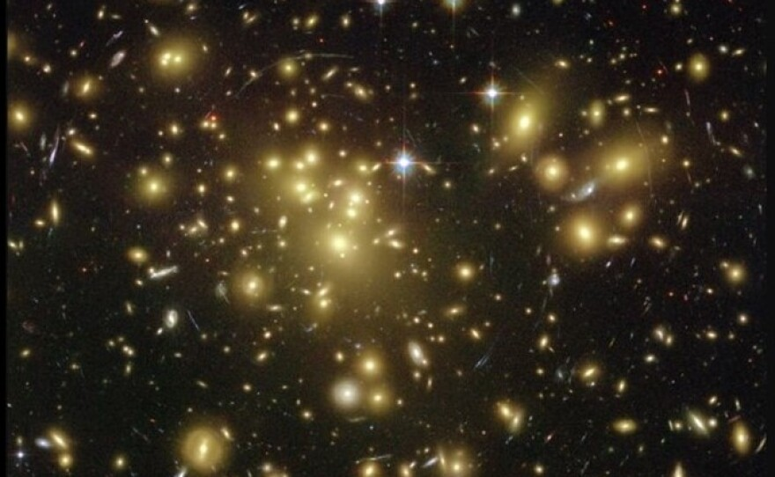
A Supercluster of Galaxies 10²⁵ m
The heavens declare the glory of God.

Slide 22
x 1,000

Slide 23
The Universe 10³¹ m 100,000,000,000 galaxies each with 100,000,000,000 stars Truly The heavens declare the glory of God

Slide 24
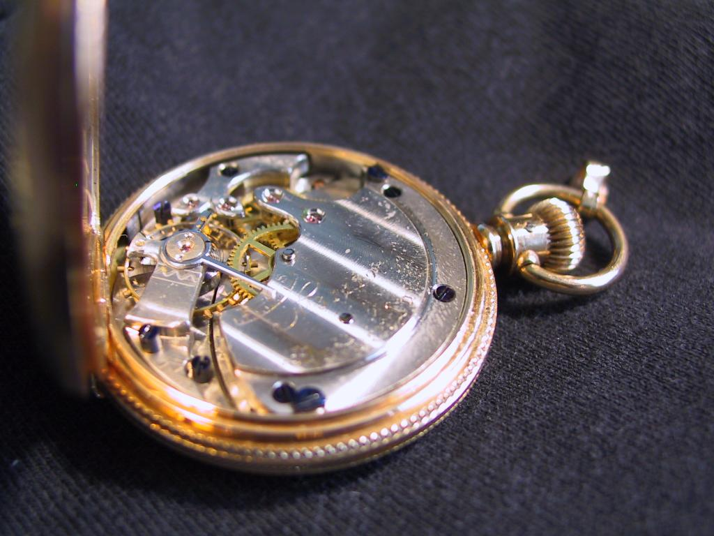
The Designed Universe
The Anthropic Principle
William Paley
Notes:
24

Slide 25
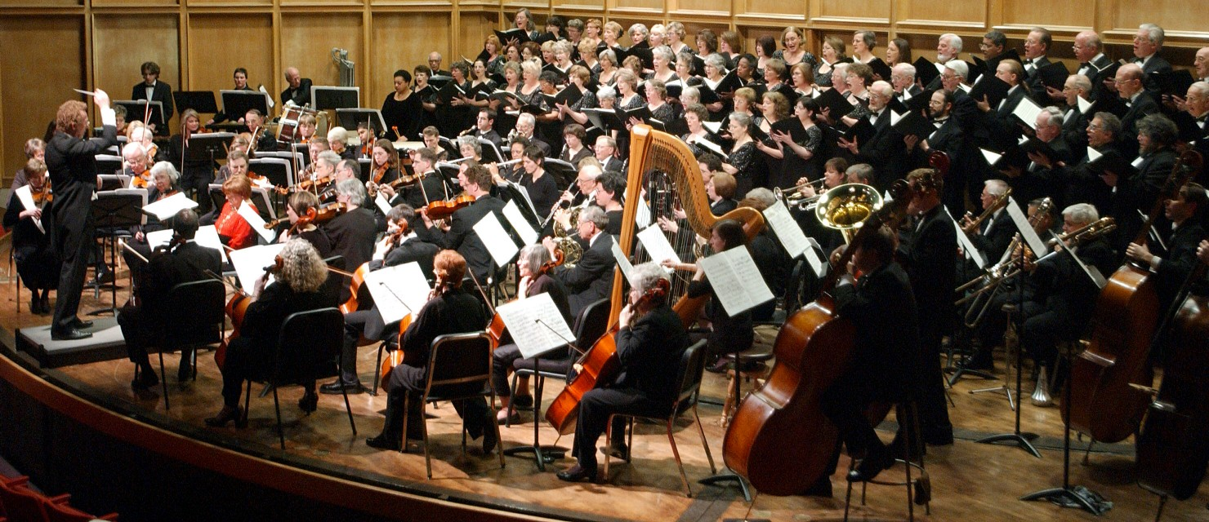
Physics:
The Finely Tuned Universe
Notes:
25

Slide 26
Fine Tuning of the Gravitational Constant
.00000000000000000000000000000000000000000000000000000000000001
Notes:
26

Slide 27
Gravity
Dominant force on astronomical size scale.
If gravity weaker by 1 in 10⁶⁰, universe expands too quickly, no galaxies or stars.
If gravity stronger by 1 in 10⁶⁰, universe collapses without forming galaxies or stars.
Gravity is fine-tuned to 1 part in 10^{60.}

Slide 28
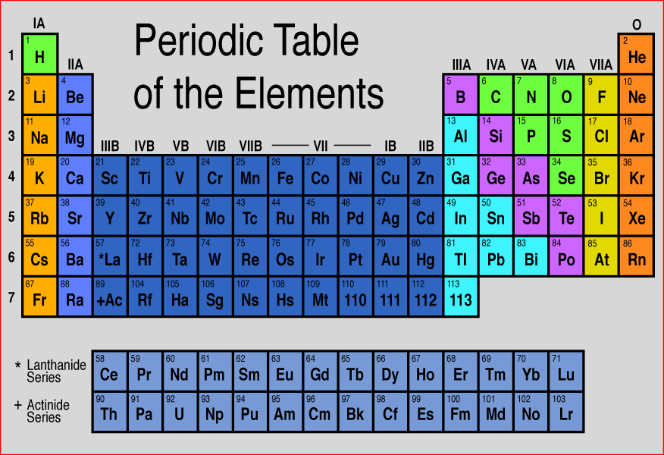
Designed Elements?
Notes:
28

Slide 29
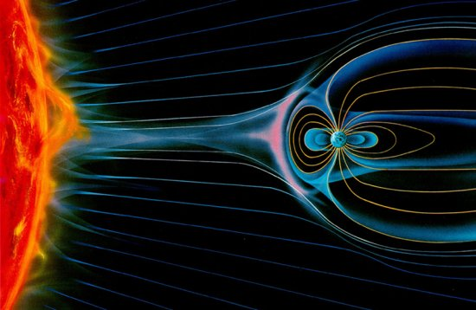
Iron: an essential element

Slide 30
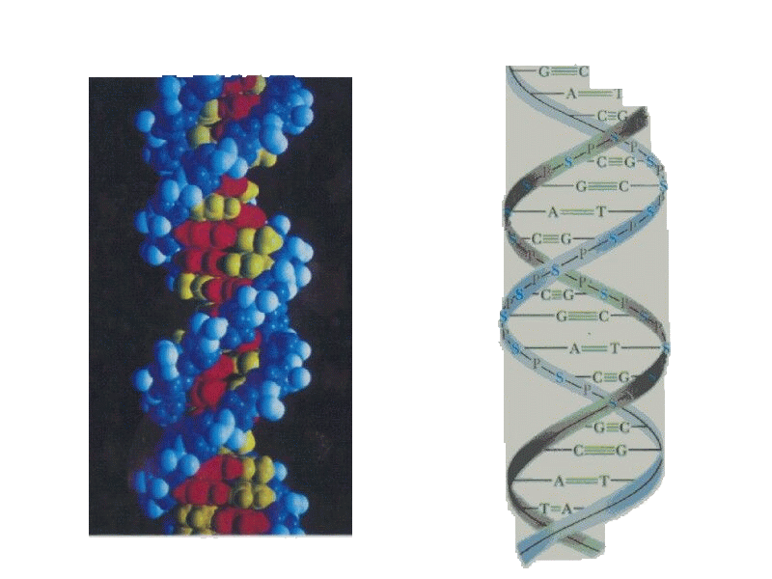
DNA
a)
b)
Notes:
30

Slide 31
Protein
Notes:
31

Slide 32
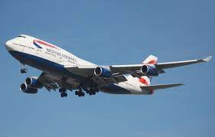
Fred Hoyle on Living Things
“The chance that higher life forms might have emerged [by chance] is comparable with the chance that a tornado sweeping through a junk-yard might assemble a Boeing 747 from the materials therein.”

Slide 33
Creation Declares the Glory of God
Romans 1: 18-20 The wrath of God is being revealed from heaven against all the godlessness and wickedness of people, who suppress the truth by their wickednesss, since what may be known about God is plain to them, because God has made it plain to the. For since the creation of the universe God’s invisible qualities—his eternal power and divine nature—have been clearly seen,being understood from what has been made, so that people are without excuse.

Slide 34
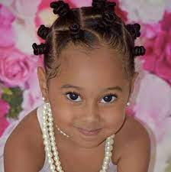
Psalm 139:13-14
For you created my inmost being; you knit me together in my mother’s womb, I praise you because I am fearfuly and wonderfully made; your works are wonderful, I know that full well.

Slide 35
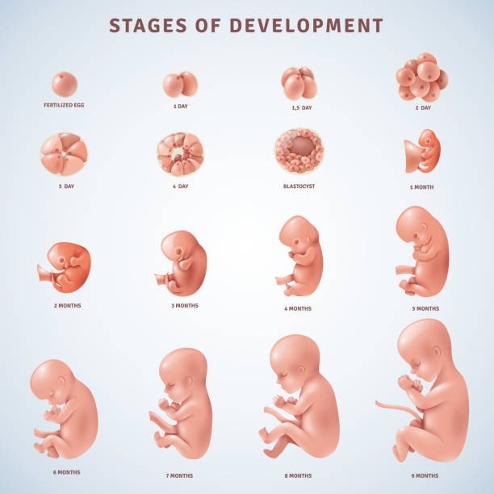
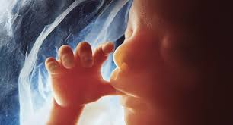
Fearfully and wonderfully made
Praise God!!!

Slide 36
Psalm 19:7-11 Not only that…
The Law of the Lord is perfect
The statutes of the Lord are trustworthy
The precepts of the Lord are right
The commands of the Lord are radiant
The decrees of the Lord are firm
Praise God!!!

Slide 37
Psalm 148 Praise the Lord
Hallelujah, praise Jehovah, from the heavens praise His Name;
Praise Jehovah in the highest, all His angels, praise proclaim.
All His hosts, together praise Him, sun and moon and stars on high;
Praise Him, O you heav’ns of heavens, and you floods above the sky.
Refrain:
Let them praises give Jehovah, for His Name alone is high,
And His glory is exalted, and His glory is exalted,
And His glory is exalted far above the earth and sky.
Let them praises give Jehovah, they were made at His command;
Them forever He established, His decree shall ever stand,
From the earth, O praise Jehovah, All ye floods, ye dragons all,
Fire and hail and snow and vapors, stormy winds that hear Him call.

Slide 38
Psalm 148 Praise the Lord
All you fruitful trees and cedars, all you hills and mountains high,
Creeping things and beasts and cattle, birds that in the heavens fly,
Kings of earth, and all you people, princes great, earth’s judges all;
Praise His Name, young men and maidens, aged men, and children small.
Refrain:
Let them praises give Jehovah, for His Name alone is high,
And His glory is exalted, and His glory is exalted,
And His glory is exalted far above the earth and sky.

Slide 39
Psalm 147 Praise the Lord
He builds up Jerusalem. Praise the Lord
He gathers the exiles Praise the Lord
He heals the brokenhearted Praise the Lord
He lifts up the humble, casts down the prideful. Praise God!!!
He gives weather and food to eat. Let’s praise the Lord
He reveals himself us. Amen and Praise God

Slide 40
Psalm 138 I Will Praise You, LORD
v. 2 Unfailing love Praise God for that!
v. 3 When we pray, God answers prayer. Praise God for that!
v. 6 The exalted God looks kindly on the lowly. Praise God for that!
v. 7 He preserves our life. Praise God for that!
v. 8 God will vindicate us! Praise God for that!
v. 8 His love endures forever. Psalm 30:5 Praise God for that!

Slide 41
Praise God
Creator, redeemer, lover, helper, builder, provider, protector, prayer-answerer, law-giver, vindicator, unmoved one, powerful one, faithful one, exalted one!

Slide 42
Psalm 100 Praise God
Shout for joy to the lord, all the earth
Worship the Lord with gladness;
Come before him with joyful songs.
Know that the Lord is God
It is he who has made us, and we are his;
We are his people, the sheep of his pasture.
Enter his gates with thanksgiving, and his coursts with praise;
Give thanks to him and praise his name.
For the Lordis good and his love endures forever;
His faithfulness continues through all generations. Shout for joy!

