Slide 1
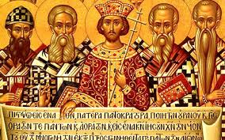
Christian Unity and Church History
John Oakes
Feb, 2022

Slide 2
How will we maintain unity and how will we remain a true family in the face of the kinds of issues that come up? And how will we do this without losing that thing we value so much, which is being a kingdom-oriented church which is a city on a hill and a growing, world-changing, dynamic counter-cultural people of God.
Ecumenism John 17:22-23, Eph 4:3
Restorationism/Patternism Eph 2:20

Slide 3
Early Schisms and Heresies
Judaizers Grace vs. Law
Gnostics Deny humanity of Jesus, deep knowledge
Docetism Jesus not a physical person
Montanists Charismatics, modern-day revelation
Novatianists Division over discipleship
Arians Denied deity of Jesus

Slide 4
Yet… The Church Remained United
Why?
1. No authoritative creeds
2. Intense commitment to unity
3. Persecution

Slide 5
Orthodoxy vs heterodoxy
correct
teaching
Orthopraxy vs heteropraxy
correct
practice

Slide 6
Creeds
A second century Roman creed (said at baptism)
I believe in one God, the Father, the Almighty, and in Jesus Christ, his only begotten Son, our Lord, and in the Holy Ghost, the holy church and the resurrection of the flesh.

Slide 7
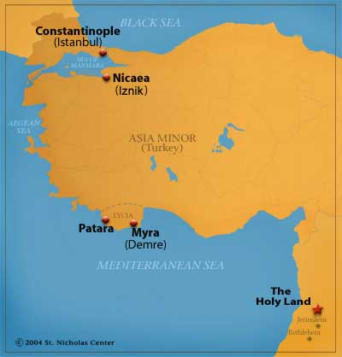
Nicaea AD 325
First general council
Arianism “There was a time when the Son was not.”
homoousios (same essence) vs
homoiousious (similar essence)
Goal: Protect the mystery

Slide 8
Nicene Creed
We believe in one God, the Father Almighty, Maker of heaven and earth, and of all things visible and invisible.
And in one Lord Jesus Christ, the only-begotten Son of God, begotten of the Father before all worlds; God of God, Light of Light, very God of very God; begotten, not made, being of one substance (homoousios, of the same substance, consubstantial as opposed to homoiousios) with the Father, by whom all things were made.
Who, for us men and for our salvation, came down from heaven, and was incarnate by the Holy Spirit of the virgin Mary, and was made man; and was crucified also for us under Pontius Pilate; He suffered and was buried; and the third day He rose again, according to the Scriptures; and ascended into heaven, and sits on the right hand of the Father; and He shall come again, with glory, to judge the quick and the dead; whose kingdom shall have no end.
And I believe in the Holy Ghost, the Lord and Giver of Life; who proceeds from the Father and the Son; who with the Father and the Son together is worshipped and glorified; who spoke by the prophets.
And I believe one holy catholic and apostolic Church. I acknowledge one baptism for the remission of sins; and I look for the resurrection of the dead, and the life of the world to come. Amen.
Is this what we believe?

Slide 9
Heterodox Theologies
Gnosticism Jesus merely spiritual, not physical
Docetism, Adoptionism Adopted as Son at baptism
Modalism Sabellianism Three modes, one person
Arianism Jesus not deity, created
Nestorianism Two persons humanity over-emphasized?
Monophysitism One nature, humanity minimized
The Great Schism 1054 filoque

Slide 10
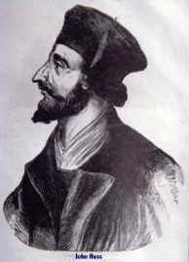
John Huss 1374-1415 Bohemia
Bible the only authority
Priesthood of all believers
Opposed indulgences, Purgatory Burned at the stake at Constance 1415 Taborites very schismatic
Brethren and Moravian Churches

Slide 11
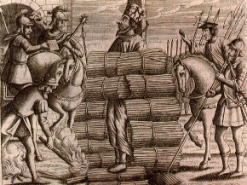
John Huss Burned at the stake, 1415

Slide 12
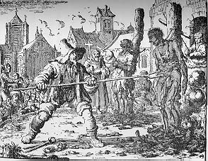
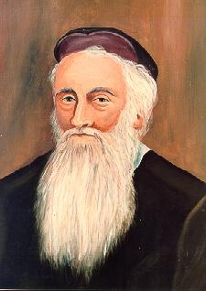
The Anabaptist Movement (1525 and later)
The Radical Reformation
Menno Simmons
Martyrdom of Anabaptists

Slide 13
The Anabaptist Movement (cont.)
Baptism by immersion of adults after confession of faith for salvation.
Bible the only authority.
Separation of church and state.
Pacifists (usually)
Many martyrs
Schismatic (Mennonites, Amish, Hutterites)

Slide 14
So far…
It is difficult for Christian movements to organize around biblical principles alone and also to maintain organizational and relational unity—to find the proper balance between the essential and the less important or matters of opinion.
What is the solution?

Slide 15
The Stone/Campbell Movement
Restoration or Reformation?

Slide 16
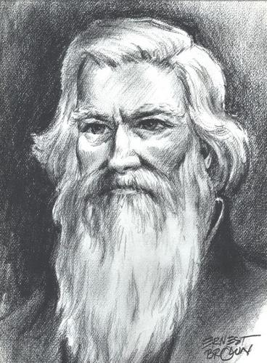
James O’Kelly
We are “Christians simply”
The Christian Connexion

Slide 17
Rice Haggard 1769-1819
“One thing I know, that whenever non-essentials are made terms of communion, it will never fail to have a tendency to disunite and scatter the church of Christ.”
“In matters of opinion, liberty”

Slide 18
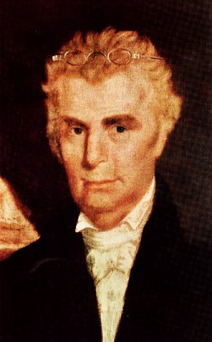
Barton W. Stone 1772-1844 The heart of the movement
The Cane Ridge Revival
The Last Will and Testament of the Springfield Presbytery
“Let Christian Unity be our Polar Star.”
“I do, so far as I see it consistent with the word of God.”

Slide 19
The Presbytery of Springfield, sitting at Cane Ridge, in the county of Bourbon, being, through a gracious Providence, in more than ordinary bodily health, growing in strength and size daily; and in perfect soundness and composure of mind; but knowing what it is appointed for all delegated bodies once to die: and considering that the life of every such body is very uncertain, do take, and ordain this our Last Will and Testament, in manner and following,….
And with that the Springfield Presbytery no longer existed and the Stone movement began.

Slide 20
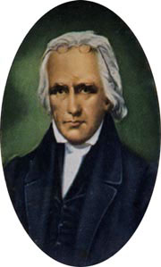
Thomas Campbell 1763-1851
Emigrated to Pennsylvania 1807
The Declaration and Address 1809
Principles for unity of Christians.

Slide 21
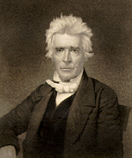
Alexander Campbell 1788-1866 The mind of the movement
Joined Thomas from Scotland 1809
Sought Bible “facts.” Weak on principles.
Bethany College 1840

Slide 22
The crowning event of the early years:
Stone and Campbell Decided to form a unified movement
Problems:
Christian (Stonites) or Disciple (Campbellites)
2. Emotional vs intellectual movements (preachers vs teachers)
Teaching on baptism
Ordination of ministers
5. Doctrine of the Holy Spirit

Slide 23
Hermeneutics of the Movement
“Command, Example and Necessary Demonstrations.”
“Where the Bible speaks, we speak, where the Bible is silent, we are silent”

Slide 24
The Turning Point:
Were they a unity movement (a reformation) or a restoration movement?
Stone and Campbell favored reformation (but Campbell’s hermeneutics were a problem)
Walter Scott, Benjamin Franklin, David Lipscomb moved toward restoration. Sought “the perfect pattern.”

Slide 25
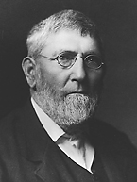
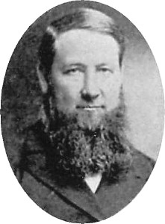
David Lipscomb (1831-1917)
“Father” of the Church of Christ
Founder of Lipscomb University
Editor of the Gospel Advocate 1866-1917
Daniel Sommer
“Watchdog” for the brotherhood.
“Daniel Sommer was a militant who left a legacy of legalistic wrangling and divided congregations.”

Slide 26
Other Controversies
One cup, Sunday School, the “instrument.”
Premillennialism
Church of Christ: restorationists/patternists
Christian Church: moderate patternists: “Let unity be our polar star.”
Disciples of Christ; The Ecumenical Movement. Open Membership.

Slide 27
How Will We Remain Unified?
Are we restorationists/patternists?
Are we ecumenists?
Will we maintain congregational autonomy?
What kinds of para-church organizations should we have to maintain unity?
How will we stay a counter-cultural kingdom of God?

