Slide 1
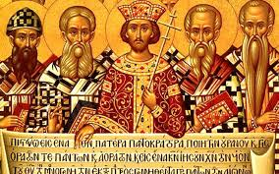
Church History
John Oakes, PhD
Bakersfield
Jan 29, 2022

Slide 2
Why Study Church History?
Learn the Mistakes of History → Avoid them? Those who cannot learn from history are doomed to repeat it.
Discover our own roots (Restoration Movement, ICOC)
Avoid swinging the pendulum Grace ↔ Legalism Truth ↔ Zeal, Emotion, Heart Asceticism ↔ Freedom

Slide 3
How is True Christianity Lost?
Growth of splinter, heretical groups with false teachings.
Gradual drift of the “true church” from biblical practice for good and sincere reasons.
Q: Which is more likely to be our problem?

Slide 4
Early Schisms and Heresies
Judaizers legalism
Ebionites Denied deity of Jesus
Gnostics Deny humanity of Jesus, deep knowledge
Docetism Jesus not a physical person
Marcionites Jehovah an evil god.
Montanists Charismatics, modern-day revelation
Novatianists Division over discipleship
Arians Denied deity of Jesus
Donatists Church authority

Slide 5
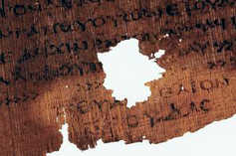
Gnosticism: The Gospel of Judas
“But you [ie. Judas] will exceed all of them. For you will sacrifice the man that clothes me.”

Slide 6
Another way to lose it: The Church Drifts
Orthodoxy vs Orthopraxy
Heterodoxy vs Heteropraxy
Theme: Almost all these examples of drift from Orthopraxy started out as a reasonable and seemingly wise response to a real problem (heresy) at the time!
Authority of Scripture vs. Tradition
Irenaeus: Defended against heresy using “Church tradition”, The rule of faith, and the authority of apostolic succession.

Slide 7
The Apostolic Church Drifts…
Leadership/Church Organization
Evangelists
Evangelists and elders
Head bishop and elders
Archbishops, bishops and priests
Metropolitans, Patriarchs and Popes
Doctrine of Baptism
Catachumens
Baptism delayed
Annointing with oil after baptism
By 400 AD baptism of infants and the unrepentant was common. Baptism is now a sacrament.
11th century churches in the West filled in their baptistries

Slide 8
The Apostolic Church Drifts…
Asceticism/Monasticism
Creeds
Sacerdotalism/Priesthood clergy and laity
Lord’s Supper becomes a sacrifice
Sacramentalism: Liturgy, Church Calendar
Ex opera operato From the work worked
Hermeneutics
Allegorizing of Scripture vs Historical/Analytical approach

Slide 9
Creeds
A second century Roman creed (said at baptism)
I believe in one God, the Father, the Almighty, and in Jesus Christ, his only begotten Son, our Lord, and in the Holy Ghost, the holy church and the resurrection of the flesh.

Slide 10
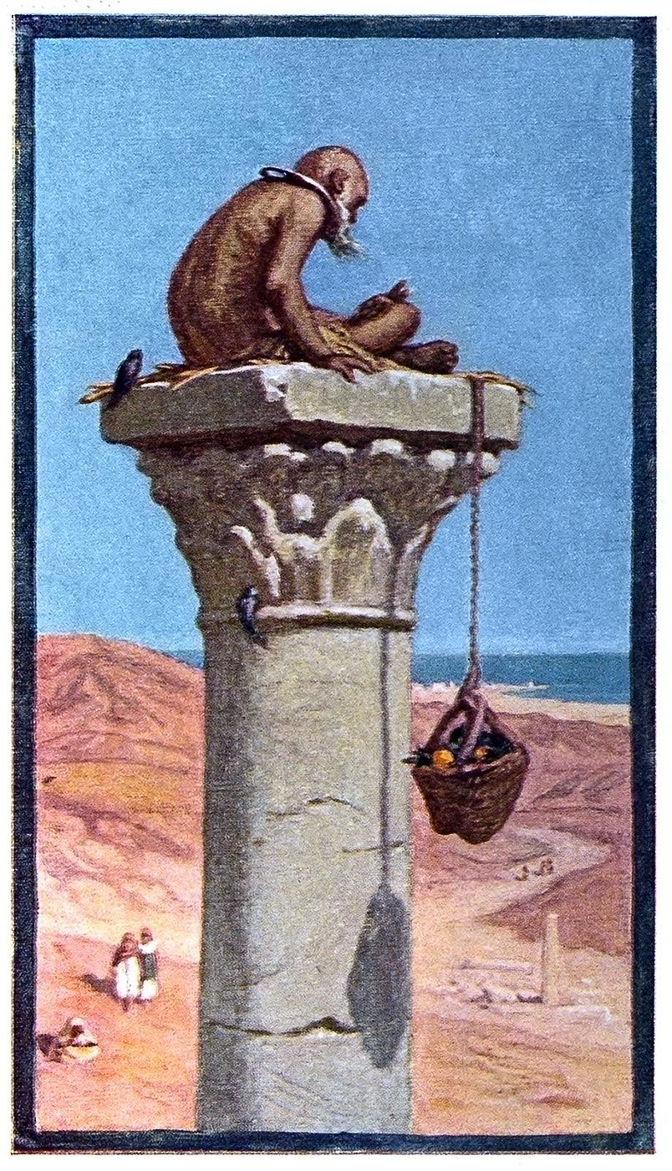
Asceticism in the Primitive Church
Anthony hermit
Pachomonius cenobites
Basil and Macrina nuns
Martin of Tours itinerant
Symeon Stylites extremist
John Cassian Western
Benedict Benedictine Rule

Slide 11
Summary so far. Avoid…
Reliance on tradition over the Bible
The tendency to ritualism in our worship
Convenient but unscriptural or unwise organizational structure
Overreaction to false doctrines
Creeds
Overemphasis or demanding denying unsinful forms of pleasure
Overreliance on professional “clergy”

Slide 12
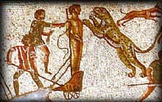
Persecutions
Decius 249-251 Valerian 253-260
Cyprian (Carthage) and Sixtus (Rome) executed
burn incense, make offering and eat meat sacrificed to an idol. Many apostasized—lead to Novatianism
Diocletian 303-304 Galerian 305-311
Scriptures burned, churches destroyed Donatists

Slide 13
Donatists
Refused to accept as priests those who had handed Scripture over to the persecutors.
traditori
Especially North Africa/Carthage where Augustine was bishop.

Slide 14
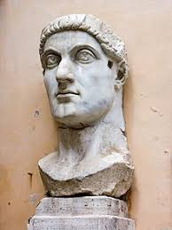
Constantine 272-337
Edict of Milan 313
Baptized on his deathbed?
Oversaw Council of Nicaea 325
Eusebius: Ecclesiastical History 323
Is he a great Christian hero or a disaster for the Church?

Slide 15
Church Councils
Nicaea AD 325
Arianism Jesus homoousios With the Father
Constantinople AD 381
Nicene Creed Holy Spirit also homoousious
Ephesus AD 431
Nestorianism condemned, Pelagius anathematized.
Calchedon AD 451
Define the “two natures” of Jesus
Constantinople II AD 553
Monophysitism
Constantinople III AD 680
Monothelitism
Nicaea II AD 787 iconoclasm

Slide 16
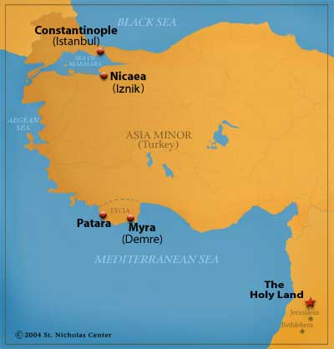
Nicaea AD 325
First general council
Arianism “There was a time when the Son was not.”
Anathemas
Canons
homoousios (same essence) vs
homoiousious (similar essence)
Goal: Protect the mystery

Slide 17
Nicene Creed
We believe in one God, the Father Almighty, Maker of heaven and earth, and of all things visible and invisible.
And in one Lord Jesus Christ, the only-begotten Son of God, begotten of the Father before all worlds; God of God, Light of Light, very God of very God; begotten, not made, being of one substance (homoousios, of the same substance, consubstantial as opposed to homoiousios) with the Father, by whom all things were made.
Who, for us men and for our salvation, came down from heaven, and was incarnate by the Holy Spirit of the virgin Mary, and was made man; and was crucified also for us under Pontius Pilate; He suffered and was buried; and the third day He rose again, according to the Scriptures; and ascended into heaven, and sits on the right hand of the Father; and He shall come again, with glory, to judge the quick and the dead; whose kingdom shall have no end.
And I believe in the Holy Spirit, the Lord and Giver of Life; who proceeds from the Father [and the Son, filoque]; who with the Father and the Son together is worshipped and glorified; who spoke by the prophets.
And I believe one holy catholic and apostolic Church. I acknowledge one baptism for the remission of sins; and I look for the resurrection of the dead, and the life of the world to come. Amen.
Is this what we believe?

Slide 18
Heterodox Theologies
Gnosticism Jesus merely spiritual, not physical
Docetism, Adoptionism Adopted as Son at baptism
Modalism Sabellianism Three modes, one person
Arianism Jesus not deity, created
Nestorianism Two persons humanity over- emphasized?
Monophysitism One nature, humanity minimized
Monothelitism One will (not my will, but yours be done)

Slide 19
Constantinople 381
Holy Spirit consubstantial with Father, Son
Published the Nicene Creed.
Homoousious of one substance
But three hypostases three natures
Antioch emphasized humanness of Jesus
Mary christotokos
vs
Alexandria emphasized deity of Jesus
Mary theotokos

Slide 20
Ephesus (431) and Chalcedon (451)
Ephesus:
Condemned Nestorianism
Condemned Pelagius
Mary, “mother of God” theotokos
Chaldedon:
The “hypostatic union” One person, two natures. Fully human and fully divine.

Slide 21
Chalcedon AD 451
“In agreement with the holy fathers we all unanimously teach that we should confess that our Lord Jesus Christ is one and the same Son; the same perfect in Godhead and the same perfect in manhood, truly God and truly man, the same of a rational soul and body; consubstantial with the Father in Godhead and the same consubstantial with us in manhood; like us in all things except sin; begotten of the Father before all ages as regards his Godhead and in the last days the same, for us and for our salvation, begotten of the Virgin Mary, the theotokos (as opposed to the christotokos of the Nestorians) (the God-bearer, the mother of God) as regards his manhood; one and the same Christ, Son, Lord, only-begotten, made known in two natures without confusion, without change, without division, without separation…

Slide 22
Chalcedon (cont.)
“Without confusion and without change”
to oppose monophysitism/Coptic Christianity
Monophysite = one nature
“Without division, without separation”
to oppose Nestorianism
Q: Are we splitting hairs here?

Slide 23
Constantinople AD 553
Anathematized Origen
Constantinople III AD 680
Opposed monothelitism “one will”
Nicaea II AD 787
Iconoclasm. It is heretical to say that one cannot be aided in worship by using an icon.

Slide 24
Augustine (354-430) The Sovereignty of God
Laid groundwork for Christendom, Medieval Christianity and Reformation theology
The City of God, Christendom, Church and State
Original Sin: Mankind totally depraved
Predestination
Sacramentalism Baptism, Ordination etc ex opere opero
Transubstantiation
Immaculate Conception
Reacted against Donatists
Reacted against Pelagius, Pelagianism

Slide 25
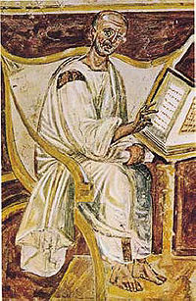
Augustine: 354-430
Sovereignty of God
Total depravity
Monoergism
Predestination
Original Sin
Infant baptism for salvation
Sacramentalism
Transubstantiation
City and State: Christendom
Opposed Donatists
Opposed Pelagius
Augustine of Hippo (from 6th century)

Slide 26
Augustine (354-430)
Confessions (397) Original Sin
City of God (416) Predestination, church/state
Opponents:
The Donatists
Pelagius

Slide 27
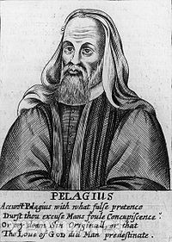
Pelagius AD c. 354-418
Works Salvation?
“Since perfection is possible for man, it is obligatory.”
Rejected Original Sin
Am I a semi-Pelagian?

Slide 28
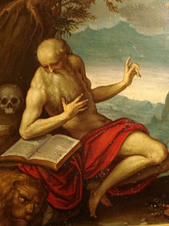
Late Church Fathers
Ambrose of Milan (339-397)
On the Sacraments
(transubstantiation)
Baptized Augustine
Jerome (347-420)
Vulgate translation
Jerome

Slide 29
Branches of Christianity after 500
Western Christendom Rome Legalistic and Hierarchical
Easter Christendom Byzantium Spiritual Experiential, Mystical
Coptic Church (Alexandria, Cairo) Monophysite One nature. Alexandrine School. Focused on divine nature of Jesus and minimized his humanity. Mary: Theotokos
Church of the East Nestorianism Dyophysite. Two Natures. Antiochene School. Humanity of Jesus and his suffering. Mary: Christotokos
Jacobites Syrian monophysitism

Slide 30
The West Falls Apart
589 Council of Toledo
filoque
Leo (441-461)
Gregory (590-604)

Slide 31
The Church of the East

Slide 32
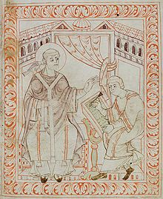
Gregory “the Great” (590-604)
Calvin: The last “good” pope
First monk/pope
Greatest scholar of his age
Great defender of the poor
Pope gains temporal power
Mary Magdalene a harlot
Purgatory
Superstitious
Gregory dictating
to a scribe

Slide 33
The Advent of Islam 7th Century

Slide 34
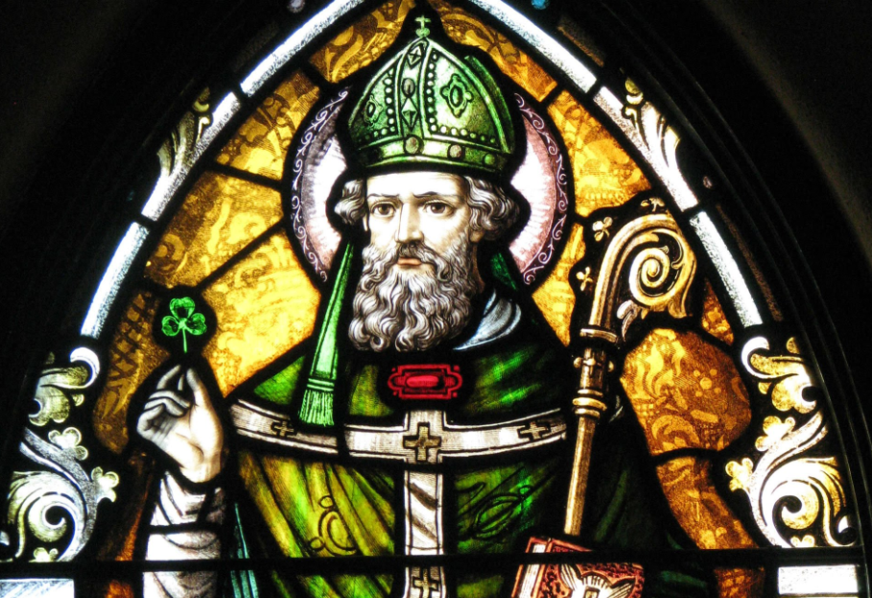
Asceticism in the West
Benedict of Nursia
Benedict’s “Rule”
Patrick and Columba in Ireland

Slide 35
Degradation Rome and Byzantium
Iconoclasm Nicaea II 787
Veneration of Mary
Cult of the Saints, Relics
Final Schism 1054
Celibacy of Priests obligatory 1074

Slide 36
Pope Urban II 1095 1st Crusade
Palestine taken, temporarily, opening the way to Christian pilgrimage.
Cyprus the only permanent gain for Christians
Byzantium conquered, sacked and weakened
Massive persecutions on Church of the East by Muslims
Increase of trade and cultural interaction with the East.
Europeans began to study Arab and Greek texts, bringing on the Renaissance.

Slide 37
True Christianity in the Middle Ages?
Paulicians 650-900’s Asia Minor
Peter of Bruys 1140 Northern Italy
Peter Waldo Waldensians 1175-1500’s Northern Italy, Switzerland
Albigenses, Cathars 1000’s-1200’s Southern France

Slide 38
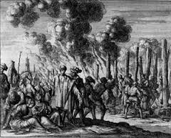
224 Waldensians being burned at the stake at Toulon in 1243
Scripture the only authority
Bible in vernacular
Sacraments do not impart holiness
Priests have no authority
Rejected Purgatory, indulgences, praying through saints, icons
Declared heretics in 1214

Slide 39
Albigensians/Cathars
Similar lifestyle to the Waldensians
Dubious theology—dualist
Defeated Catholic teachers in open debates
The Inquisition (Holy Office) was created to destroy them.
Arnold of Citeaux: “Kill them all, for God will know his own.
1233 Dominicans put in charge of Inquisition
1255 Authorization to use the rack

Slide 40
The Late Middle Ages: Scholasticism
Emphasis on Reason. No contradition with faith.
Reliance on Aristotle
Universities Established
Studied Rhetoric, Dialectic and Expounded on Scripture, Aristotle and Roman authors.
Penance emphasized, Mary more personal that Jesus
Realism vs. Nominalism
Anselm (1033-1109)
Abelard (1079-1142), Ockham
Thomas Aquinas (1225-1274)
Ockham (1285-1349)

Slide 41
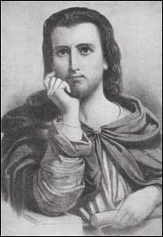
Scholasticism
Anselm: I believe that I may know.
Satisfaction theory of atonement (vs. ransom theory)
Peter Abelard: Doubt in order to believe.
Moral/exemplary theory of atonement
Sic et Non
Peter Abelard

Slide 42
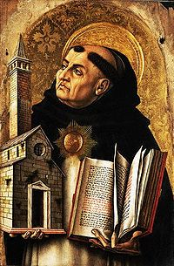
Thomas Aquinas 1225-1274
Revived Aristotle
Revelation by reason
Summa Theologica
Arguments for existence of God
Unmoved Mover
First Cause
Argument from contingency
Argument from degree
Teleological argument

Slide 43
Thomas Aquinas:
“God, therefore, is the first cause, who moves causes both natural and voluntary. And just as by moving natural causes He does not prevent their actions from being natural, so by moving voluntary causes He does not deprive their actions of being voluntary; but rather is He the cause of this very thing in them, for He operates ineach thing according to his own nature.”
In other words, Aquinas believed in free will and not a strict monergism.
Thanks to Aquinas, Roman Catholic theology is generally more biblical than Reformation theology.

Slide 44
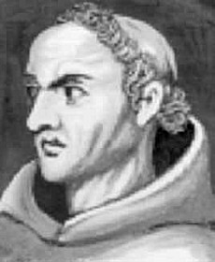
William of Ockham (1285-1349)
“The first of the reformers”
Nominalist/Empiricist
Rejected the idea of innate ideas/universals
Therefore rejected sacramentalism a priori
The philosopher most responsible for leading to the Reformation.

Slide 45
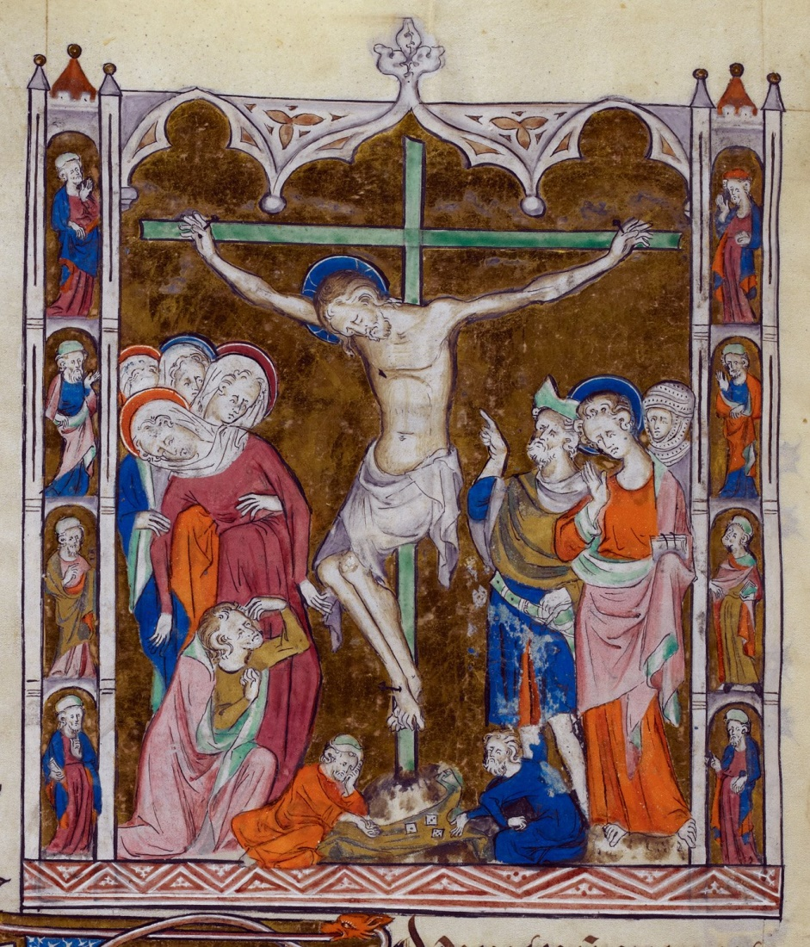
Friars: Francis of Assisi
Lover of nature
Brown Friars (not monks)
Franciscans 1208
Connected with common people
Humanized Jesus
First nativity scenes
Use of crucifixes

Slide 46
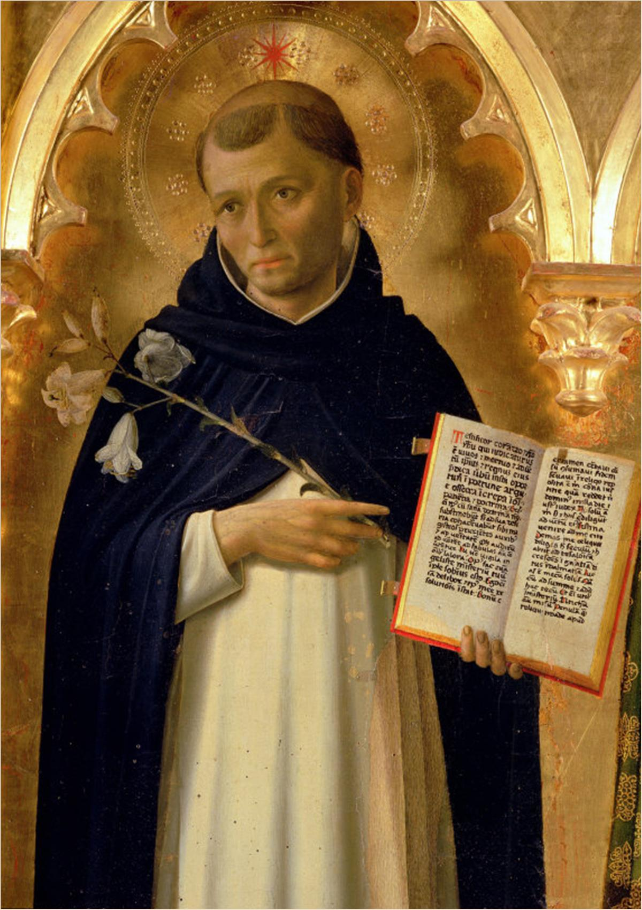
Dominic and the Dominicans
Opposite of Francis in every way
Intellectual, disciplined
Francis: Win Muslims by loving them.
Dominic: Win Muslims by defeating their arguments
Dominicans became the chief instrument of popes—oversaw the Inquisition.

Slide 47
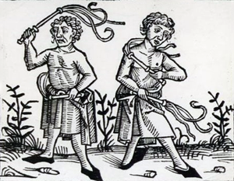
Penitentes
Christian Life in the late Middle Ages
Dominated by idea of Purgatory
Confession became obligatory
Penance
Masses
Confession
Pilgrimages
Crusades
Indulgences
Chapels, Cathedrals
Cult of Mary

Slide 48
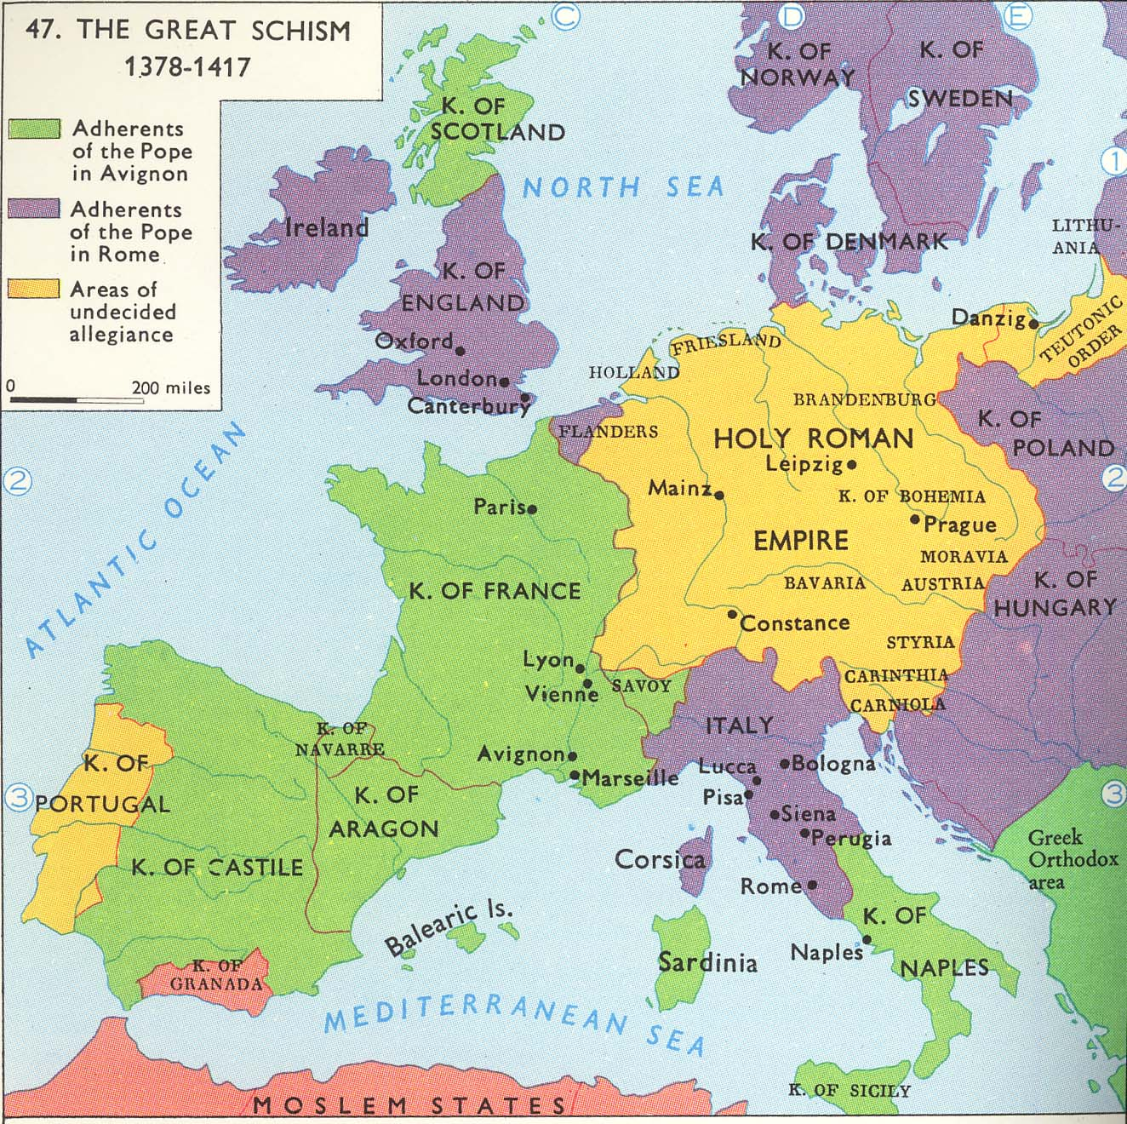
Babylonian Captivity of the Church
French stole the papacy
Two and sometimes even three rival popes
Council of Constance called to solve the problem

Slide 49
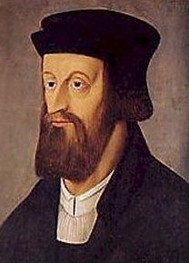
John Wyclif 1324-1384
Bible the only rule of faith
Translated Vulgate into English Opposed indulgences, idols, priesthood, monks
Lord’s Supper is a remembrance
The Pope is the antichrist Followers known as Lollards
Declared heretics 1401

Slide 50
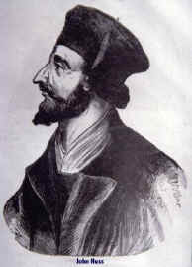
John Huss 1374-1415 Bohemia
Influenced by Wyclif Bible the only authority
Communion in both kinds
Priesthood of all believers
Opposed indulgences, Purgatory Burned at the stake at Constance Hussites nearlyly wiped out by Inquisition Brethren and Moravian Churches

Slide 51
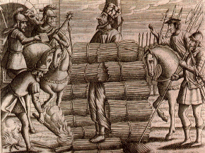
John Huss Burned at the stake, 1415

Slide 52
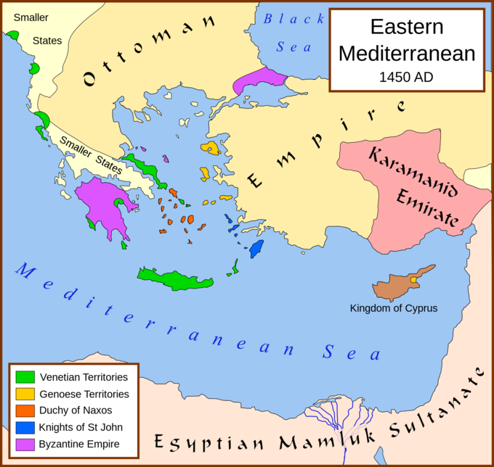
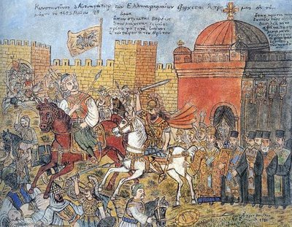
Fall of Byzantium 1453

Slide 53
The Reformation
John Wyclif England, 1324-1384
John Huss Bohemia, 1374-1415
Martin Luther Germany, 1483-1546
Ulrich Zwingli Switzerland, 1484-1531
William Tyndale England, 1494-1536
John Calvin France, 1509-1564
John Knox Scotland, 1505-1572

Slide 54
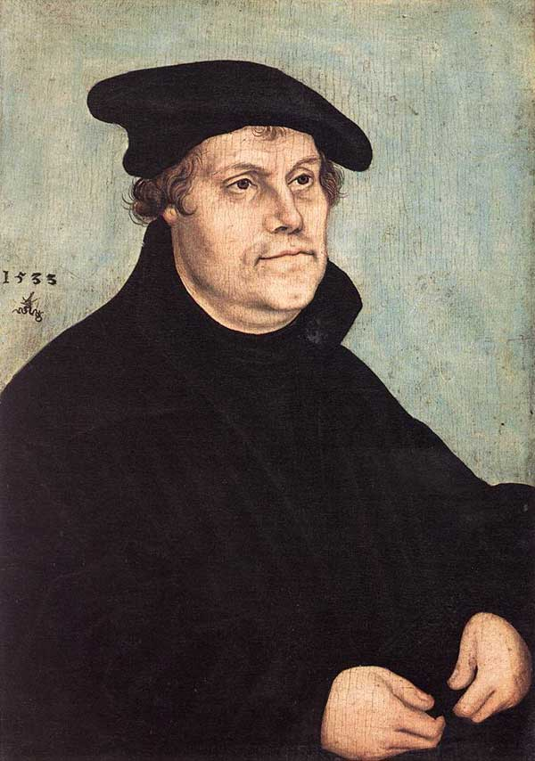
Martin Luther 1483-1546
Augustinian Monk
95 Theses in Wittenburg 1517
Studied Romans
Grace Through Faith Only
Scripture Only
Predestination
Book of James a “book of straw.”
Kept much of Catholic worship practices

Slide 55
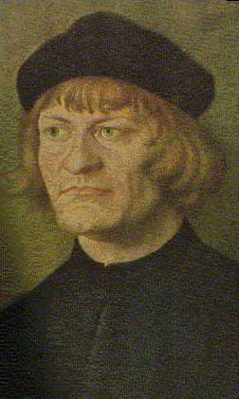
Ulrich Zwingli (1484-1531)
Swiss Reformer
More radical than Luther
Rejected almost all Catholic forms of worship. “Four bare walls and a sermon.”
Differed on the Lord’s Supper
Lord’s Supper and Baptism are “symbolic ceremonies.”
His influence led to the Anabaptists
Principle influence on John Calvin
Died as a soldier fighting a Catholic Swiss canons.

Slide 56
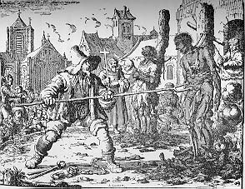
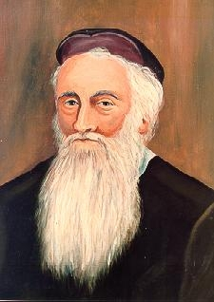
The Anabaptist Movement (1525 and later)
The Radical Reformation
Menno Simmons 1496-1561
Martyrdom of Anabaptists

Slide 57
The Anabaptist Movement (cont.)
Baptism by immersion of adults after confession of faith for salvation.
Bible the only authority.
Separation of church and state.
Emphasized both life and doctrine
Pacifists (usually)
Many martyrs
Began evangelistic, but became exclusive and withdrawn. (Mennonites, Amish, Hutterites)
Tended to be very schismatic

Slide 58
John Calvin 1509-1564
Followed Zwingli
Most influential theologian of the Reformation
Emphasized Historical/Covenantal Theology
Wrote Institutes of Christian Religion
Established an autocratic theocracy in Geneva
Best known for his strong emphasis on predestination/monergism.
God has two wills: his revealed will (1 Tim 2:3-4) and his secret will: foreordination of souls
Calvinist denominations: Presbyterian, Dutch Reformed, Puritan, Baptist, Anglican(?)

Slide 59
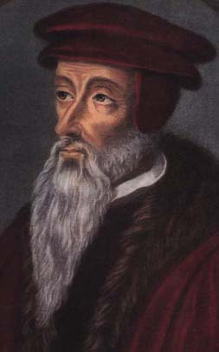
TULIP
John Calvin
Total depravity of mankind
Unconditional election
Limited atonement
Irresistible grace
final Preservation of the saints

Slide 60
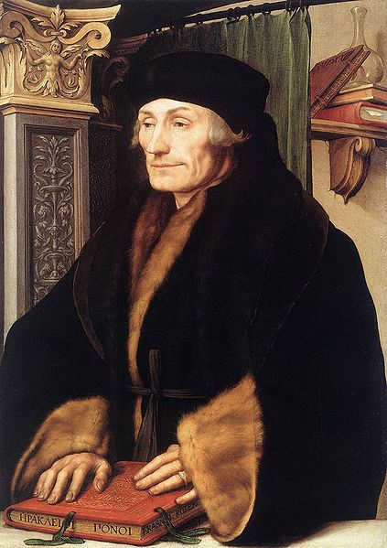
The Catholic Reformation
Erasmus 1466-1536
Sought to reform Roman Church acc to humanist principles.
“Praise of Folly” attacks relics, pilgrimages, monasticism, Catholic hierarchy
“On the Freedom of the Will” 1524
Greek New Testament 1514

Slide 61
The Counter-Reformation
Council of Trent 1545-1563
Eliminated many Medieval excesses (indulgences, etc.)
Gave official status to many Catholic teachings.
Declared church tradition equal to biblical authority.
Condemned Luther and others as heretics.
Confirmed works sanctification.
Confirmed sacraments, especially the priesthood. (opposing the priesthood of all believers)

Slide 62
Other Important Figures in the Reformation
William Tyndale Translated NT from Greek and OT from Hebrew. KJV was a revision of Tyndale. Martyred 1536.
John Knox 1505-1572. Brought Calvinism to Scotland. Became Presbyterian Church
Puritans. English dissenters. Congregational autonomy. Became Congregational Church
Baptists. Added believer’s baptism to Calvinism.
Quakers. Literally quaked. Charismatic, emotional movement. Pietist/pacifist offshoot of Radical Reformation.

Slide 63
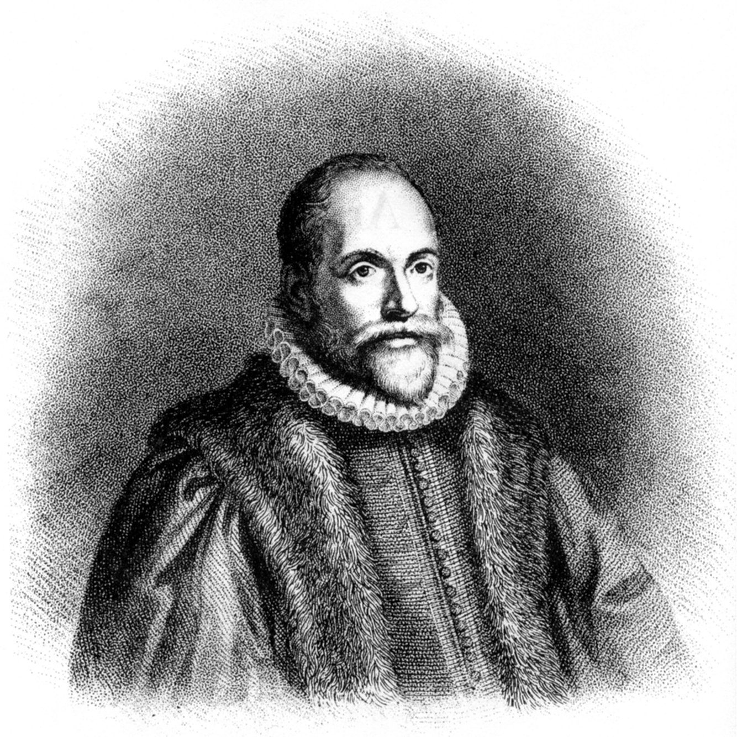
Jacob Arminius (1569-1609)
“Arminianism”
Semi-Pelagianism?
Opposed supralapsarianism
Prevenient grace. God foreknows, but does not predetermine.
Calvinism makes God the author of sin.
Methodists, Restoration Movement

Slide 64
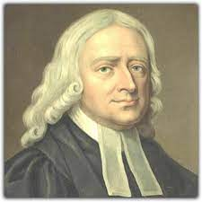
John and Charles Wesley
Holy Club at Oxford
George Whitefield
Arminian
A second sanctification
Perfectionism?
Holiness Movement
19th century US
Methodism became the
Largest denomination.
John Wesley 1703-1791

Slide 65
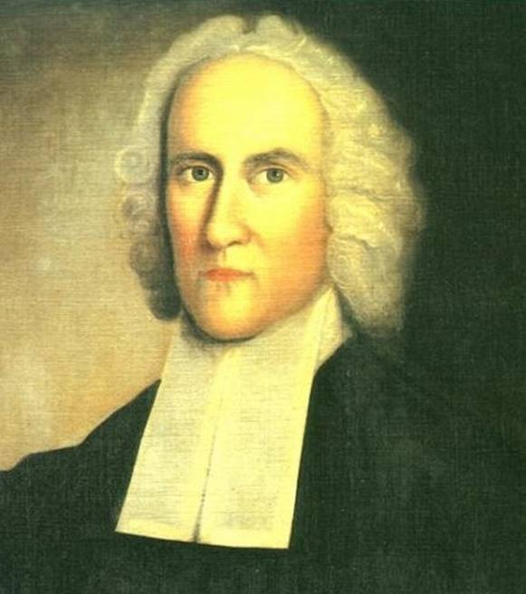
History of American Evangelicalism
Jonathan Edwards
“A Sinner in the Hands of an Angry God.”
How do we know we are of the elect?

Slide 66
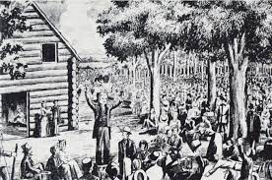
The Second Great Awakening 1800-1845
Cane Ridge Revival 1801
Highly individualistic
Reject church authority
Biblicist
Common Sense Philosophy
More Arminian
Happy Calvinism

Slide 67
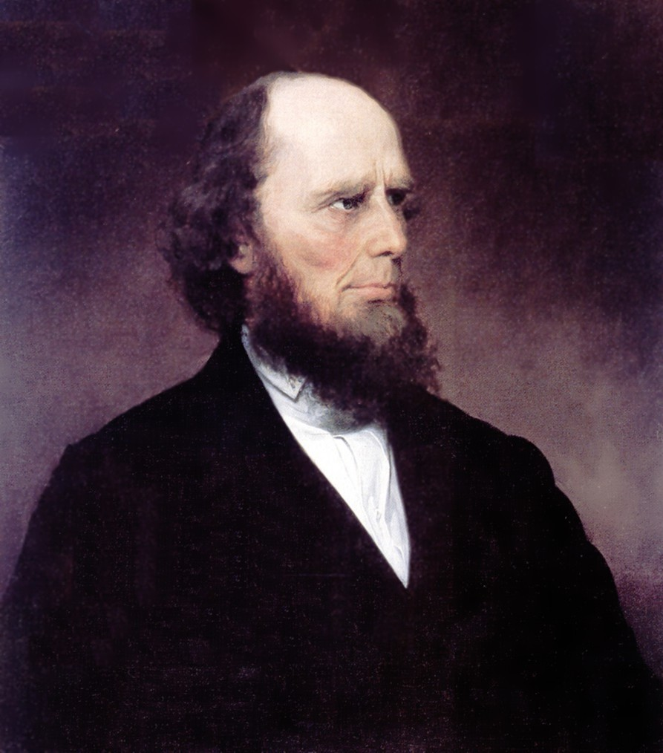
Charles Finney 1792-1875
The Burned-over District.
Happy Calvinism. (four or three point Calvinism)
Anxious Bench/instantaneous conversion

Slide 68
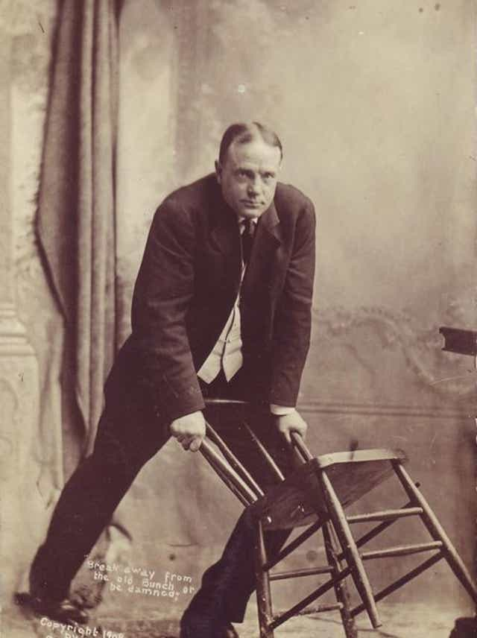
Billy Sunday 1862-1935
Baseball player
Sawdust Trail
Revivalism the pattern
Evangelical Christianity aligns with political conservativism and fundamentalism.

Slide 69
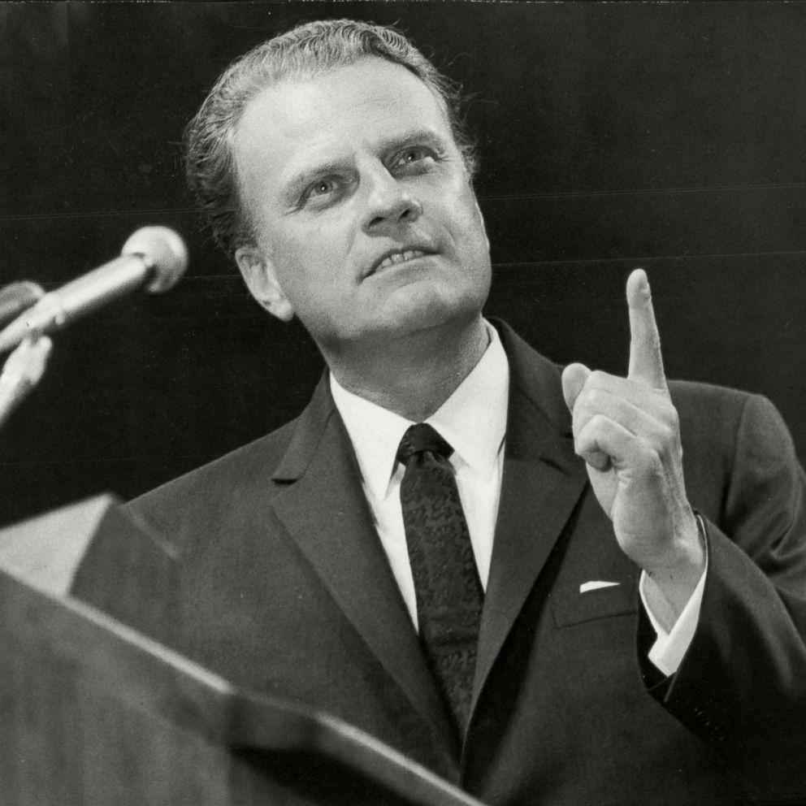
Billy Graham, Bill Bright Modern Evangelicalism
Four Spiritual Laws
Sinner’s Prayer

Slide 70
The Stone/Campbell Movement
Restoration or Reformation?

Slide 71
Influences
Francis Bacon and inductive logic: the scientific approach to the facts of the Bible.
John Locke: the “Christian Philosopher”
The Scottish school of Common Sense Philosophy (Adam Smith, Thomas Reid, etc.)
The Seceder Presbyterians, the Sandemanians, the Brethren/Moravians

Slide 72
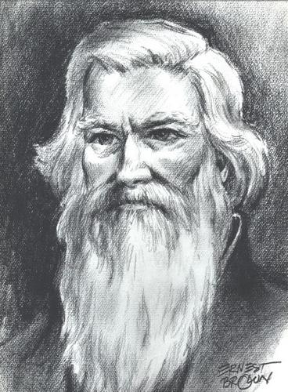
James O’Kelly
We are “Christians simply”
The Christian Connexion

Slide 73
Rice Haggard 1769-1819
“One thing I know, that whenever non-essentials are made terms of communion, it will never fail to have a tendency to disunite and scatter the church of Christ.”
“In matters of opinion, liberty”

Slide 74
Barton W. Stone 1772-1844 The heart of the movement
The Cane Ridge Revival
The Last Will and Testament of the Springfield Presbytery
“Let Christian Unity be our Polar Star.”
“I do, so far as I see it consistent with the word of God.”

Slide 75
The Presbytery of Springfield, sitting at Cane Ridge, in the county of Bourbon, being, through a gracious Providence, in more than ordinary bodily health, growing in strength and size daily; and in perfect soundness and composure of mind; but knowing what it is appointed for all delegated bodies once to die: and considering that the life of every such body is very uncertain, do take, and ordain this our Last Will and Testament, in manner and following,….
And with that the Springfield Presbytery no longer existed and the Stone movement began.

Slide 76
Thomas Campbell 1763-1851
Emigrated to Pennsylvania 1807
The Declaration and Address 1809
Principles for unity of Christians.

Slide 77
Alexander Campbell 1788-1866 The mind of the movement
Joined Thomas from Scotland 1809
Sought Bible “facts.” Weak on principles.
Bethany College 1840

Slide 78
Walter Scott (1796-1861)
First evangelist in the movement
“Restored the gospel” in 1827
The five step “plan” of salvation
Scott’s: faith, repentance, baptism, remission of sins, Holy Spirit
CoC today: hear, believe, repent, confess, be baptized

Slide 79
The crowning event of the early years:
Stone and Campbell Decided to form a unified movement
Problems:
Christian (Stonites) or Disciple (Campbellites)
2. Emotional vs intellectual movements (preachers vs teachers)
Teaching on baptism
Ordination of ministers
5. Doctrine of the Holy Spirit

Slide 80
Hermeneutics of the Movement
“Command, Example and Necessary Demonstrations.”
“Where the Bible speaks, we speak, where the Bible is silent, we are silent”

Slide 81
The Turning Point:
Were they a unity movement (a reformation) or a restoration movement?
Stone and Campbell favored reformation (but Campbell’s hermeneutics were a problem)
Walter Scott, Benjamin Franklin, David Lipscomb moved toward restoration. Sought “the perfect pattern.”

Slide 82
The Dominating Influences in the Movement
The Colleges (Bethany College, David Lipscomb College, etc.)
The Periodicals (editor/bishops) (The Millennial Harbinger, The American Christian Review, The Gospel Advocate, Firm Foundation, etc.)
These were forces for unity and for division

Slide 83
Other Controversies
The Civil War
The Missionary Society
One cup, Sunday School, the “instrument.”
Premillennialism

Slide 84
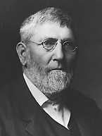
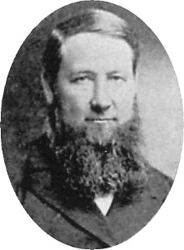
David Lipscomb (1831-1917)
“Father” of the Church of Christ
Founder of Lipscomb University
Editor of the Gospel Advocate 1866-1917
Daniel Sommer
“Watchdog” for the brotherhood.
“Daniel Sommer was a militant who left a legacy of legalistic wrangling and divided congregations.”

Slide 85
Restoration Movement Today
Church of Christ: restorationists/patternists
Christian Church: moderate patternists: “Let unity be our polar star.”
Disciples of Christ; The Ecumenical Movement. Open Membership.

Slide 86
How Will We Remain Unified?
Are we restorationists/patternists?
Are we ecumenists?
Will we maintain congregational autonomy?
What kinds of para-church organizations should we have to maintain unity?
How will we stay a counter-cultural kingdom of God?

Slide 87
Book Recommendations:
Reviving the Ancient Faith (Hughes)
The Stone Campbell Movement (Garrett)
Into All Nations (Foster Stanback)
The Search for the Ancient Order (West)

Slide 88
Crossroads/Boston/ICOC Movement
1960’s “College Chairs” Within CoC
1967 Chuck Lucas 14th Street CoC (Crossroads CoC)
Soul talks
Prayer partners
Emphasis on evangelism
After 1975 “campus ministries”
Tom Brown, Andy Lindo, Kip McKean, etc…
Many church splits resulted
1979 Kip McKean, Lexington/Boston CoC
“sold out” disciples only in the church
Amazing growth
Emphasis on world evangelism
Vertical discipling trees, uniformity and simplicity of methodology

Slide 89
Boston/LA/ICOC movement (cont.)
Chuck Lucas resigns at Crossroads CoC 1985
Official split with CoC 1986
Who’s fault was it?
Church Reconstructions 1988
You are in or you are out
Evangelization Proclamation 1994
Kip McKean removed as world evangelist/head of the movement November, 2001
Kreite letter/ICOC structure falls apart Feb 2003
Attempts at para-church organization, the “unity letter”

Slide 90
Hermeneutics of CoC and ICOC
Alexander Campbell: “Where the Bible speaks, we speak, where the Bible is silent, we are silent.”
Kip McKean: Where the Bible speaks, we are silent, where the Bible is silent, we speak.”
CoC: Strong emphasis on Bible Study, Bible colleges
Kip McKean: Anti-intellectual tendency and skeptical of theological training.

Slide 91
Pentecostal and Charismatic Movements
Evolved from Methodist Holiness Movement
What is the sign of the “second blessing”?
Answer: Speaking in tongues
1906 Azusa Street Mission in Los Angeles
Finished Work vs. Third Work
Oneness Pentecostalism
1960s Neo-Pentecostal/Charismatic Movement

Slide 92
Growth of the Pentecostal/Charismatic Churches
1945 16,000,000
1965 50,000,000
1985 247,000,000
2000 550,000,000
2020 644,000,000

