Slide 1
Ecclesiastes II Wisdom from Solomon
Ecclesiastes I:
Under the sun, life is
Meaningless, Meaningless!

Slide 2
Without God:
Knowledge is meaningless
Wisdom is meaningless
Pleasure is meaningless
Accomplishments are meaningless
They are chasing after the wind

Slide 3
Ecclesiastes 3:1-8 A Time for Everything
Balance
Work Rest
Weeping Laughing
Careful Risky
Control Let go
Keep Throw away
Anger Forgive

Slide 4
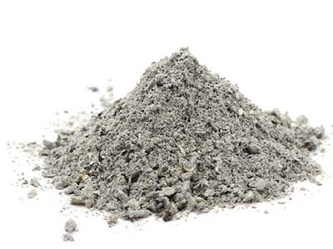
Ecclesiastes 3:16-22
Life’s not fair!
But God will judge
Ashes to Ashes,
Dust to Dust

Slide 5
Ecclesiastes 4:9-12 Two are Better Than One
And a cord of three strands is even much stronger…

Slide 6
Ecclesiastes 5:4-7 Vows to God

Slide 7
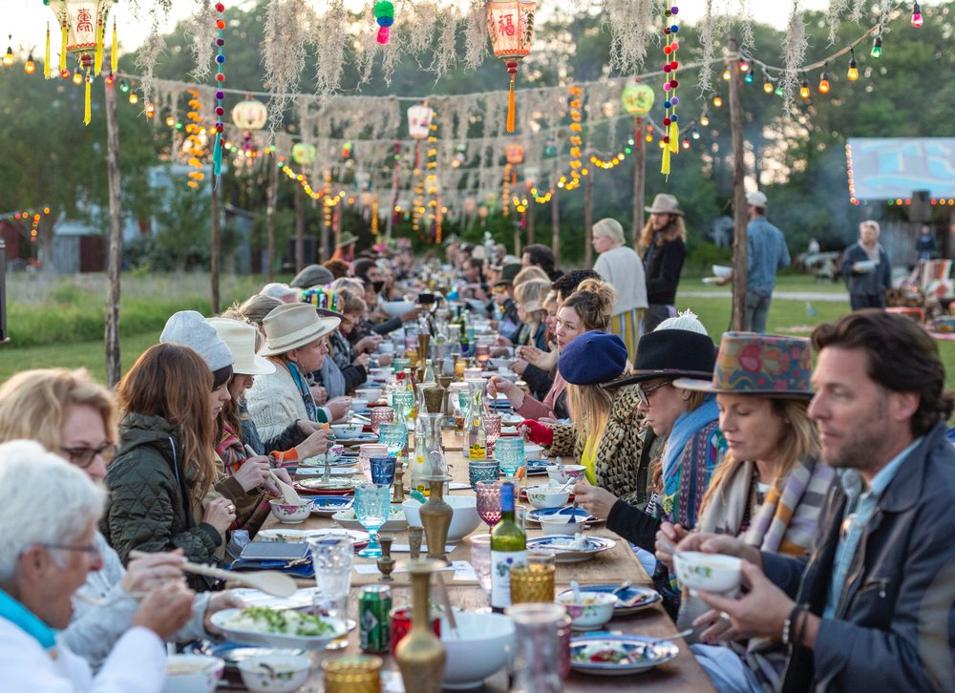
Ecclesiastes 7:2 Mourning Is Better Than Feasting

Slide 8
Ecclesiastes 12:1-7
Remember your Creator
in the days of your youth
I don’t have time!
I am too busy!
I have to study!

Slide 9
Ecclesiastes 12:8-14 The End of the Matter
Life under the sun: Meaningless, Meaningless!
Life in God’s hands: Meaningful! Meaningful!
So…
Remember your Creator in the days of your youth.

