Slide 1
The History of Christian Hermeneutics
Dr. John Oakes
Feb 24, 2022
The Art of
Scripture Reading
Philo of Alexandria

Slide 2
Resources
William Yarchin History of Biblical Interpretation: A Reader Baker Academic
Stanley Porter and Jason Robinson Hermeneutics: An Introduction to Interpretive Theory Eerdmans
Typology: John Oakes From Shadow to Reality Illumination Publishers
Notes: www.evidenceforchristianity.org

Slide 3
Outline
Hermeneutics of Judaism in the First Century
Early Christian Hermeneutics: Alexandria vs Antioch
Medieval Hermeneutics
Hermeneutics of the Protestant Reformation: Calvin
Modernism: Hermeneutics of Liberal Protestantism
Modernism: Hermeneutics of Conservative Protestantism
Postmodern Hermeneutics
Final Reflections

Slide 4
1st Century Judaism
Literal/Historical meaning
Historical Prophecy Fulfillment
Typological Interpretation “Expectation Fulfillment”
Allegorical Interpretation: Philo of Alexandria

Slide 5
Hermeneutics in the Primitive Church: Alexandria vs Antioch
Typology
Prophecy Fulfillment: Justin
Allegorical: Origen and Alexandria
Historical/Literal: Antioch
Origen:
Body Literal/historical
soul typological/figurative
spirit deeper, allegorical.

Slide 6
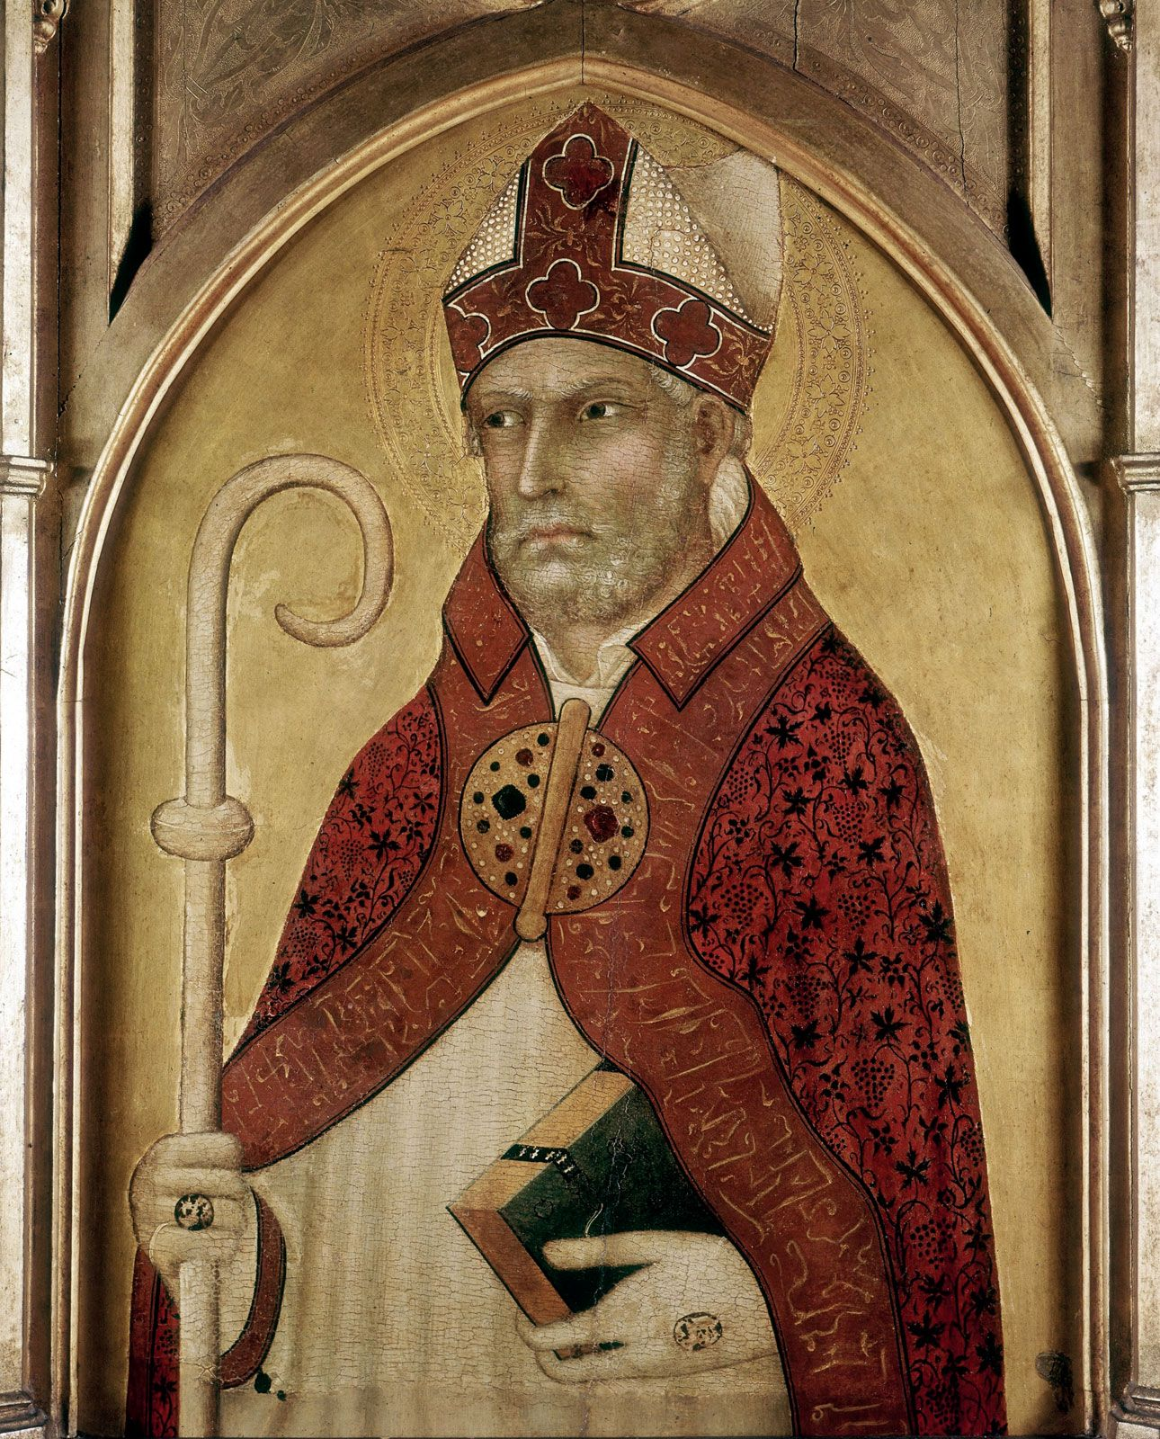
Augustine!
3 lenses
Manichaeism
Neoplatonism
Love
Used allegory liberally, but more balanced than Origen

Slide 7
Medieval Hermeneutics
Augustine the chief model.
Limited original hermeneutics.
Thomas Aquinas: Aristotle and Empiricism

Slide 8
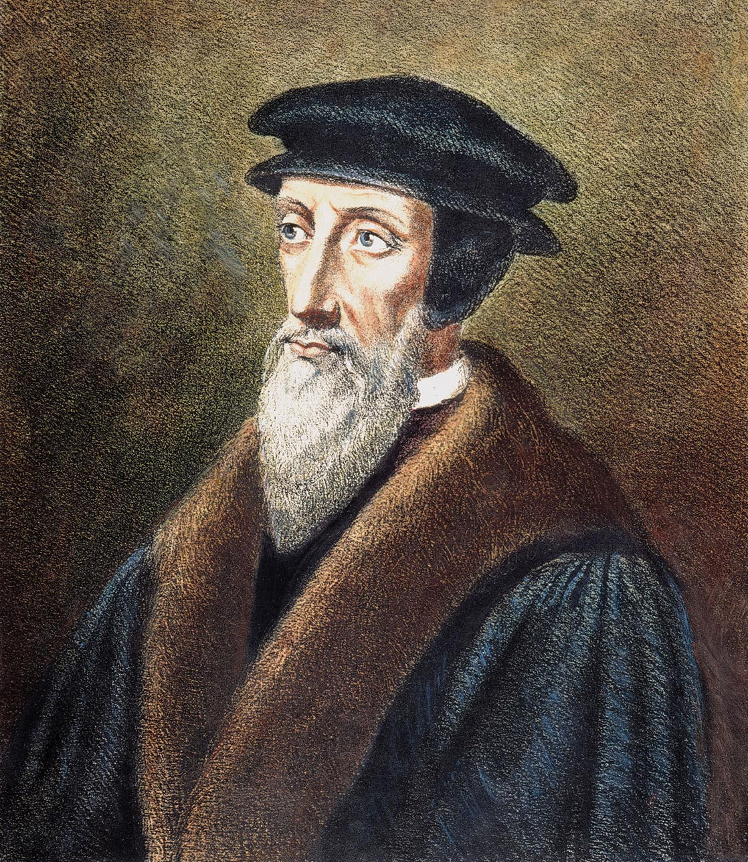
Hermeneutics of the Protestant Reformation
John Calvin, John Calvin, John Calvin
-Return to Antiochene School
-Sought original Jewish and Greek meanings of words and idioms

Slide 9
Calvin’s Hermeneutics
--Sought authorial intent
-Opposed allegorical interpretation
-Word-by-word analysis of text
-exegesis = hermeneutics
“The only business he [the commentator] has is to lay open the mind of the writer he has set out to explain. The more he deviates the reader away from it, the more he deviates from his own purpose, and is sure to wander out of bounds.”

Slide 10
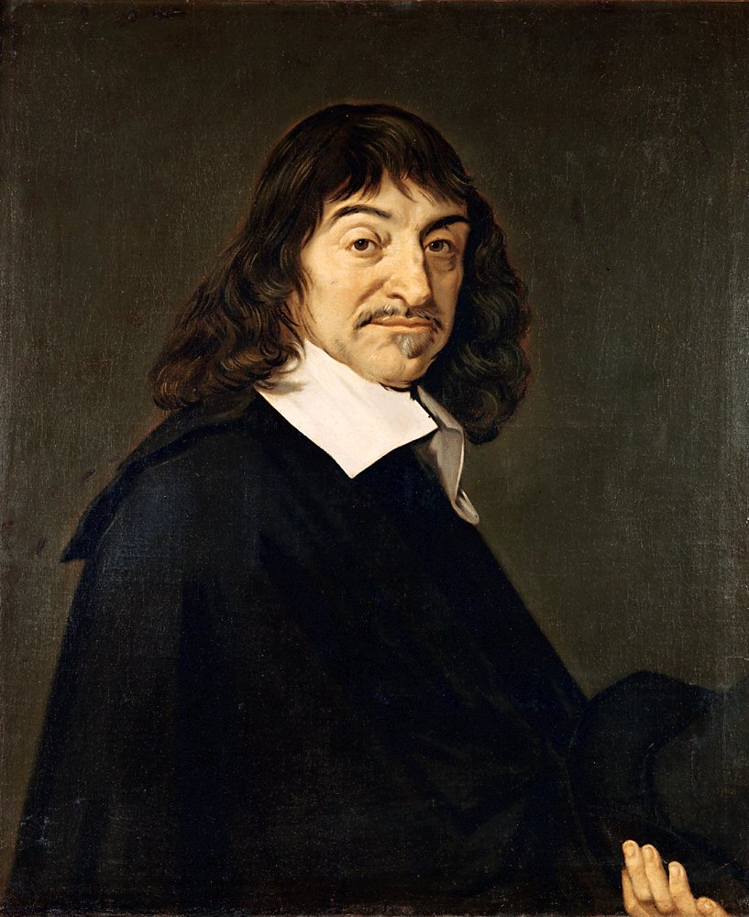
The Enlightenment
Descartes, Newton sough only what was reasonable in the Bible.
The Bible a source of moral teaching rather than theology.
Are miracles “reasonable?”
Rene Descartes

Slide 11
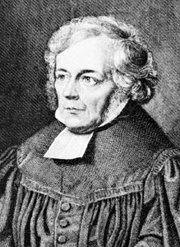
Modernism and Liberal Protestantism
Friedrich Schliermacher
Romanticism
Author-oriented hermeneutics
Fideism
True religion is a feeling, awareness or consciousness of God.
Gefuhl

Slide 12
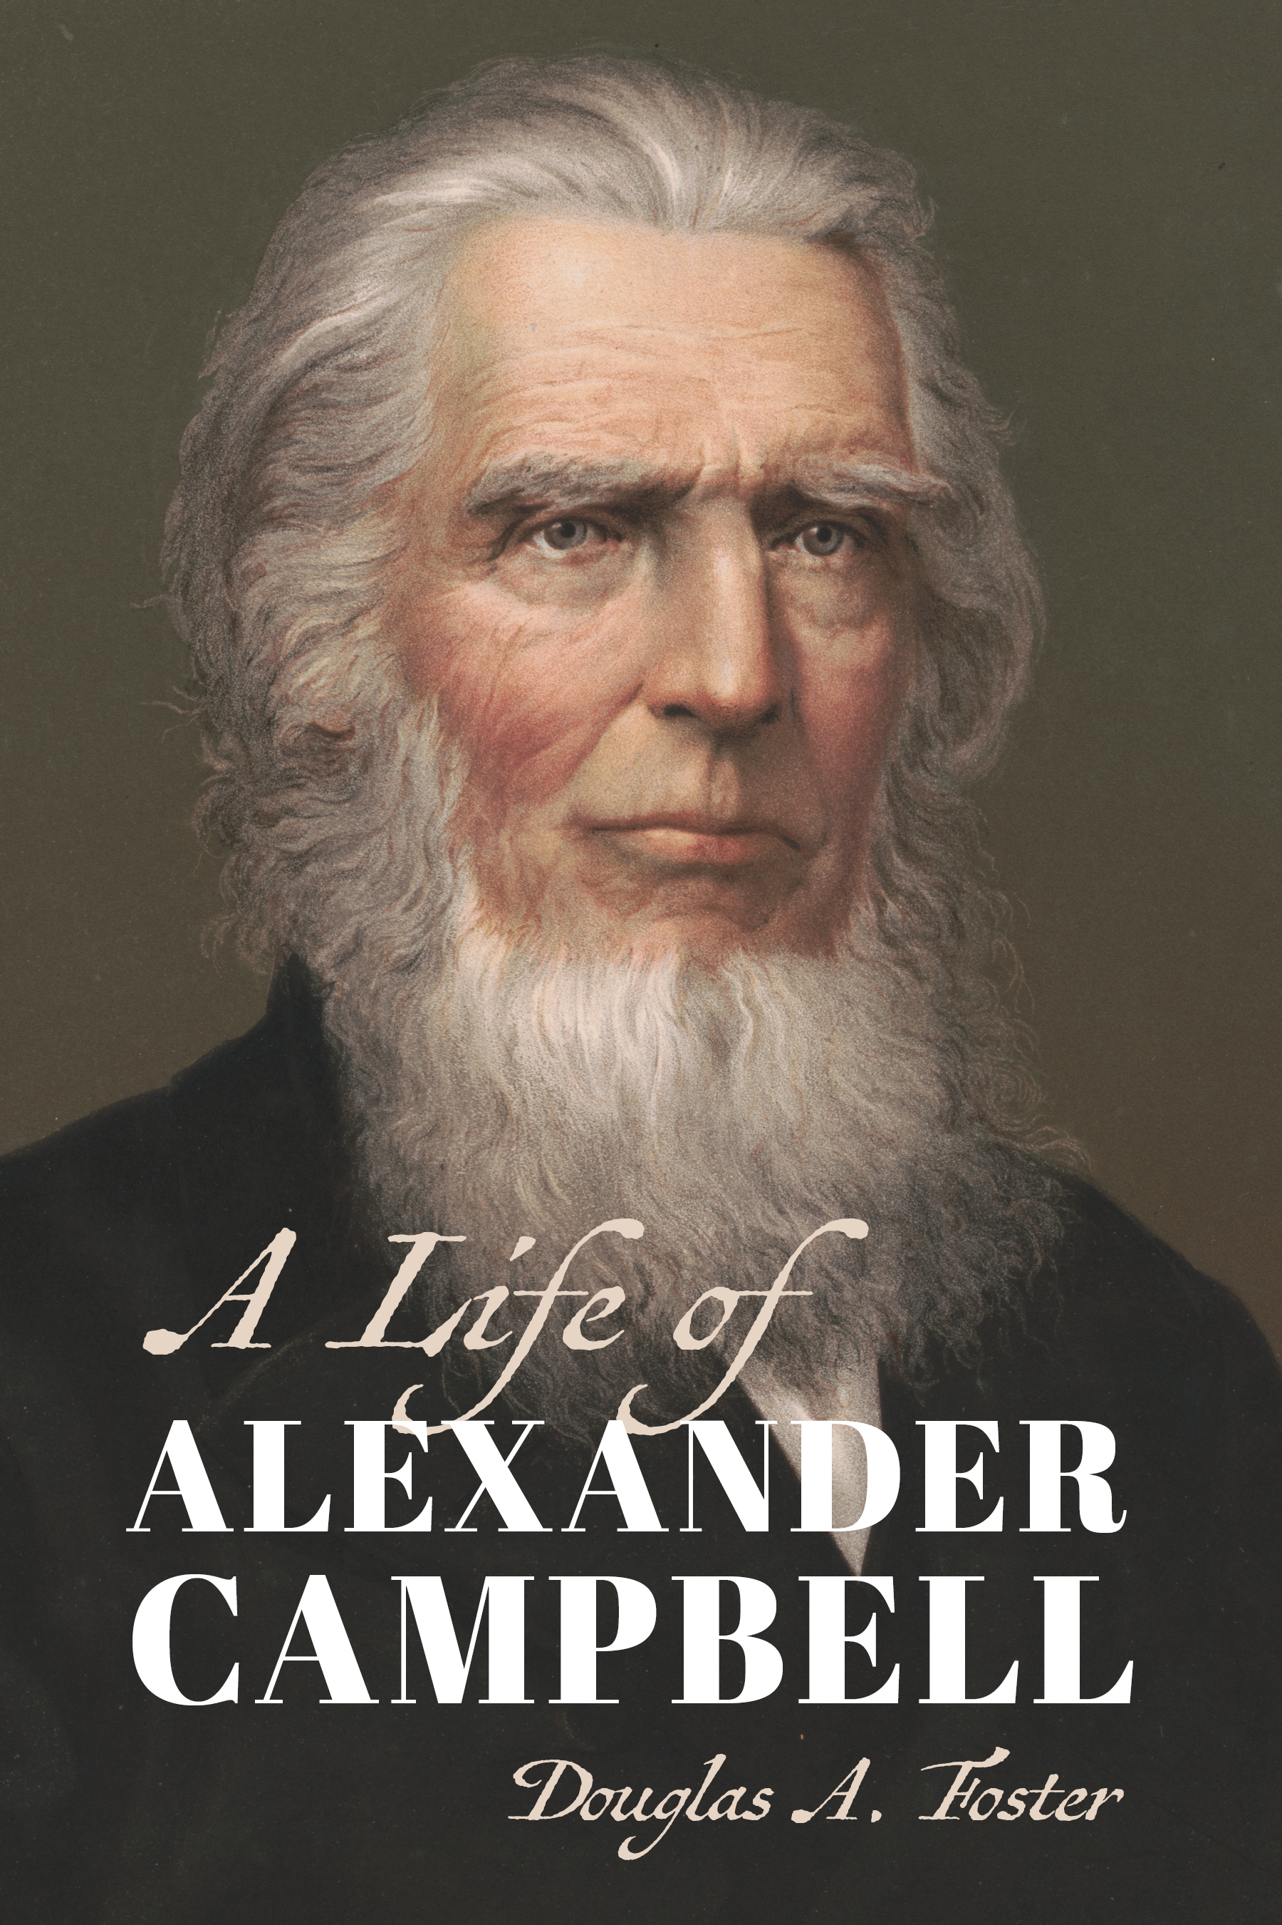
Modernism and Conservative Protestantism
Francis Bacon: Inductive analysis
Scottish School of Common Sense Philosophy
Alexander Campbell
Sought the “facts” of the Bible
Command, Example, Necessary Demonstration

Slide 13
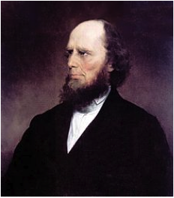
Modernism and Conservative Protestantism
Authorial intent is the “holy grail” of Christian hermeneutic.
The Bible as a source of propositional truth.
Example: Penal Substitutionary Atonement.
Charles Finney

Slide 14
“Rules” of Biblical Hermeneutics
1. Every passage has one meaning.
2. The most obvious meaning is usually the correct one.
3. Always allow the author’s explanation to stand.
4. Always interpret a passage within the context of the passage, the book, and the situation.
5. An interpretation of a passage should conform to the environment of the author.
6. Rightly divide books by dispensation, covenant and setting.
7. Interpret every passage in the light of all others.

Slide 15
“Rules” of Biblical Hermeneutics
8. One passage will often explain another.
9. Let plain passages interpret difficult ones.
10. All passages on a subject must be studied before a conclusion is drawn.
11. Observe the proper balance of scriptural truth.
12. Passages should be interpreted in harmony with the idioms contained.
13. Rightly divide the language (grammar and figures of speech).
14. Learn to distinguish the figurative from the literal.
15. Know the meaning of sentences, phrases and words.
16. Rightly divide books by type of literature

Slide 16
20th Century Hermeneutics: Postmodernism
Don’t Forget Karl Barth
Missional Hermeneutics
Narrative, Narrative, Narrative
Attention to Culture
Bible Not a Source of Theories (ex atonement)
Bible Not a Source of Propositional Truth
Narrative > Metaphor > Proposition/Theory

Slide 17
Missional Hermeneutics: Examples
1. The “women’s role” John Mark Hicks concludes full egalitarianism based on culture and kingdom narrative.
2. Atonement theory: PSA is either rejected or a small part of the narrative on atonement

Slide 18
Final Reflections
Is typological interpretation dead?
Can we find a balance between Modernism and Postmodernism?
Can narrative and culturally-affected hermeneutics live in peace with modernism and propositional truth?

