Slide 1

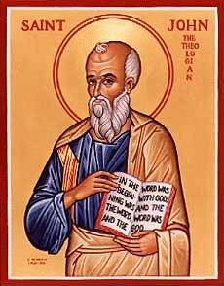
The Gospel of John I
Let’s Meet jesus
John Oakes
Bakersfield
Fall, 2020

Slide 2
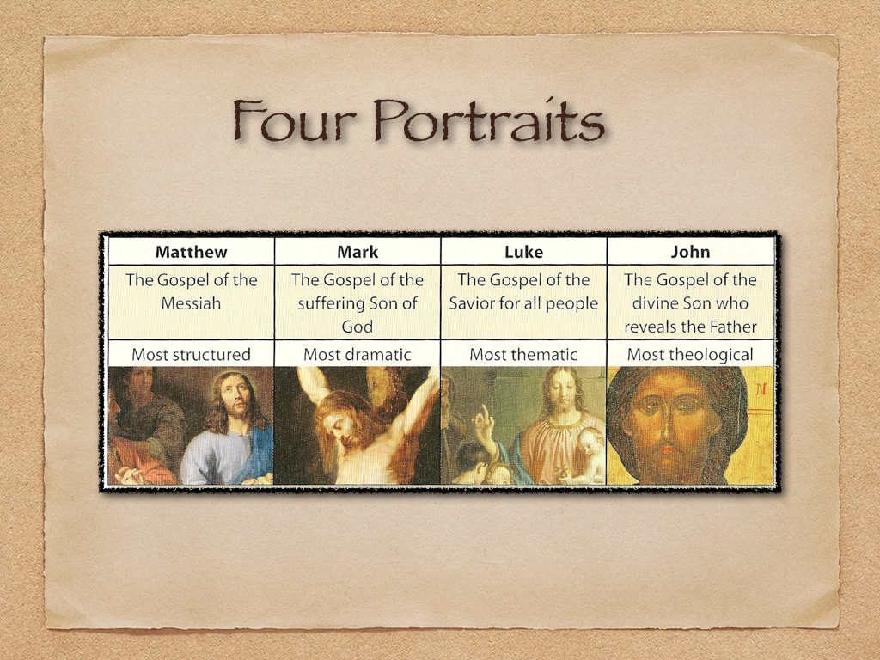
In John Jesus is revealed through his miracles and his statements about himself

Slide 3
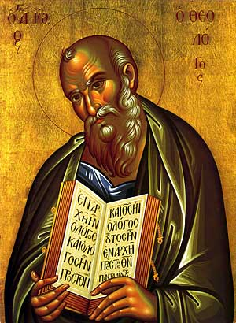
Theme and Purpose of John
Theme: Jesus is the Son of God who reveals the Father, providing eternal life to all who believe.
Purpose: John 20:30-31 But these are written that you may believe that Jesus is the Messiah, the Son of God and that by believing you may have life in his name.
Key verse: John 1:14

Slide 4
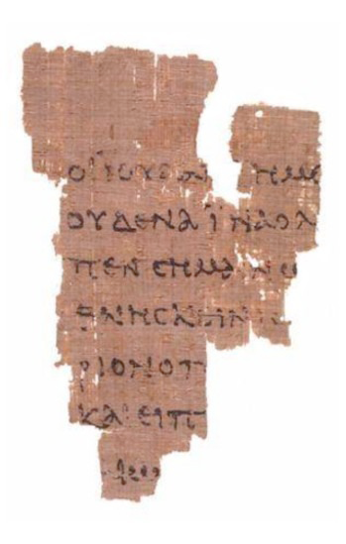
Things to Bear in Mind in John
Chronology based on the Jewish festivals (the three year ministry.
The nature of Jesus is revealed through the festivals as well.
Use of metaphors (light, life, bread, gate, door, lamb, glory…)
Use of irony.
The Rylands Papyrus
AD 125

Slide 5
Seven I Am Statements
I AM the bread of life John 6:35
I AM the light of the world John 8:12, John 9:5
I AM the door (and the gate) John 10:7
I AM the good shepherd John 10:1,14
I AM the resurrection and the life John 11:25
I AM the Way the Truth and the Life John 14:6
I AM the true vine John 15:1
All are metaphors

Slide 6
Jesus Revealed Through Seven Signs
[knew thoughs of Nathanael 1:43-50]
Water to wine John 2:1-11
Healing of official’s son John 4:43-54
Healing at pool of Bethesda John 5:1-5
Feeding of 5000 John 6:1-14
Walking on water John 6:16-21
Healing man born blind John 9:1-12
Resurrection of Lazarus John 11:1-44
[miraculous catch of fish John 21:1-13]

Slide 7
Outline of John
I. Prologue 1:1-1:18
II. Book of Signs 1:19-12:50
III. Book of Glory Passion Story 13:1-20:31
IV. Epilogue 21:1-21:25
Theme: The Son of who reveals God’s glory.
Theme verses 1:14, 1:18, 3:16

Slide 8
Prologue John 1:1-18
John 1:1 In the beginning was the Word. The Word was with God and the Word was God.
En archon In the Beginning (Genesis 1:1)
The Word logos
word, underlying principle, omnipresent wisdom, reason
The Word: Psalm 33:6 Isaiah 55:11

Slide 9
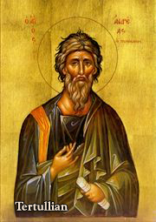
John 1:1 The “Trinity”
The Word was with God and the Word was God.
Yesterday I was with Vince. I am Vince.
Deuteronomy 6:4 Hear, O Israel the Lord is one God.
The “Trinity” is about relationship. God is essentially relational.
A God who would be known.
Tertullian AD 160-220

Slide 10
John 1:2-5 Important Metaphors
Creator Through Him all things were made. Without him nothing was made that has been made.
Life In Him was life
Light The light shines in the darkness and the darkness has not overcome/understood it.

Slide 11
John 1:9-13
To all who did receive him… he gave the right to become children of God.
…born of God.

Slide 12
John 1:14 A Key Verse!
The Word became flesh and made his dwelling among us. We have seen his glory, the glory of the one and only Son, who came from the Father, full of grace and truth.
The Word became flesh. Logos became sarx
He made his dwelling (tabernacled) among us.
We beheld his glory (doxa).
Full of grace and truth.

Slide 13
Grace and Truth!
John 1:17 The Law was given through Moses, grace and truth came through Jesus Christ.
The Law vs Grace and Truth
Which is more important to you?
Grace or Truth?

Slide 14

John 1:16 Grace upon Grace
grace grace grace grace grace grace grace grace grace grace grace grace grace grace grace grace grace grace
Piles of grace

Slide 15
John 1:18
No one has ever seen God, but the one and only Son, who is himself God, the one who is at the Father’s side, has made him known.
The only begotten Son monogeneis The only one like that. The unique Son.
Jesus has made God known.
What would Jesus do?

Slide 16
Let’s Meet Jesus
Behold the glory of God.
Behold the unique One.
Behold God the Son who tabernacled with us
Full of grace and truth!

Slide 17
The Gospel of John II
Jesus at Cana
The First Sign
Water to Wine

Slide 18
John 1:35-51 Jesus meets Nathanael
Jesus: What do you want?
Come, and you will see
What about the contradictions in the Bible? What about all the hypocrites? What about all the killing in the Bible? I am really busy. I’m Catholic. I don’t believe in God.
Come, and you will see!!!

Slide 19
Who Is Jesus?
John 1:41 the Messiah
John 1:49 Rabbi
Son of God
King of Israel!

Slide 20
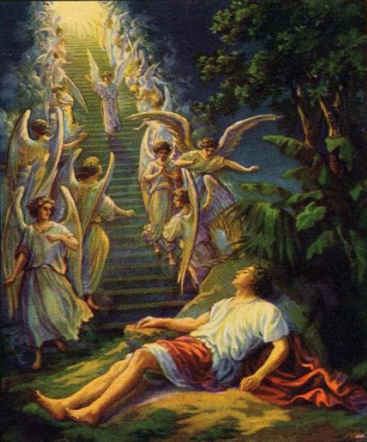
Jacob’s Ladder Gen 28:10-13
John 1:51 Very truly I tell you, you will see heaven open, and the angels of God ascending and descending on the Son of Man

Slide 21
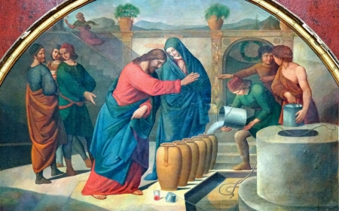
John 2:1-12 Jesus at Cana
The First of Seven Signs

Slide 22
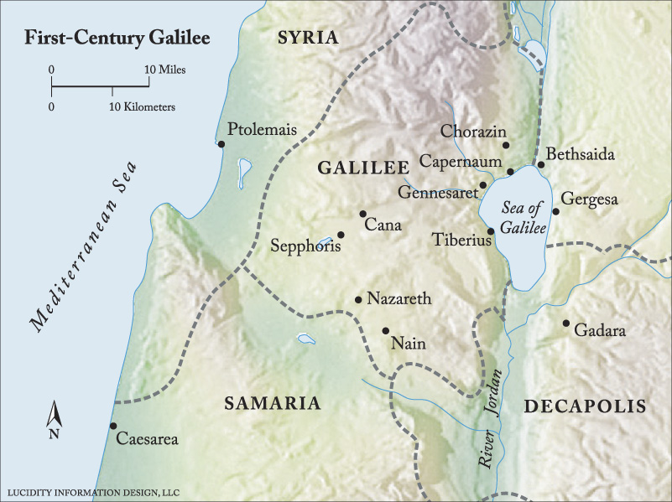
On The Third Day A Wedding Took Place

Slide 23
Why Did Jesus Go To a Wedding?
Because he was invited.
Because it would be fun.
But…
My time has not yet come

Slide 24
Why Did Jesus Do the Miracle?
Because his mom asked him to.
Because of the symbolic meaning.
We are invited to a marriage feast. (Isaiah 25:4-6, Revelation 19:6-9)
Empty vessels (Judaism) turned into full containers of wine (Jesus’ blood)

Slide 25
John 2:11
What Jesus did here in Cana of Galilee was the first of the signs through which he revealed his glory and his disciples believed in him.
In John, Jesus’ miracles:
Reveal his glory and
Cause us to believe in Him

Slide 26
The Gospel of John III
Jesus and Nicodemus

Slide 27
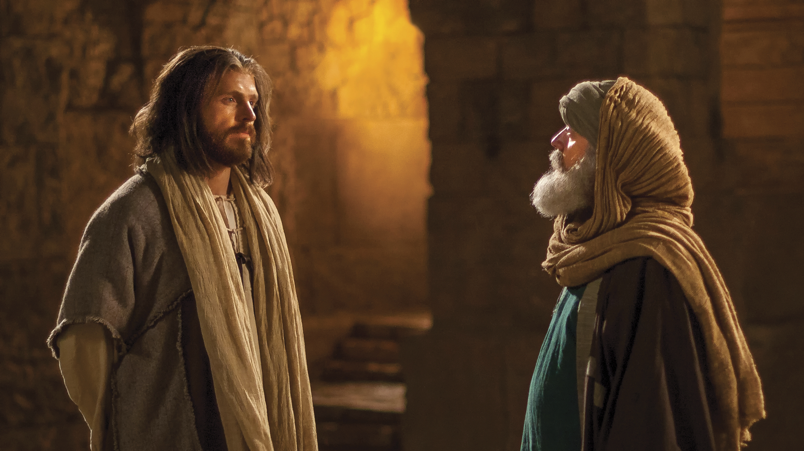
John 3:1-21 Jesus and Nicodemus
Who is Jesus?

Slide 28
John 3:1-21 Jesus and Nicodemus
Jesus’ interviews: a pattern
Jesus makes an enigmatic statement which provokes thought
Confusion
Jesus explains the statement
Jesus identifies himself

Slide 29
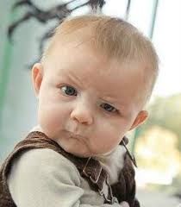
John 3 Nicodemus
John 4 Samaritan Woman
John 3 The insider believes
John 4 The outsider believes
Nicodemus: Let’s have a spiritual conversation.
Jesus: You must be born again!

Slide 30
You Must Be Born Again
Truly I tell you, unless you are born again of the water and of the spirit, you will never enter into the kingdom of God.
Nicodemus: How can this be?
Jesus: You are Israel’s teacher, and you do not know Ezekiel 36:24-28? (Acts 2:36-38)

Slide 31
John 3:10-13
v. 11 We testify to what we have seen.
Jesus is talking about John the Baptist and his disciples baptizing people.
v. 12 Now I will speak of heavenly things.
The Son of Man came to reveal these greater things.

Slide 32
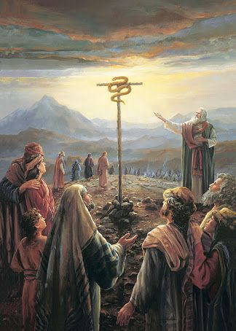
John 3:14
Numbers 21:7-9
Just as Moses lifted up the snake in the wilderness, so the Son of Man must be lifted up.

Slide 33
The Gospel of John IV
Jesus and the Samaritan Woman at the Well

Slide 34
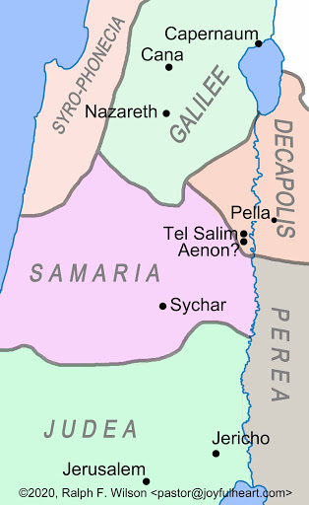
John 4 Jesus and the Samaritan Woman
John 4:1-9
Jesus ministers in Samaria

Slide 35
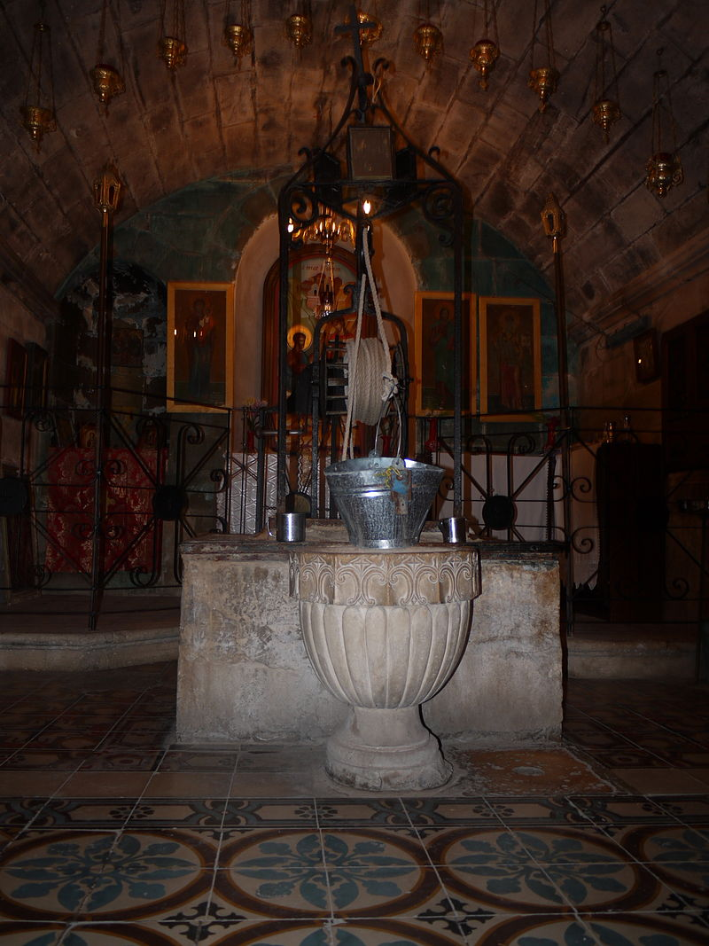
Jacob’s Well
Jesus and Outsiders
A Samaritan
A woman
A “sinful” unmaried Samaritan woman.
Jesus: Will you give me a drink?

Slide 36
John 4:10-26
v. 10 living water
v. 14 Whoever drinks the water I give them will never thirst. Indeed, the water I give them will become in them a spring of water welling up to eternal life.
Jesus is talking about the Holy Spirit. John 7:37-39.

Slide 37
When people put up a spiritual smokescreen:
1. Respectfully and gently answer the question. And
2. Bring the conversation around to the heart of the matter—matters related to eternal life!!!

Slide 38
John 4:17 The third miracle of Jesus
“You are right when you say you have no husband.”
“Sir, I can see that you are a prophet.”
The Samaritan woman puts up another spiritual smokescreen: Mt. Gerizim.

Slide 39
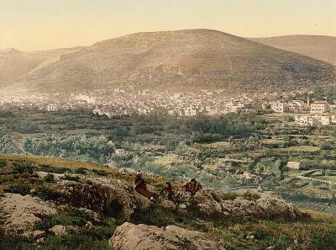
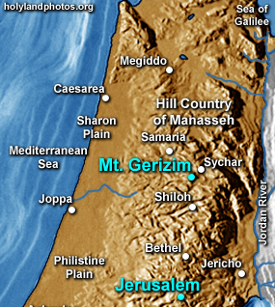
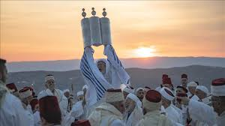
Mt Gerizim and the Samaritans

Slide 40
John 4:24 True Worship
God’s worshipers must worship in spirit and in truth.
I who speak to you—I am He.
Jesus claims to be God!!!!

Slide 41
John 4:27-38 The Disciples are Confused
v. 29 Come and see…
v. 34 My food is to do the will of him who sent me and to finish his work.
Q: What is YOUR food?
Open your eyes! The fields are ripe for harvest.

Slide 42
The Gospel of John V
The Healing at the Pool of Bethsaida

Slide 43
John 5 Healing at Bethsaida
Do you want to get well?
Jesus is Lord of the Sabbath
Testimonies about Jesus

Slide 44
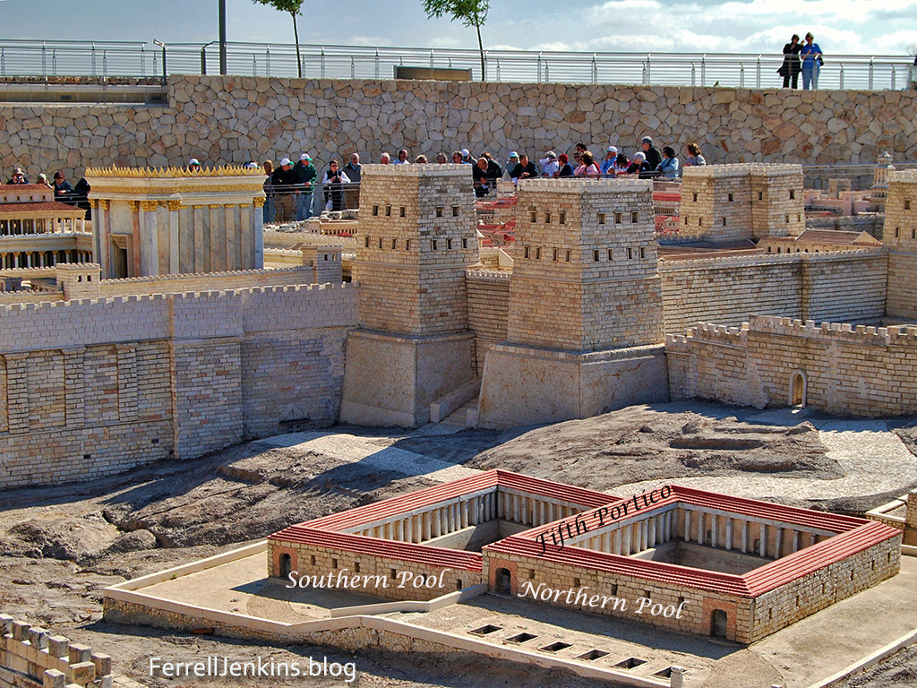
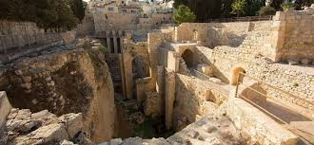
The Pool of
Bethsaida

Slide 45
John 5:6 Do You Want to Get Well?
What if Jesus healed you?
What would you have to change?

Slide 46
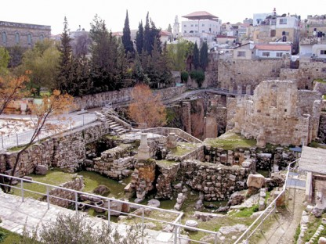
John 5:7-15 Jesus 3rd Sign
John 5:8 Jesus: “Get up your mat and walk”
To be healed:
Trust Jesus
Take action
The cure was
Sudden and complete
Stop sinning!

Slide 47
John 5:16-30
Jesus the Lord of the Sabbath
v. 17 My Father is always at work.
v. 18 They tried all the more to kill Jesus.
Why? Because he claims to have authority over the Sabbath.
Sabbath for man Mark 2:27
Jesus Lord of the Sabbath Matthew 12:1-8, Luke 6:1-5

Slide 48
Theme: Jesus Replacing/Greater than the Jewish Festivals
1. Jesus greater than the Sabbath Jn 5:1-18
2. Jesus fulfills the Passover Jn 6:1-70
3. Jesus fulfills Booths/Tabernacles Jn 7:1-9:41
4. Jesus fulfills Feast of Dedication (Hanukkah)
Jn 10

Slide 49
Testimonies of Jesus John 5:31-40
Jesus: There are three things which testify about me: Do you believe in Jesus? Why?
a. John the Baptist 5:31-35
b. The “works” (miracles) of Jesus 5:36-38
c. Prophecy/Scripture 5:37-40
Jesus: The entire Hebrew Bible is about me!!!

Slide 50
John 5:41-47 One Greater than Moses
Who do you accept glory from? God or people?
v. 45 Your accuser is Moses
Deuteronomy 18:15
What about you?
Who will you listen to and who will you seek glory from?

Slide 51
Do you want to get well?
Get up and walk.
Stop sinning
Come to Jesus
Lord of the Sabbath
Fulfillment of Passover
Fulfillment of Tabernacles
The One greateer than Moses.

Slide 52
The Gospel of John VI
John 10:22-42
Jesus and the Feast of Dedication
(Hanukkah)

Slide 53
Theme: Jesus Replacing/Greater than the Jewish Festivals
1. Jesus greater than the Sabbath Jn 5:1-18
2. Jesus fulfills the Passover Jn 6:1-70
3. Jesus fulfills Booths/Tabernacles Jn 7:1-9:41
4. Jesus fulfills Feast of Dedication (Hanukkah)
Jn 10

Slide 54
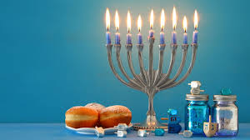
John 10:22-25 Jesus at the Feast of Dedication
Jesus is the antitype to the Feast of Dedication.
Hanukkah
Celebrates the rededication of the temple on 25th of Chislev (December, 164 BC)

Slide 55
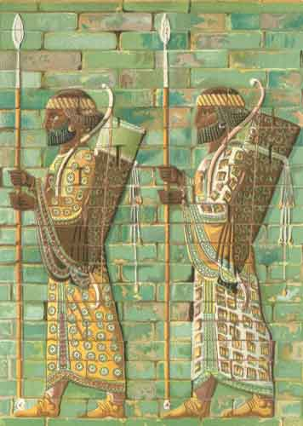
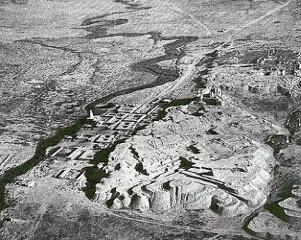
Daniel Chapter Eight: A Ram and a Goat
Ancient Susa and the Ulai Canal

Slide 56
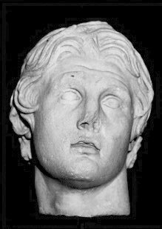
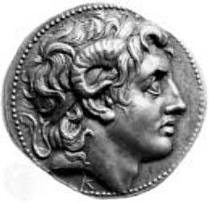
Alexander the Great
Died “at the height of his power” at the age of 35
323 BC

Slide 57
The Four Horns of Daniel Seven
Horn (King) | Territory Ruled
Antigonus | The East. From Syria to India.
Cassander | The West. Macedonia and Greece.
Lysimachus | The North. Thrace and Asia Minor.
Ptolemy | The South. Egypt and Palestine.

Slide 58
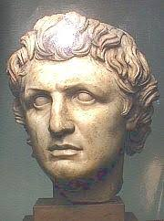
Out of one of these horns…
Seleucus I Nicator 321-285 BC
South: Syria
East: Persia
Beautiful Land:
Canaan

Slide 59
Daniel’s Prophecy Fulfilled
1 Maccabees 1:46-47 sacrifices banned, pigs slaughtered in temple, death for circumcision of children.
1 Maccabees 1:57-58, 60, 62 The Abomination of Desolation. Antiochus Epiphanes. Many stood firm.
1 Maccabees 2:42 The Hasidim/Pharisees

Slide 60
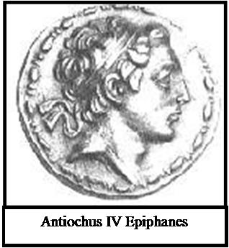
Daniel 8: The Abomination of Desolation
How long?
2300 Evenings and Mornings = 1150 days
Nov 167 BC – Dec 25, 164 BC = 1150 days

Slide 61
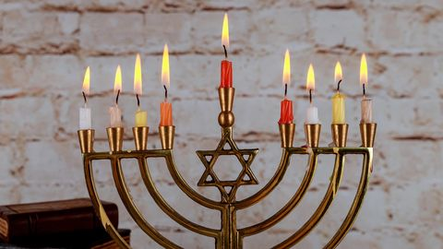
Hanukkah: God Saves His People
What is Hanukkah about? It is about God saving his people.
Judas Maccabeeus is a prefigure of the Messiah.
He defeated Antiochus Epiphanes, and rededicated the temple.
His people are raised from the dead on the 8th day.

Slide 62
John 10:24-42
v. 24 If you are the Messiah, tell us plainly.
v. 25, 32, 38 Believe the miracles/signs!
v. 28 I give them eternal life.
v. 30 I and the Father are One!
John 10:34-36 A strange argument. Psalm 82:6

Slide 63
Jesus Fulfills Hannukah/Dedication
John 10:36 Jesus: I am the one whom the Father has set apart (dedicated)
1. I am the one dedicated to God.
2. I am God’s Son.
3. The Father is in me and I am in the Father.

Slide 64
John 11 Look what Jesus did next!
Jesus fulfills the expectation of Hanukkah:
Jesus is the one dedicated to God.
Like Jacob Maccabeeus, Jesus will bring his people back from the dead. John 11:25

Slide 65
What Do We Learn From Hanukkah/Feast of Dedication?
Jesus celebrated Hanukkah.
God is in control.
God will save and resurrect his people.
Jesus fulfills the expectation of Hanukkah/Dedication.
Jesus gives eternal life
Jesus is God’s Son.

Slide 66
The Gospel of John VII
Jesus fulfills Passover.
Jesus the Second Moses

Slide 67
Theme: Jesus Replacing/Greater than the Jewish Festivals
1. Jesus greater than the Sabbath Jn 5:1-18
2. Jesus fulfills the Passover Jn 6:1-70
3. Jesus fulfills Booths/Tabernacles Jn 7:1-9:41
4. Jesus fulfills Feast of Dedication (Hanukkah)
Jn 10

Slide 68
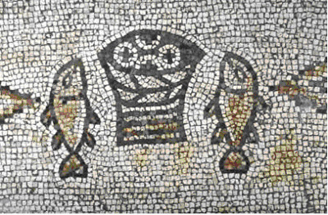
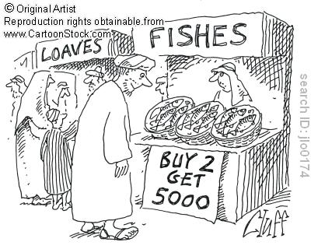
Sign #4 Feeding the 5000
Theme: Jesus the second Moses and
Jesus fulfills the Passover.
Jesus gives bread (like the manna)

Slide 69
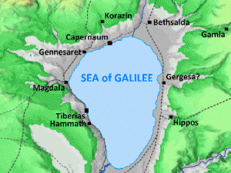
Sign #4 Jesus feeds 10,000 +
People’s response: Jn 6:14 “Surely this is the prophet” (Deuteronomy 18:15-19)
Moses:
Gave them bread (sign #4)
Parted the Red Sea (sign #5)
Gave them water (John 4:10, John 7:38)

Slide 70
John 6:16-21
Sign #5 Jesus Walks on Water
Jesus walking on water the antitype to Moses parting the Red Sea.
John 6:20 “It is I”
ego eimi
I, I Am.
Jesus is God.

Slide 71
John 6:25-71 Jesus the Bread of Life
v. 27 Work for food that will last.
Q: What are you working for?
v. 29 The work that God requires is to believe in Jesus who was sent by God.
v. 30 Give us a sign! Are you greater than Moses?
v. 32 Were you paying attention yesterday? I am greater than Moses. I bring bread from heaven!
v. 34 We want this bread!

Slide 72
John 6:35-44 I AM the Bread of Life
I, I AM the bread of life
Not “I have bread”
Not “I offer bread”
Not “I bring bread”
I AM the bread of life
What do you hunger for?
What do you thirst for?
Where do you go for spiritual food?

Slide 73
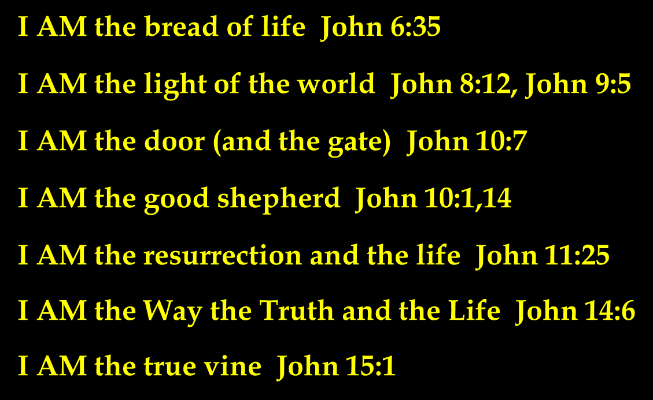
7 I AM Statements in John

Slide 74
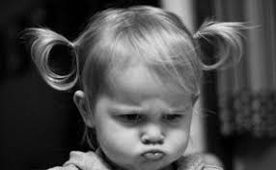
John 6:41 Grumbling
Is this not Jesus, the son of Joseph, whose father and mother we know?
Jesus: stop grumbling!
It is true! I AM the bread of life!

Slide 75
John 6:45-59 Eat of Me!
v. 49, 58 Your ancestors ate bread from Moses and died.
I am greater than Moses!!! I am living bread!
If you eat my flesh me you will not die!
v. 53 Very truly I tell you, unless you eat the flesh of the Son of Man and drink his blood, you have no life in you!!! My flesh is real food.
Wow!!! Are you feeding on Jesus?

Slide 76
John 6:60-70 What Is Your Respose?
v. 60 This is a hard teaching!
v. 67 Do you want to leave too?
Peter: To whom [else] shall we go?
Consider the alternative.
Let us eat the bread and drink the blood of Jesus.

Slide 77
The Gospel of John VIII
Jesus and the Feast of Tabernacles

Slide 78
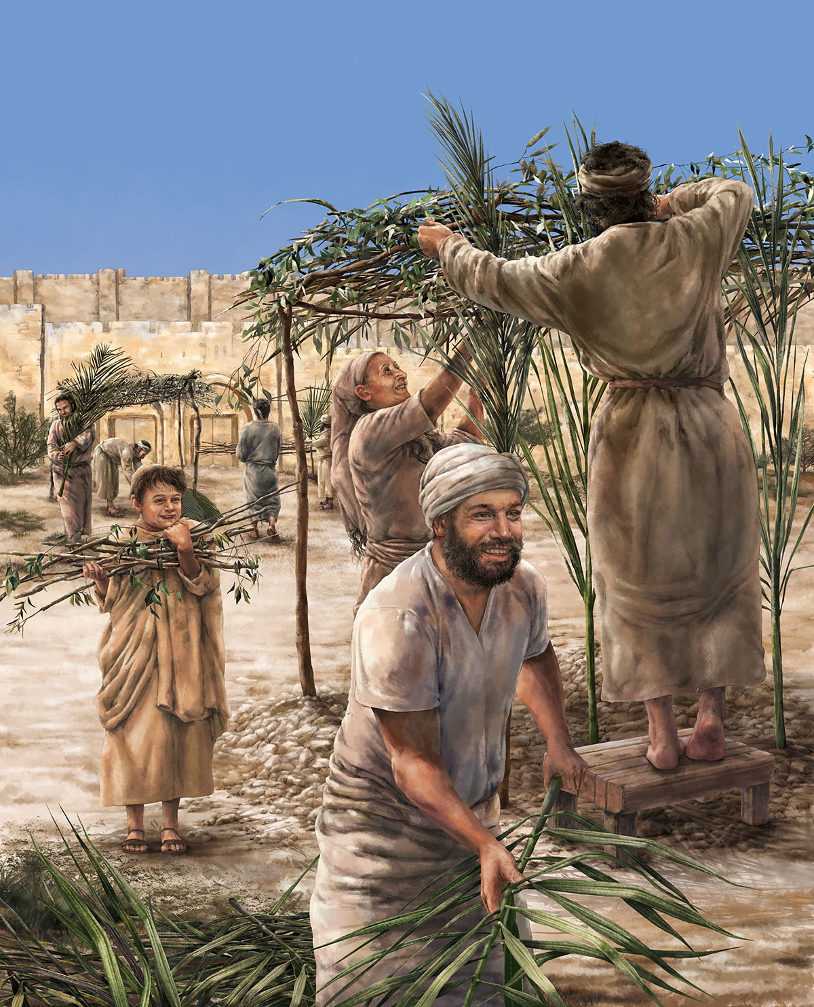
John 7 & 8 Jesus and Tabernacles
Feast of Tabernacles
Feast of Booths
Sukkot
A harvest festival Sept/Oct
Remembering God dwelling with his people

Slide 79
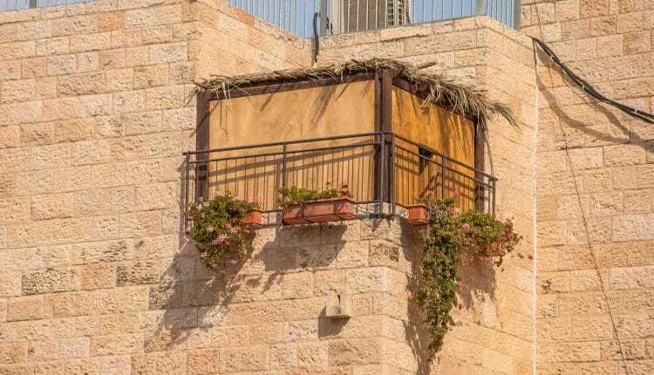
John 7:14-24
Sukkot in a city
John 7:17
If anyone chooses to do God’s will, he will find out whether my teaching comes from God or whether I speak on my own.

Slide 80
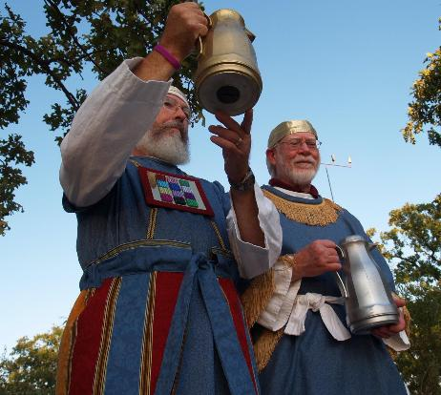
John 7:37-43 Living Water
John 7:37 “Whoever believes in my, as Scripture says, rivers of living water will flow from within them.” By this he meant the Spirit…
Isaiah 12:3 With joy, you will draw water from the well of salvation.
Zechariah 14:6-9, 16-17
Ezekiel 47:1-11
Joel 3:18
The Water Ceremony

Slide 81
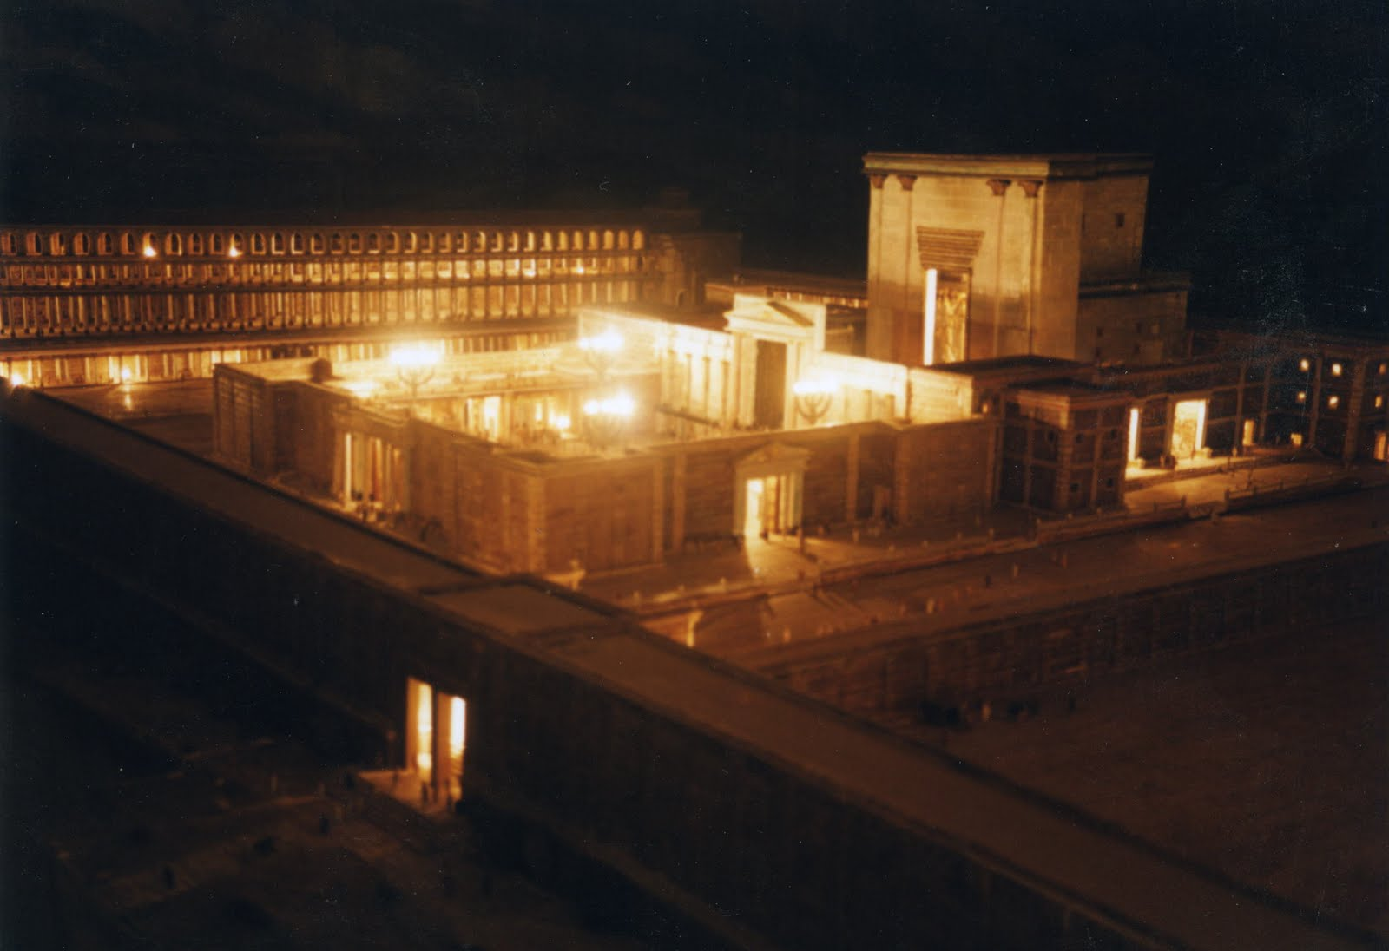
John 8:12-20
I AM the Light of the World
Illumination of the Temple
Purpose: To remember the Shekinah—the Glory of God who dwelt with them in the wilderness

Slide 82
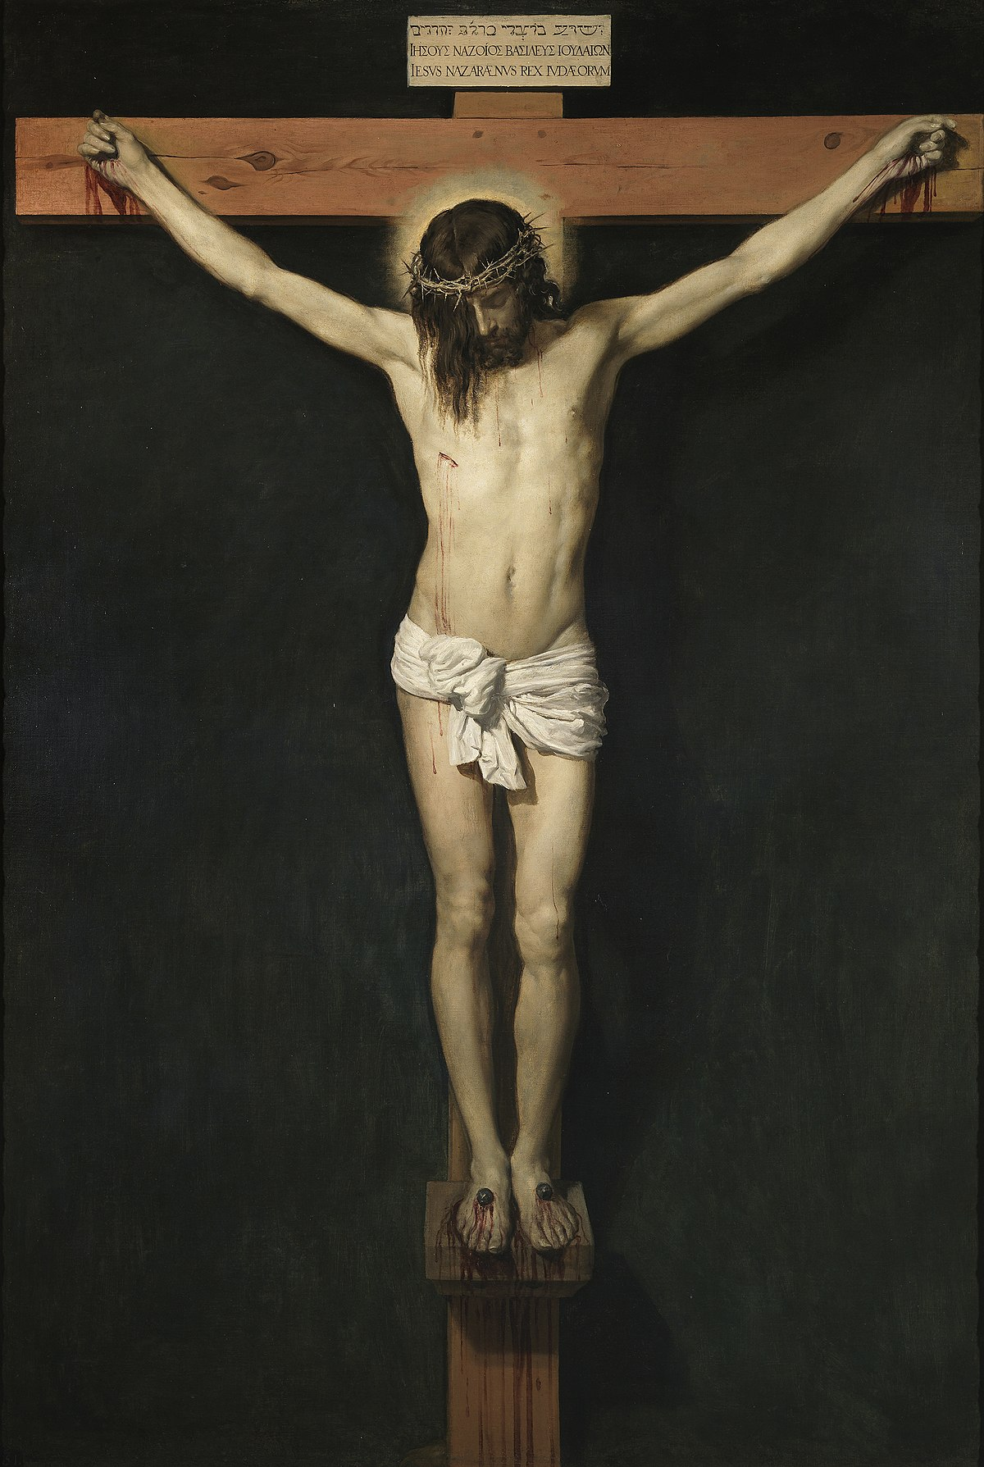
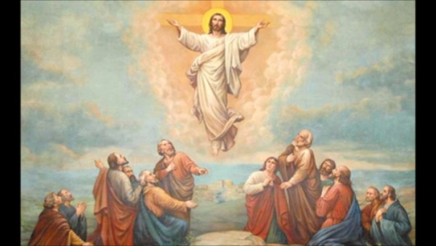
John 8:28 I AM He ego eimi
When you have lifted up the Son of Man, then you will know that I AM He
Have you been lifting Jesus up?

Slide 83
John 8:31-48 True Disciples
John 8:31 “Belief” is not enough.
We need to hold to Jesus’ teachings!
John 8:46 Can any of you prove me guilty of sin?
Jesus was sinless!!!
John 8:48 Response: You are demon-possessed!

Slide 84
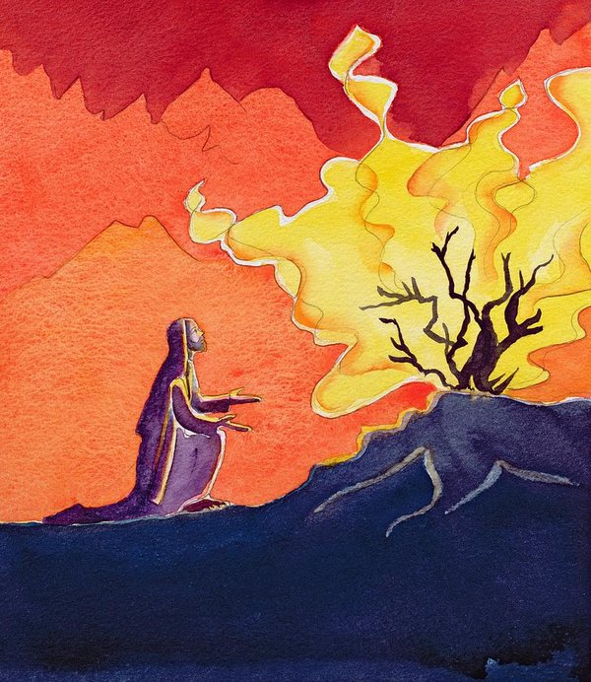
John 8:49-59 I AM
John 8:51 Whoever obeys my word will never see death.
Jesus: I am greater than Abraham.
John 8:58 Before Abraham was born, I AM
They picked up stones…
YHWH I AM

Slide 85
The Gospel of John IX
Jesus Heals a Man Born Blind

Slide 86
Theme: Jesus Replacing/Greater than the Jewish Festivals
1. Jesus greater than the Sabbath Jn 5:1-18
2. Jesus fulfills the Passover Jn 6:1-70
3. Jesus fulfills Booths/Tabernacles Jn 7:1-9:41
4. Jesus fulfills Feast of Dedication (Hanukkah)
Jn 10

Slide 87
John 7 & 8 Jesus and Tabernacles
Feast of Tabernacles
Feast of Booths
Sukkot
Remembering God dwelling with his people

Slide 88
John 9 Jesus Heals a Man Born Blind
John 6 Jesus gives bread, then claims “I AM the bread of life.
John 8:12 Jesus says I AM the light of the world, then in John 9 Jesus heals a man born blind.
In John
Miracles: Give glory to God John 9:3
Create faith (as we will see)
Tell us who Jesus is John 9:5

Slide 89
John 9:1 The Problem of Suffering
Who sinned, this man or his parents that he was born blind?
Jesus: This happened so that God can be glorified.
Has God used suffering in your life to his glory?

Slide 90
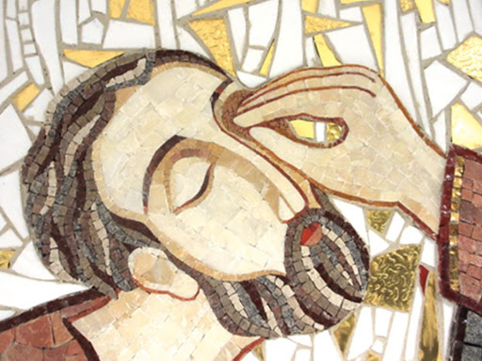
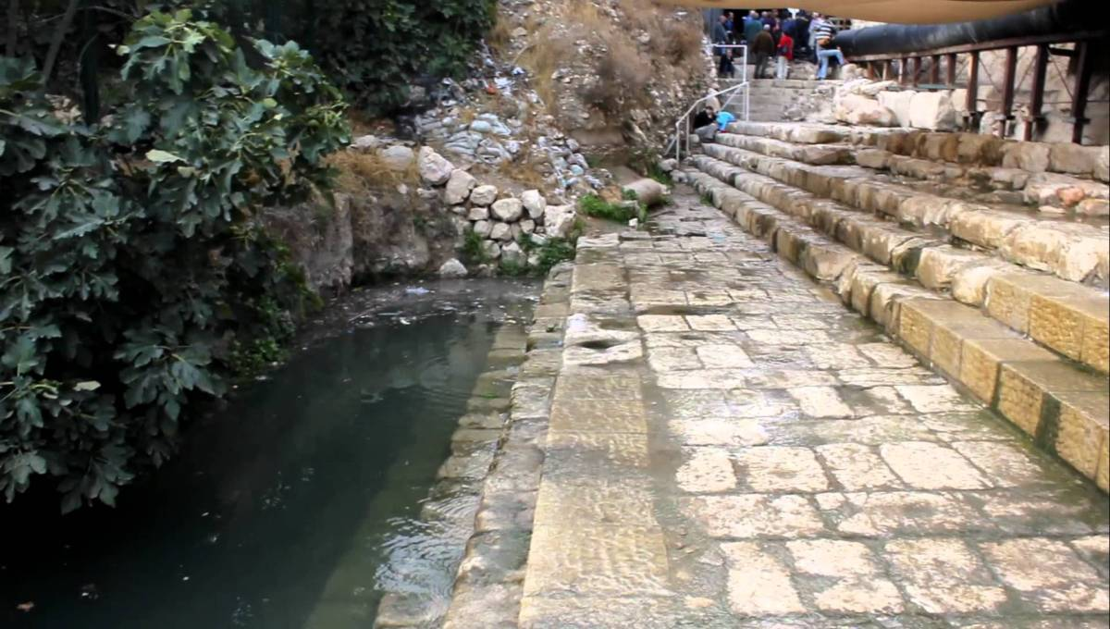
What healed the man?
The mud?
The water?
The man’s faith?
The man’s obedience?
Jesus’ power?
2 Kings 5:1-15 Namaan

Slide 91
John 9:1-7 What saves us?
Jesus the light of the world saves us.
But not without our faith.
And not without our complete obedience to his command.
It involves water.

Slide 92
John 9:8-34 Who is Blind and Who Can See?
The Man born blind
The Parents
The Pharisees
Which are you?
Requirements to be healed?
Recognize you are sick/blind/a sinner
Go to the right doctor
Take the medicine

Slide 93
The Blind Man Coming to faith
John 9:11 the “man” Jesus
He does not see yet.
John 9:17 He is [the] prophet
He is getting there…

Slide 94
John 9:18-23 The Parents
They believed but they did not believe. They are blind
Why not?
They were afraid of the Jewish leaders
What about you? Whom do you fear?
Matthew 10:38 Do not fear him who can only destroy the body…

Slide 95
John 9:24-34 The Pharisees are Blind
Why?
They can see Moses, but they cannot see “the one like Moses”
They claim that they can see.

Slide 96
John 9:35-41 The Man Now Sees
v. 11 the man named Jesus
v. 17 a prophet
v. 33 He is from God
v. 38 Lord, I believe! He now sees!!!
Where are you in this progression?

Slide 97
The Blind and the Seeing
Jesus is the Light of the World
For judgement I have come into the world, so that the blind will see and those who see will become blind.
If you see Jesus, but do not “see” Jesus—if you do not admit you are blind, then your guilt remains.

Slide 98
The Gospel of John X
Jesus Raises Lazarus
I AM the Resurrection and the Life

Slide 99
John 9:24-34 The Pharisees are Blind
Why?
They can see Moses, but they cannot see “the one like Moses”
They claim that they can see.

Slide 100
John 11 Jesus Raises Lazarus
John 6 Jesus makes bread then Jesus says “I AM the Bread of Life.”
John 8:12, 9:5 Jesus says “I AM the light of the world, then he heals the man born blind.
John 11 Jesus says “I AM the resurrection and the life.” Then Jesus resurrects Lazarus.

Slide 101
Seven I Am Statements
I AM the bread of life John 6:35
I AM the light of the world John 8:12, John 9:5
I AM the door (and the gate) John 10:7
I AM the good shepherd John 10:1,14
I AM the resurrection and the life John 11:25
I AM the Way the Truth and the Life John 14:6
I AM the true vine John 15:1

Slide 102
Jesus Revealed Through Seven Signs
[knew thoughs of Nathanael 1:43-50]
Water to wine John 2:1-11
Healing of official’s son John 4:43-54
Healing at pool of Bethesda John 5:1-5
Feeding of 5000 John 6:1-14
Walking on water John 6:16-21
Healing man born blind John 9:1-12
Resurrection of Lazarus John 11:1-44
[miraculous catch of fish John 21:1-13]

Slide 103
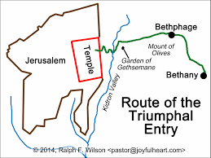
John 11:1-16 Jesus Comes to Bethany

Slide 104
John 11:26-27
Jesus: I AM the resurrection and the life. He who believes in me will live, even though he dies; and whoever lives and believes in me will never die.
Do you believe this? Then you will never die!
Martha: Yes, Lord, I believe that you are the Christ, the Son of God, who was to come into the world.

Slide 105
Jesus Raises Lazarus
Jesus was deeply moved.
Jesus wept.
Jesus: Take away the stone!
Martha: By this time there is a bad odor.
You too, were dead in your sins. You, too, were royally stinking it up.
But Jesus says, “Take away the stone!”

Slide 106
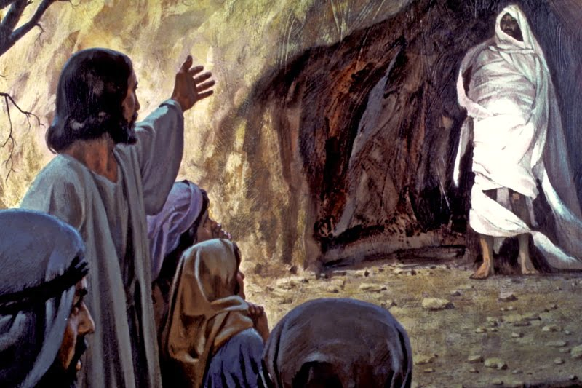
Lazarus, Come Out!

Slide 107
Unbind Him
Jesus says to you ___________ come out!
Jesus says to you, unbind him!

Slide 108
John 11:45-51 Responses to Jesus
John 11:45 Many believed. What a shock!
What about you? Do you believe?
Did the Pharisees believe Jesus raised Lazarus? Yes!!! Did they believe? No!!!
Caiaphas: You do not realize that it is better for you that one man die for the people than that the whole nation perish. How ironic!

Slide 109
John 11:53-57
From that day on they plotted to take his life.
The die is cast.
The Passover is at hand.
Jesus no longer says “the time has not yet come.”
Do you believe?

Slide 110
The Gospel of John XI
The Glorification
(and the self-humbling) of King Jesus

Slide 111
John Chapter 12
Theme: The Glorification of the King
A transition… Jesus enters Jerusalem
A transition… Jesus’ public ministry ends
A transition… The Book of Signs ends and the Book of the Passion begins

Slide 112
The Glorification of the Messiah/King
John 12:1-8 Anointing of a Messiah/King.
John 12:12-16 Triumphal entry of the King.
John 12:28 God: I will glorify your name.
John 12:32 Jesus will be lifted up (glorified)

Slide 113
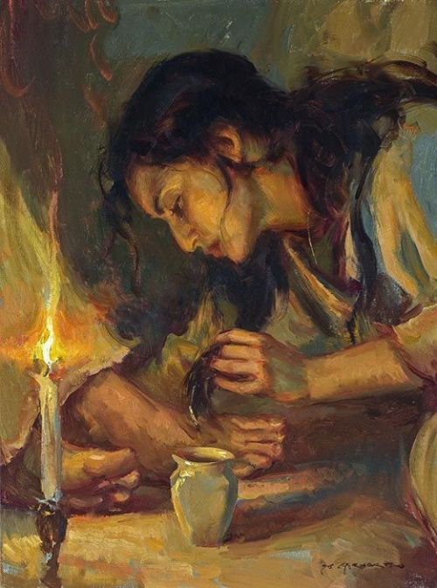
John 12:1-8
Jesus Anointed as King and For His Burial

Slide 114
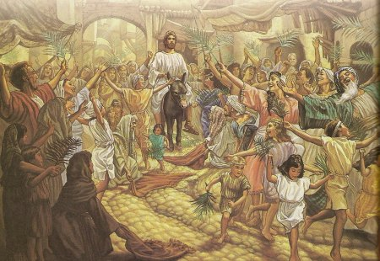
John 12:12-16 The Passion Story Begins
I Maccabees 13:21
(Simon Maccabeus)
Hosannah! Ps 118:25-26
Jesus hailed as King and Messiah.
King of Peace (donkey)
Zechariah 9:9

Slide 115
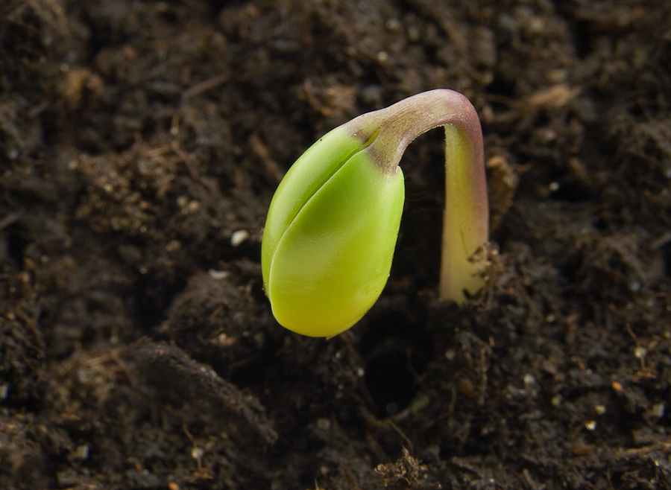
John 12:23-29 The Hour Has Come!
Truly, truly I tell you, unless a kernel of wheat falls to the ground and dies, it remains only a single seed. But if it dies, it produces many seeds. John 12:24
John 12:32 I will draw all men to myself. How??? By dying!

Slide 116
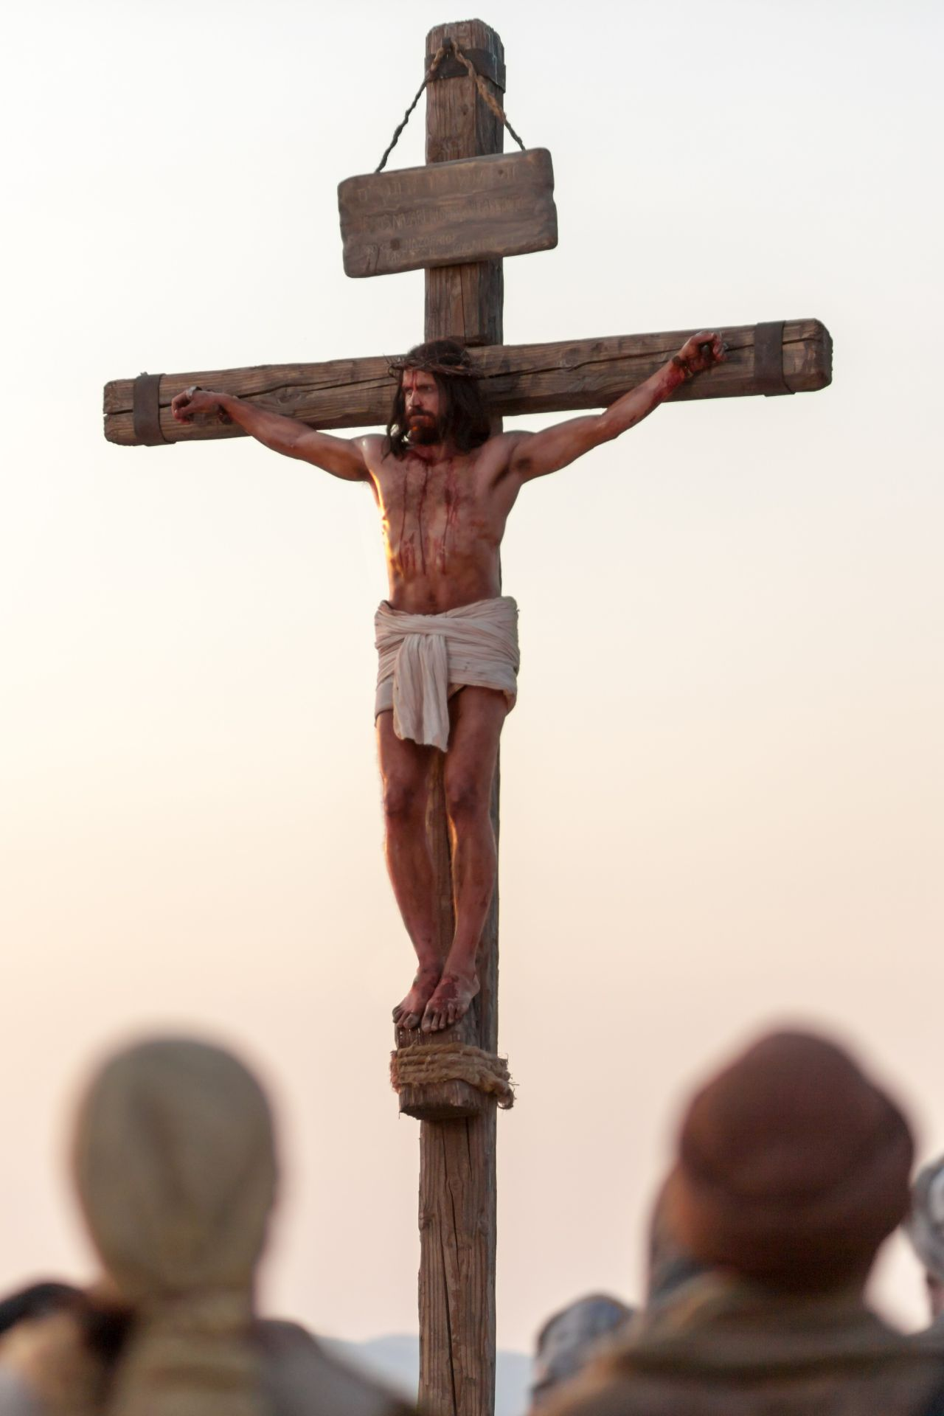
John 12:30-36 Jesus Glorified
How is Jesus glorified?
How does Jesus glorify God?
Answer: By dying!
Lifted up:
-on a cross
-resurrection
-ascencsion to heaven
-when we lift up Jesus

Slide 117
John 12:44-50
Summary of the Book of Signs
Jesus did not come to judge—that was not his purpose in coming.
But…
Jesus’ words (and his miracles) will judge us at the last days.
Are you ready for judgment?

Slide 118
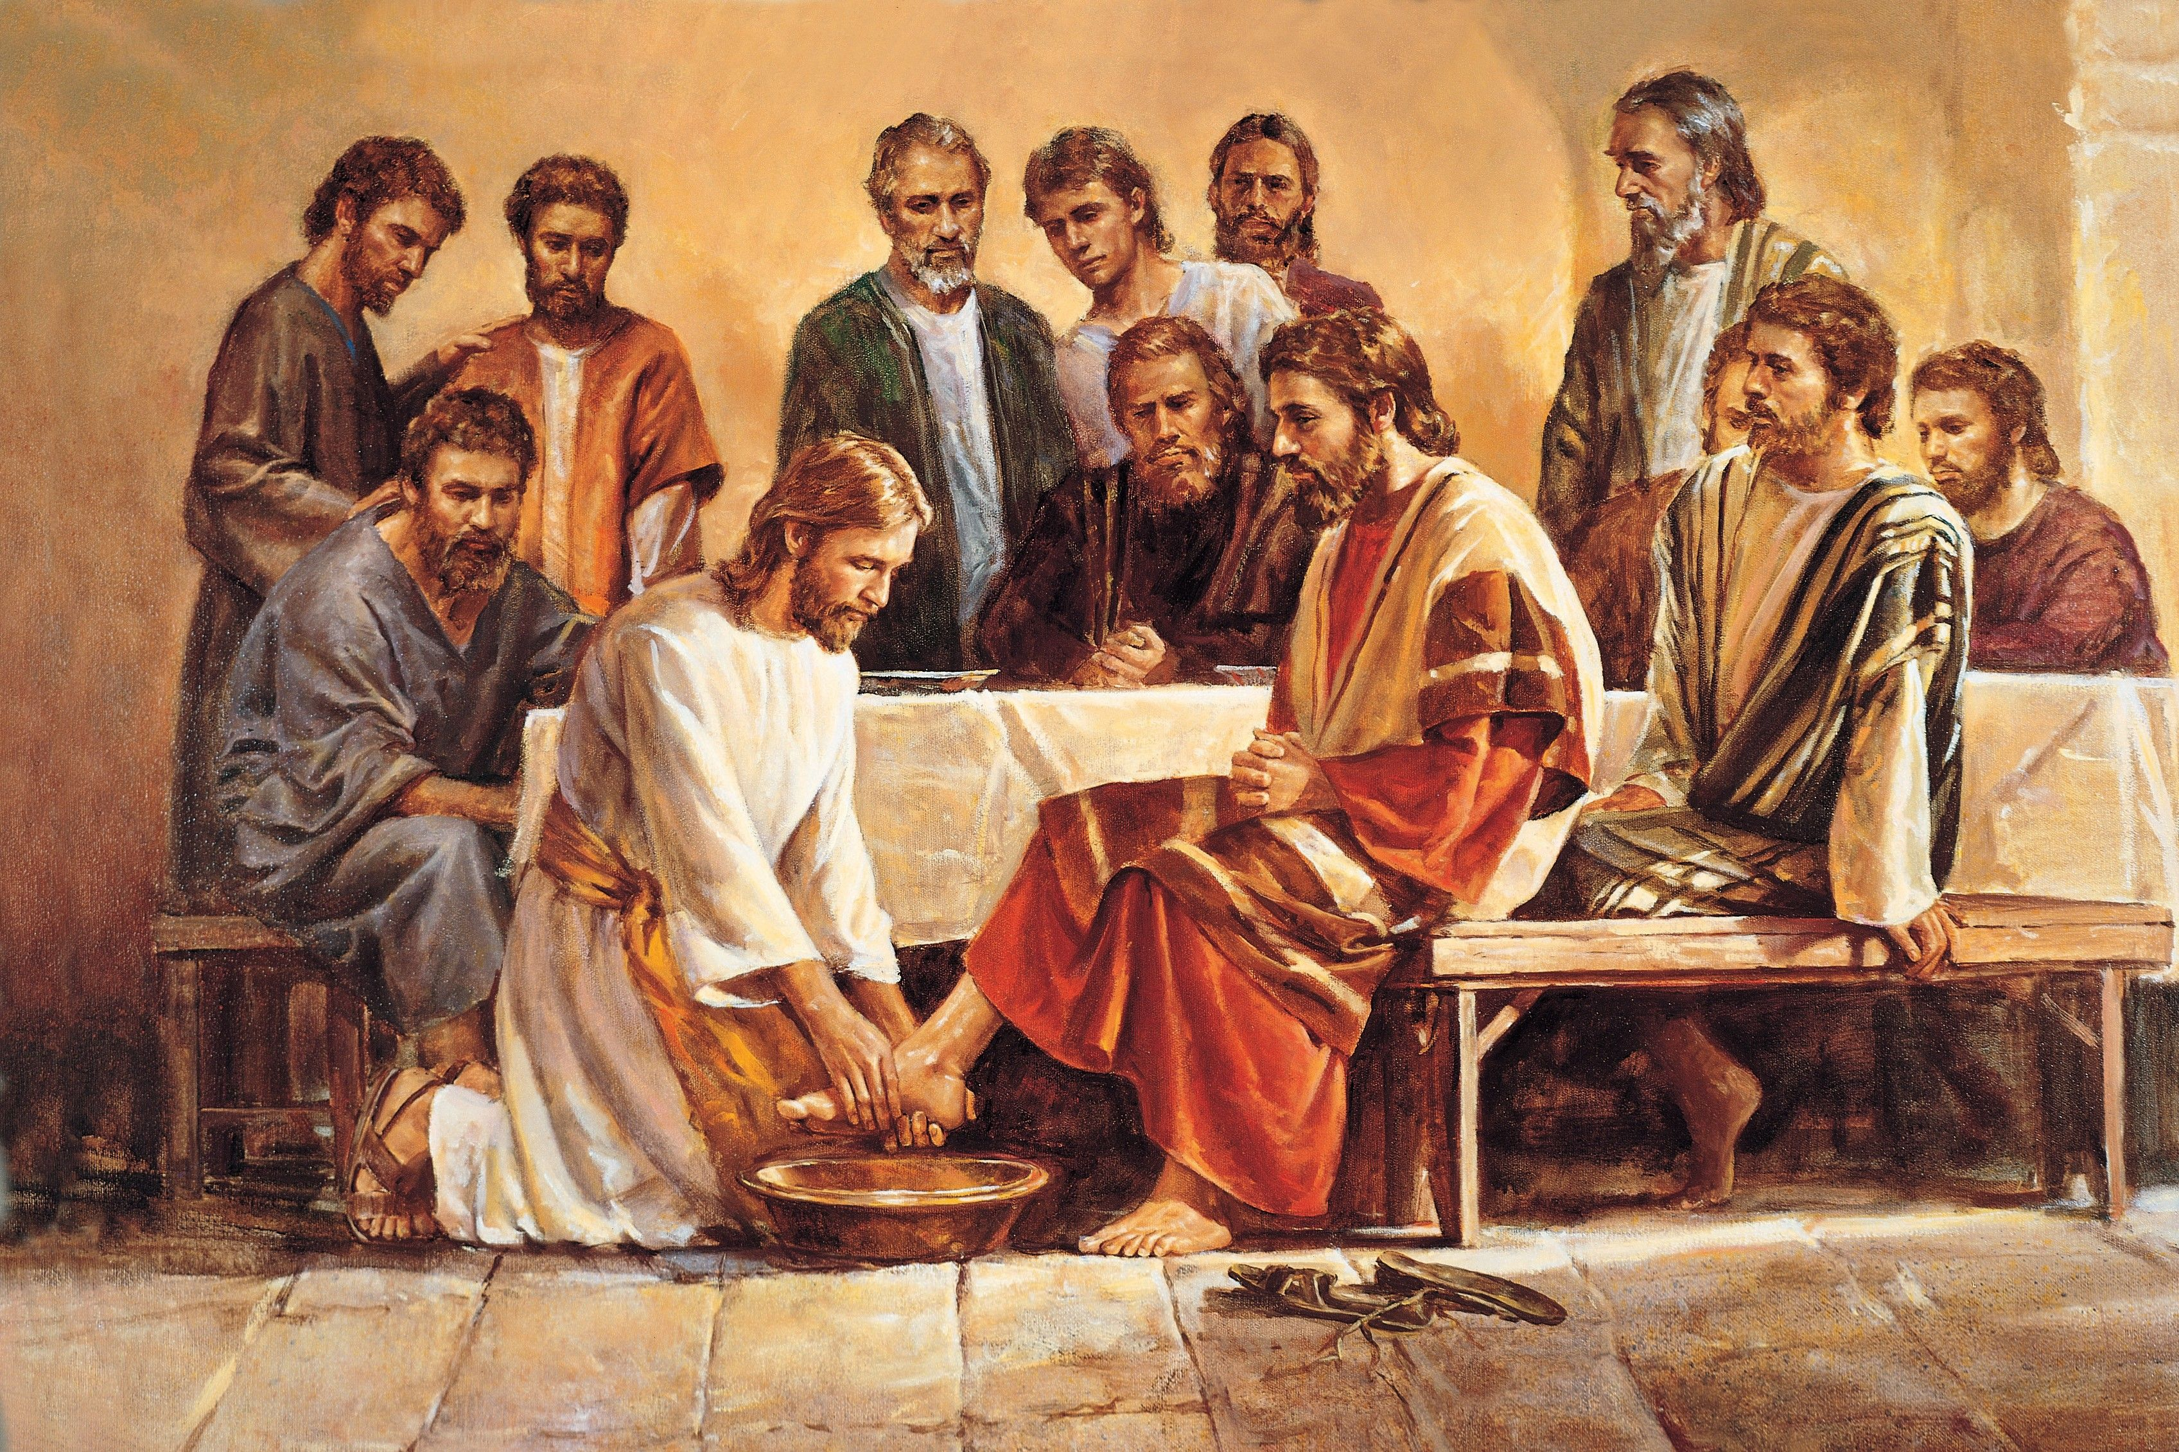
John 13 Jesus’ Love for His Disciples
John 13:1 Jesus loved them “to the end.”

Slide 119
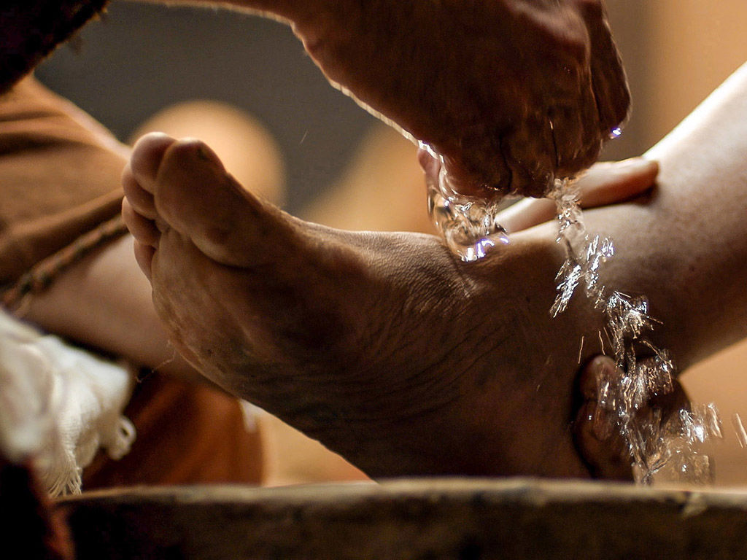
John 13:15
Jesus:
Now that I, your Lord and Teacher have washed your feet, you also should wash one another’s feet.

Slide 120
The Gospel of John XIII
Jesus Comforts His Disciples
Abide In Me

Slide 121
John 13 Jesus’ Love for His Disciples
John 13:1 Jesus loved them “to the end.”

Slide 122
John 13:15
Jesus:
Now that I, your Lord and Teacher have washed your feet, you also should wash one another’s feet.

Slide 123
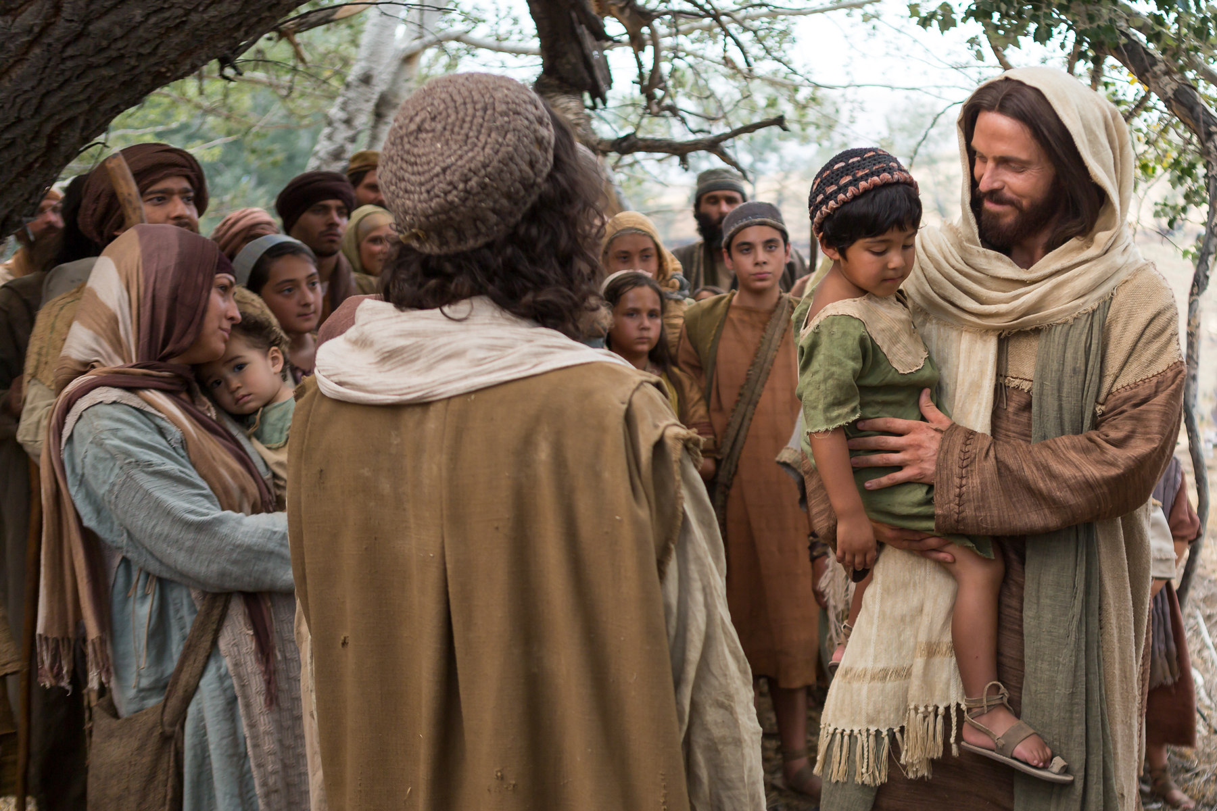
John 13:33-35 As I Have Loved YOU
Little children…
Love one another as I have loved you.
By this all people will know that you are my disciples.

Slide 124
John 14 Jesus Comforts His Disciples
I will be with you.
You will be with me.
I will send the Holy Spirit as a Comforter.

Slide 125
John 5:1-4 Jesus: Trust in me
Trust in God, trust also in me.
  Do you trust God?
Wedding metaphor
  Jewish betrothal: Groom promises to “build a room” for the bride.
Claim to be deity
  Trust in God, Trust also in me.
  If you have seen me, you have seen the father.

Slide 126

In My Father’s There are Many Rooms

Slide 127

John 14:5-14
I AM the Way the Truth and the Life
I AM the way
“The Way” Acts 22:14, Acts 9:2, 19:9, 22:4
The Only Way to God?
I AM the truth
I Am the life
Which is most comforting to you?

Slide 128
Comfort
John 14:12 Greater works than these:
Bringing salvation and offering the Holy Spirit
v. 14 Ask Me anything in my name.
We can pray through Jesus or
We can pray to Jesus.

Slide 129
Jesus Comforts the Disciples
I will not leave you alone.
I will send the comforter/Counselor.
You are not an orphan.
“We will come to him and make our home with him.
My peace (shalom) I leave you.

Slide 130
The Gospel of John XIV
John Ch 15
Abiding in Christ

Slide 131

John 15 The Vine and the Branches
Jesus: I AM the vine
God is the gardener
We are the branches
Unfruitful branches will be cut off

Slide 132
Seven I Am Statements
I AM the bread of life John 6:35
I AM the light of the world John 8:12, John 9:5
I AM the door (and the gate) John 10:7
I AM the good shepherd John 10:1,14
I AM the resurrection and the life John 11:25
I AM the Way the Truth and the Life John 14:6
I AM the true vine John 15:1

Slide 133

I am the Vine. My Father is the gardener
In what sense is Jesus a vine?
In what sense is the Father a gardener?
In what sense are we branches?

Slide 134

John 15 Abide in Me
Abiding = Bearing fruit. What fruit?
Answer: The things we ask for. 15:7-8
John 15:9-17 The key to abiding is loving and obeying.

Slide 135

John 15:18-16:4 The reason we need so much comfort: Persecution
Jesus “assures” them with six if… then.. statements. 15:18, 19, 20 (2x), 22, 24.
They do not hate you. They hate me and they hate my Father.
Their hatred is not reasonable

Slide 136
John 16:5-16 Jesus Comforts Again
It is good for you that I am going away.
Really???? Why????
I will be raised by my Father and will go to the Father.
I will send the Holy Spirit.
All this will finally make sense
Through my death the opportunity for righteousness will be created.

Slide 137

John 16:29-33
Here is our take-home lesson:
Take heart, I have overcome the world!

Slide 138
The Gospel of John XV
John Ch 17
The Hour Has Come
Jesus Prays For Unity

Slide 139
John 17 The Hour Has Come
What hour is this?
The hour of Jesus’ death
The hour of the redemption of humanity
The greatest hour in human history
The hour God’s plan is consummated
The hour Old Testament prophecy is fulfilled
The lamb, slain from the creation of the world is slain

Slide 140


Slide 141
John 17:1 Glorify Your Son
Glory/glorify 9 times in John 17 (36 times in John)
Glorify:
John 3:14
John 8:28
John 12:32

Slide 142
John 3:14
Numbers 21:7-9
Just as Moses lifted up the snake in the wilderness, so the Son of Man must be lifted up.

Slide 143
John 8:28 I AM He ego eimi
When you have lifted up the Son of Man, then you will know that I AM He
Have you been lifting Jesus up?

Slide 144
John 12:32 Jesus Glorified
How is Jesus glorified?
How does Jesus glorify God?
Answer: By dying!
Lifted up:
-on a cross
-resurrection
-ascencsion to heaven
-when we lift up Jesus

Slide 145
John 17:3
That they may know Jesus Christ
This is eternal life: That they may know you, the only true God and Jesus Christ, whom you have sent.
Ginosko: To know intimately, to experience
Do you know Jesus?

Slide 146
John 17:4
Glory by finishing the given work
2 Tim 4:6-8
What is the work God has given you?
Are you completing this work?

Slide 147
John 17:6-19
Jesus Prays for the Apostles
v. 10 All I have is yours and all you have is mine.
v. 11,12,15 Protected
v. 13 the full measure of my joy
v. 17 Sanctified (set apart) by the truth for the work you gave them.

Slide 148
John 17:20-26
Jesus Prays for Us
May they be one as we are one.
Coming Home!
Then the world will know….

Slide 149

John 18 & 19 The Passion of Christ
Jesus is completely in control.
Jesus has predicted what is happening.
Jesus is fulfilling prophecy.
Jesus is being bold.

Slide 150
Summary: John 20:21-31
My Lord and my God!
These things were written that you may believe that Jesus is indeed the Christ, the Son of God, and that, by believing, you will have life in his name.
Do you believe? Will you lift up Jesus?
And to God be the glory!

Slide 151
John 21 Epilogue
Apparently written later and appended to Ch 1-20.
Purpose:
-To tell about an 8th sign
-To explain how Peter was restored to his leadership position in the apostles
-To undermine a false rumor about John

Slide 152

The scene:
The disciples, including Peter, have not fallen away, but they have lost vision and direction.

Slide 153


Slide 154
John 21:1-14
The disciples are discouraged and lost their sense of mission.
Jesus: Let’s have breakfast together
Jesus restores their vision.

Slide 155
John 21:15-25
Jesus reinstates Peter.
What are the qualifications to lead God’s people?
Do you love me? Then feed my sheep.
v. 24 Summary: His testimony is true.

