Slide 3
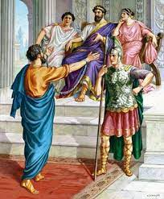
Acts VI Paul Speaks Before Kings
John Oakes
Bakersfield
Winter/Spring 2022

Slide 4
Themes in Acts
1. The work of the Holy Spirit in establishing
the Church.
2. The Kingdom of God.
3. Growth and development of the Church.

Slide 5
Acts 20:22-23
And now, compelled by the Spirit, I am going to Jerusalem, not knowing what will happen to me there. I only know that in every city the Holy Spirit warns me that prison and hardships are facing me.
Paul had a plan to get to Rome…. It involved going through Jerusalem.

Slide 6
Acts 21 On to Jerusalem
Acts 21:10-14 Paul: “I am ready, not only to be bound, but also to die in Jerusalem for the name of the Lord Jesus.
Acts 23:11 “Take courage! As you have testified about me in Jerusalem, so you must also testify in Rome.
Matthew 10:17-20 “On my account you will be brought before governors and kings as witnesses to them and to the Gentiles. But… do not worry.

Slide 7
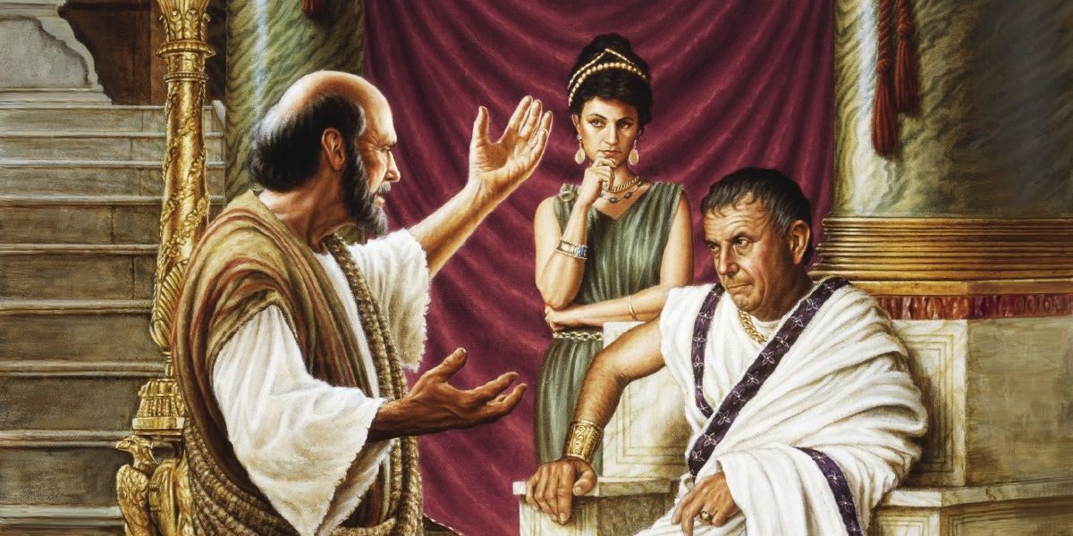
Acts 24 Paul Preaches to Felix
Acts 24:1-9 Dishonest charges against Paul.
Acts 24:10-21 Paul’s defense.
Acts 24:24-27 Paul preaches the gospel to Felix.
“Indecision is a decision”

Slide 8
Acts 25-26 Paul, Festus and King Herod
Acts 25:9-12 Paul appeals to Caesar.
Acts 26:1-32 Paul shares the gospel with Festus and King Herod.
What will your moment be like: When you “speak before kings?”

