Slide 1
Act Like Men
Running the Race
A Laurel Wreath

Slide 2
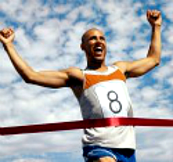
1 Corinthians 9:24-27
Do you not know that in a race all the runners run, but only one gets the prize? Run in such a way as to get the prize. Everyone who competes goes into strict training. They do it to get a crown that will not last, but we do it to get a crown that will last forever. Therefore, I do not run aimlessly. I do not fight like a boxer beating the air. No. I strike a blow to my body and make it my slave so that after I have preached to others, I myself will not be disqualified for the prize.

Slide 3
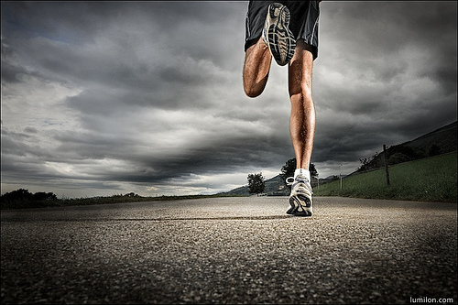
Running To Win The Prize
Pace Yourself
But…
Give maximal effort
End the Race completely exhausted

Slide 4
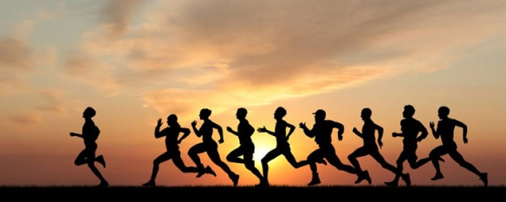
But… The Christian Race is Not Like the Olympics in one way.
Everyone who runs so as to win the prize, wins the prize.

Slide 5
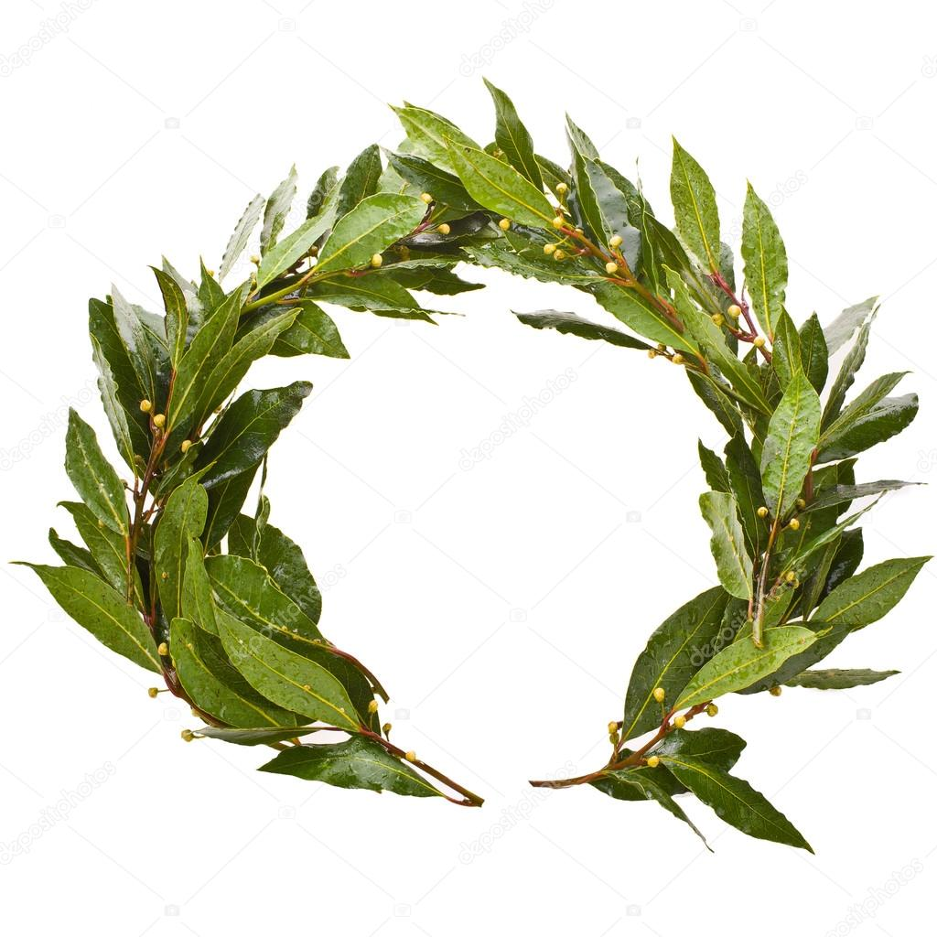
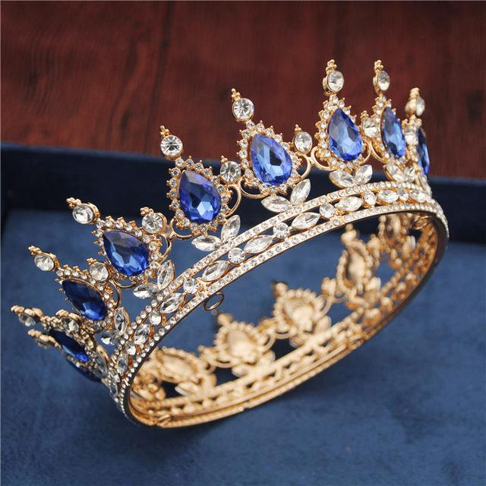
A Crown That Will Last
vs

Slide 6
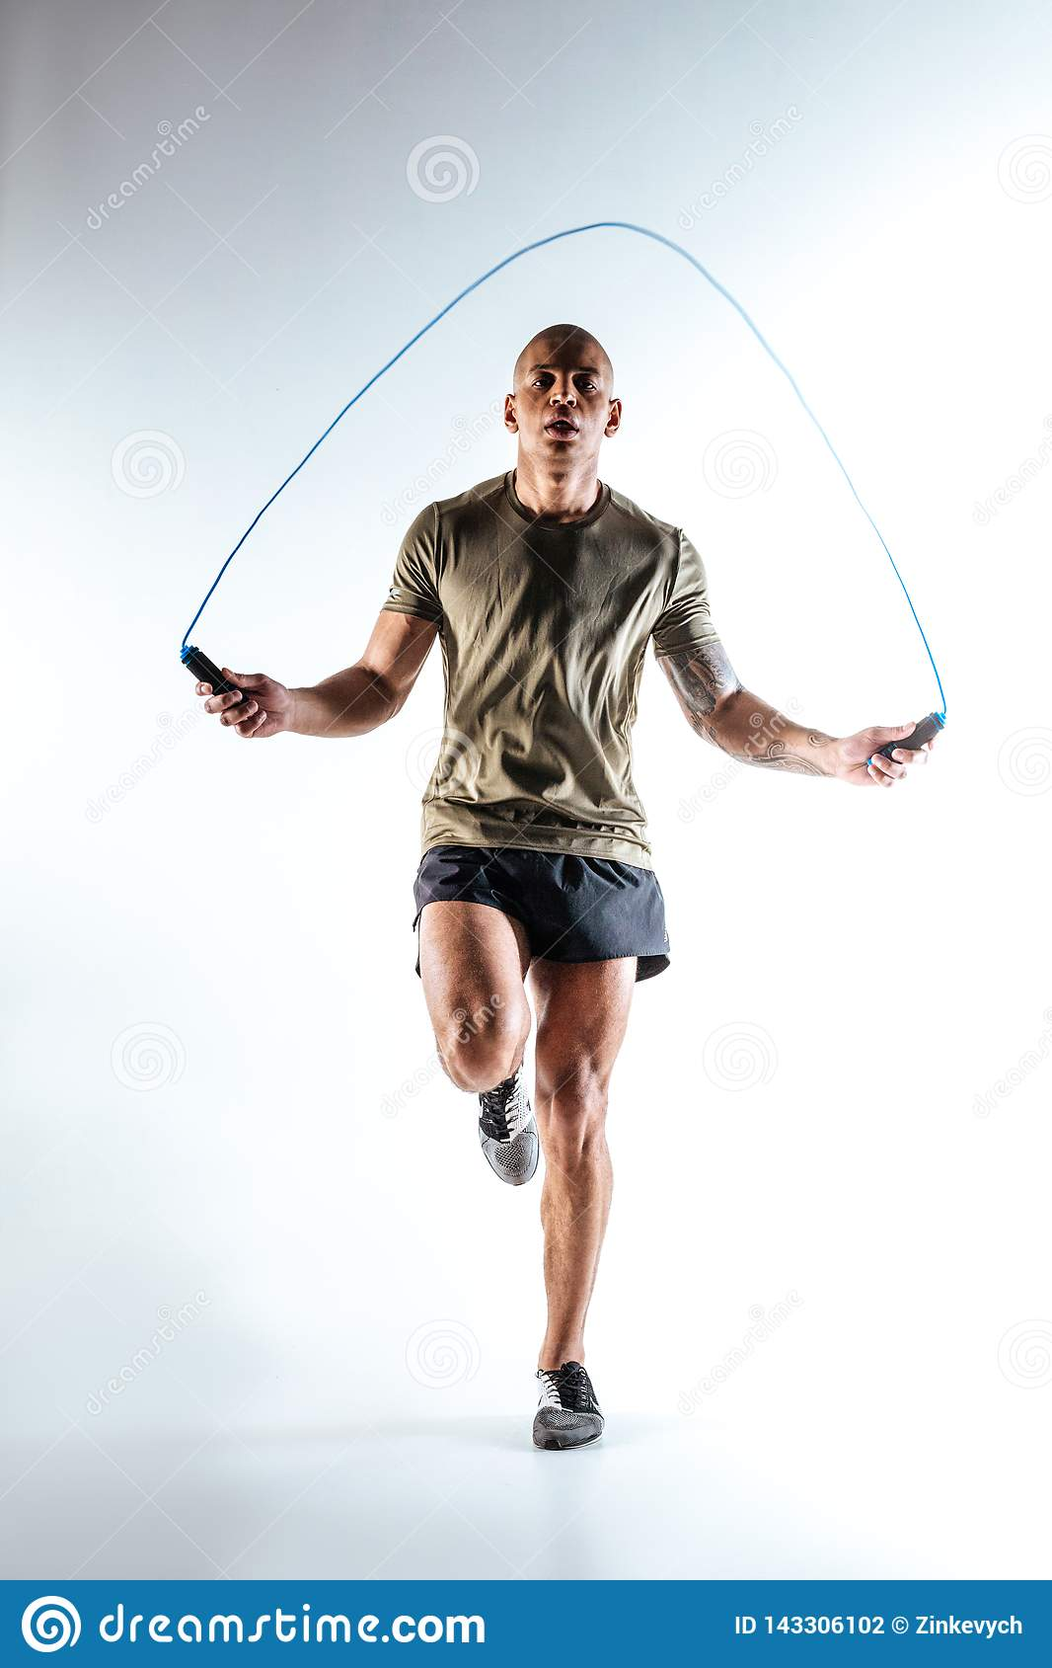
Go Into Strict Training
Paul: I beat my body.
What is your training regimen?
Do you have a trainer/mentor?

Slide 7
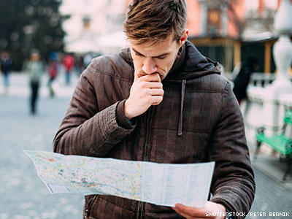
Do Not Run Aimlessly
Do you have a plan?
Do you have spiritual goals?

Slide 8
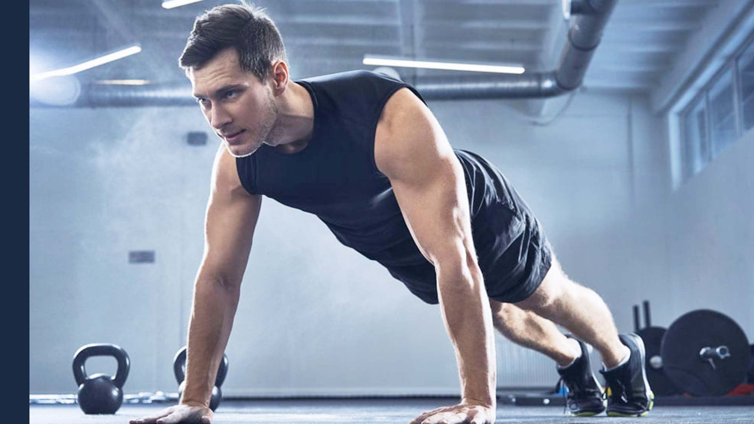
1 Tim 4:7-8
Physical training is of some value…
But godliness has value for all things…

Slide 9
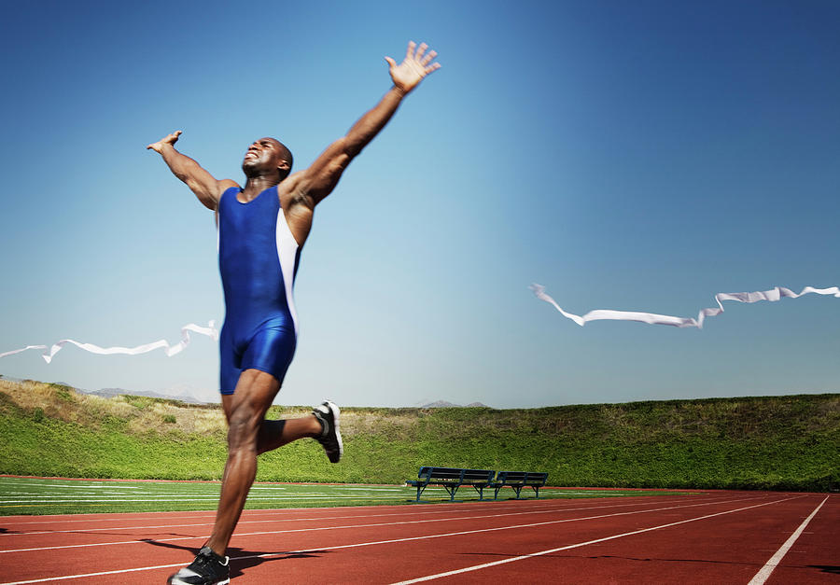
2 Timothy 4:6-8
For I am already being poured out like a drink offering, and the time for my departure has come. I have fought the good fight. I have finished the race. I have kept the faith. Now there is in store for me the crown of righteousness, which the Lord, the righteous judge, will award to me that day.

Slide 10
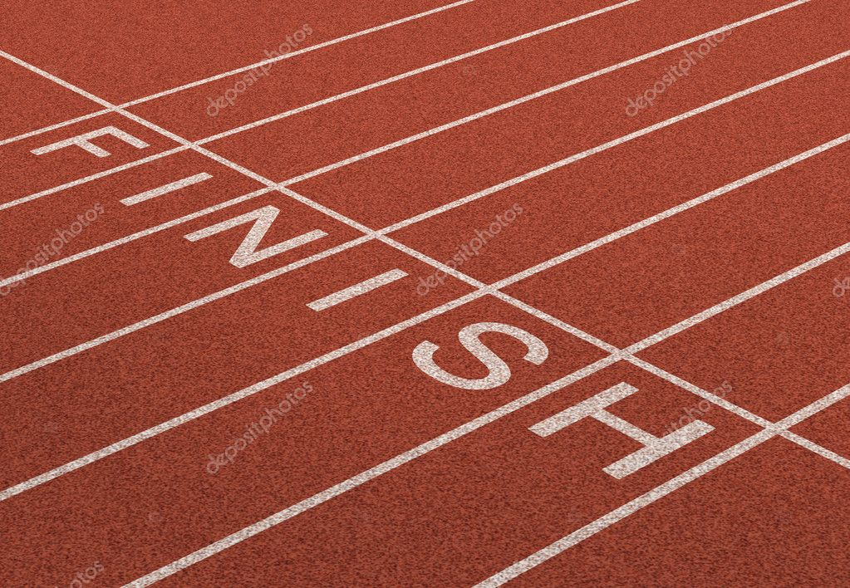
Let’s be Christian men
Run so as to get the prize
Go into strict training
Train in godliness
Finish the race
The result:
Win as many as possible
A crown that will last

