Slide 2
Are you ready for the Christian adventure?
So, what can you do?
Give generously to special missions.
Consider transferring or moving to Merced.
Go to http://mercedchurch.com
Contact me at john.oakes@gcccd.edu or 858-344-5323

Slide 3
Set Apart for God
John Oakes
4/10/2022

Slide 4
A God-Shaped Hole
We need to:
Feel safe.
Feel value and purpose.
Feel a connection.
Give and receive love.

Slide 5
The need is met In Christ Philippians2:1 Encouragement in Christ. Coll 1:13-14 Redeemed in Christ Gal 3:26 Children of God in Christ. Colossians 2:10 Fullness of God in Christ Ephesians 1:3 Spiritual blessing in Christ

Slide 6
Things We Have In Christ
Ephesians 1:4, 11 Chosen in Christ
1 Corinthians 15:22 Made alive in Christ.
2 Corinthians 5:21 Righteous in Christ.
Romans 6:23 Eternal life in Christ Jesus
Romans 8:38-39 Secure love of God in Christ.
2 Corinthians 5:17 New creation in Christ.
Romans 8:1 No condemnation in Christ.

Slide 7
In Christ the Hole is Filled/Need is Met
We are set apart in Christ.
We are holy in Christ.
We are transformed in Christ.

Slide 8
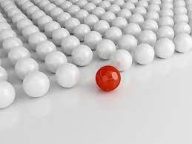
Romans 1:1 Set Apart In Christ.
aphorizo to set apart, separate. Having a special purpose.
1 Peter 2:9 But you are a chosen people, a royal priesthood, a holy nation, God’s special possession, that you may declare the praises of him who called you out of darkness into his wonderful light.

Slide 9
Holy/Sanctified In Christ
Phil 1:1 To all God’s holy people in Christ Jesus at Philippi…
1 Cor 1:2 To the church of God in Corinth, to those sanctified in Christ Jesus and called to be his holy people…
hagios Holy, sanctified.
In Christ you are called apart and you are holy
You are special to God

Slide 10
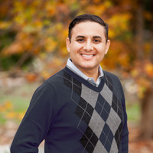
Say Hello to a Saint
Saint Rafael
Saint Tiffany

Slide 11
In Christ we are set apart.
In Christ we are holy.
In Christ we are sanctified
Sanctified for what?

Slide 12
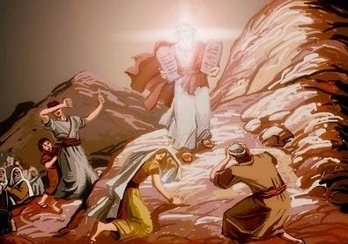
2 Corinthians 3:7-18
In Christ the Veil is Removed
In Christ we are Transformed

Slide 13
Our Ministry is Glorious!
It bring righteousness
It lasts

Slide 14
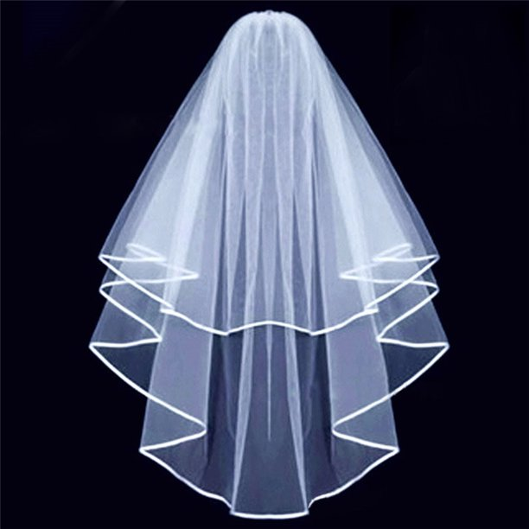
In Christ the Veil is Removed
Whenever anyone turns to the Lord, the veil is removed.
I can finally see!

Slide 15
Veil-Removal is Not the Goal
And we all, who with unveiled faces contemplate the Lord’s glory, are being transformed into his image with ever-increasing glory, which comes from the Lord, who is the Spirit.
Contemplate → Reflect → Contemplate → Reflect
The goal is transformation into the likeness of Christ.

Slide 16
Set Apart and Transformed for What?
2 Cor 4:1-2
We have this ministry.
We commend our selves to everyone’s conscience.
In Christ we are set apart
In Christ we are holy/sanctified
In Christ the veil is removed
In Christ we are transformed into the image of Christ

