Slide 2
Are you ready for the Christian adventure?
So, what can you do?
Give generously to special missions.
Consider moving to Merced.
Go to http://mercedchurch.com
Contact me at john.oakes@gcccd.edu or 858-344-5323

Slide 3
In Christ Philippians2:1 Encouragement in Christ. Coll 1:13-14 Redeemed in Christ Gal 3:26 Children of God in Christ. Colossians 2:10 Fullness of God in Christ Ephesians 1:3 Every Spiritual blessing in Christ

Slide 4
Things We Have In Christ
Ephesians 1:4, 11 Chosen in Christ
1 Corinthians 15:22 Made alive in Christ.
2 Corinthians 5:21 Righteous in Christ.
Romans 6:23 Eternal life in Christ Jesus
Romans 8:38-39 Secure love of God in Christ.
2 Corinthians 5:17 New creation in Christ.
Romans 8:1 No condemnation in Christ.

Slide 5
2 Corinthians 3:7-18
The unwritten chapter:
In Christ, the veil is removed.

Slide 6
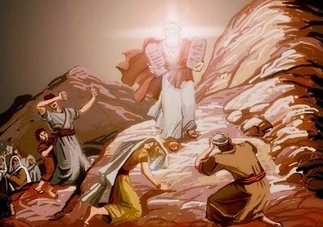
2 Corinthians 3:7-11
A ministry that brought death…
But it was glorious!!!

Slide 7
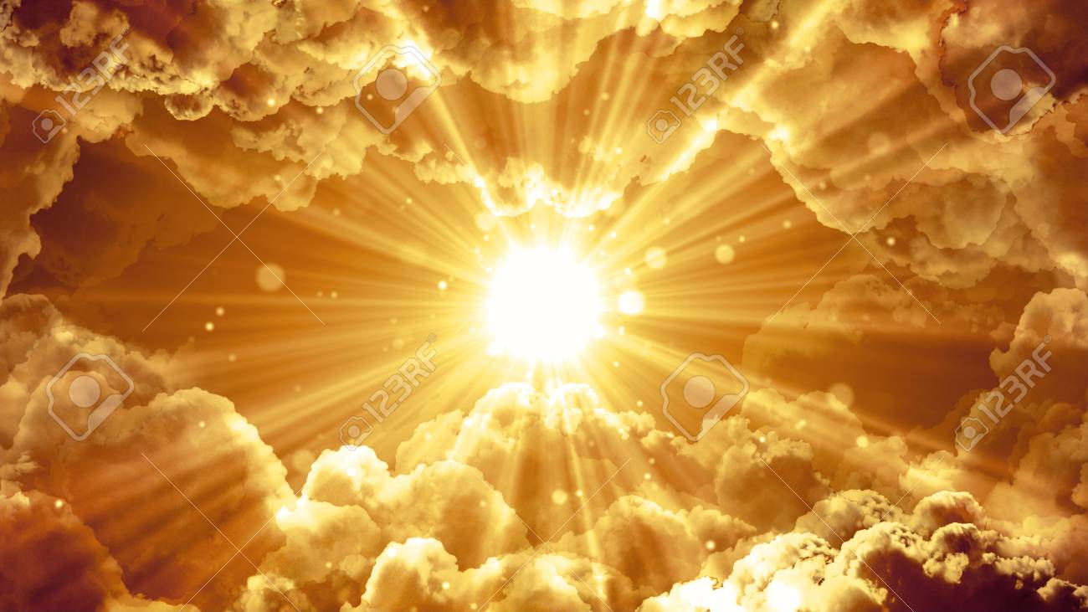
Our Ministry is far more Glorious!
It bring righteousness
It lasts

Slide 8
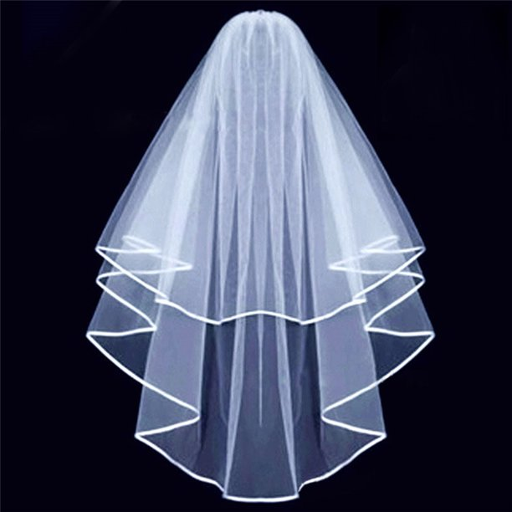
2 Cor 3:12-18 In Christ the Veil is Removed
We are very bold!
v. 16 Whenever anyone turns to the Lord, the veil is removed.
I can finally see!

Slide 9
Veil-Removal is Not the Goal
2 Corinthians 3:18 And we all, who with unveiled faces contemplate the Lord’s glory, are being transformed into his image with ever-increasing glory, which comes from the Lord, who is the Spirit.
Contemplate → Reflect → Contemplate → Reflect
The goal is transformation into the likeness of Christ.

Slide 10
Set Apart and Transformed for What?
2 Cor 4:1-6 We do not lose heart.
Why? We have this ministry.
So, what do we do?
Set for the truth plainly.
We commend our selves to everyone’s conscience.
What do we preach?
Jesus as Lord and us as servants

Slide 11
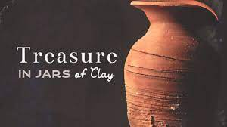
2 Cor 4:7-12
We are “jars of clay.” Mere mortals.
We carry the death of Christ in our bodies.
Death is at work in us so life can be at work in others.

Slide 12
2 Cor 4:13-18
We believe. The veil has been lifted. So we speak!
We do not lose heart. Why?
v. 14 We know God will raise us.
v.15 God’s grace is reaching more and more people.
Our jars of clay are wasting away.
But we fix our eyes on the unseen things.

Slide 13
2 Cor 5:1-10
The Power of Knowing
Know… guarantee… confident… live by faith…
What is it we know? We have an eternal home in heaven.
We long to be clothed… To have our immortal bodies.
Meanwhile we groan.
But we are confident. Why? Because the Holy Spirit is a guarantee!!! We live by faith, not sight.

Slide 14
2 Cor 5:11-15
Therefore we try to persuade people.
Enough so that some may think we are crazy!
We are compelled by Christ’s love.
Why? Because we are convinced Christ died for us.

