Slide 1
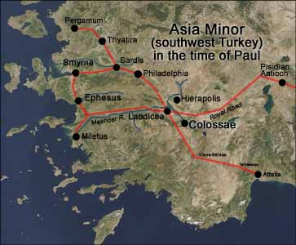
Christ vs. The World’s Philosophies
Colossians 2:6-23
John Oakes
8/1/2022

Slide 2
Main Road to Colossae and Laodicea

Slide 3
Colossians
Theme: The supremacy of Christ. The all-suffiency of Christ.
Written to oppose the supposed “Colossian Heresy.”
This is a philosophy/world view that includes the stoicheia—ABCs of the world.

Slide 4
Christ in Colossians
Col 1:2 We are brothers and sisters in Christ.
Col 1:3 We thank God, the father of our Lord Jesus Christ.
Col 1:4 Our faith is in Christ Jesus.
Col 1:7 Epaphras a faithful servant and minister of Christ.
Col 1:13 God has brought us into the kingdom of his Son.
Col 1:14 We have redemption in Christ.
Col 1:14 We have forgiveness of sins in Christ.
Col 1:15 The Son is the firstborn over all creation.
Col 1:16 In Christ, through him and for him all things were created.

Slide 5
Christ in Colossians
Col 1:17 Christ is before all things.
Col 1:17 In Christ all things hold together.
Col 1:18 Christ has supremacy in all things.
Col 1:19 All the fullness of God dwells in Christ.
Col 1:20 Christ is reconciling all things to Himself.
Col 1:22 We are presented holy in God’s sight by Christ.
Col 1:24 Christ is the head of the body.
Col 1:27 God’s glorious mystery is Christ in you.
Col 1:28 Christ is him who we proclaim.

Slide 6
Christ in Colossians
Col 1:29 Christ’s power works in us.
Col 2:2 The mystery of God is in Christ.
Col 2:5 Our faith is in Christ.
Col 2:6 We live our lives in Christ.
Col 2:9 In Christ, the fullness of deity dwells in bodily form.
Col 2:10 In Christ, we are brought to fullness.
Col 2:11 In Christ we were circumcised.
Col 2:13 We are made alive in Christ.
Col 2:17 The Law is a shadow. The reality is in Christ.

Slide 7
Christ in Colossians
Col 2:20 We died with Christ.
Col 3:1 We have been raised with Christ.
Col 3:3 Our life is hidden with Christ.
Col 3:4 Christ is our life.
Col 3:11 Christ is all in all.
Col 3:17 Do all in the name of the Lord Jesus

Slide 8
Christ in You
Holy Spirit mentioned:
Romans 25 times
1 Corinthians 20 times
2 Corinthians 10 times
Galatians 15 times
Ephesians 10 times
Philippians 3 times
1 Thessalonians 4 times
Colossians 1 time (Col 1:8)

Slide 9
What do we have in Christ?
Coll 1:14 We have redemption, the forgiveness of sins in Christ
Col 2:2 The mystery of God is in Christ.
Col 2:6 We live our lives in Christ.
Col 2:10 In Christ, we are brought to fullness.
Col 2:11 In Christ we were circumcised.
Col 2:13 We are made alive in Christ.
Col 2:17 The Law is a shadow. The reality is in Christ.

Slide 10
Colossians 2:8 stoicheia
Let no one take you captive to hollow and deceptive philosophy which depends on human tradition and the elemental forces (stoicheia) of the world rather than on Christ.
Elemental forces
Basic components of philosophy
First principles of the world
ABCs
stoicheia vs Christ and his Kingdom

Slide 11
Stoicheia of our world
Prosperity gospel
American dream
Comfort/materialism
Personal security 401-k
Being a good person
Universal salvation
Moral relativism
Entertainment/leisure

Slide 12
stoicheia of our world
Postmodernism
Modernism/Scientism
Republicanism and social conservative politics
Democratism and progressive politics
Can these philosophies deceive us, kidnap us, and drag us from Christ?

Slide 13
Fullness in Christ
Col 1:10 We have fullness in Christ. We need nothing from the world.
Fullness = pleroma =filled full
Col 1:11-12 We are circumcised in Christ—the world/flesh has been removed in Christ.
We are moral being in Christ, not by moral behavior.
We are socially just people in Christ, not through supporting social justice causes.

Slide 14
v. 13-15 Christ has canceled the written code
The world’s “written codes” are not in charge.
Charge of legal indebtedness. NIV
Record of charges NLT
Certificate of death, with its obligations HCSB
v. 15 Christ nailed the stoicheia to the cross. They are disarmed and powerless.

Slide 15
Application
There cannot be a Christian political party or partisan effort.
As disciples, we value all human life, but our means of realizing this is principally through bringing people into the kingdom of God, and bringing the kingdom of God to the lost.
The same for issues such as homosexuality and social or racial justice. Our principle means of working in these areas is through the work of God in his kingdom, not through establishment of laws or through coercion.

Slide 16
Col 2:16-23
Therefore, do not let anyone judge you by what you eat or drink, or with regard to a religious festival, a New Moon celebration or a Sabbath day. found in Christ. Do not let anyone who delights in false humility and the worship of angels disqualify you. Such a person goes into great detail about what they have seen…
Since you died with Christ to the elemental forces (stoicheia) of this world, why, as though you still belonged to the world, do you submit to its rules: “Do not handle! Do not taste! Do not touch!” These rules, which have to do with things that are all destined to perish with use, are based on merely human commands ad teachings. Such regulations indeed have an appearance of wisdom, with their self-imposed worship, their false humility and their harsh treatment of the body, but they lack any value in restraining sensual indulgence.

Slide 17
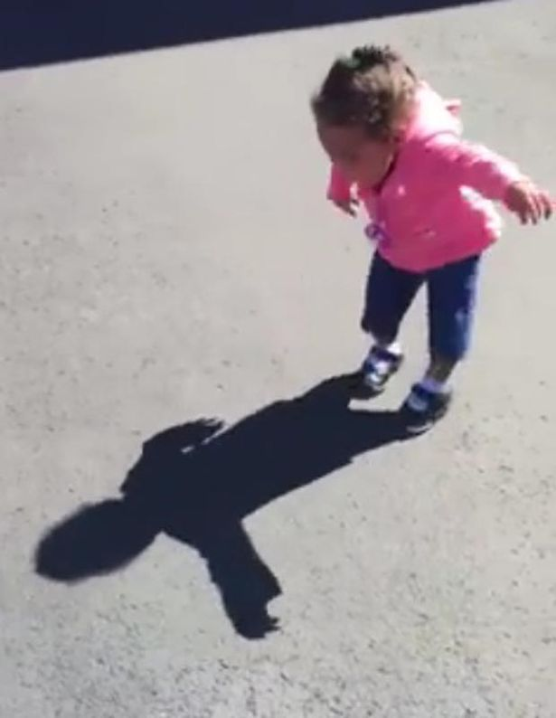
The Reality is In Christ
In v. 16-23 Paul deals with a particular philosophy, which is the legalism of grace-free Judaism, but this can be applied to any human idea or philosophy.
Even the Law of Moses was a mere shadow.
Therefore the stoicheia of the world are powerless
Rules are powerless to create righteousness.
We do not use the politics of power. We use Christ as our power.

Slide 18
Stay Connected to Christ
Col 2:18 Do not rely on personal religious experience
Col 2:19 Those who rely on the stoicheia of the world have lost their connection with Christ.
Col 2:20 We have died to the stoicheia of the world in Christ.
So, do not obey its rules.

Slide 19
Conclusion
Our fullness is in Christ
Let us stive to be like Christ and to exemplify his kingdom
Let us seek righteousness through Christ, not the stoicheia of the world

