Slide 1
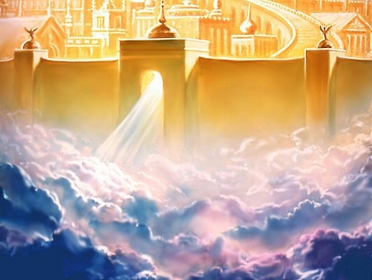
The Kingdom of God and The Day of the LOrd
John Oakes
Bakersfield
4/28/2019

Slide 2
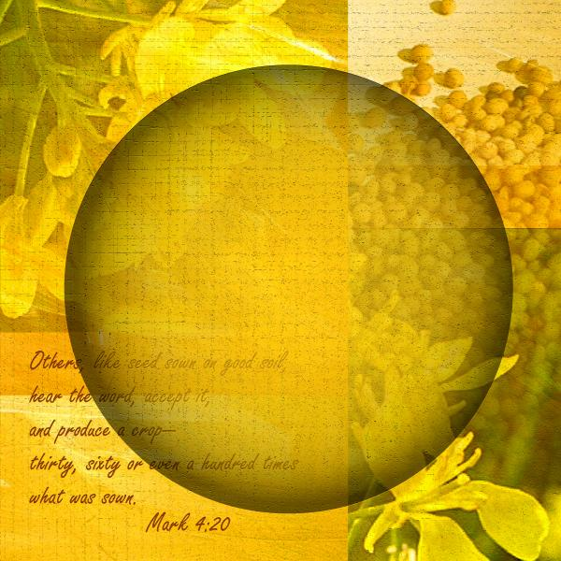
What is the Kingdom of God?
Mustard Seeds
The Kingdom of God is….
The Kingdom of God is not…

Slide 3
I. The Kingdom of God is the topic Jesus spent by far the most time talking about.

Slide 4
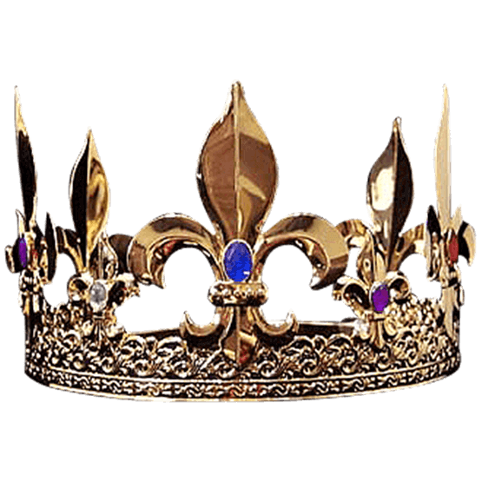
II. The Kingdom of God is a “place” where God is king—where God reigns. -It is a life lived in submission to God

Slide 5
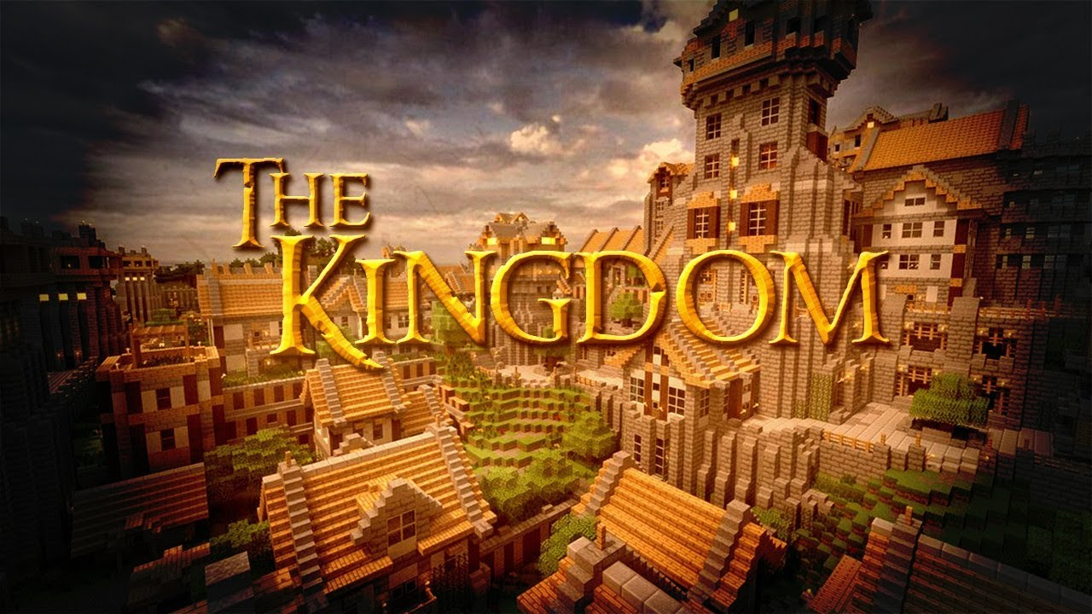
III. The Kingdom of God is a very big concept.

Slide 6
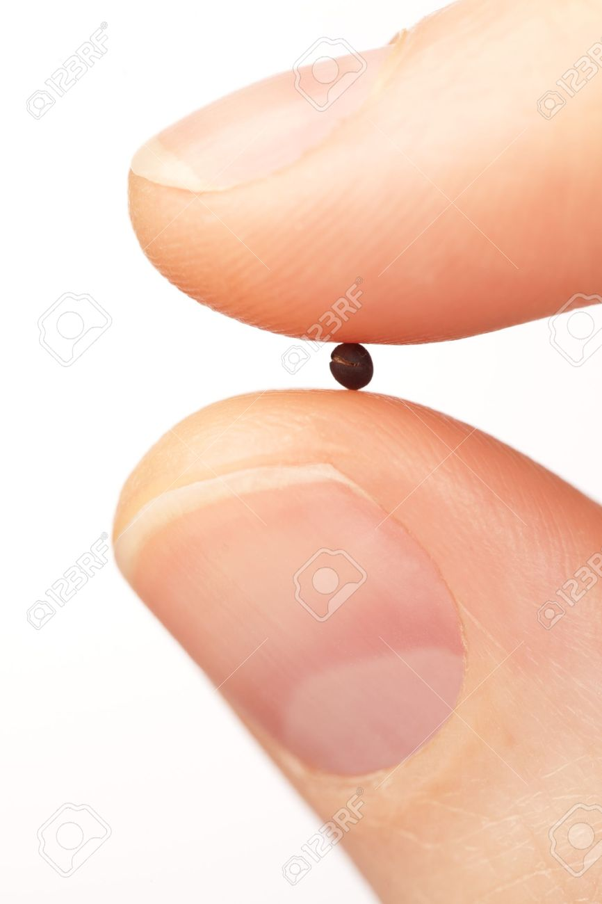
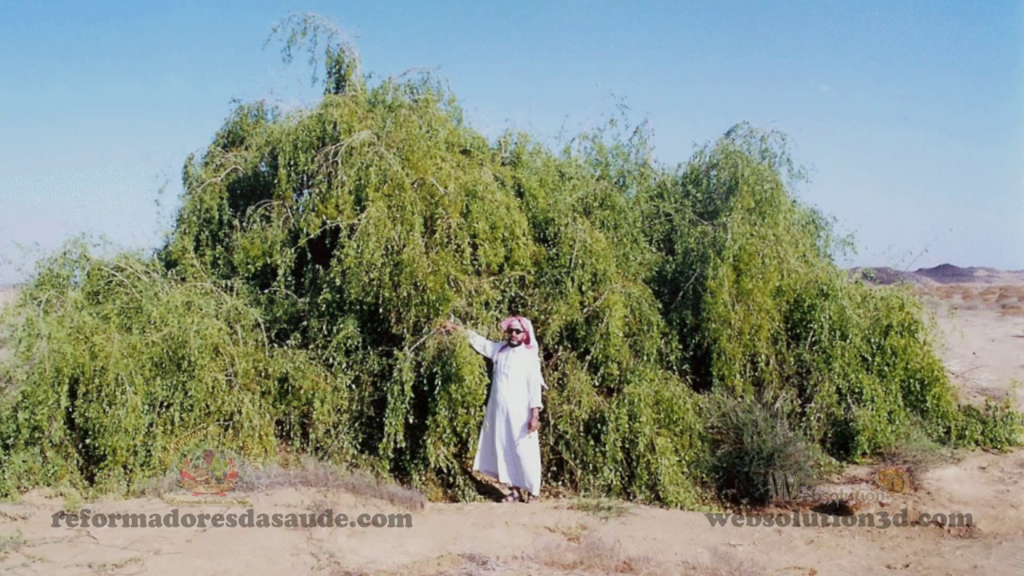
IV. The Kingdom of God is revealed in parables (because it has to be)

Slide 7
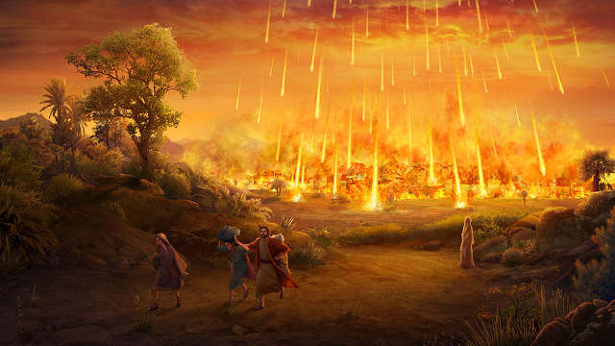
V. The Kingdom of God is something which breaks out suddenly and dramatically.

Slide 8
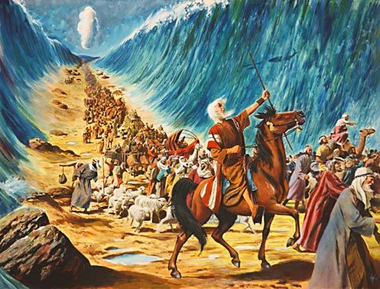
VI. The Kingdom of God is revealed in history.

Slide 9
VII. The Kingdom of God is not coextensive with or equal to the church.

Slide 10
VIII. The Kingdom of God (Mark, Luke, John) is the Kingdom of Heaven (Matthew)

Slide 11
IX. The Kingdom of God is already but not yet.

Slide 12
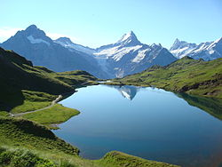
X. Nature—the physical earth is the Kingdom of God.

Slide 13
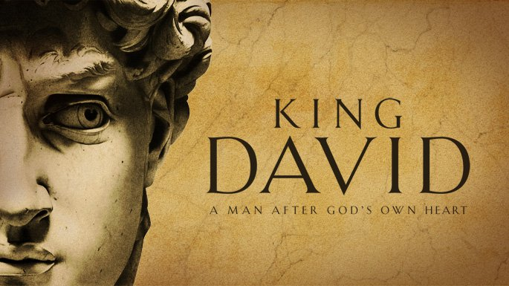
XI. Israel is the Kingdom of God.

Slide 14
XII. The Church is the Kingdom of God. (and I am not contradicting myself) The church is an outpost of the Kingdom of God. The church is a city on a hill. The church is the best chance many non-believers have of seeing the kingdom.

Slide 15
XIII. The Kingdom of God is any individual who has Jesus as his or her king.

Slide 16
XIV. The Garden of Eden is the Kingdom of God.

Slide 17
XV. The Kingdom of God is heaven on earth.

Slide 18
XVI. The Kingdom of God is within (among) us. Luke 17:21

Slide 19
XVII. The Kingdom of God is not a physical place.

Slide 20
XVIII. The Kingdom of God is not of this world. John 18:36 Matthew 6:25 Do not give a thought to your life….

Slide 21
XIX. The Kingdom of God is not a premillennial kingdom with Jesus reigning on the earth.
X

Slide 22
XX. The Kingdom of God is entered by being born again. John 3:1-9

Slide 23
XXI. The Kingdom of God is something you are completely in or completely out of. Mark 12:28-34

Slide 24
XXII. The Kingdom of God is a radical ethic in complete opposition to the worldly ethic.
Hebrews 11:13-16 Foreigners and Strangers
Hebrews 11:8-10 like a stranger in a foreign country.
Philippians 3:20 Citizens of heaven.

Slide 25
XXIII The Kingdom of God is best understood from the Sermon on the Mount
Matthew 5:3-10
poor
mourn
meek
hungry
Merciful
Matthew 18:1-4 The servant is the greatest.

Slide 26
XXIII The Kingdom of God is best understood from the Sermon on the Mount
Matthew 5:17-22, 38-48
Matthew 6:19-21 Treasure in the kingdom.
Matthew 6:22-23 The eye is the lamp
Matthew 6:25-33 Do not give a thought to your life… Seek first his kingdom

Slide 27
XXIV. The Unrighteous will not inherit the kingdom of God.
1 Corinthians 6:9-11
Matthew 6:24

Slide 28
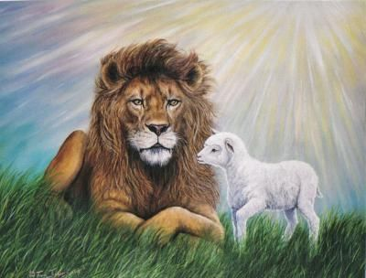
XXV. The Kingdom of God is a “place” where things are as they ought to be.
Isaiah 11:6-9
Isaiah 65:17-25
Isaiah 2:3-4

Slide 29
XXVI. The Kingdom of God cannot be moved. Hebrews 12:25-29

Slide 30
XXVII. The Kingdom of God is a place where God’s will is done. Matthew 6:10

Slide 31
XXVIII. The Kingdom of God is of inestimable value.
Searched for
A pearl…
A hidden treasure.

Slide 32
XXIX. The Kingdom of God is a place Jesus is.
Luke 4:18-21

Slide 33
XXX. The Kingdom of God is about a relationship with God.
Ephesians 2:19-22
Leviticus 26:9-12

Slide 34
XXXI. The Kingdom of God is revealed, proclaimed, preached, announced.
Mark 1:14-15

Slide 35
Our Role in the Kingdom
Individually
In our churches
In our communities

Slide 36
Individual in the Kingdom of God
Seek first the kingdom yourself
Live a life in submission to God
Live as his instrument.
Living out the Sermon on the Mount.
One Year Challenge
Become a Missionary
Your job: Transform the world.

Slide 37
In Our Churches
Join the life of the church.
Ask: What is God doing right now in Merced. What is the Holy Spirit doing?
Give generously
Start a program, a ministry.

Slide 38
In Our Communities
Get intimately involved in creating social justice.
Bring the kingdom to the community and the community to the kingdom.
Social justice is not something we do, it is who we are.
Example: Lindsey Dominguez in SD

Slide 39
The Kingdom of God in the Old Testament
The Day of the Lord is a period of time when God openly intervenes in history and the affairs of men—both in judgment and in blessing. Joel 1:15 Woe because of that day!!!
Isaiah 2:12-22 Prideful individuals
Isaiah 13:6-13, 17-21 Babylon
Isaiah 34:4,8-10 Edom
Jeremiah 46:10 Egypt

Slide 40
The Kingdom of God in the Old Testament
Joel 2:1-2 Joel 2:11-17 Blow the trumpet! Jesus is coming back!!!
Joel 2:28-31 The Day of the Lord can be good news for some
Joel 3:9-14 Decision Time!
(Amos 5:18-20, Obadiah 15, Zephaniah 1:1f)
Malachi 4:5

Slide 41
The Day of the Lord in the NT
2 Thess 1:6-10
Matt 24:36-39
Phil 2:14-16 (and 2 Cor 1:12-14)
1 Cor 5:5
2 Thess 2:1-4
1 Thess 5:1-11
2 Pet 3:8-10
Finish: Zechariah 14:1-21

