Slide 1
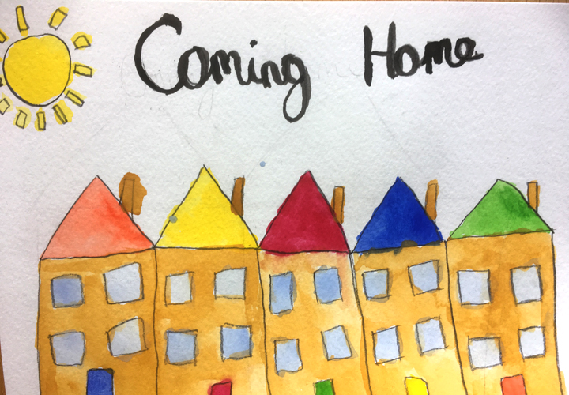
Coming Home One Another Scriptures #1
Ephesians 2:11-12
Outside of Christ we were:
v. 11 Uncircumcized
v. 12 Separate from Christ
v. 12 Excluded from citizenship
v. 12 Without hope
v. 12 Without God
No home!!!!

Slide 2
Ephesians 2:13-22 But in Christ we have come home
v. 13 We are brought near by the blood of Christ.
v. 14 We are made one (Jew and Gentile)
v. 14 The barrier of hostility has been destroyed.
v. 16 We are one body
v. 19 We are fellow-citizens with God’s people.
v. 19 We are members of God’s household/family.
v. 21 We are a holy temple in the Lord
v. 22 We are a dwelling in which God lives by his Spirit.

Slide 3
So, How Do We Create Home? By implementing the One Another Passages
I. Love One Another
John 13:34-35
John 15:12
John 15:17, 1 John 3:11,23 4:7,11,12

Slide 4
So, How Do I Do That?
Philippians 2:3 Do nothing out of selfish ambition or vain conceit. Rather, in humility, value others above yourselves, not looking to your own interests, but also to the interests of others. In your relationships with one another, have the same mindset as Christ Jesus…
1 Peter 1:22 Now that you have purified yourselves by obeying the truth so that you have sincere love (phileo) for one another, love (agape) one another deeply from the heart.
phileo: warm, friendly, save, intimate, warm, family-love for one another

Slide 5
Coming Home One Another Scriptures
II Submit to one another
Ephesians 5:21 Submit yourselves to one another or of reverence for Christ.
huptasso: to place in rank under, to obey
What would that look like?

Slide 6
Coming Home One Another Scriptures
III. Serve One Another
Gal 5:13 Serve one another in love
This is a home where needs are met.
Whose needs tend not to be met?
a. People on the “fringe.”
b. People who do not want to ask/be served
Acts 20:35

Slide 7
More One Another Passages
Bear with one another
Encourage one another
Be devoted to one another/honor one another
Teach and admonish one another
Confess your sins to one another and pray for each other
Accept one another
Carry each other’s burdens
Forgive one another
Encourage each other/Build each other up

Slide 8
Discussion Questions
1. What does “submit your selves to one another” mean to you and how do you intend to put it into practice?
2. Are you someone that others consider a servant? Are you one of those who does not like to be served?
3. Is there someone in our fellowship or not who you feel needs to be served more?

