Slide 2
Daniel, Prophet to the Nations
Is the Bible the inspired word of God?

Slide 4
Theme of Daniel:
God Rules the Nations: Do Not Fear!
Message of Daniel:
Stay Righteous in an Unrighteous World
God is in Control!

Slide 5
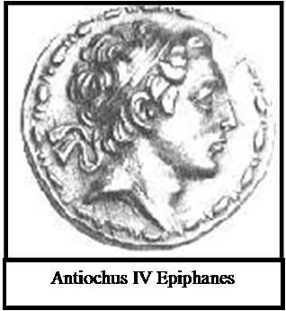
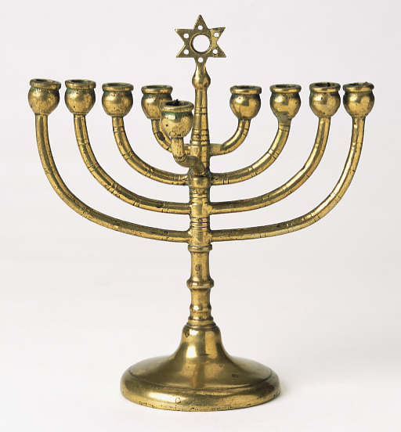
Principle Audience of Daniel
Jews suffering incredible persecution under Antiochus Epiphanes

Slide 6
Daniel is Unique Because…
Daniel ↔ O T like Revelation↔ N T
Apocalyptic
End Times (eschatology)
Written to a persecuted people
Daniel is the fighting ground for Bible skeptics
Daniel has the most specific material on angels in the OT.
Set in a pagan nation (also Esther) A prophet to the nations
Most clear description of a final resurrection in the OT
A history book… of the future!

Slide 7
Sir Isaac Newton
The folly of Interpreters has been, to foretell times and things, by this Prophecy, as if God designed to make them Prophets. By this rashness they have not only exposed themselves, but brought the Prophecy also into contempt. The design of God was much otherwise. He gave this and the Prophecies of the Old Testaments, not to gratify men's curiosities by enabling them to foreknow things, but that after they were fulfilled they might be interpreted by the event; and his own Providence, not the Interpreters, be then manifested thereby to the world. For the event of things predicted many ages before, will then be a convincing argument that the world is governed by providence.[7]

Slide 8
Was Daniel Written about 150 BC?
Pro:
Greek words in the text?
A modern form of Aramaic?
The real reason…
Con:
Septuagint translation
Dead Sea Scrolls
Credulity of Rabbis
Prophecies fulfilled after 150 BC

Slide 9
Historical Background
722 BC Northern Kingdom Destroyed by Assyria
605 BC Nubuchadnezzar (Bablyon) enters Judah, taking tribute and hostages (DSM&A)
586 BC Zedekiah rebels, Nebuchadnezar destroys Jerusalem and the temple
538 BC Cyrus takes Babylon, Persians/Medes take control of Babylon and Judea.
536 BC Captives return to Judea and Jerusalem.
334-332 BC Alexander destroys and conquers Persian Empire
185-163 BC Antiochus Epiphanes, Seleucid Emperor, rules over Jerusalem. Great persecutions. 1 Maccabees
167 BC Temple desecrated
164 BC Temple rededicated by Macabeean leaders.

Slide 10
Historical Background (cont.)
Battle of Actium 31 BC Ptolemaic Greek power destroyed Dan 11:36f
6 BC Birth of Jesus
AD 30 Crucifixion and resurrection of Jesus
AD 70 Destruction of Jerusalem by Titus
AD 81-96 Domitian, emperor of Rome
AD 395 Final division of Rome into East and West
AD 476 Last emperor of Western Rome
AD 1453 Byzantium (Eastern Rome) taken by Ottomans
AD 2014 Jesus comes back to rule in Jerusalem

Slide 11
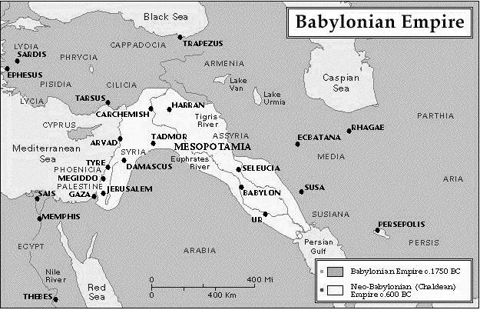
Babylonian Empire c. 1750 BC and c. 600 BC

Slide 12
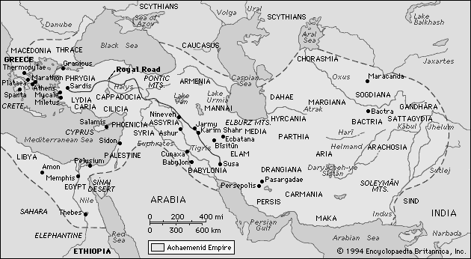
Achaemenid Persian/Median Empire at its Height c. 450 BC

Slide 13
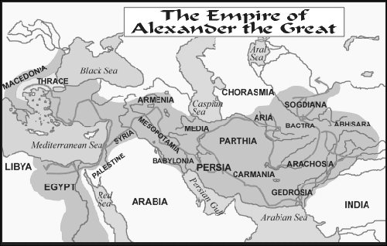
Alexander the Great Empire Nations c. 330 BC

Slide 14
Very Brief Outline of Daniel
Practical examples in the lives of Daniel, Shadrach, Meshach and Abednego: how to remain righteous in an unrighteous world. Ch 1, 3-6
Prophecies of the future: God Rules the Nations Ch 2, 7-12

Slide 15
Daniel Chapter One
Righteous behavior on the job.
Pressure from the world to compromise and conform.
Isaiah 39:6,7 (note: they are eunuchs)
Belshazzar = Bel protects
God is in control
1:2 The Lord delivered Jehoiachim…
1:9 God caused the official to show favor to Daniel
1:17 God gave them knowledge and understanding
1:8 Daniel resolved not to defile himself.
What about you?

Slide 16
Daniel Chapter Three
Righteousness in a religious context: Standing up for God and for the truth
The fires of persecution.
“I will bow my head, but not my heart.”
What would you have done?
App’n: Persecution of Diocletian or of Antiochus Epiphanes

Slide 17
Shadrach, Meshach and Abednego’s Response:
King Nebuchadnezzar, we do not need to defend ourselves before you in this matter. If we are thrown into the blazing furnace, the God we serve is able to deliver us from it, and he will deliver us from Your Majesty’s hand. But even if he does not, we want you to know, Your Majesty, that we will not serve your gods or worship the image of gold you have set up.

Slide 18
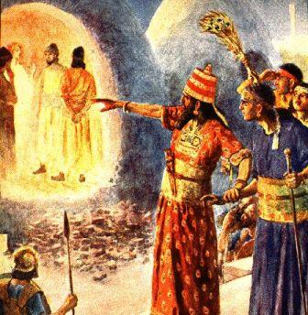

Slide 19
Daniel 4 A King Eats Grass
Daniel 4:10-12 A vision of a great tree

Slide 20
Daniel Chapter Four
Those who walk in pride, he will humble.
Pride in our accomplishments: “Look at this great Babylon that I have built… by my mighty power and for the glory of my majesty.”
(1 Corinthians 4:7, Deuteronomy 8:6-18, 2 Cor 12:7-10)
Two ways to be humbled:
God’s blessings
God’s discipline

Slide 21
The city stands on a broad plain, and is an exact square 120 furlongs (13.5 miles) in length each way, so that the entire circuit is four hundred and eighty furlings. It is surrounded, in the first place, by a groad and deep moat, full of water, behind which rises a wall fifty royal cubits in width (87 feet) and two hundred in height (350 feeet). On the top, along the edges of the wall, they constructe buildings on a single chamber facing one another, leaving between them room for a four hourse chariot to turn… The city is divided into two portions by the river which runs through the midst if it.
Herodotus, c. 450 BC

Slide 22
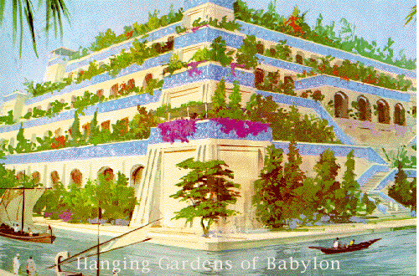
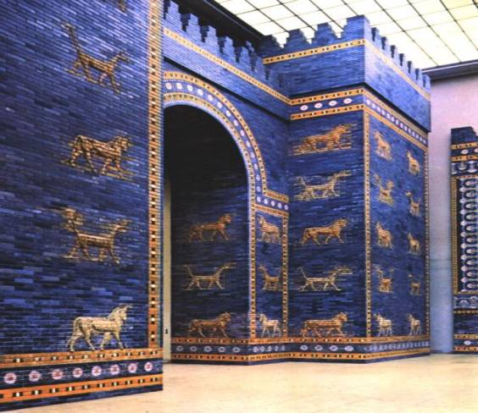
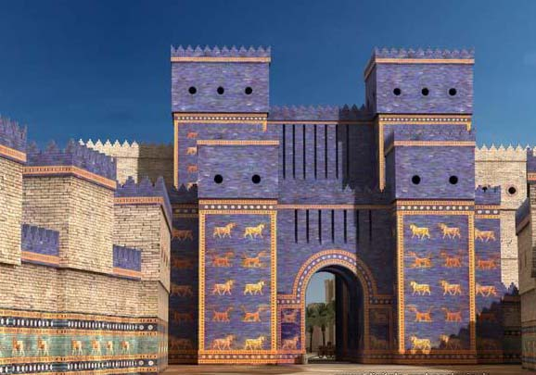

Slide 23
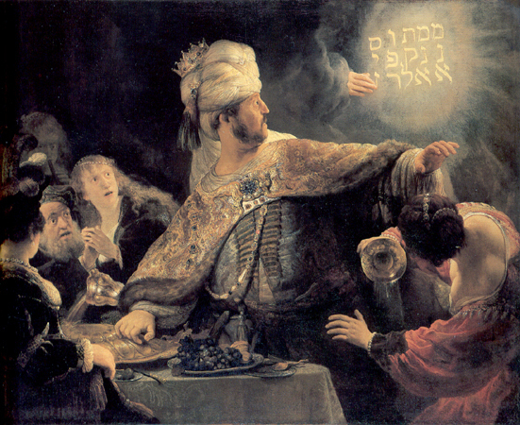
Daniel Chapter Five
Oct. 12, 539 BC
Party animal meets man of God.
V. 4 They praised the gods of gold
and silver, bronze and iron, wood and
stone
The writing is on the wall, literally!!!
Side note: v. 8 “I will make you third highest ruler in the kingdom.” Q: Why third?
Message: If you stand up against unrighteousness, God will cover your back and he will take revenge on the unrighteous.

Slide 24
Ziggurat in Ur: Nabonidus and Belshazzar

Slide 25
The Writing on the Wall
Mene counted
Mene finished
Tekel weighed
Parsin divided (by the Persians)

Slide 26
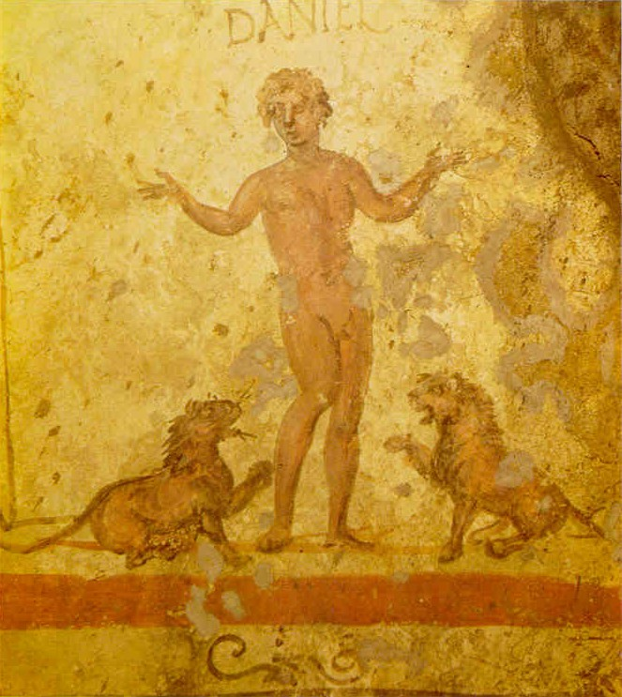
Daniel Chapter Six
Thrown to the lions for being righteous.
Righteousness on the job.
v. 4-5 “We will never find any basis for charges against this man Daniel unless it has something to do with the law of his God.”
neither corrupt nor negligent
Would they say that about you?
Why did he pray with his windows open?

Slide 27
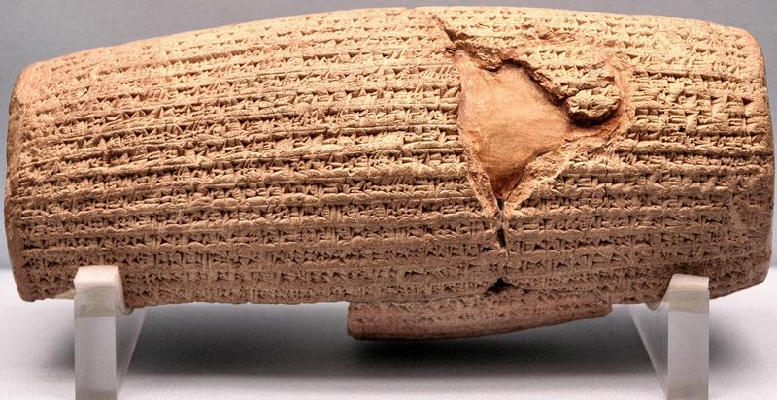
Cyrus Cylinder British Museum 535 BC
Ezra 1:2-4

Slide 28
Part II
Visions of the future…

Slide 29
Daniel Chapter Two:
Nebuchadnezzar’s Vision of a Great Statue
Part of the Statue | Nation
Head of Gold | Babylon
Chest of Silver | Persia/Media (539 BC)
Belly of Bronze | Greece (331 BC)
Legs of Iron | Rome (31 BC)

Slide 30
Babylon
Persia/Media
Greece
Rome: A divided kingdom

Slide 31
Babylonian Empire c. 1750 BC and c. 600 BC

Slide 32
Achaemenid Persian/Median Empire at its Height c. 450 BC

Slide 33
Alexander the Great Empire Nations c. 330 BC

Slide 34
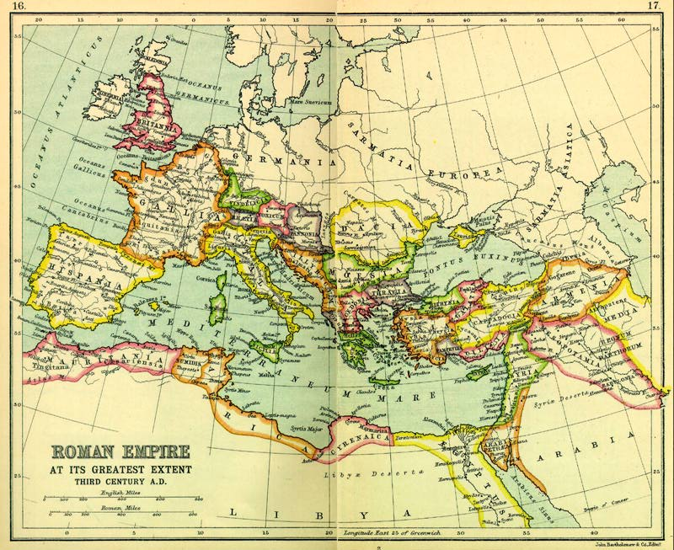
Rome At Its Height
Divided:
Diocletian AD 284
Theodosian AD 395
West:
Fell AD 476
East Byzantium):
Fell 1453

Slide 35
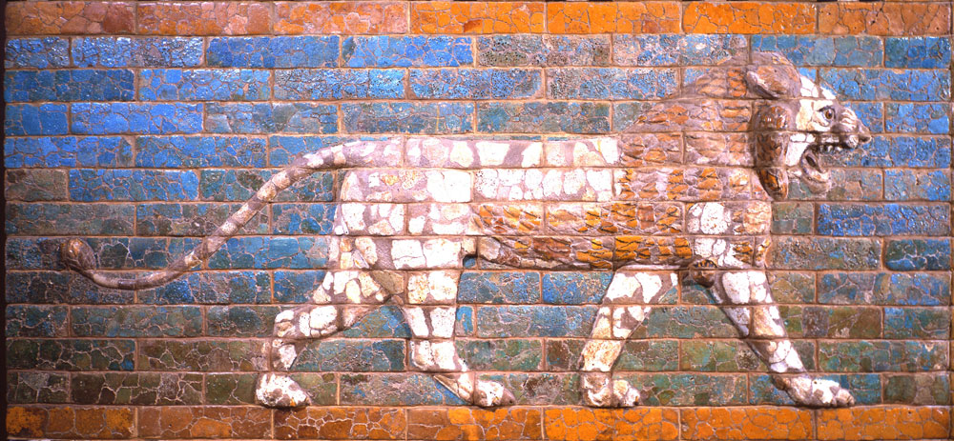
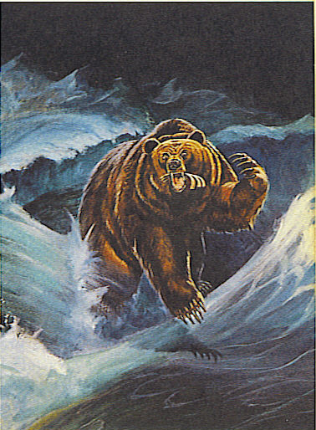
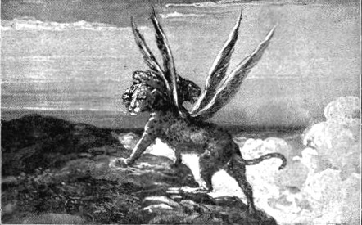
Daniel Chapter 7 Four Beasts

Slide 36
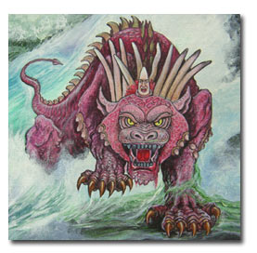
Daniel 7: Ten Horns and a Little Horn

Slide 37
The First Eleven Emperors of Rome
Emperor
Dates of Rule
Significance to Biblical Events
Augustus
27 BC-14 AD
Birth of Christ
Tiberius
14 AD-37 AD
Crucifixion of Christ
Gaius (Caligula)
37 AD-41 AD
Claudius
41 AD-54 AD
Jews Exiled from Rome
Nero
54 AD-68 AD
First persecutions, Execution of Paul and Peter
Galba
68 AD-69 AD
One of the three overcome by Vespasian
Otho
69 AD-70 AD
One of the three…
Vitellius
69 AD-70 AD
One of the three…
Vespasian
69 AD-79 AD
Attack on Jerusalem
Titus
79 AD-81 AD
The general who destroyed Jerusalem
Domitian
81 AD-96 AD
First Systematic Persecutor of the Church

Slide 38
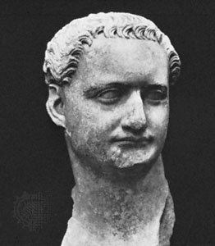
Domitian (c. 81-96 AD)
Demanded to be called “My Lord God Domitian
Changed October to Domitianus and November to Germanicus
Replaced Roman law with Domitian law.

Slide 39
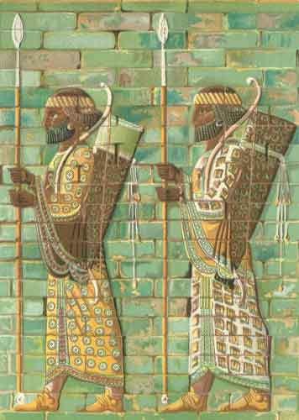
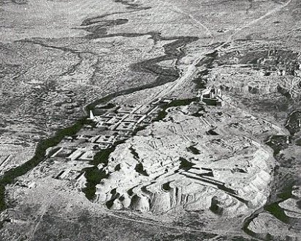
Daniel Chapter Eight: A Ram and a Goat
Ancient Susa and the Ulai Canal

Slide 40
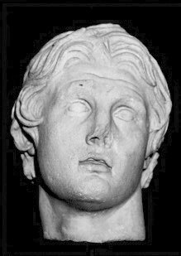
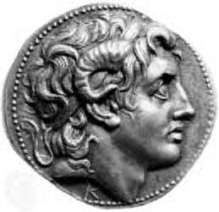
Alexander the Great
Died “at the height of his power” at the age of 35
323 BC

Slide 41
The Four Horns of Daniel Seven
Horn (King) | Territory Ruled
Antigonus | The East. From Syria to India.
Cassander | The West. Macedonia and Greece.
Lysimachus | The North. Thrace and Asia Minor.
Ptolemy | The South. Egypt and Palestine.

Slide 42
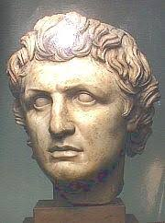
Out of one of these horns…
Seleucus I Nicator 321-285 BC
South: Syria
East: Persia
Beautiful Land:
Canaan

Slide 43
Daniel 8: The Abomination of Desolation
How long?
2300 Evenings and Mornings = 1150 days
Nov 167 BC – Dec 25, 164 BC = 1150 days

Slide 44
Daniel Chaper Nine: The Messiah Comes to Jerusalem
Seventy sevens = 490 years
The decree to restore and rebuild Jerusalem
Ezra 7:13-16 458 BC
458 - 490 = AD 32
No…… (no zero BC) = AD 33
Actually, during the last week: AD 26-33

Slide 45
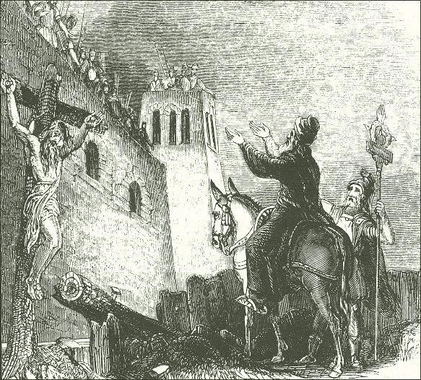
The Destruction of Jerusalem AD 70 Josephus: The Jewish Wars

Slide 46
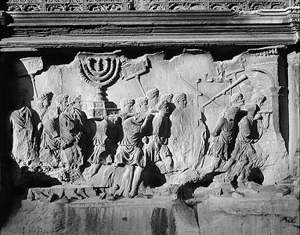
Romans Taking Spoils of Jerusalem from the Arch of Titus, Rome, c. 81 AD

Slide 47
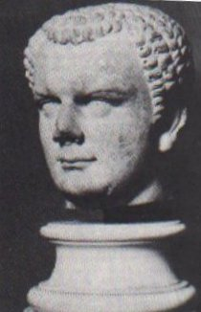
Roman General and Emperor Titus who destroyed Jerusalem in AD 70

Slide 48
The Kings of the South and the Kings of the North in Daniel Eleven
Kings of the South
Kings of the North
Daniel 11 Verse
Ptolemy I 323-283 BC
Seleucus I Nicator 321-282 BC
Daniel 11:5
Ptolemy II Philadelphus 283-247 BC
Antiochus I Soter 280-261 BC
Daniel 11:6
Antiochus II Theos 261-246 BC
Daniel 11:6
Ptolemy III Eugertes 247-221 BC
Seleucus II Callinicus 246-226 BC
Daniel 11:7,8
Seleucus III Soter 226-223 BC
Daniel 11:8
Ptolemy IV Philopator 221-203 BC
Antiochus III “The Great” 223-187 BC
Daniel 11:9-19
Ptolemy V Epiphanes 203-181 BC
Seleucus IV Philopator 187-175 BC
Daniel 11:20
Ptolemy VI Philometor 180-146 BC
Antiochus IV Epiphanes 175-164 BC
Daniel 11:21-35
Antiochus V Eupator 164-162 BC
(v. 6) After some early, indecisive struggles, the Ptolemaic kingdom and the Seleucid kingdom will agree to share power peacefully. In order to seal the deal, Ptolemy II

Slide 49
The Theme of Daniel Eleven
Those who are wise will instruct many, though for a time they will fall by the sword or be burned or captured or plundered. When they fall, they will receive a little help, and many who are not sincere will join them. Some of the wise will stumble, so that they may be refined, purified and made spotless until the time of the end, for it will come at the appointed time. 11:33-35

Slide 50
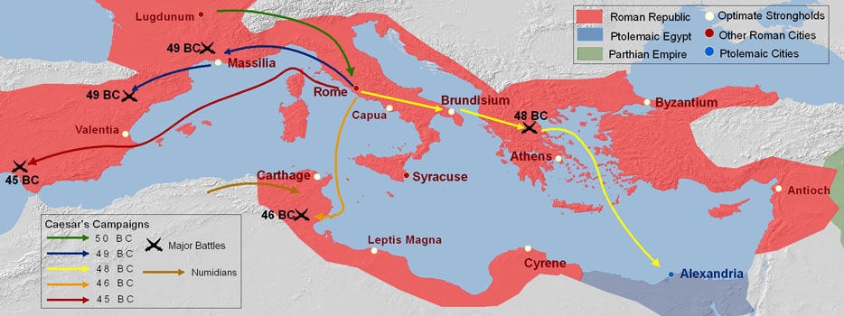
Daniel 11:36-45 The End of the Greek Kingdoms: The Battle of Actium.

Slide 51
Daniel Chapter Twelve: The Time of the End
Those who are wise will shine like the brightness of the heavens, and those who lead many to righteousness, like the stars for ever and ever.
Daniel 12:3-4
How do I know that I will raise from the dead?

Slide 52
Daniel: What about….
(fill in the blank with your favorite “issue”)
God: Let me mind my business. I rule the nations. Take care of your local ministry and trust in me.

Slide 53
Questions?
www.evidenceforchristianity.org

