Slide 1
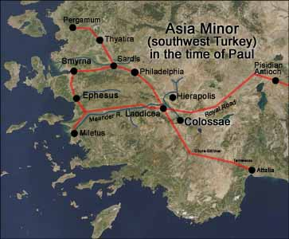
Dealing with Progressive Theology
Colossians 2:6-15
John Oakes
11/10/22

Slide 2
A Response to Progressive Theology
Progressive politics
vs.
Progressive thinking
vs.
Progressive theology

Slide 3
Progressive Theology: What is It?
The idea that Christianity itself needs to progress.
The idea that the Bible itself is outdated.
It undermines the idea of the authority of the Bible.
Does God change?
Malachi 3:6 I, the Lord, do not change.

Slide 4
What is Progressive Theology?
It undermines the idea of absolute truth and absolute morality.
It implies that the Bible is sufficiently ambiguous that it must be reinterpreted according to current human thinking.
Much of God’s truth is delivered through narrative, but is there also propositional truth in the Bible?

Slide 5
Colossians
Theme: The supremacy of Christ. The all-suffiency of Christ.
Colossians 2:6-15 Christ vs the stoicheia/elemental truths of the world

Slide 6
What do we have in Christ?
Coll 1:14 We have redemption, the forgiveness of sins in Christ
Col 2:2 The mystery of God is in Christ.
Col 2:6 We live our lives in Christ.
Col 2:10 In Christ, we are brought to fullness.
Col 2:11 In Christ we were circumcised.
Col 2:13 We are made alive in Christ.
Col 2:17 The Law is a shadow. The reality is in Christ.

Slide 7
stoicheia
Let no one take you captive to hollow and deceptive philosophy which depends on human tradition and the elemental forces (stoicheia) of the world rather than on Christ.
Elemental forces
First principles of the world
ABCs
stoicheia vs Christ and his Kingdom

Slide 8
Stoicheia of our world
Prosperity gospel
American dream
Comfort/materialism/entertainment/leisure
Personal security 401-k
Being a good person
Universal salvation
Moral relativism

Slide 9
Stoicheia of our world
Postmodernism
Republicanism and social conservative politics
Democratism and progressive politics
Can these philosophies deceive us, kidnap us, and drag us from Christ?

Slide 10
Fullness in Christ
Col 1:10 We have fullness in Christ. We need nothing from the world. Fullness = pleroma = filled full
Col 1:11 We are circumcised in Christ—the world/flesh has been removed in Christ.
We are moral beings in Christ, not by moral behavior.
We are socially just people in Christ, not through supporting social justice causes.

Slide 11
Conclusion
Our fullness, our sufficiency is in Christ.
Let us strive to be like Christ and to exemplify his kingdom.
Let us be students of God’s authoritative, inspired, infallible Word, not necessarily of the world’s ideas.
Let us seek righteousness through Christ, not the stoicheia of the world

Slide 12
Application
There cannot be a Christian political party or partisan effort.
As disciples, we value all human life, but our means of realizing this is principally through bringing people into the kingdom of God, and bringing the kingdom of God to the lost.
The same for issues such as homosexuality and social or racial justice. Our principle means of working in these areas is through the work of God in his kingdom, not through establishment of laws or through coercion of unbelievers.

Slide 13
Michael Burns: Escaping the Beast
“When we yoke ourselves with one of the philosophies of the present age, we lose the ability to distinguish ourselves from the world, and the prophetic voice is silenced, as we are shouted down by those within our own ranks who accuse us of being what they actually are, which is partisan and beholden to the world.”

Slide 14
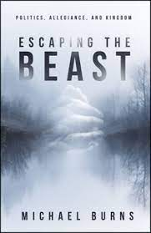
IPI Book Recommendations
Escaping the Beast by Michael Burns
Wildfire: How Progressive Theology is Impacting the Church Daren Overstreet

