Slide 1
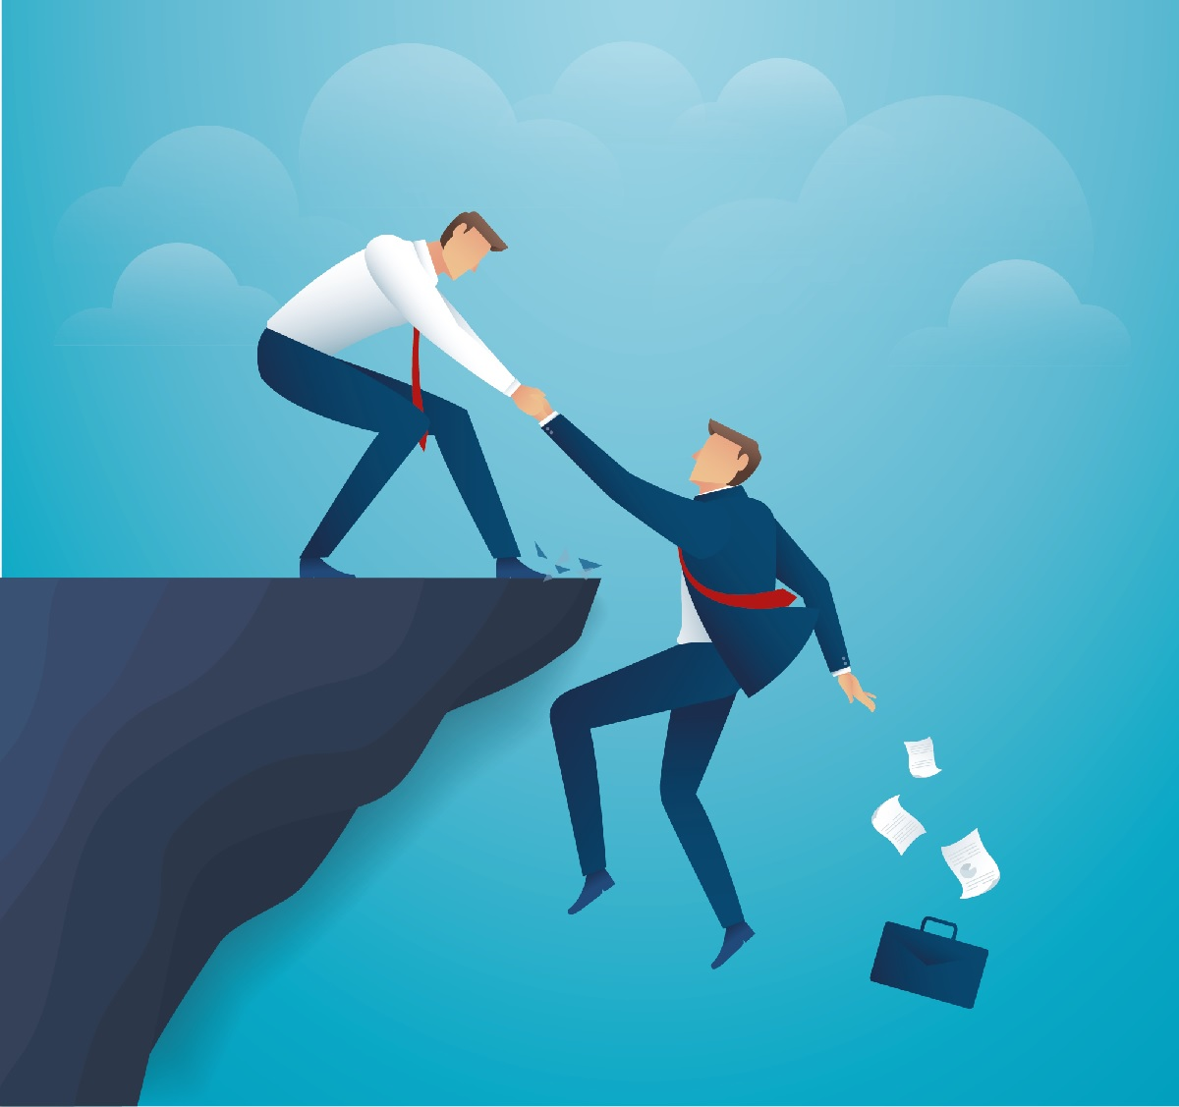
You Can Trust The Bible
John Oakes
November, 2022

Slide 2
Why Can I Trust the Bible?
I. Because the autographs/original writings are inspired by God.
II. Because the original writings have been faithfully transmitted to us.

Slide 3
The Original Writings are Inspired by God
2 Timothy 3:16
Psalm 119:160
1 Thess 2:13
Fine, but how do I know that is true?
2 Peter 1:19-21 We have the prophetic word made more certain.
Why is that?

Slide 4
How Can We Be “More Certain?”
Because the Messiah/Jesus was born in Bethlehem (Micah 5:2)
Because the Messiah/Jesus was indeed from Galilee—from the land of Zebulun and Naphtali—and even more specifically from Nazareth. (Isaiah 9:1-2,6 Isaiah 11:1, Jeremiah 23:5, Zechariah 3:8)

Slide 5
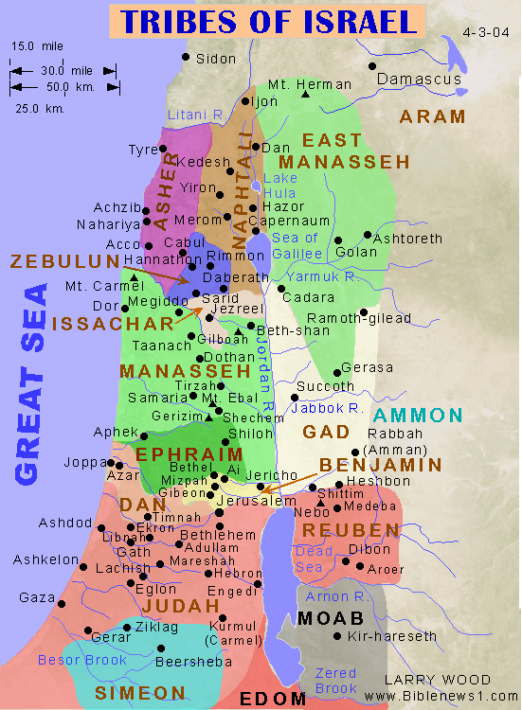

Slide 6
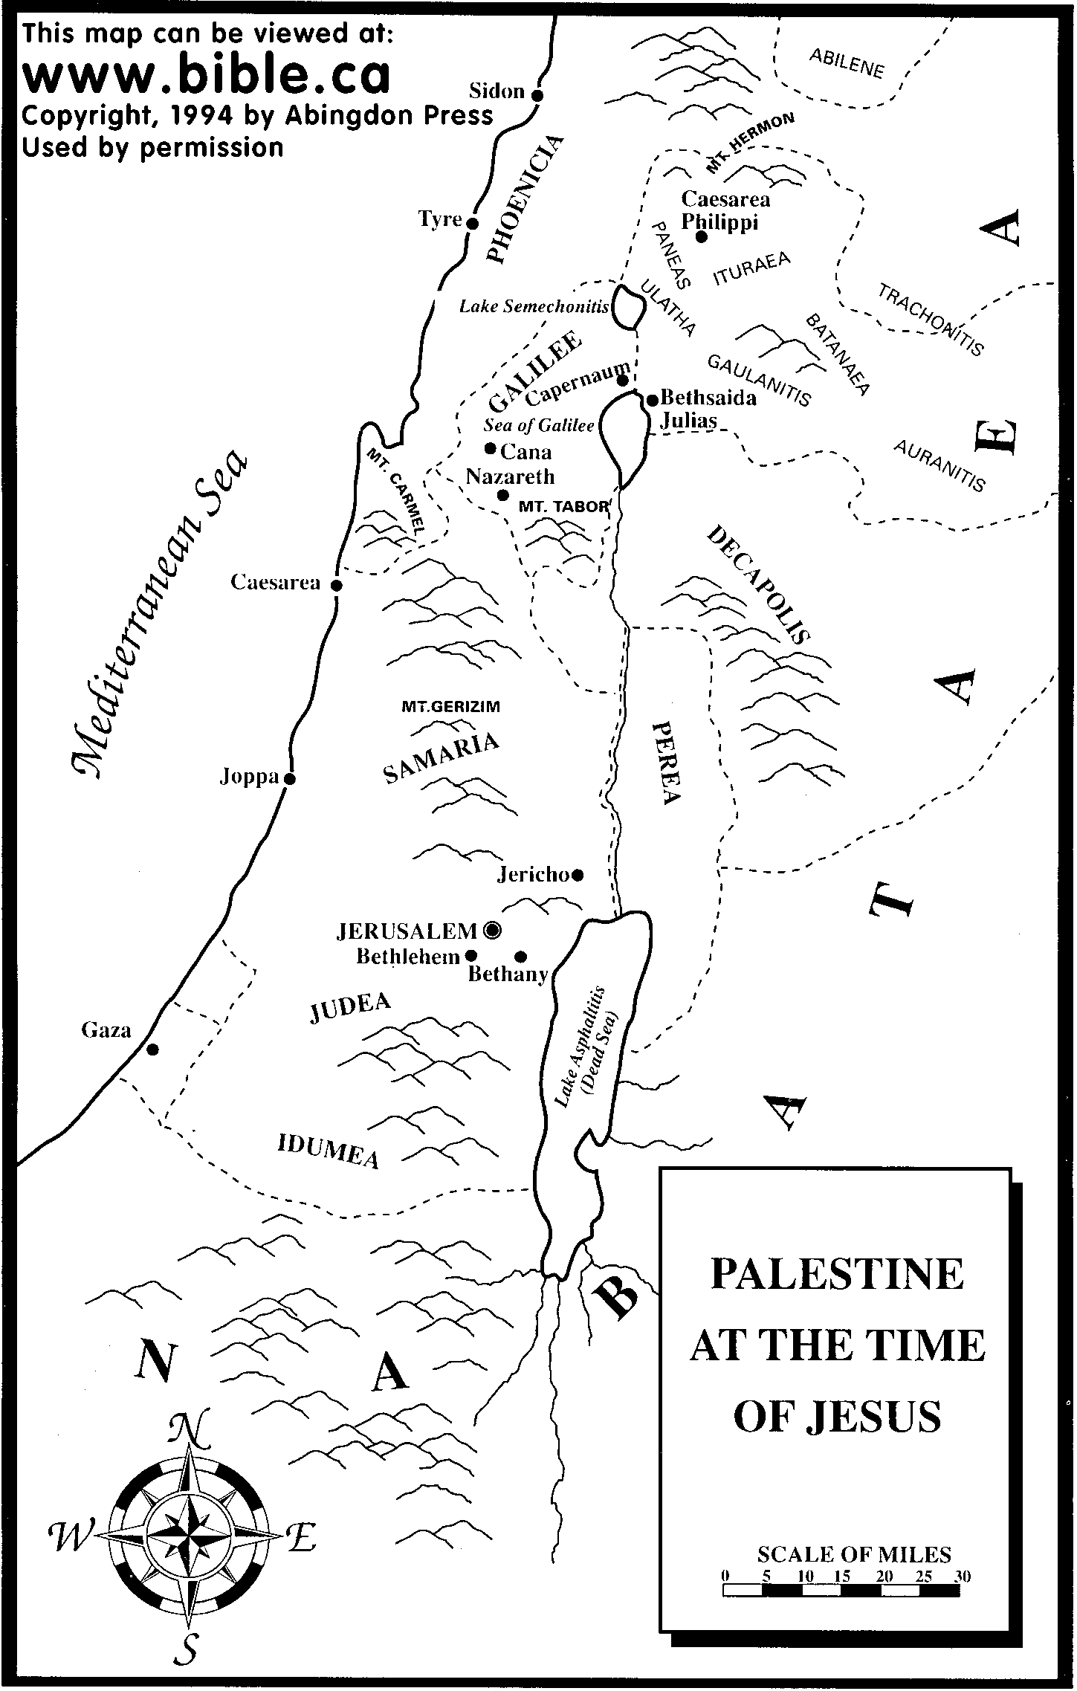

Slide 7
How Can We Be “More Certain?”
Because Jesus was despised and rejected, did not open his mouth when accused, and was pierced (Isaiah 53:1-12)
Because Jesus was born of a Virgin (Isaiah 7:14)
Because Jesus was pierced in his hands and feet, and his garments were gambled over. (Psalm 22:16-18)

Slide 9
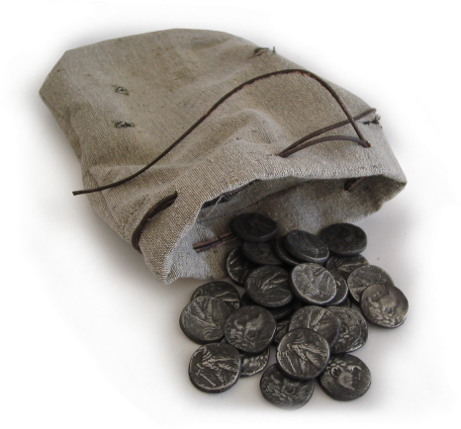
How Can We Be “More Certain?”
Because Jesus rode in triumph into Jerusalem as a king, riding on a donkey (Zechariah 9:9)
Because Jesus was betrayed for 30 pieces of silver, and those 30 pieces of silver were used to buy a potter’s field. (Zechariah 11:12-13)

Slide 10
According to the Old Testament, the Messiah must:
Be born of a virgin in Bethlehem
Be raised in Galilee near Nazareth
Be despised and rejected by men
Be meek and silent before his accusers
Be “pierced”
Be crucified
Have his garments divided and gambled over
Ride as a king into Jerusalem on a donkey
Be betrayed for 30 pieces of silver
Come to Jerusalem to make atonement for sin in about AD 33 (Daniel 9:24-25)

Slide 11
How Can We Be “More Certain?”
Because Jesus fulfilled hundreds of types, prefigures and foreshadows. He quite literally fulfilled the Law and the Prophets (Matthew 5:17 From Shadow to Reality)
Because Jesus worked many signs, wonders and miracles “as you yourselves know.” (Acts 2:22)

Slide 12
How Can We Be “More Certain?”
Because of the empty tomb. Jesus was resurrected from the dead!!!
-the empty tomb
-the fact of the crucifixion
-the fact that it was proclaimed in Jerusalem at Pentecost
-the fact of 500+ eye-witnesses.
-but what about….
I don’t know, but Jesus was raised from the dead.

Slide 13
Why Can I Trust the Bible?
I. Because the autographs/original writings are inspired by God.
II. Because the original Hebrew and Greek writings have been faithfully transmitted to us.

Slide 14
Textual Evidence for Ancient Manuscripts
Author
Date
Oldest Copy
Interval
Copies
Aristophanes
400 BC
AD 900
1,300 years
45
Aristotle
340 BC
AD 1100
1,450 years
5
Demosthenes
300 BC
AD 1100
1,400 years
200
Julius Caesar
50 BC
AD 900
950 years
10
Herodotus
435 BC
AD 900
1,350 years
8
Homer
800 BC
AD 100
900 years
643
Plato
360 BC
AD 800
1,150 years
15
Sophocles
415 BC
AD 1000
1,400 years
7
Thucydides
410 BC
AD 900
1,300 years
8
Old Testament
1400 BC – 430 BC
250 BC
200-400 years
5,000
New Testament
AD 50-90
AD 125
50 years
8,000

Slide 15
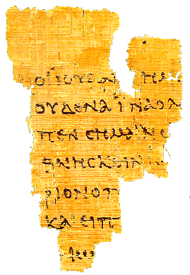
Manuscript evidence for the canonical gospels
The Rylands
Fragment
John 18:31-33, 37
AD 125

Slide 16
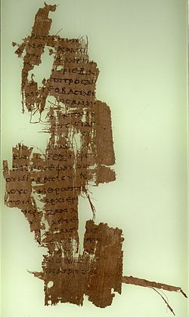
Sackler Library
John 18:36-19:1
150 AD

Slide 17
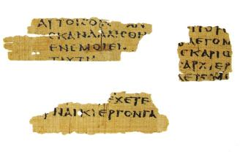
Magdalen Manuscript Matthew 3:5,26 AD 175

Slide 18
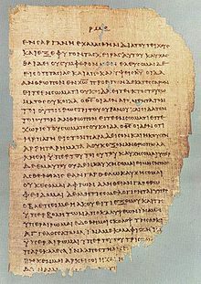
Chester Beatty Papyrus
2 Cor 11:33-12:9
200 AD

Slide 19
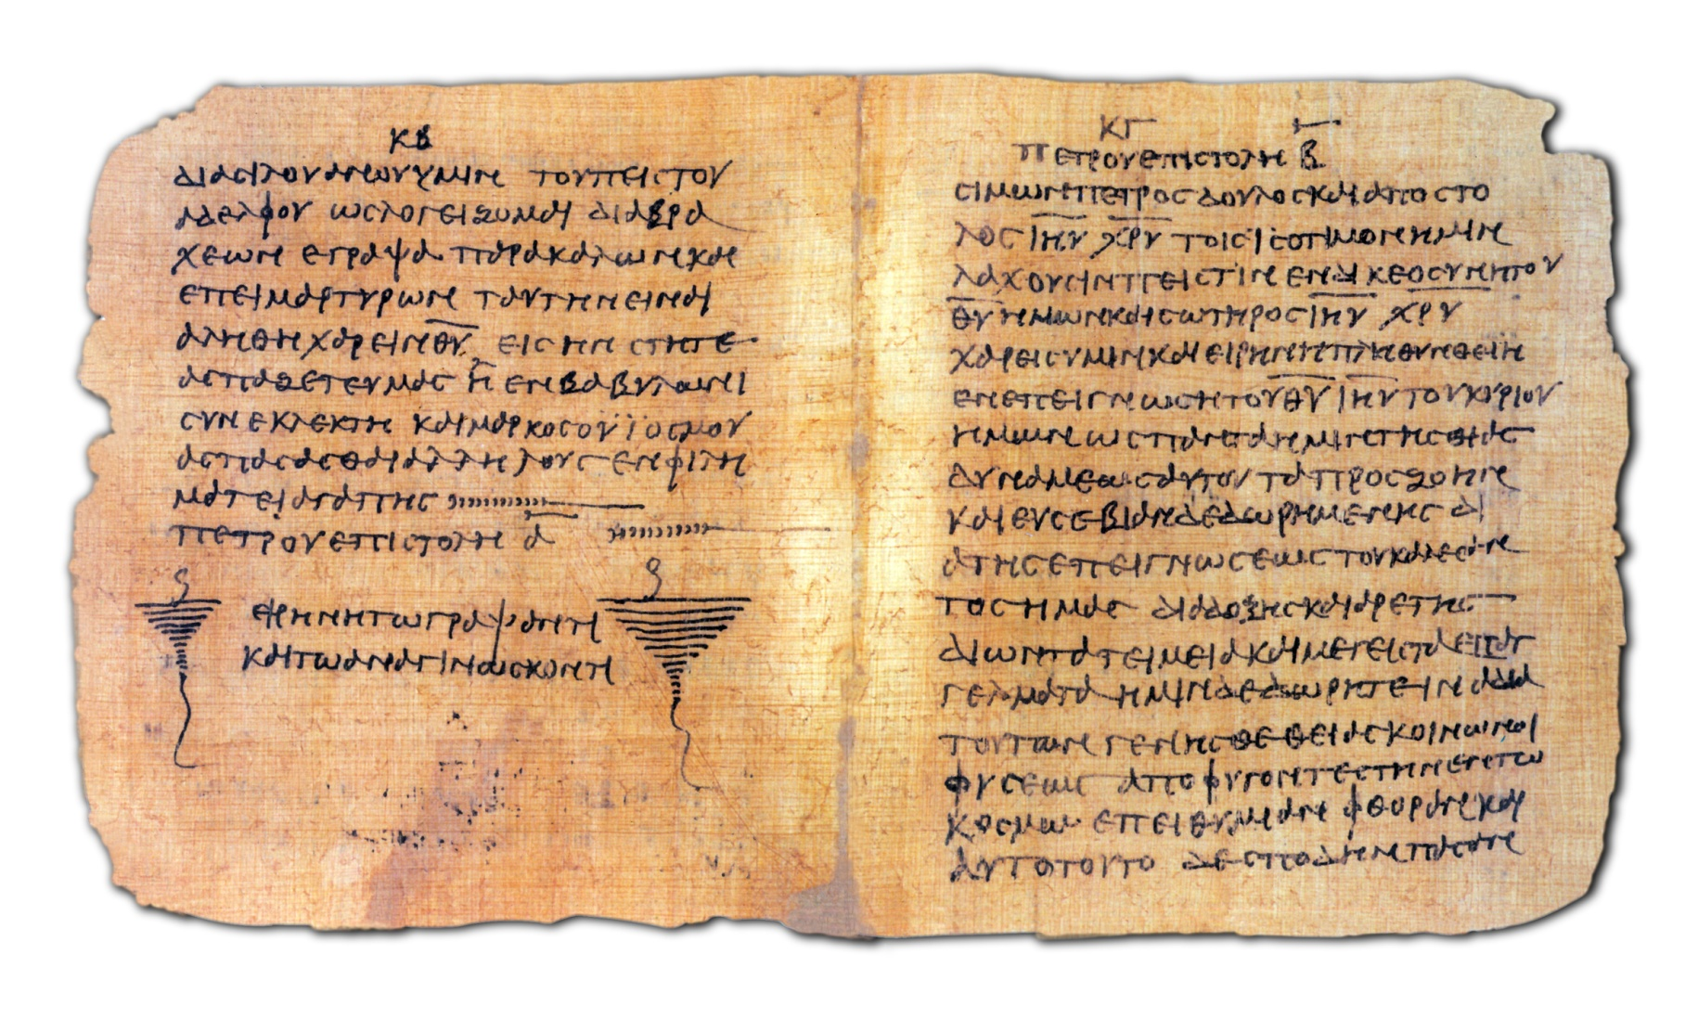
Bodmer Papyrus Codex c. 200AD

Slide 20
Codex Sinaiticus AD 350 British Museum

Slide 21
Church Father Quotes
Clement of Rome AD 95 or 96 quotes from ten of the twenty-seven New Testament books. Matthew, Mark Luke, Acts, Romans 1 Corinthians, Hebrews, James, 1,2 Peter.
Ignatius d. AD 108 Quotes from: Matthew, Luke, John, Acts, Romans, 1,2 Corinthians, Galatians, Ephesians, 2 Thessalonians, 1,2 Timothy, Hebrews, James, 1 Pet, 1,3 John, Revelation.

Slide 22
Church Father Quotes (cont.)
Polycarp, writing to the Philippians in AD 120 quotes from Matthew, Mark, Luke, Acts, 1,2 Corinthians, Galatians, Ephesians, Philippians, 1,2 Thessalonians, 1,2 Timothy, Hebrews, 1 Peter, and 1,3 John.
Irenaeus AD 180 quotes from all NT books.
Nearly the entire New Testament can be reconstructed from quotes of the church fathers in the 2nd and 3rd centuries.
None of these ever quoted from a Gnostic gospel, ever!

Slide 23
Textual Criticism
What about Constantine changing the Bible?
What about all those copying errors?
What about Mark 16:9-20, John 5:3-4, John 7:53-8:11?
Our Greek New Testament are between 99 and 99.9% certain and no important teaching is in question.

Slide 24
IV. The Hebrew Text of the Old Testament
A section of the Psalms from the Dead Sea Scrolls

Slide 25
Reliability of the Old Testament Hebrew and Aramaic Text
The Masoretic Text
The Dead Sea Scrolls
The Septuagint and Other Early Translations

Slide 26
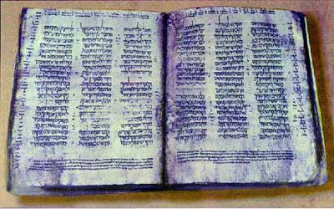
The Hebrew Text of the Old Testament
The Cairo Codex: The former and latter prophets AD 895
The Aleppo Codex: Oldest Hebrew manuscript of the entire Old Testament AD 920
The Leningrad Codex: Manuscript of the whole Old Testament AD 1008
The Cairo Codex

Slide 27
But… There is still that annoying 1400 years or so!

Slide 28
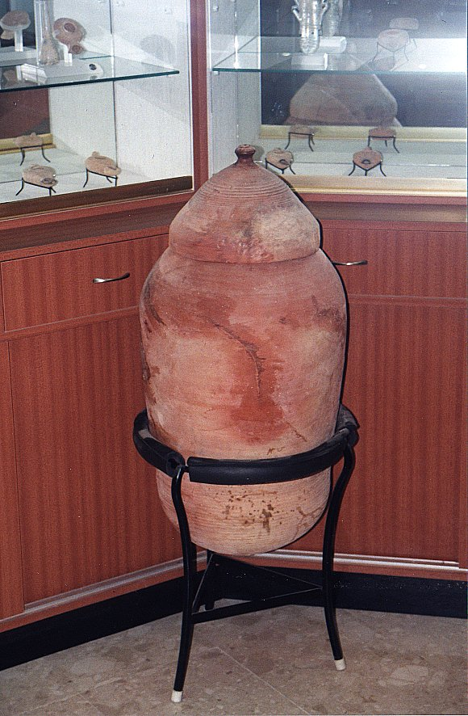
All this changed in 1947 with an Arab child in the hills east of Jerusalem….

Slide 29
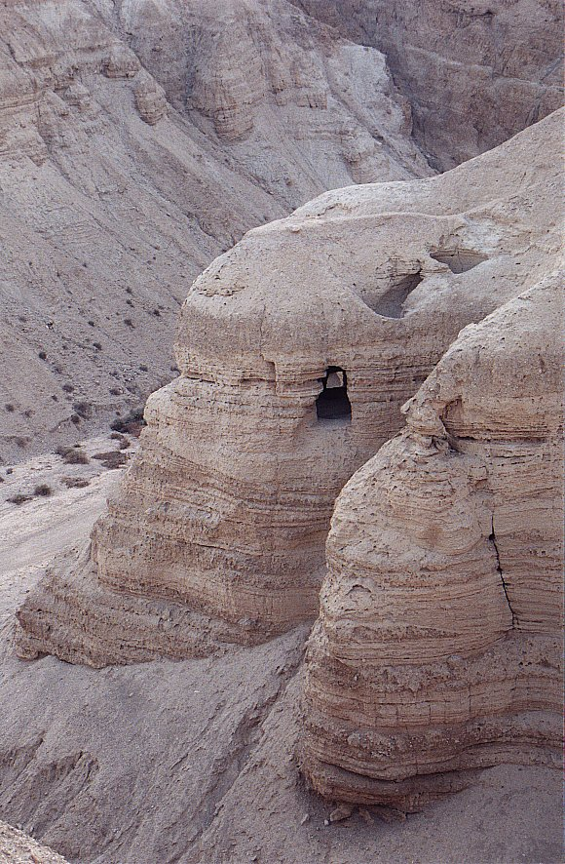
Qumran
Cave #4

Slide 30
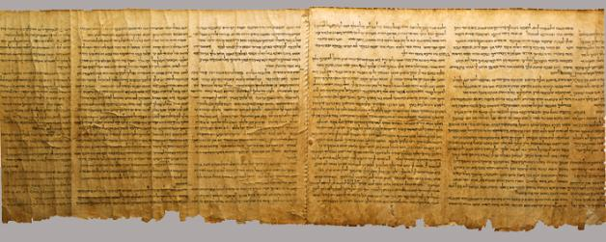
Important Dead Sea Scrolls
Isaiah 58:6-65:4
Isaiah A 100 BC 13 changes t0 1952 RSV
Isaiah B 150 BC
1 & 2 Samuel 250 BC
Exodus paleo-Hebrew 200 BC

Slide 31
The Effect of the Dead Sea Scrolls
Last Old Testament Book Written Autograph | Dead Sea Scrolls Written | Oldest Old Testament Manuscript Before Dead Sea Scrolls

Slide 32
You Can Trust The Bible Can You Understand the Bible?
I do not read Hebrew or Greek
I live 2000+ year removed from the culture of the Old and the New Testament
What about BEMA?

Slide 33
My Claim (for what it’s worth)
We have so many resources for understanding both the ancient Greek and Hebrew languages and the religious and cultural background to the Old and New Testaments that we can understand the words of Paul, Luke, John and Peter as well as the original hearers of the Scriptures.
…and you do not need to know Greek or Hebrew to access this knowledge and understanding.

Slide 34
So, What Do I Do?
-Psalm 119:72 The Law from your mouth is more precious to me than thousands of pieces of silver and gold.
1. Take the long view. Work hard but be patient.
2. Study Hermeneutics.
3. Read commentaries. (do more reading than podcast listening!)

Slide 35
So, What Do I Do?
4. Study background history, culture and religion of the ancient Near East.
5. Learn to ask the right questions.
-essential, important, not important
-command, principle, example
6. Be careful, be discerning and be humble. Do NOT become a know-it-all.
-Remember, the Bible is inspired and reliable.

