Slide 1
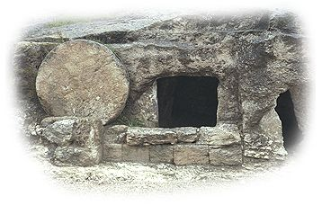
Hebrews 9 A Greater Sacrifice
John Oakes, 7/14/2019

Slide 2
The Greatness of Jesus
I Jesus is greater than all the prophets
II Jesus is greater than the angels
III Jesus is greater than Moses
IV Jesus the great High Priest
V The Priesthood of Melchizedek is superior to the Priesthood of Aaron
VI Jesus is greater than Abraham
VII The New Covenant (in and through Jesus) is superior to the Old Covenant (through Moses)
VIII The heavenly Tabernacle is greater than the earthly Tabernacle.
IX The sacrifice of Jesus is of far greater worth than the OT sacrifices

Slide 3
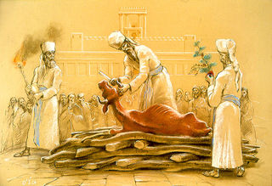
Heb 9:12-10:18 Greater Sacrifices
Heb 9:12-14 The blood of bulls and goats and the ashes of a red heifer only made the Jews outwardly clean. They were shadows, prefigures
Bulls and Goats: yom kippur
Ashes of a heifer: Red Heifer sacrifice (Numbers 19)

Slide 4
Sacrificial Type and Antitype
Old Testament Sacrifice
New Testament fulfillment
Scriptures
Sweet Savor Offerings (gifts)
The Burnt Offering
Jesus’ and our devotion to God
Ephesians 5:1,2 Romans 12:1,2
The Grain Offering
Giving back a contribution to God
Matthew 6:19-21
Romans 8,9
The Drink Offering
Pouring out our life for God
Luke 22:20 Philippians 2:16
The Fellowship Offering
Celebrating our blessings from God
John 10:10
1 Thess 5:16
Blood Sacrifices
The Sin Offering
Jesus’ sacrifice for our sins
1 Peter 1:18,19
2 Corinthians 5:21
The Guilt Offering
Maintaining a relationship with one another
Matthew 5:23,24

Slide 5
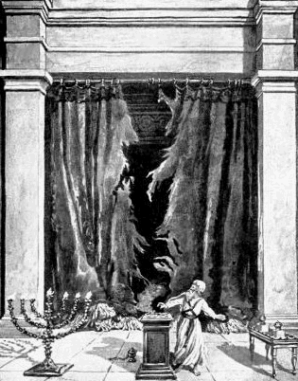
The Day of Atonement Yom Kippur
Sacrificial goat and scape goat.
Sins laid on sacrificial goat, killed outside the camp.
Incense fills the Holy of Holies
Priest enters the Holy of Holies and puts blood on the Mercy Seat

Slide 6
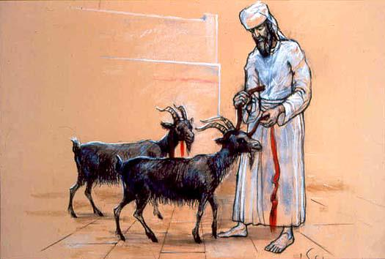
The Day of Atonement Yom Kippur
Scapegoat (Azazel) sent off into the wilderness
Bodies burned outside the camp (Hebrews 13:11-14)
Prefigure of the salvation of Jesus. Hebrews 9:11-15, 23-24

Slide 7
The Red Heifer Sacrifice
Aspects of the Red Heifer Sacrifices | Antitype in the sacrifice of Jesus
A very rare red heifer | A unique son
Sacrificed outside the camp | Sacrificed outside Jerusalem
Purifies both Jew and Gentile | Atones for the sin of both Jew and Gentile
A sacrifice without blemish | A sacrifice without sin
Had never been yoked | Offered himself voluntarily
Scarlet wool and wood included | Blood was shed on a wooden cross
Hyssop included (for purification from the effects of death) | Purifies us from the effects of sin
Water included for purification | We are baptized into Christ for forgiveness

Slide 8
Jesus: A Better Sacrifice Heb 9:12-14
1. Eternal redemption. v. 12.
2. A clean conscience v. 14.
3. We can now serve (worship) God. v. 14.

Slide 9
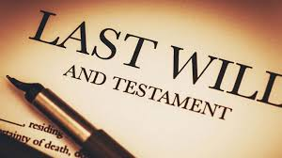
Hebrews 9:16-22 A New Covenant

Slide 10
A Better Sacrifice Hebrews 9:23 better sacrifices than these
The lesser sacrifice (goats, bulls, red heifer) | The greater sacrifice (Jesus)
Outward (appearance) | Inward (spiritual)
Temporary (repeated again and again) | Eternal (only done once)
Ceremonial | Real
Not voluntary | Voluntary
Mechanical | Spontaneous (by choice)
Unaware | Rational, aware
Did not remove guilt | Removes guilt eternally

Slide 11
Hebrews 10:1-4 From Shadow to Reality
10:1 Shadow vs. Reality eikon a perfect representation.
The reality has great power—It makes us perfect
They still felt guilty (because they were)
How about you?
v. 3 But the Law of Moses did do something. They reminded us how sinful we are. Rom 7:13 It “made sin utterly sinful.”

Slide 12
Heb 10:5-10 What Does God Want From Us?
Psalm 40:6-8 An obedient heart.
Heb 10:7 Here I am… I have come to do your will.
1 Sam 15:22, Psalm 51:16-17, Hosea 6:6, Micah 6:6-8

Slide 13
Hebrews 10:19-38 Exhortation #4
Exhortation #1 Pay attention Heb 2:1-18
Exhortation #2 Don’t rest. Make every effort Heb 3:6-4:13
Exhortation #3 Grow up. Become mature Heb 5:11-6:20
Exhortation #4 Hebrews 10:19-12:29 Draw near to God. The peril of rebellion.

Slide 14
Heb 10:19-21 Therefore…. Draw Near to God
10:19 Confidence to enter the Most Holy Place.
We have access!!!!
v. 20 a new and living way
Through the curtain, that is his body.
Q: How do you feel about this?

Slide 15
Salad time!
10:22 Let us draw near [to God]
10:23 Let us hold to our confession of hope without wavering
10:24 Let us be concerned about one another and encourage one another toward love and good deeds
10:25 Let us not stop meeting together.
10:25 Let us encourage one another.

