Slide 1
Karaoke

Slide 4
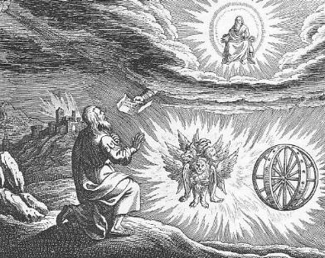
Ezekiel II Dramatic Symbolism

Slide 5
Themes in Ezekiel
1. The Sovereignty/glory of God
a. Theodicy: Free will
2. The utter sinfulness of humanity/Judah
3. The inescapability of God’s justice
4. The Messiah is coming/ The restoration of God’s Remnant.

Slide 6
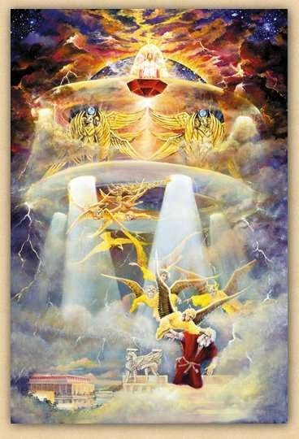
Ezekiel 1:4-28 I. We need to see god’s glory
Ezek 1:4-28 Ezekiel sees the glory of God—a prerequisite for being a prophet.
On the throne, surrounded by the cherubim (Rev 4:6f).
The cherubim are the ones who guard God’s holiness

Slide 7
Ezekiel Commissioned II. We need to stand up for god
Ezek 2:1-7 Ezekiel’s mission
v. 4 say to them: this is what the Lord says.
2:1 Stand on your feet.
2:4 Say to them: This is what the Lord says.
2:4 Ezekiel needs to be obstinate and stubborn. Why? Because the people are obstinate and stubborn.

Slide 8
III. We need to eat the scroll

Slide 9
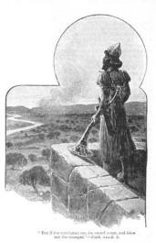
IV. The Watchman of Israel
Ezekiel 3:16-21 Ezekiel a watchman
Q: Are you willing to be God’s watchman?

Slide 10
Ezekiel 4 & 5 Dramatic symbolism
Ezek 4:1-3 Ezekiel acts out the siege of Jerusalem (588-586 BC)
a. Draws the city
b. Siege works: Babylon
c. Iron pan God is against Jerusalem and will not hear their prayers

Slide 11
Ezekiel 4 & 5 Dramatic symbolism
4:4-7 430 Days = 430 years = symbolically, length of captivity in Egypt
390 days for sin of Ephraim/Samaria/Northern Kingdom
40 days for sin of Judah
v. 4 “bear their sin” = bear the consequences
4:9-11 mixing, weighing grain = shortage of food during siege.
4:12 cook over human dung = unclean during exile.

Slide 12
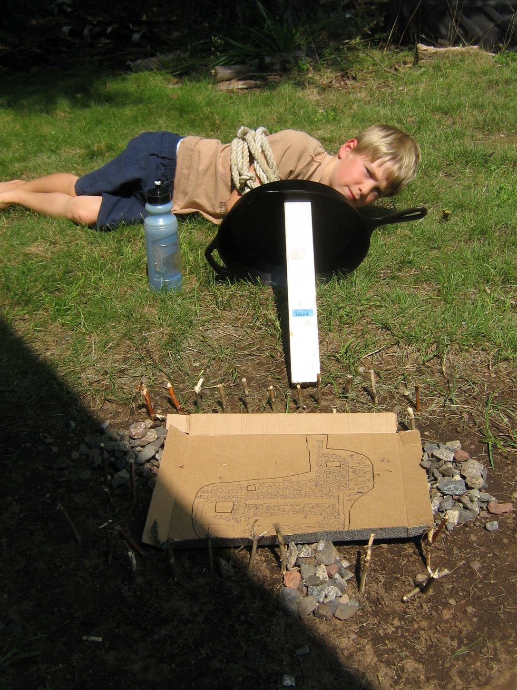
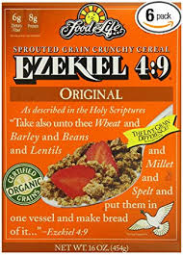

Slide 13
Ezekiel 5 Ezekiel gets a haircut
A haircut: The point: From those to whom much has been given, much will be expected.
Cutting off hair and beard a big deal for Jews.
v. 2 fire, sword and exile
v. 3 The remnant motif (but even some of them will suffer v. 4)
v. 5 I have set you in the center of the nations. Great responsibility.

Slide 15
Ezekiel 7 Cursed Money
Ezekiel 7:16 -22 They will throw their silver into the streets. On the Day of Judgment, what the world holds to be valuable will be abominable.
Things you can buy Things you cannot buy
Medicine health
Books knowledge of God, wisdom
Position favor with God
Attention love

Slide 16
Ezekiel 9
9:1 Executioners from North (Babylon).
9:2 Put a mark on the foreheads of those who grieve and lament. Rev 7:1-17 Mark = protect from eternal judgment. (note: not protected from temporal judgment Ezek 21:3-4)
For us, the mark is the Holy Spirit Eph 1:13-14.
9:3 The shekinah moves to the threshold of the temple. God is about to abandon temple, city and people.

Slide 17
Nebuchadnezzar Comes From the NOrth

Slide 18
Ezekiel 9 (cont.)
Ezek 9:5 Kill without pity or compassion. Whew!
9:6 Begin at my sanctuary (leaders, the church)
(1 Pet 4:17)
9:9-10 They brought this on themselves
9:11 It (God’s wrath) is accomplished!

Slide 19
Summary
God will hold his people accountable.
God will protect a remnant
God holds the “religious” especially to account
God will judge the world due to sin, but those who worship him will be sealed from final judgment.

Slide 20
Ezekiel 10,11 Necessity of Judgment
Ezek 10:1 God on a sapphire (blue, royal) throne with his cherubim protecting his holiness.
Ezek 10:18 A momentous event. The Lord departs from the temple in Jerusalem. Judgment is around the corner. Jerusalem is doomed.

Slide 21
Ezekiel 11 Judgment on the Leaders of Judah
Remember, this is being said to the elders.
Their sin? Ezek 11:3 They say “peace, peace” when there is no peace.
11:23 The end of the road (so much for the P in TULIP)
God goes to Mt. of Olives. An interesting foreshadow.
.

Slide 22
Ezekiel 12 Acting out the destruction of Jerusalem
12:3 Son of man, pack your bags… A visual prophecy. Hopefully we, like Ezekiel, have packed our bags (Heb 11:13f)
12:5-10 A prophecy about Zedekiah. Dig through wall (v. 5) Cover your face (v. 6) At night (v. 7). Zedekiah (v. 10-14)
All fulfilled in detail. Jeremiah 52:4-11, 2 Kings 25:1-7 Ezekiel is a prophet!
12:16 But I will spare a remnant.
12:28 God replies: No more delay!

Slide 23
Ezekiel 18 Individual Righteousness
Ezek 18:2 A bogus proverb: Sour grapes.
The exiles: It is not our fault. Blame it on our fathers!
God: Wrong! Everyone is accountable for their own actions. So much for predestination/Original sin.
Ezek 18:4 All souls are mine. All can be saved (Rom 8:28-30)
Ezek 18:5-18 God’s justice. (does this contradict Exodus 20:4?)

Slide 24
Ezek 18 (cont) individual righteousness
Ezek 18:20 (for emphasis) God repeats himself.
Ezek 18:21-24 Our final state determines our eternal destiny (but be aware of Hebrews 6:4-6 and 2 Peter 2:20-22)
18:22 For the righteous: None of his offenses will be remembered
18:24 For the unrighteous: None of his good deeds will be remembered.
18:25-29 Godly vs human justice. (Matthew 20:1-16 exp. v. 14)
18:30 Here is the bottom line for us: Each will be judged according to his own ways.
18:32 The bottom line for God. He wants all to be saved. 1 Tim 2:4 The T and the P in TULIP are a lie.

Slide 25
Ezekiel 23 Oholah and oholibah Shameful History IV
Oholah (Heb: her tent) is Samaria/Ephraim/Northern Kingdom
Oholibah (Heb: my tent is in her) is Jerusalem/Judah
This chapter is R-rated. It is shocking on purpose.
Message: God will give us over to our lusts if we live by sight, not by faith (Romans 1:24-28)
Ezek 23:5-10 Oholah prostituted herself with Egypt and Assyria.
Ezek 23:11-27 Oholibah was worse than her sister!
v. 20 This is disgusting! Sin is disgusting. Their mistake: They were not satisfied with God. 1 Tim 6:8 Are you satisfied with what God has for you?

Slide 26
Oholah and Oholibah cont.
Ezek 23:22 The take-home lesson: I will give you over to what you give yourself to.
Ezek 23:25 God: I am jealous. Amazingly, God still loves Samaria and Judah. This is the story of Hosea. Romans 5:8 While we were still sinners, Christ died for us.
Ezek 23:28 I will give you over to the very thing you hate. This is what sin does. John 10:10 The thief comes to steal and kill and destroy. Jesus came that we can have life.
Summary: 23:49 Then you will know that I AM the Lord.

Slide 27
Ezekiel 24 The cauldron Ezekiel refuses to mourn
Jan 588 BC A date to mark down. The date Jerusalem was put under siege. Again, Ezekiel proves himself to be a prophet.
Ezek 24:6 A cauldron with encrusted layers of unrepented sin. Judah. 24:12 A heavy deposit.
Ezek 24:11,13 When God’s wrath is poured out, it will get hot enough to burn off the encrusted layers.
24:14 I will not have pity (as illustrated later in Ezek 24:15-24)
24:15-24 God to Ezekiel: Do not mourn when your wife dies. I will take away the delight of your eyes. How does God feel about judging Judah? Like Ezekiel feels about God taking away his wife.
The point: When we suffer discipline for our sins, we should accept it without complaint.

