Slide 1
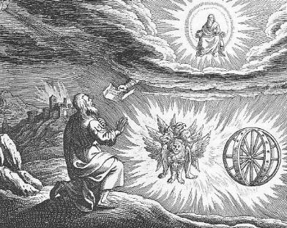
Ezekiel I God Calls a Prophet

Slide 2
Themes in Ezekiel
1. The Sovereignty/glory of God
a. Theodicy: Free will
2. The utter sinfulness of humanity/Judah
3. The inescapability of God’s justice
4. The Messiah is coming/ The restoration of God’s Remnant.

Slide 3
Ezekiel’s Place in History

Slide 4
Ezek 1:1-3 The Setting
Judah defeated by Nebuchadnezzar 597 BC
10,000 in Exile “the cream of the crop”
Jeremiah 30 years old
5th year of the exile 592 BC
Has Judah been humbled?

Slide 5
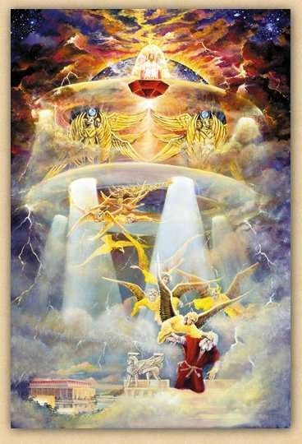
Ezekiel 1:4-28 I. We need to see god’s glory
Ezek 1:4-28 Ezekiel sees the glory of God—a prerequisite for being a prophet.
On the throne, surrounded by the cherubim (Rev 4:6f).
The cherubim are the ones who guard God’s holiness

Slide 6
Ezekiel’s vision
1:4 cloud, flash of lightening = judgment From the North = Babylon
v. 5 four living creatures = cherubim Rev 4:6b-8 Ezek 10:1
v. 10 four faces man, lion, ox, eagle
v. 12, 17 move God’s judgment coming like a chariot
v. 15-18 Wheels in wheels, eyes to protect God’s holiness

Slide 7
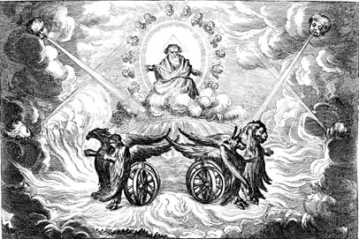
The throne of god
v. 25-28 The throne of God.
v. 28 rainbow = hope
Q: How do you see God in your own vision?

Slide 8
Ezekiel Commissioned II. We need to stand up for god
Ezek 2:1-7 Ezekiel’s mission
v. 4 say to them: this is what the Lord says.
2:1 Stand on your feet.
v. 4 obstinate and stubborn. Why? Because the people are obstinate and stubborn.
Jer 7:3-8
Jer 6:13-15

Slide 9
Ezekiel’s Commission: Our Commission
Ezek 2:5 Whether they listen or fail to listen….
Jim McGuiggan: Successful evangelism is faithful proclamation by word and life.
v. 5 They will know a prophet had been among them…. How?
Because we declared the full counsel of God.

Slide 10
III. We need to eat the scroll
Ezek 2:8-3:3 Ezekiel eats the scroll. To be God’s prophet we must:
I. Have a personal encounter with God
II. Stand up for God
III. Digest his Words (Jeremiah 15:16, Rev 10:9-11)
3:8 God’s solution: We need to be as hard and stubborn as they are.

Slide 11
Eat the scroll

Slide 12
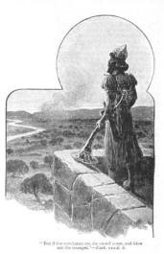
IV. The Watchman of Israel
Ezekiel 3:16-21 Ezekiel a watchman
Q: Are you willing to be God’s watchman?
Eph 2:1-3 and Eph 2:4-10.
We need to see God
We need to stand up for God
We need to eat the scroll
We need to be God’s watchman

Slide 13
Ezekiel 4 & 5 Dramatic symbolism
Ezek 4:1-3 Ezekiel acts out the siege of Jerusalem (588-586 BC)
a. Draws the city
b. Siege works: Babylon
c. Iron pan God is against Jerusalem and will not hear
their prayers
4:4-7 430 Days = 430 years = symbolically, length of captivity in Egypt
390 days for sin of Ephraim/Samaria/Northern Kingdom
40 days for sin of Judah
v. 4 “bear their sin” = bear the consequences
4:9-11 mixing, weighing grain = shortage of food during siege.
4:12 cook over human dung = unclean during exile.

Slide 14
