Slide 1
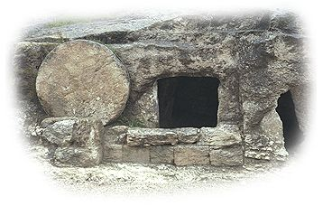
Hebrews 12 The Mountain of the Lord
John Oakes 1/29/2023

Slide 2
Last Week: Lots of Advice To Us
Draw Near to God
Encourage Each Other
Keep Running—Endure
Throw Off Things That Hinder You
Remember That Heaven Awaits You
Fix Your Eyes on Jesus
Accept Hardship and Discipline For What It Is—Evidence of God’s love.

Slide 3
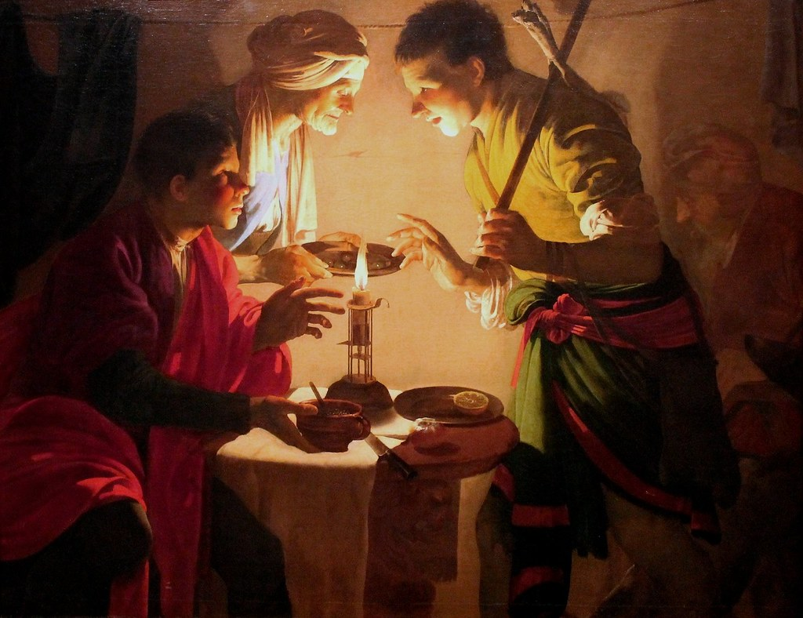
Hebrews 12:14-17 Esau No Bitter Root
Genesis 25:27-33.
Esau sold his birthright (as first son) for a bowl of lentil stew.
What will you sell your birthright for? Is it worth it?
Later, Esau could not repent, even though he wanted to.

Slide 4
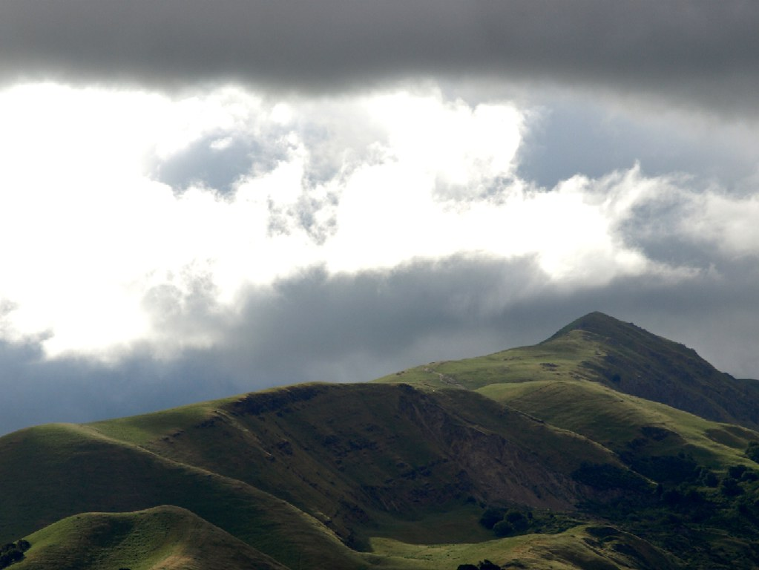
Heb 12:18-24 The Mountain of the Lord
Exodus 19:12-16
For them: Fear of God.
For us: Access to God.
A kingdom which cannot be shaken (12:25-27)

Slide 5
Hebrews 12:25-29 An Unshakable Kingdom
v. 26 “Once more” (besides at Sinai) I will shake the earth.
Haggai 2:6 Coming of the Kingdom.
v. 28 We are receiving an unshakable kingdom!!!!!

Slide 6
Heb 12:28 Summary of the summary.
Therefore, since we are receiving a kingdom that cannot be shaken, let us be thankful, and so worship God acceptably with reverence and awe, for our God is a consuming fire.

Slide 7
Hebrews 13: Final Exhortations Essential Qualities of the Christian Life
1. Brotherly love Heb 13:1
2. Hospitality Heb 13:2
3. Sympathy for those in trouble. Heb 13:3
4. Sexual purity Heb 13: 4
5. Christian contentment. Heb 13:5-6
6. Respect for spiritual leaders and the mature. Heb 13:7-8, 17
-Golden Rule Membership Judges 5:1

Slide 8
Jesus Is Amazing! Therefore:
Fix our eyes on Jesus
Make every effort
Move on to maturity
Draw near to God
Walk by faith
Pull out every bitter root
Live holy lives
Show hospitality
Be content with what we have

