Slide 2
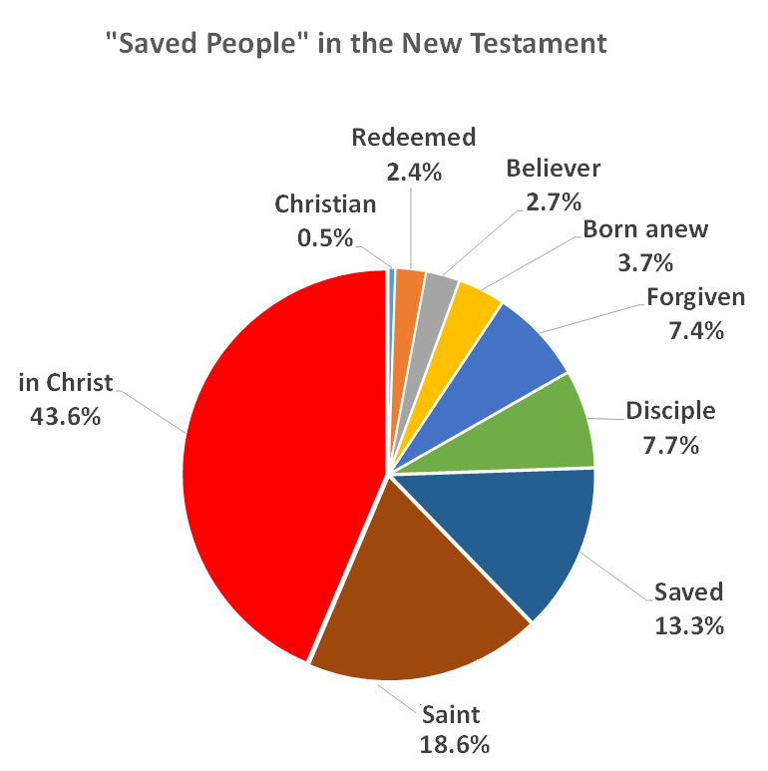

Slide 3
In Christ Philippians2:1 Encouragement in Christ. Coll 1:13-14 Redeemed in Christ Gal 3:26 Children of God in Christ. Colossians 2:10 Fullness of God in Christ Ephesians 1:3 Every Spiritual blessing in Christ

Slide 4
Things We Have In Christ
Ephesians 1:4, 11 Chosen in Christ
1 Corinthians 15:22 Made alive in Christ.
2 Corinthians 5:21 Righteous in Christ.
Romans 6:23 Eternal life in Christ Jesus
Romans 8:38-39 Secure love of God in Christ.
2 Corinthians 5:17 New creation in Christ.
Romans 8:1 No condemnation in Christ.

Slide 5
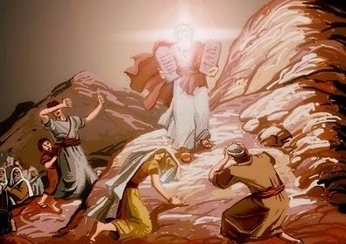
In Christ the Veil is Removed
The Unwritten Chapter
2 Corinthians 3:7-18

Slide 6
2 Corinthians 3:7-11
A ministry that brought death…
But it was glorious!!!

Slide 7
2 Corinthians 3:7-11 Glory
v. 7 A ministry that brought death— “engraved in letters of stone.”
Romans 7:13
-came with glory. Glory = shining forth.
v. 9 How much more glorious is the ministry that brings righteousness.
It lasts… It does not fade. Q: Has your glory faded?

Slide 8
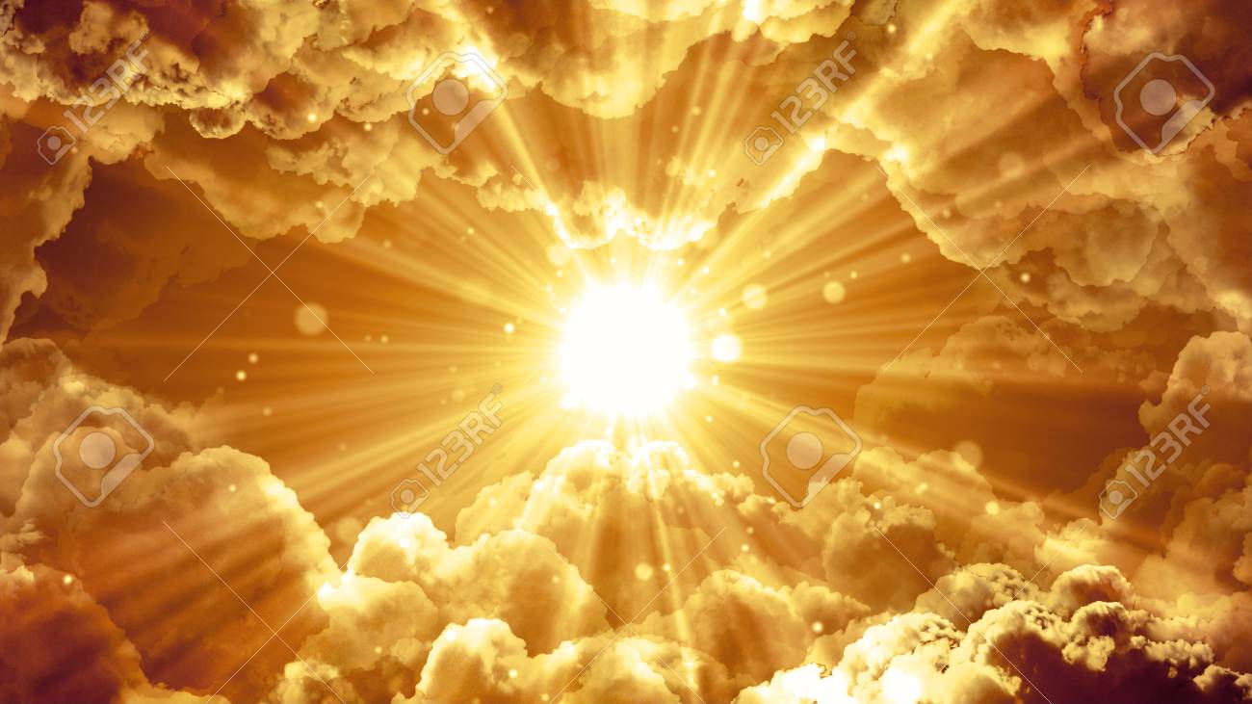
Our Ministry is far more Glorious!
It bring righteousness
It lasts

Slide 9
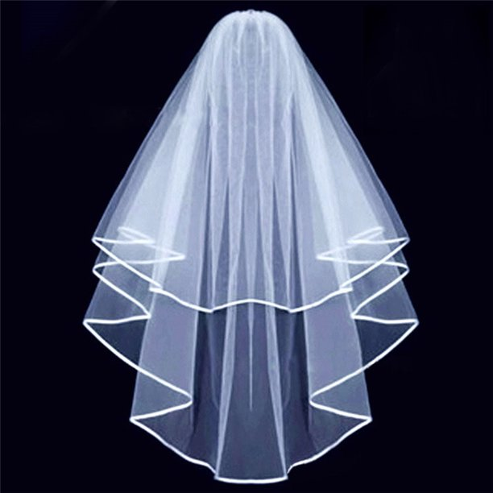
2 Cor 3:12-18 In Christ the Veil is Removed
We are very bold!
v. 16 Whenever anyone turns to the Lord, the veil is removed.
I can finally see!

Slide 10
2 Corinthians 3:12-18
We had a veil over our faces. We could not see God.
v. 16 But God removed the veil.
Q: Is this enough? Are you satisfied with having the veil removed?

Slide 11
TRANSFORMED
2 Corinthians 3:18
And we all, who with unveiled faces contemplate the Lord’s glory, are being transformed into his image with ever-increasing glory, which comes from the Lord, who is the Spirit…
contemplate/reflect
Thewayofthepilgrim.com

Slide 12
Veil-Removal is Not the Goal
And we all, who with unveiled faces contemplate the Lord’s glory, are being transformed into his image with ever-increasing glory, which comes from the Lord, who is the Spirit.
Contemplate → Reflect → Contemplate → Reflect
The goal is transformation into the likeness of Christ.

Slide 13
Set Apart and Transformed for What?
2 Cor 4:1-2
We have this ministry.
We commend our selves to everyone’s conscience.
In Christ we are set apart
In Christ we are holy/sanctified
In Christ the veil is removed
In Christ we are transformed into the image of Christ

Slide 14
2 Cor 4:1-6
Therefore we do not lose heart. Why? Because we have this ministry.
So, what do we do?
-Set forth the truth plainly
-Commend ourselves to everyone’s conscience
What do we preach? Jesus as Lord
Ourselves as servants for their sake.

Slide 15
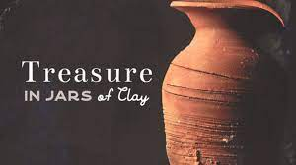
2 Cor 4:7-12
We are “jars of clay.” Mere mortals.
We carry the death of Christ in our bodies.
Death is at work in us so life can be at work in others.

Slide 16
2 Cor 4:13-18
We believe. The veil has been lifted. So we speak!
We do not lose heart. Why?
v. 14 We know God will raise us.
v.15 God’s grace is reaching more and more people.
Our jars of clay are wasting away.
But we fix our eyes on the unseen things.

Slide 17
2 Cor 5:1-10
The Power of Knowing
Know… guarantee… confident… live by faith…
What is it we know? We have an eternal home in heaven.
We long to be clothed… To have our immortal bodies.
Meanwhile we groan.
But we are confident. Why? Because the Holy Spirit is a guarantee!!! We live by faith, not sight.

Slide 18
2 Cor 5:11-15
Therefore we try to persuade people.
Enough so that some may think we are crazy!
We are compelled by Christ’s love.
Why? Because we are convinced Christ died for us.

