Slide 1
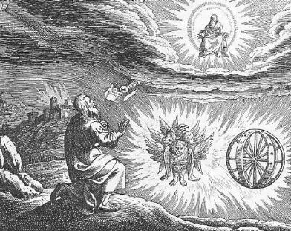
Ezekiel III God’s Justice

Slide 2
Themes in Ezekiel
1. The Sovereignty/glory of God
a. Theodicy: Free will
2. The utter sinfulness of humanity/Judah
3. The inescapability of God’s justice
4. The Messiah is coming/ The restoration of God’s Remnant.

Slide 3
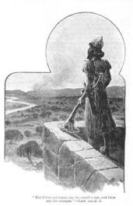
The Watchman of Israel
We need to see God
We need to stand up for God
We need to eat the scroll
We need to be God’s watchman

Slide 4
Ezekiel 4 & 5 Dramatic symbolism
Ezek 4:1-3 Ezekiel acts out the siege of Jerusalem (588-586 BC)
a. Draws the city
b. Siege works: Babylon
c. Iron pan God is against Jerusalem and will not hear their prayers
Ezekiel 8 Gross idolatry in the temple.

Slide 5
Ezekiel 9 Judgment on Judah
9:1 Executioners from North (Babylon).
But…
9:2 Put a mark on the foreheads of those who grieve and lament over the sin of Judah.
For us, the mark is the Holy Spirit Eph 1:13-14.

Slide 6
Ezekiel 9 Judgment!
Ezek 9:5 Kill without pity or compassion. Whew!
9:6 Begin at my sanctuary
9:11 God’s wrath is accomplished!

Slide 7
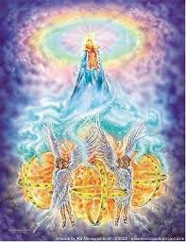
Ezekiel 10,11 Necessity of Judgment
Ezek 10:1 God on a sapphire throne with the cherubim.
Ezek 10:18 The Lord departs from the temple. Jerusalem is doomed.
Ezekiel 11:22-23 The end of the road for Jerusalem.
But… Good news in Ezekiel 43:1-5 God will return to his temple.

Slide 8
conclusion so far
If we are in a relationship with God but become unfaithful, he will come in judgment. If the Holy Spirit leaves us we are lost. “Once saved always saved is not biblical!”
But… God will always save a remnant, no matter how bad it gets.
This is a pattern throughout the Bible.

Slide 9
An Outline of the Bible
I. Genesis 1 God created the universe and the earth. It was very good.
II. Genesis 2 God created man so that we could have an intimate relationship with him.
III. Genesis 3 and 4 We messed up very badly—destroying that relationship.
IV. Genesis 5-Rev 20 God is repairing the damage done by sin.
V. Rev 21-22 God has fixed the problem and we are back in a relationship with him.

Slide 10
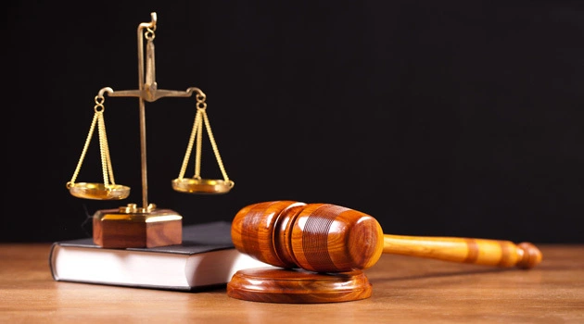
Ezekiel 18 God’s Justice
Q: Is God good? Is God a just God?
If so, what is his justice like?
Theodicy

Slide 11
Ezekiel 18 Individual Righteousness
Ezek 18:2 A proverb: Sour grapes.
The exiles: It is not our fault. Blame it on our fathers!
Ezek 18:3 God: Wrong! Everyone is accountable for their own actions.
Ezek 18:4 All souls are mine. All can be saved (Rom 8:28-30)
Ezek 18:5-18 God’s justice. (does this contradict Exodus 20:4?)

Slide 12
individual righteousness
Ezek 18:21-24 Our final state determines our eternal destiny (but be aware of Hebrews 6:4-6 and 2 Peter 2:20-22)
18:22 For the righteous: None of his offenses will be remembered. Great!
18:24 For the unrighteous: None of his good deeds will be remembered. Scary!

Slide 13
individual righteousness
18:25-29 Godly vs human justice. (Matthew 20:1-16 exp. v. 14)
18:30 The bottom line: Each will be judged by their ways.
18:32 The bottom line for God. He wants all to be saved.

Slide 14
Theodicy: Is God Good?
Is God just?
Answer: Yes!
God to you and to me:
Repent and Live!

