Slide 1
Is God Good? The Problem of Pain and Suffering (and The Problem of Evil)
John Oakes
Accra, Ghana
2/28/2023

Slide 2
The Problem of Pain and Suffering and the Problem of Evil
An apologetic/intellectual problem
A human/emotional problem

Slide 3
Pain and Suffering: An Apologetic Problem
Agnostic:
God of the Bible is completely good and loving.
God of the Bible is all-knowing and all-powerful.
Conclusion: Given all the pain and suffering in the world, the God of the Bible is not real.

Slide 4
Kinds of Suffering
Are they truly bad/evil?
Are they God’s fault?

Slide 5
Kinds of Suffering
Physical pain: acute and chronic
Disease: acute and chronic
Broken relationships
Poverty, hunger, etc.
Violence; terrorism, genocide, violent crime, etc.
Chronic fear (rape, natural disasters, abuse, etc.)
Disappointment, feelings of failure, loss of hope
Death of a loved one, mourning

Slide 6
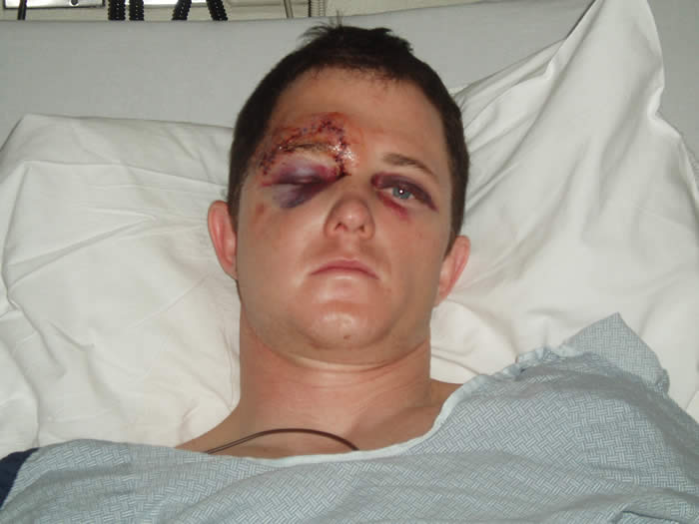

Slide 7
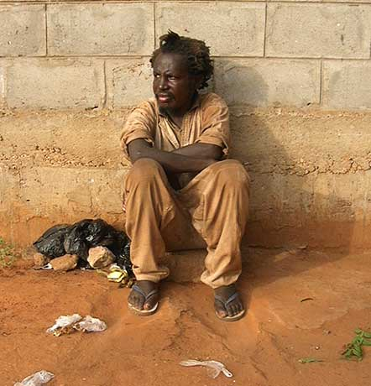

Slide 8
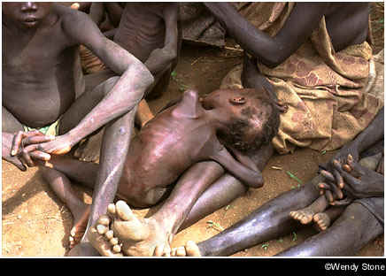

Slide 9
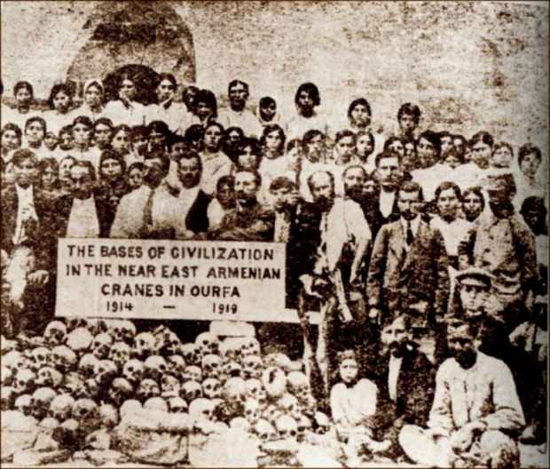

Slide 11
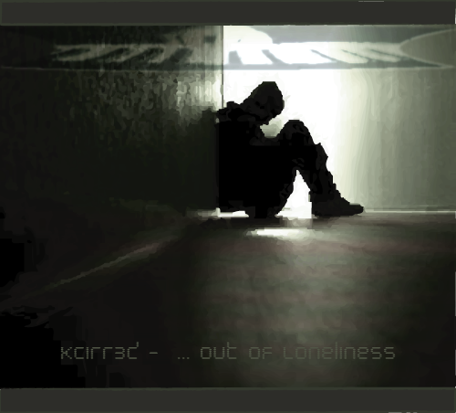

Slide 12
Bottom line, there is a lot of pain and suffering in the world.
Question: Is this because God does not care, or is this because he is not sufficiently powerful to prevent human suffering and evil in the world?
Caution: There is no simple answer.

Slide 13
Causes of Suffering
Free Will
Sin
Natural Disasters

Slide 14
Free Will: God Gives Us a Choice Why? Because he loves us. The result: We rebelled and brought evil into the world. Is this God’s fault? What is the alternative?
This is what happened in the Garden
Deuteronomy 30:15-20
Question: What is the alternative?
Question: Is this a sign that God does not love us?
God took a huge risk…

Slide 15
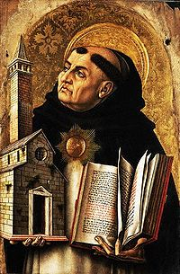
If God is sovereign and all-powerful…
Thomas Aquinas:
“God, therefore, is the first cause, who moves causes both natural and voluntary. And just as by moving natural causes He does not prevent their actions from being natural, so by moving voluntary causes He does not deprive their actions of being voluntary; but rather is He the cause of this very thing in them, for He operates in each thing according to his own nature.”

Slide 16
Augustine: Evil and Free Will
“Evil arises from the corruption of a nature which is essentially good. What is called evil is good corrupted; if it were not corrupted it would be wholly good; but even when it is corrupted, it is good in so far as it remains a natural thing, and bad only in so far as it is corrupted.”

Slide 17
Apologetics and Evil: What are the alternatives?
Dualism: Good and Evil in an unending more or less equal balance
Pantheism: The physical world is evil. Evil is being tied down to the physical—it is missing the god-likeness in you.
Naturalism: There is no evil.
Postmodernism: Evil???
Determinism/Fate God is the cause of evil.

Slide 18
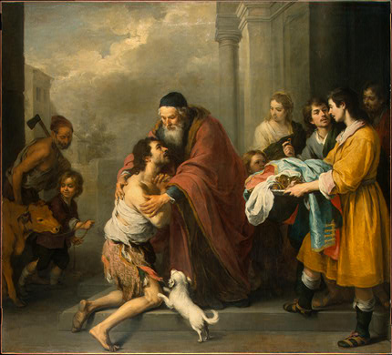
Free Will, An Illustration: The Prodigal Son

Slide 19
Christianity and the Problem of Evil
Evil is very much real. Quite indirectly, it is the product of God’s love. God loved us so much that he loved us and that he gave us a choice. We chose evil, and thus evil came into the world.
Remember your alternatives:
Predestination/Determinism God is the cause of evil.
Pantheism Deny evil exists
Physical creation is evil, but you are God
An unending battle/balance between good and evil.

Slide 20
Cause of Human Suffering and Evil: SIN
The great majority (but not all) of suffering is the result of sin
Addiction, lack of self-control
Sexual immorality, perversion and abuse
Anger, violence
Greed
Pride, arrogance, jealousy, desire for control
Selfishness

Slide 21
God’s Moral Law is Simple: Sin Produces Suffering
Exodus 20:5-6 You shall not bow down to them (the idols you have made) or worship them; for I, the Lord your God, am a jealous God, punishing the children for the sin of the fathers to the third and fourth generation of those who hate me, but showing love to thousands who love me and keep my commands.
God is love and God is just.
Bear in mind Ezekiel 18:19-20

Slide 22
Is Sin the Cause of All Suffering?
Job: Why did he suffer?
John 9
Is AIDS God’s punishment for homosexuality? No!

Slide 23
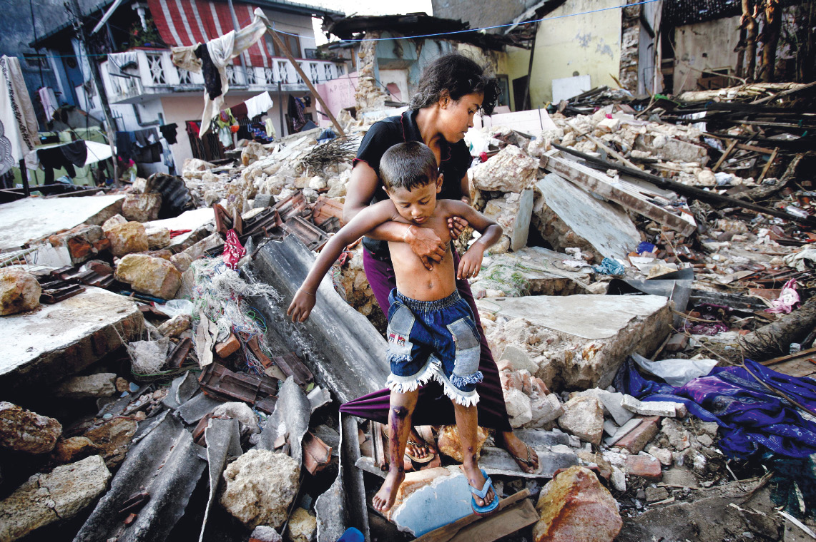
Tsunami off Sumatra in 2004: Whose sin was this a punishment for?

Slide 24
Causes of Suffering #3: Natural Causes
Plate Tectonics
Weather
Bacteria
These are all very good things.

Slide 25
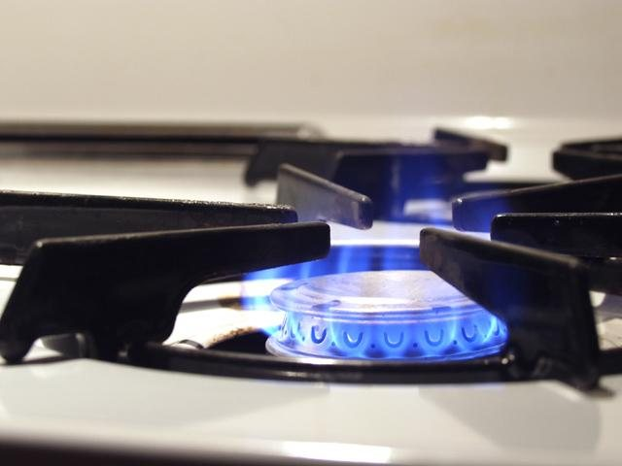
A Question: Is Pain Evil?
Touch a burner on the stove
Broken Bone
Overeating
Emotional Pain
Pain is Good. Pain is from God
But… Not all pain is explained so easily.

Slide 26
A Question: Is Death Evil?
For plants and animals, death is a positive good.
Isaiah 57:2
Philippians 1:21
For humans, death is a transition, not an end.
If the atheist is right, then maybe death is evil, but if the atheist is right, there is no evil.

Slide 27
Question: Is Suffering Evil?
Psalm 30:5 For Humans, without suffering there is no joy.
John 9:1-3 Suffering, if received correctly, glorifies God.
Romans 8:28 All kinds of suffering can be used for good (but be careful how you use this passage)
Romans 5:3, James 1:2-3 Suffering produces good character. No pain, no gain.
1 Peter 2:20-22, 2 Tim 3:12. Suffering is the natural result of doing good.
Coll 1:24-29, 1 Pet 4:12-17 Suffering is how we come to know Christ and to fill up his suffering.
Through shared suffering is how we become close to one another.

Slide 28
Suffering and Evil: The Apologetic Problem A Summary
Most suffering is the result of free will and our choice to sin. It is because God loves us, not because he does not care or is not powerful enough to stop us from suffering.
Pain is not evil, death is not evil, suffering is not evil. All of these are gifts from a loving God.

Slide 29
The Problem of Pain and Suffering Part II The Human Problem
Our response to suffering depends on our world view.
Pantheism/Hinduism Suffering is an illusion Dispassion is the answer.
Atheism. Suffering is purely random and meaningless.
Islam: Kismet (fate) Inshallah (God wills it)
Christians do a majority of the benevolent work in most countries.

Slide 30
The Christian World View
The physical world is real.
The physical world is good, not evil. (Gen 1:31)
Pain and suffering are very real, but they are not the problem: the human problem is sin and separation.
The Christian response: Compassion! Micah 6:8, James 1:27

Slide 31
The Christian Response to the Problem of Suffering: Compassion!
James 1:27 Pure religion…
John 11:35 Jesus wept. Matthew 23:37
Jeremiah 12:1
Hebrews 2:17-18, Hebrews 4:15. Jesus understands
Matthew 9:36-38 Compassion

Slide 32
Julian “the apostate.” (332-363)
“Atheism (i.e. Christian faith) has been specially advanced through the loving service rendered to strangers, and through their care for the burial of the dead. It is a scandal that there is not a single Jew who is a beggar, and that the godless Galileans care not only for their own poor but for ours as well; while those who belong to us look in vain for the help that we should render them.”

Slide 33
God Understands (and so should we)
God is ready and willing to hear our complaints.
Habakkuk 1:2-4, Jeremiah 12:1
Even Jesus cried out in his suffering. “My God, my God…
Jesus can relate fully to our suffering.
Hebrews 2:17-18, Hebrews 4:15.
This ought to affect our response to others’ suffering. 2 Cor 5:14-15
Look at Jesus’ response to suffering: John 11:35 Jesus wept. Matthew 23:37 O Jerusalem, Jerusalem… Compassion.

Slide 34
What Should We Do?
Live with integrity, like Job.
Use your suffering as an opportunity to show empathy.
Alleviate suffering, not because it is evil, but because that is how God responds to suffering
Show compassion. Matthew 9:36-38

Slide 35
Jesus the Perfect High Priest
What is a priest?
A Pontifex Literally, a bridge-builder. A mediator. An advocate. A representative. One who give access. One who can speak the language of both the worshipper and the one worshipped.
The bridge before Jesus:
The Law
The Priest and the Sacrificial System
But they did not work, and that is the point of Hebrews 7-10:18

Slide 36
Yom Kippur: The Day of Atonement
1. Wash hands and feet in the laver
2. Change into perfectly white linen clothes
3. Lay hands on a bull paid for by the High Priest and sacrifice it
4. Sprinkle the blood in the Holy Place for sin of the High Priest
5. Fill a censer with incense and fill the MHP with the smoke.
6. Select two goats, kill one, as well as a bull for the sin of the people (the other goat is the scape goat)
7. Enter the Most Holy Place, first with the blood of the goat, then the blood of the bull, to sprinkle it on the Mercy Seat.

Slide 37
Jesus the Great High Priest
Like a High priest:
Can relate to us (Heb 4:15)
Makes intercession before God for us (Heb 4:16)
Offer gifts (fragrant offerings) and sacrifices (sin, guilt offering) (Heb 5:1)
Selected by God from men (Heb 5:1,4-5)
Represents man to God (Heb 5:1)
Greater than any High Priest
Serves in the Heavenly Tabernacle, not the earthly one. (Heb 4:14)
Tempted, yet was without sin. (Heb 4:15)
Did not need to offer sacrifices for his own sin. (Heb 5:3)
A priest forever (Heb 5:6)
A priest from the order of Melchizedek (Heb 5:6)

Slide 38
A wonderful word…
metriopatheia Heb 5:2
Empathy, Sympathetic feeling,
Bear with people without becoming angry
Completely unlike the Greek concept of God
God cannot possibly feel anything or he is weak.

Slide 39
Hebrews 5:2 cont.
“He deals gently with those who are ignorant and going astray.” This is accidental sin, not willful sin.
There was no sacrifice for willful sin in the Law of Moses. Hebrews 10:26, Leviticus 4:13, Numbers 15:30-31
Willful sin is defiance, rebellion, willful (obviously)
Unwillful sin is an act of impulse or thoughtlessness or ignorance.

Slide 40
Willful Sin

Slide 41
Hebrews 5:8-9
5:8 Jesus learned obedience through suffering.
“learned” in the sense of experiencing.
5:9 once made perfect (teleio) = complete

