Slide 1
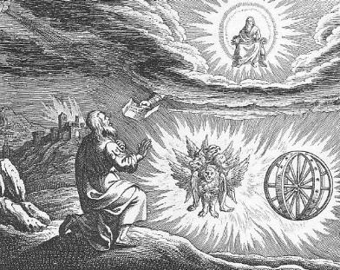
Ezekiel IV The End of the Road & God Saves a Remnant

Slide 2
Themes in Ezekiel
1. The Sovereignty/glory of God
a. Theodicy: Free will
2. The utter sinfulness of humanity/Judah
3. The inescapability of God’s justice
4. The Messiah is coming/ The restoration of God’s Remnant.

Slide 3
Last Week: Ezekiel 18 God’s Justice
The soul who sins is the one who will die.
In this life, sin leads to suffering of many, but in eternity we are judged for our own actions only.
Those who repent will be saved. Those who do not will not be saved.
God: Repent and live!

Slide 4
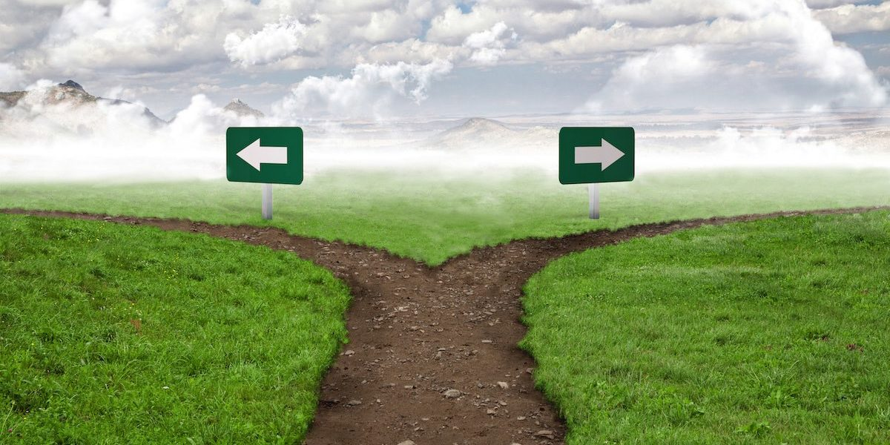
IV. The End of the road
Ezek 21:18-24 A signpost.
Ezekiel 21:27 A ruin!
Ammon
Jerusalem

Slide 5
Ezekiel 23 Oholah and oholibah
Oholah (Heb: her tent) is Samaria/Northern Kingdom
Oholibah (Heb: my tent is in her) is Jerusalem/Judah
Ezek 23:5-10 Oholah prostituted herself with Egypt and Assyria.
Q: What have you given yourself to?
Ezek 23:11-27 Oholibah was worse than her sister!
Their mistake: They were not satisfied with God. 1 Tim 6:8 Are you satisfied with what God has for you?

Slide 6
Babylonians/Chaldeans

Slide 7
Oholah and Oholibah cont.
Ezek 23:22 The take-home lesson: I will give you over to what you give yourself to.
Ezek 23:28 I will give you over to the very thing you hate. This is what sin does.
Summary: 23:49 Then you will know that I AM the Lord.

Slide 8
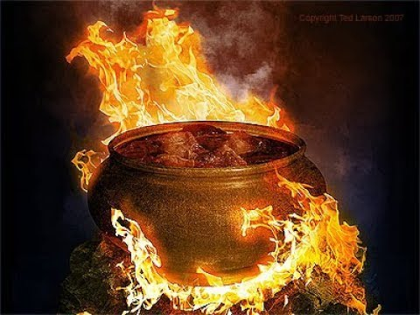
Ezekiel 24:1-14 The cauldron
Ezekiel 24:1 Jan 588 BC Mark it down. Jerusalem put under siege. Ezekiel a prophet.
Ezek 24:6 A cauldron with encrusted layers of unrepented sin.
Ezek 24:11-14 God’s wrath: it will get hot.
24:14 I will not have pity

Slide 9
Ezekiel 24:15- Ezekiel Does not Mourn
24:15-24 God to Ezekiel: Do not mourn when your wife dies. I will take away the delight of your eyes.
God does not want to judge Judah, but he will, without mercy.
24:27 Ezekiel will be silent for two years.

Slide 10
Ezekiel 33 Jerusalem has fallen
Ezekiel 33 is a transition from Ch 1-24 to Ch 34-48
God’s judgment has now been completed, so the message will turn from principally rebuke to principally encouragement. The Messiah is coming.
33:21 A messenger arrives (as prophesied in Ezek 24:26). Jerusalem has fallen!!! Ezekiel is vindicated as a prophet.
Jerusalem has fallen: Good news!!! God’s wrath has been completed.

Slide 11
V ezekiel 34-48 The Messiah is coming! God is saving a remnant
The tone shifts toward comfort, now that God’s wrath has been completed.
Deuteronomy 30:1-6
There is much double (or even triple) prophecy in this section.
1. The restoration of Judah under Zerubbabel.
2. The restoration of the Kingdom/The Church
3. The final kingdom of God—heaven.

Slide 12
Ezekiel 34 The Messiah: A better shepherd
The job of a shepherd:
Ezek 34:2 To care for the flock, not for yourself.
Ezek 34:4 To care for the weak
Ezek 34:4 To bring back the strays.
Ezek 34:4 To bring in the lost.
God’s charge: You treated my sheep harshly. The result is the sheep are scattered.
Ezek 34:7-10 I will hold you accountable.
I will remove you from leading my flock

Slide 13
I will Shepherd my flock
34:11-22 I will shepherd the flock myself.
34:13-16 Q: Is he talking about Judah restored to the Promised Land, or is he talking about the us, restored to a relationship with God?
v. 17-20 Even in the absence of good shepherds, the sheep have some responsibilities.

Slide 14
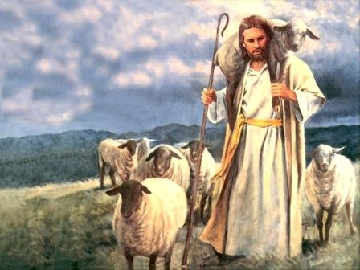
Ezek 34 The Good shepherd is coming
Ezek 34:23f God’s shepherd is coming. “My servant David.”
John 10:1-18 I am the good shepherd.
34:26 Showers of blessings
34:27 Much fruit, Security, Freedom (John 8:31f)
34:29 Spiritual food, the bread of life.

Slide 15
Our message today
Rebellion and sin will bring about God’s justice, and even faithful believers may be caught up in the consequences.
Our sin will lead us to the end of the road. God will judge. His wrath will come.
But, God’s wrath is for a moment, and his blessing is for a lifetime. God will restore and rebuild our lives as a good shepherd.

Slide 16
Ezek 36 a new covenant
Ezek 36:24f A remnant devoted to God. A New Covenant.
v. 24 all nations
v. 25 cleansed by water
v. 26 a new heart and a new spirit
v. 27 receive the Holy Spirit
v. 29-30 blessings
v. 31 repentance
No wonder Jesus challenged Nicodemus he should have known
v. 32 not because you are awesome

Slide 17
A new eden
v. 33 much fruit
v. 35 imagery from the Garden of Eden. The Kingdom of God Isaiah 65:19-25
v. 36 When people see how God has blessed us, “Then they will know that I am the Lord”

