Slide 1
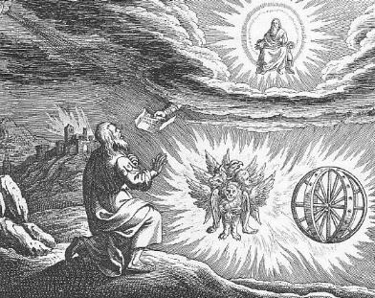
Ezekiel V God will save a remnant

Slide 2
Themes in Ezekiel
1. The Sovereignty/glory of God
2. The utter sinfulness of humanity/Judah
3. The inescapability of God’s justice
4. The Messiah is coming/ The restoration of God’s Remnant.

Slide 3
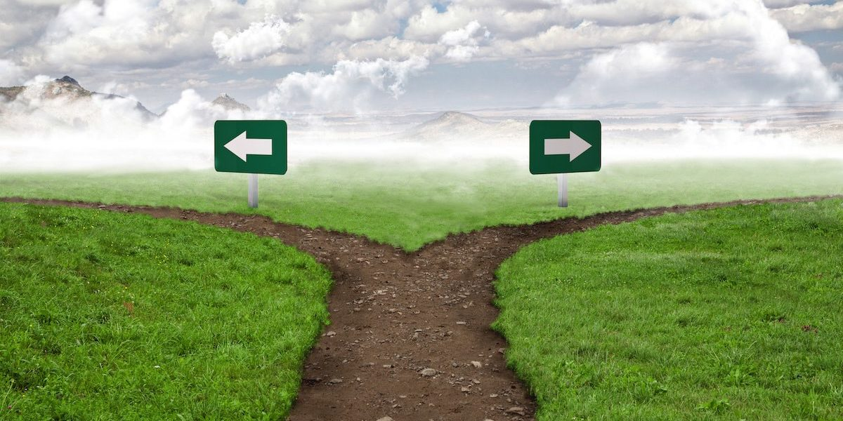
IV. The End of the road
Ezek 21:18-24 A signpost.
Ezekiel 23 Oholah and Oholibah
Ezekiel 24 The Cauldron
Ammon
Jerusalem

Slide 4
V ezekiel 34-48 The Messiah is coming! God is saving a remnant
The tone shifts toward comfort, now that God’s wrath has been completed. Deuteronomy 30:1-7
There is much double (or even triple) prophecy in this section.
1. The restoration of Judah under Zerubbabel.
2. The Church
3. The final kingdom of God—heaven.

Slide 5
Ezekiel 34 The Messiah: A better shepherd
The job of a shepherd:
Ezek 34:2 To care for the flock, not for yourself.
Ezek 34:4 To care for the weak
Ezek 34:4 To bring back the strays.
Ezek 34:4 To bring in the lost.
God’s charge: You treated my sheep harshly. The result is the sheep are scattered.
Ezek 34:7-10 I will hold you accountable.
I will remove you from leading my flock

Slide 6
I will Shepherd my flock
34:11-22 I will shepherd the flock myself.
34:13-16 Q: Is he talking about Judah restored to the Promised Land, or is he talking about the us, restored to a relationship with God?
v. 17-20 Even in the absence of good shepherds, the sheep have some responsibilities.

Slide 7
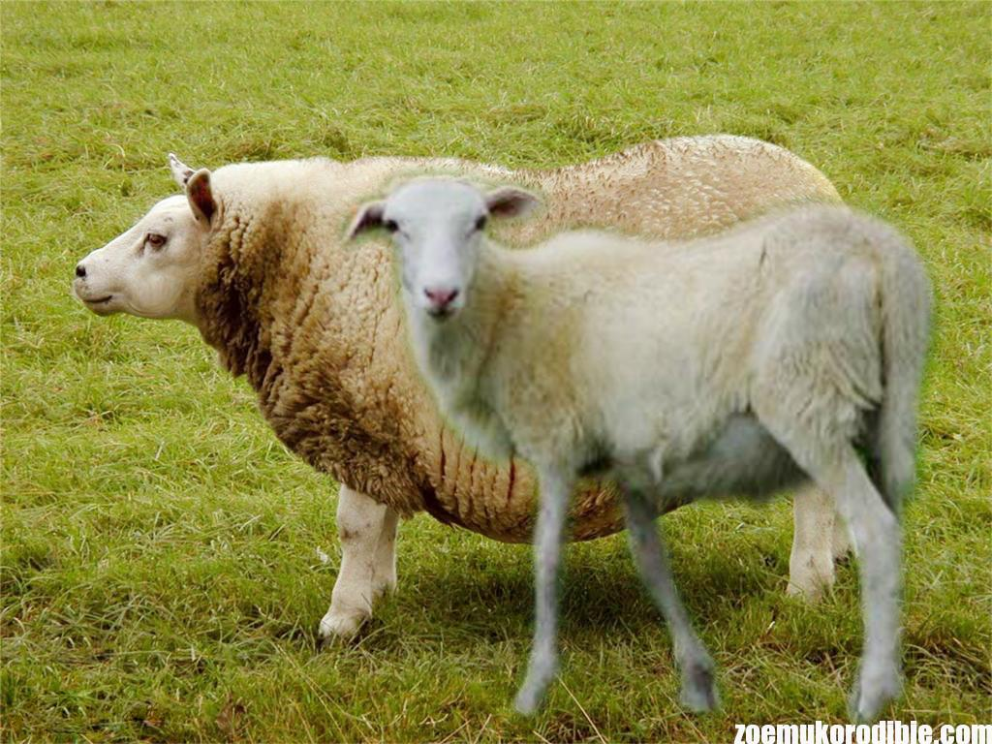
The sheep have responsibility too!
Ezekiel 34:17-21
Do not muddy the water
Are you a fat sheep?
Have you shoved with flank and shoulder?

Slide 8
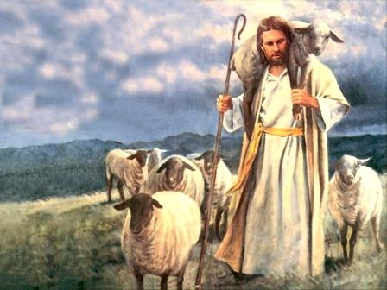
Ezek 34 The Good shepherd is coming
Ezek 34:22-31 God’s shepherd is coming. “My servant David.”
John 10:1-18 I am the good shepherd.
34:26 Showers of blessings
34:27 Much fruit, Security, Freedom (John 8:31f)
34:29 Spiritual food, the bread of life.

Slide 9
Ezek 36 a new covenant God is Saving a remnant
Ezek 36:24f A remnant devoted to God. A New Covenant.
v. 24 all nations
v. 25 cleansed by water
v. 26 a new heart and a new spirit
v. 27 receive the Holy Spirit
v. 29-30 blessings
v. 31 repentance
v. 32 not because you are so awesome

Slide 10
Ezekiel 36:33-38 A new eden
v. 33 much fruit
v. 35 imagery from the Garden of Eden. The Kingdom of God Isaiah 65:19-25
v. 36 When people see how God has blessed us, “Then they will know that I am the Lord”

Slide 11
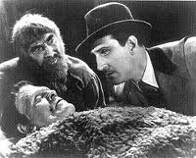
Ezekiel 37 the valley of dry bones
The promise of resurrection (on many levels and in many ways) God creates a remnant—something from nothing.
He’s Alive!

Slide 12
Ezek 37 The valley of dry bones
Ezek 37:2 The bones are “very dry” No hope!!! God specializes in this kind of situation.
37:11-14 Primary application is to Israel. God will bring them back to life in Canaan. (but it is a double prophecy)
37:24-28 God will dwell with his remnant.

Slide 13
Meshech, Tubal and Magog

Slide 14
Ezekiel 38-39 gog and magog
This is an idealized vision of enemies attacking God’s people and God defending them
Jim McGuiggan: “Gog is a grand illustration of any and all who oppose God’s people.”
v. 8 You will invade the Promised Land “gathered from many nations to the mountains of Israel”
v. 11 unwalled cities. God’s people living in security. No problem. God will destroy them without a shot.
v. 25-29.

Slide 15
Ezekiel 40-48 The Temple rebuilt the remnant Has been restored
Is it about restoration and the rebuilding of temple in 516 BC?
Is it about the church and us as God’s tabernacle?
Is it about the Kingdom of God/Heaven? Yes.
Hebrews 8:3-6 “See to it that you make everything according to the pattern shown you on the mountain.” (or in Ezekiel 40-48).
Ultimately, it is about God’s holiness—his perfection.

Slide 16
Ezekiel 40-48
Ezek 40:1 The twenty-fifth year of the exile (572 BC)
Ezek 43:1 The glory of the Lord returns to the temple (after leaving it Ezekiel 8:6). He enters through the East Gate (as he had exited it through the East Gate).
43:10 Why all the details? “that they may be ashamed of their sins.”

Slide 17
We are the zadokites!
44:15f Only the Zadokites (also 43:19) can minister in the temple.
v. 16 We are the Zadokites (1 Pet 2:9)
v. 23 We are to teach difference between the holy and common.
v. 28 I am to be their only inheritance. They will have no possessions in the land.

Slide 18
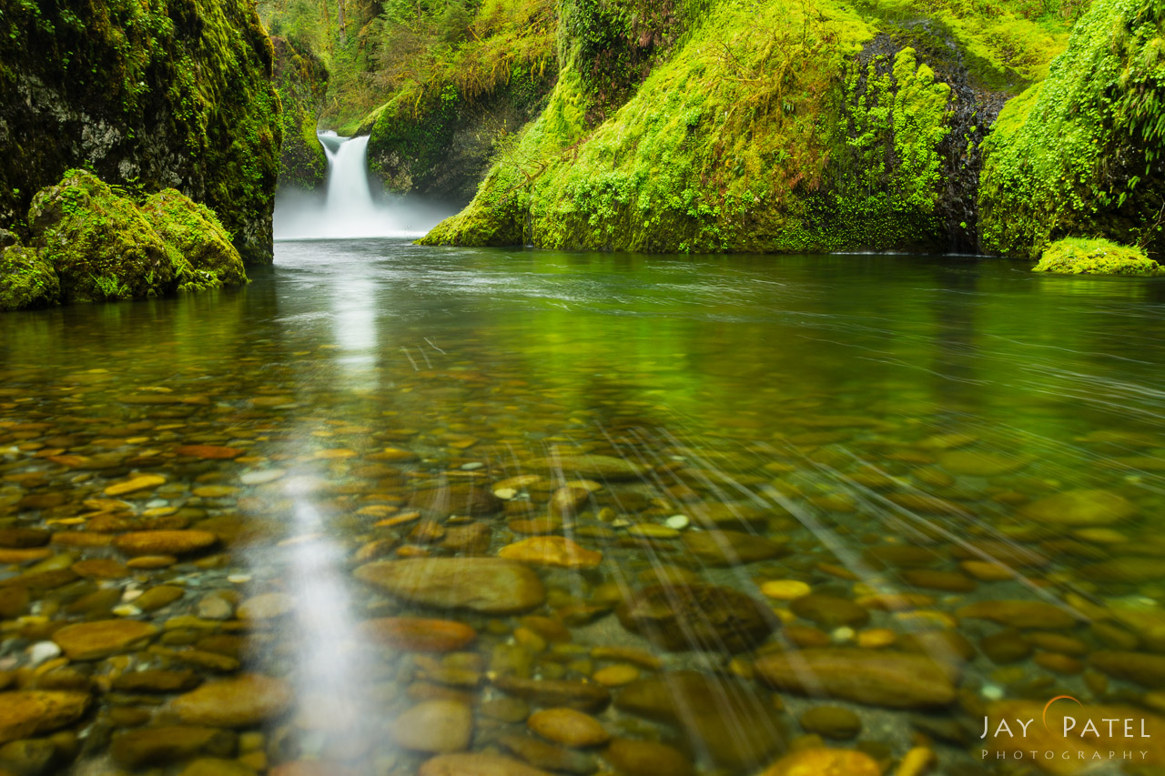
Back in the garden
Ezekiel 47 The river from the temple. (Revelation 22:1-5, Zech 14:8-9) Imagery from the Garden of Eden.
It comes from the temple—from God.
It cleanses (Zech 13:1)
It is living water (Zech 14:8, John 7:37-39)

Slide 19
Summary of Ezek 40-48 (and perhaps of the entire book of ezekiel)
Ezekiel 48:35 And the name of the city from that time on will be:
THE LORD IS THERE
We are back in the Garden if Eden—in the fully realized Kingdom of God, where God intended us to be all along.

