Slide 1
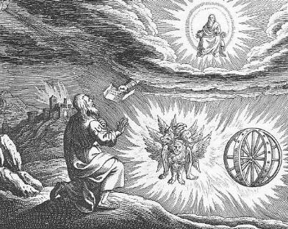
Ezekiel VI The Valley of Dry Bones

Slide 2
Themes in Ezekiel
1. The Sovereignty/glory of God
2. The utter sinfulness of humanity/Judah
3. The inescapability of God’s justice
4. The Messiah is coming/ The restoration of God’s Remnant.

Slide 3
V ezekiel 34-48 The Messiah is coming! God is saving a remnant
The tone shifts toward comfort, now that God’s wrath has been completed. Deuteronomy 30:1-7
There is much double (or even triple) prophecy in this section.
1. The restoration of Judah under Zerubbabel.
2. The Church
3. The final kingdom of God—heaven.

Slide 4
Ezekiel 34 The Messiah: A better shepherd
The job of a shepherd:
Ezek 34:2 To care for the flock, not for yourself.
Ezek 34:4 To care for the weak
Ezek 34:4 To bring back the strays.
Ezek 34:4 To bring in the lost.
34:11-22 I will shepherd the flock myself.

Slide 5
Ezek 36 a new covenant God is Saving a remnant
Ezek 36:24f A remnant devoted to God.
v. 25 cleansed by water
v. 26 a new heart and a new spirit
v. 27 receive the Holy Spirit
Ezek 36
A New
Eden

Slide 6
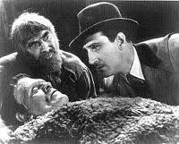
Ezekiel 37 the valley of dry bones
The promise of resurrection (on many levels and in many ways)
He’s Alive!

Slide 7
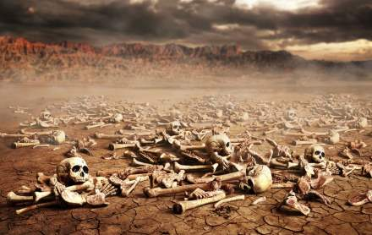
Ezek 37 The valley of dry bones
Ezek 37:2 The bones are “very dry” No hope!!! God specializes in this kind of situation.
Ezek 37:3 Son of man, can these bones live?
Q: Can your neighbor live? Can your marriage live? Can you spiritual life be revived? Can you overcome an addiction?

Slide 8
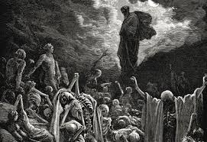
I. Hear the word of the lord
The solution:
I. 37:4 “Dry bones, hear the word of the Lord.” Sometimes we need to preach to dry bones!
37:5-8 A bizarre vision!

Slide 9
II. Breath: The Holy Spirit
II. We need to receive the Holy Spirit.
Ezekiel 37:9-10
Zech 4:6 Rom 8:9-11
37:11-14 God interprets the vision. Resurrection!!!!
Primary application: Israel. God will bring them back to Canaan.
Secondary application: the Church.
Tertiary application: Heaven.

Slide 10
Ezekiel 37:22-28 The Messiah!
One nation v. 22
One king v. 22
I will save them v. 23
I will cleanse them v. 23
My servant David will be king over them v. 24
A new covenant. v. 26
I will dwell (tabernacle) with them v. 26-27 John 1:14
This is about the Church but it is also about heaven—the Kingdom

Slide 11
The Valley of dry bones
God can work in “hopeless” situations.
We need to “hear the words of the Lord.”
We need the breath—the Holy Spirit.
The Messiah is coming, bringing salvation

