Slide 1
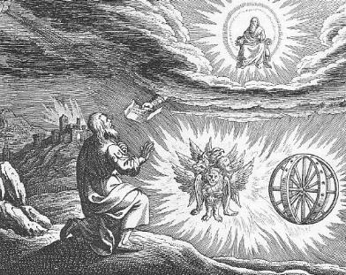
Ezekiel VII Gog and Magog

Slide 2
Themes in Ezekiel
1. The Sovereignty/glory of God
2. The utter sinfulness of humanity/Judah
3. The inescapability of God’s justice
4. The Messiah is coming/ The restoration of God’s Remnant.

Slide 3
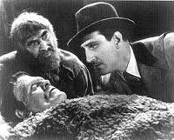
Ezekiel 37 the valley of dry bones
The promise of resurrection (on many levels and in many ways) God creates a remnant—something from nothing.
He’s Alive!

Slide 4
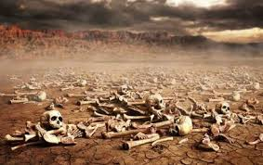
Ezek 37 The valley of dry bones
Ezek 37:2 The bones are “very dry” No hope!!! God specializes in this kind of situation.
37:11-14 Primary application is to Israel. God will bring them back to life in Canaan. (but it is a double prophecy)

Slide 5
Ezekiel 38:1-6 gog and magog
This is an idealized vision of enemies attacking God’s people and God defending them
Jim McGuiggan: “Gog is a grand illustration of any and all who oppose God’s people.”
Gog, Magog, Meshech, Tubal, Cush, Persia Put
God’s people are surrounded!
Q:Have you ever felt surrounded and outnumbered by Satan?

Slide 6
Meshech, Tubal and Magog

Slide 7
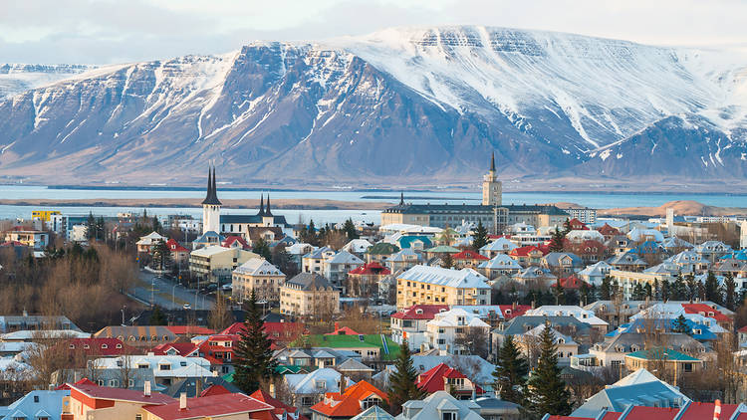
Ezekiel 38 & 39
v. 8 You will invade the Promised Land “gathered from many nations to the mountains of Israel”
v. 11 unwalled cities. God’s people living in security. No problem. God will destroy them without a shot.

Slide 8
Ezekiel 39 God will defeat our enemies
Ezekiel 39:1-10 God will defeat our enemies.
Romans 8:31 If God is with us, who can be against us?
2 Cor 10:3-5 We have powerful weapons.
Hebrews 13:5-6 What can man do to me?
Eph 6:10-20 Full armor. Mighty power.

Slide 9
Ezekiel 39:25-29 If God is for us….
v. 26 We can forget our shame and our unfaithfulness.
v. 27 God will prove himself holy through us.
v. 28 Sure, I sent them into exile, but I will restore them to their proper place with me.
v. 29 I will pour out my Holy Spirit on them.
Q: What will God do for you?

Slide 10
Ezekiel 40-48 The Temple rebuilt the remnant Has been restored
Is it about restoration and the rebuilding of temple in 516 BC?
Is it about the church and us as God’s tabernacle?
Is it about the Kingdom of God/Heaven? Yes.
Hebrews 8:3-6 “See to it that you make everything according to the pattern shown you on the mountain.” (or in Ezekiel 40-48).
Ultimately, it is about God’s holiness—his perfection.

Slide 11
Ezekiel 43 God returns to the Temple
Ezek 40:1 The twenty-fifth year of the exile (572 BC)
Ezek 43:1-7 The glory of the Lord returns to the temple (after leaving it Ezekiel 8:6). He enters through the East Gate (as he had exited it through the East Gate).
43:10 Why all the details? “that they may be ashamed of their sins.”
We do not need to feel ashamed, but we should remember the shame.

Slide 12
We are the zadokites!
44:15f Only the Zadokites (also 43:19) can minister in the temple.
v. 16 We are the Zadokites (1 Pet 2:9)
v. 23 We are to teach difference between the holy and common.
v. 28 I am to be their only inheritance. They will have no possessions in the land.

Slide 13
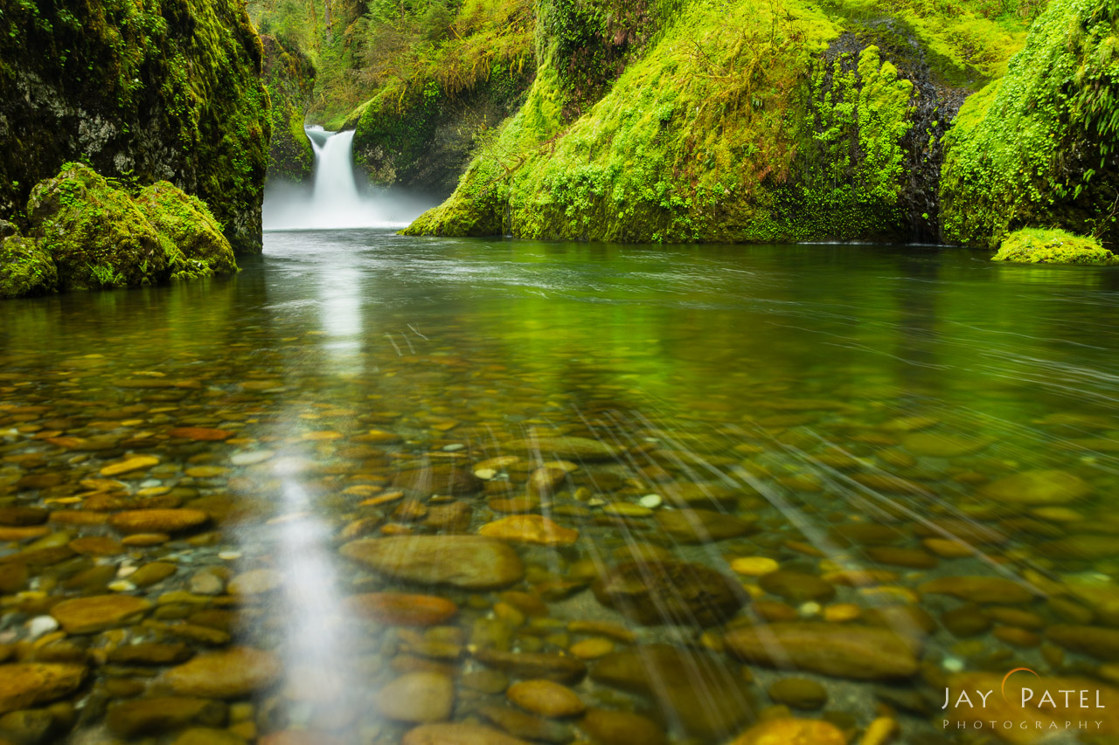
Back in the garden
Ezekiel 47 The river from the temple. (Revelation 22:1-5, Zech 14:8-9) Imagery from the Garden of Eden.
It comes from the temple—from God.
It cleanses (Zech 13:1)
It is living water (Zech 14:8, John 7:37-39)

Slide 14
Summary of Ezek 40-48 (and perhaps of the entire book of ezekiel)
Ezekiel 48:35 And the name of the city from that time on will be:
THE LORD IS THERE
We are back in the Garden if Eden—in the fully realized Kingdom of God, where God intended us to be all along.

Slide 15
God will restore his people
God will protect his people without firing a shot.
God will restore those who have left him
Streams of living water will come from us

