Slide 1
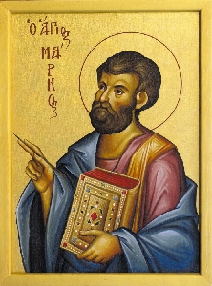
The Gospel of Mark Part II
Merced
Spring, 2023

Slide 2
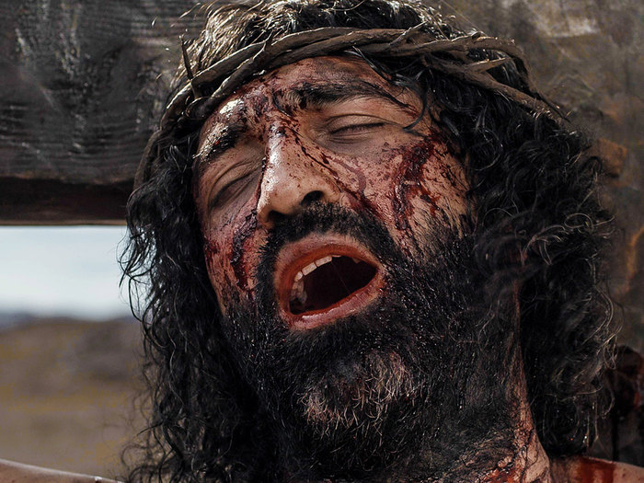
Theme of Mark
Jesus: Messiah and Son of God: suffering servant and savior of mankind.

Slide 3
Theme Passage of Mark
Mark 10:45 For even the Son of Man did not come to be served, but to serve, and to give his life as a ransom for many.
Q: Did Jesus’ life agree with this mission statement?

Slide 4
Mark 1:14-3:12 The Kingdom of God
Mark 1:14-20 The call of discipleship
The time has come
Drop your nets
Follow immediately
Start fishing for people.

Slide 5
Mark 1:14-20 Jesus’ Mission: Our Mission The Time Has Come
Fishing for People

Slide 6
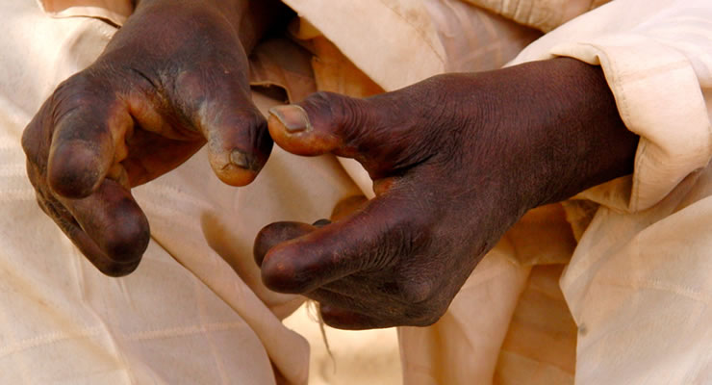
Mark 1:21-45 Jesus has great authority
Mark 1:40-45 Jesus and the unclean.
Many are amazed at Jesus

Slide 7
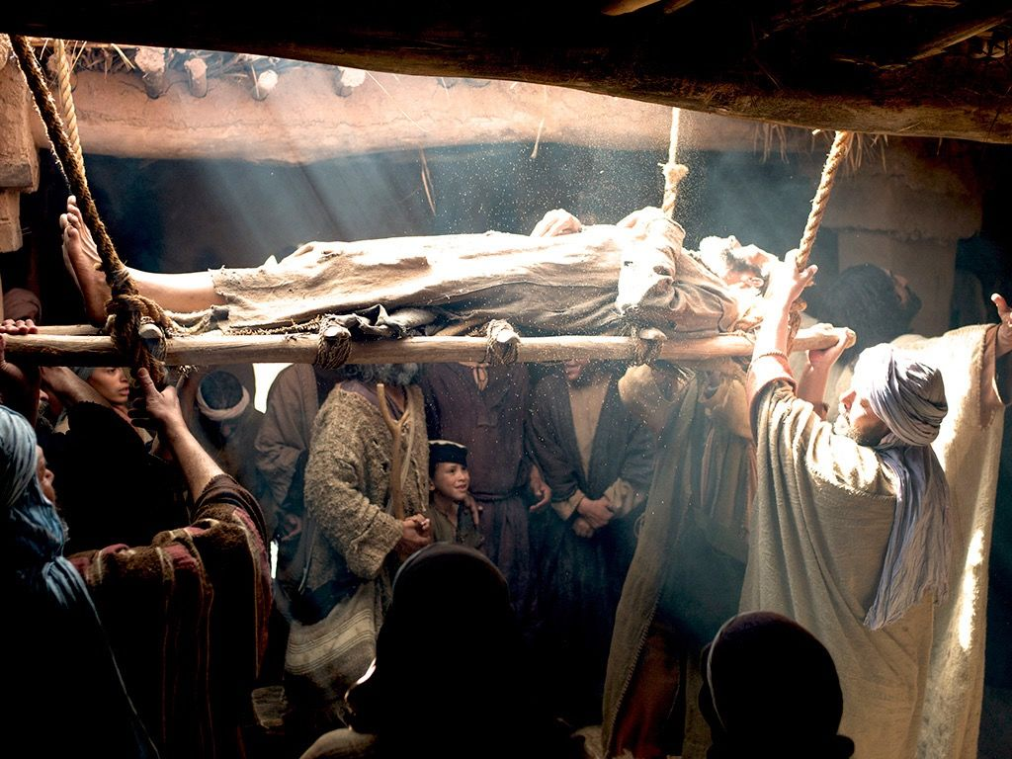
Mark 2:1-12 Authority to forgive sins
Mark 2:1-12 Authority to forgive sins
Q: Which is harder, to heal a paralytic or to forgive sins?

Slide 8
Mark 2:13-28 Jesus Has Religious Authority
Mark 2:13-17 It doesn’t matter who you are, but whether you will answer the call.
Are you a sinner? God wants you on his team and he wants to be your doctor.

Slide 9
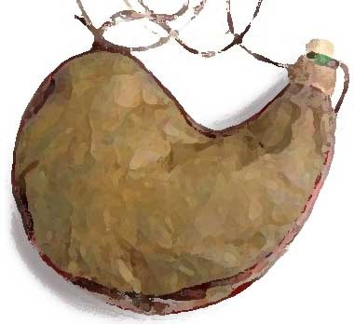
Mark 2:13-28 Jesus Is Making Everything New
Mark 2:18-22 New wineskins.
God is not improving the old. He is replacing the old with the new.

Slide 10
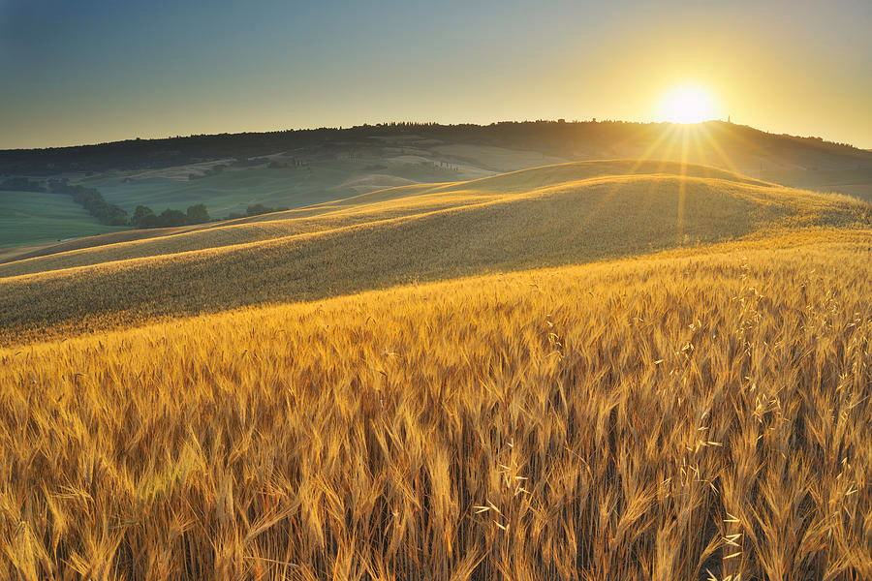
Mark 2:13-28 Jesus Is Making Everything New
Mark 2:23-28 Authority even over the Sabbath/Law!!!!

Slide 11
Jesus
Astounding
Authoritative
Power over both the spiritual and the physical world
Yet, a man of great compassion
He is making everything new. Are you ready to get on the Jesus train?

Slide 12
Who Is My Family?
Mark 3:20-21, 31-34
The world (and even his family) thinks that Jesus is crazy.
Q: Who is my family?

Slide 13
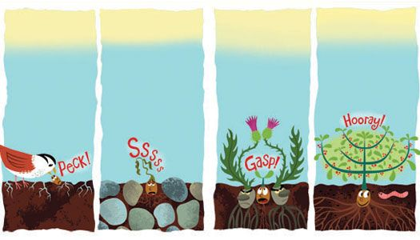
Mark 4:1-20 Parable of the Soils
The seed: The Word of God
The soil: Your heart!

Slide 14
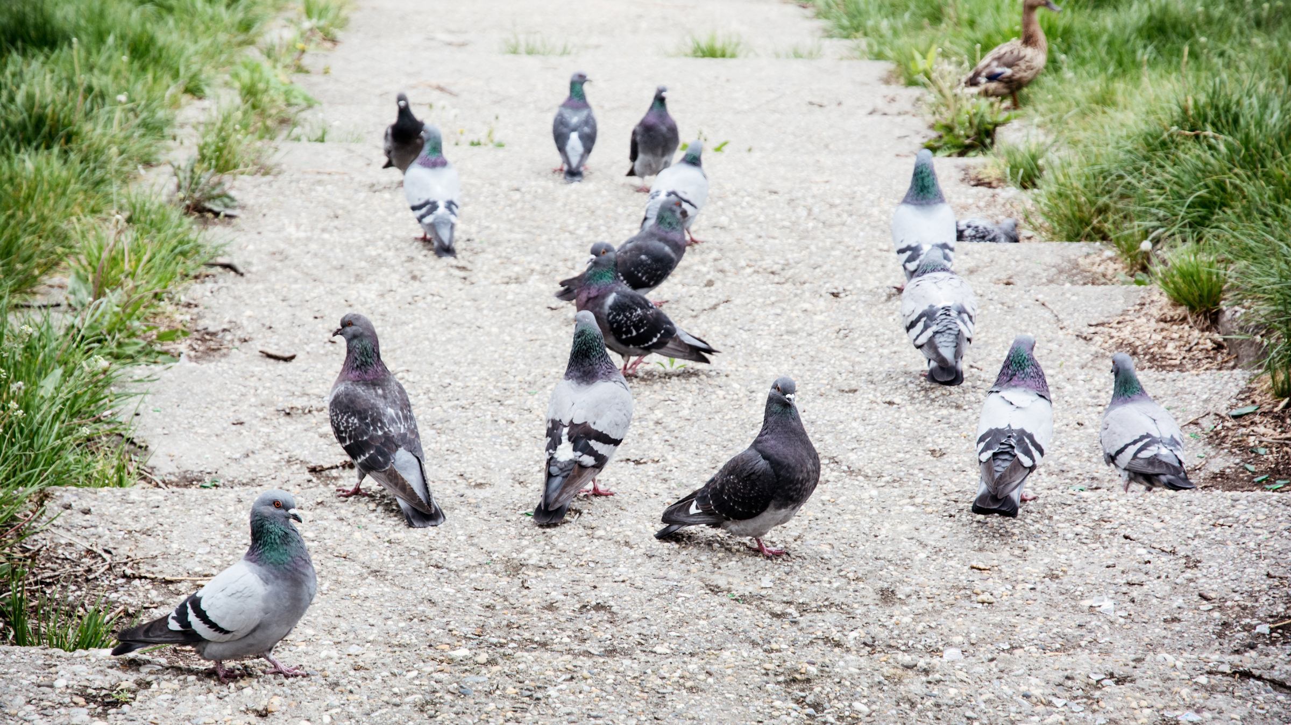
The Hard Path
Q: Has your heart been hardened?

Slide 15
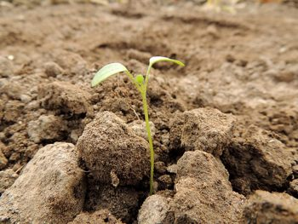
The Shallow/Rocky Soil
Q: Does your soil/motivation run deep?

Slide 16
Thorny Soil
What weeds do you need to pull out?

Slide 17
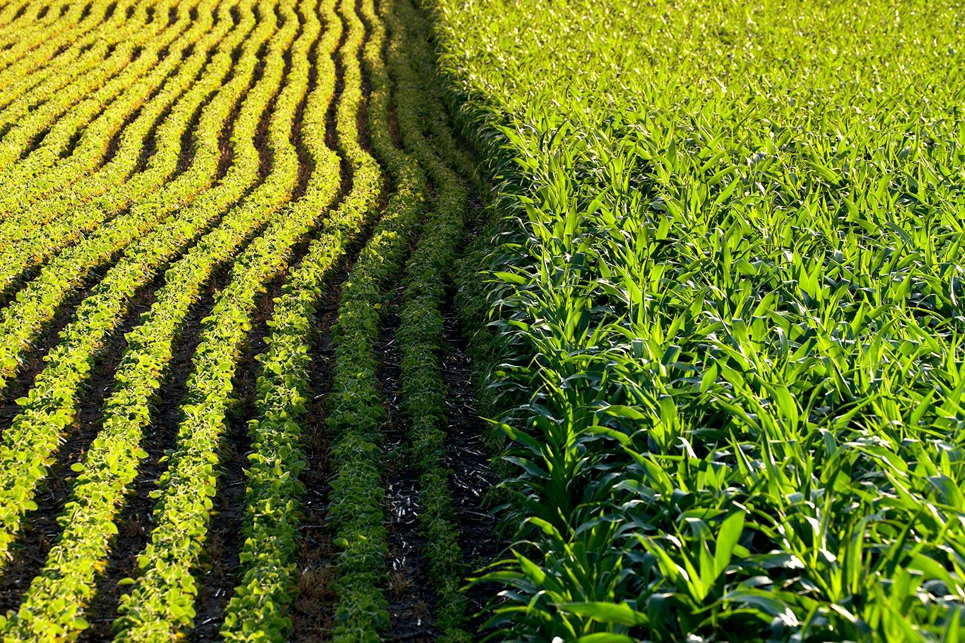
Good Soil
Soft heart
Deep roots
Well-weeded

Slide 18
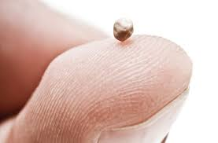
Mark 4:30-34 Parable of the Mustard Seed

Slide 19
Mark II Kingdom Parables
Are you willing to tough the “unclean?”
Are you willing to shake things up?
Do you have an undivided heart with deep roots?
Then get ready to see the seed grow!

