Slide 1
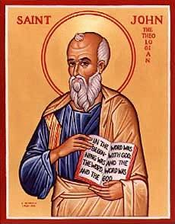
The Gospel of John
John Oakes
San Diego
April, 2016

Slide 3
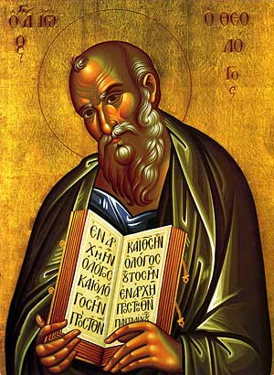
Theme and Purpose
Theme: Jesus is the Son of God who reveals the Father, providing eternal life to all who believe.
Purpose: But these are written that you may believe that Jesus is the Messiah, the Son of God and that by believing you may have life in his name.

Slide 4
Gospel of John 80s -90s AD
Key Verses:
John 1:14
John 3:16

Slide 5
Uniqueness of John

Slide 6
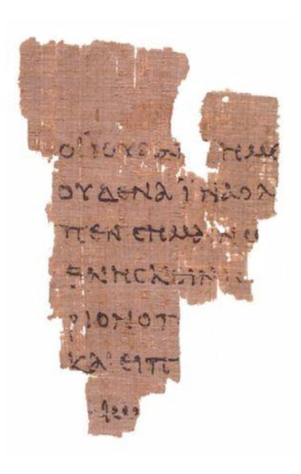
Uniqueness
In the Synoptics but not in John
Birth
Baptism
Temptation
Transfiguration
Agony in the Garden
Lord’s Supper
Parables
Exorcisms
Emphasis on the Kingdom of God
Secrecy theme

Slide 7
J0hn the solo Gospel
Things unique to John
Dialogues (5:19-21, 6:25-29, 7:14-44, 8:12-59, 10:22-42, etc.)
Personal Conversations (3:1-21, 4:1-38)
Private Teaching with the Disciples (14:1-16:37)
Raising Lazarus a key transition point.
Emphasis on the Holy Spirit (Ch 14, 16)
Jews in Negative Light (9:18; 10:31; 18:12, 36–38, 19:12)
Chronology based on festivals and 3-year ministry
Much more time in Judea and Jerusalem

Slide 8
Characteristics of John
80% of material unique to John
Simple vocabulary but deep theology
Symbols and metaphors (light, life, bread, gate, door, shepherd, etc.)
More philosophical
Emphasis on who Jesus is
Miracles as signs
Use of irony (John 1:46, 3:14, 4:12, 11:50, 19:19)
Dualistic Themes (light vs dark, belief, unbelief, etc.)
Special words: logos beloved disciple only begotten
Believe 98 times live 35 times

Slide 9
Seven I Am Statements
I AM the bread of life 6:35
I AM the light of the world 8:12,9:5
I AM the door (and the gate) 10:7
I AM the good shepherd 10:1,14
I AM the resurrection and the life 11:25
I AM the Way the Truth and the Life 14:6
I AM the true vine 15:1
All are metaphors

Slide 10
Outline of John
I. Prologue 1:1-1:18
II. Book of Signs 1:19-12:50
III. Book of Glory Passion Story 13:1-20:31
IV. Epilogue 21:1-21:25
Theme: The Son of who reveals God’s glory.
Theme verses 1:14, 1:18, 3:16

Slide 11
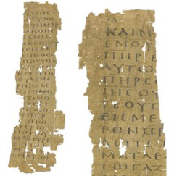
Genesis 1
ἐν ἀρχῇ
In the Beginning
Saturday, October 13, 12

Slide 12
John 1:1
ἐν ἀρχῇ
In the Beginning
Saturday, October 13, 12

Slide 13
Prologue John 1:1-18
John 1:1 In the beginning was the Word. The Word was with God and the Word was God.
En archon In the Beginning (Genesis 1:1)
The Word logos
word, underlying principle, omnipresent wisdom, reason
The Word: Psalm 33:6 Isaiah 55:11

Slide 14
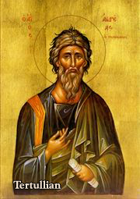
John 1:1 The “Trinity”
The Word was with God and the Word was God.
Yesterday I was with Vince. I am Vince.
Deuteronomy 6:4 Hear, O Israel the Lord is one God.
The “Trinity” is about relationship. God is essentially relational.
A God who would be known.
Tertullian AD 160-220

Slide 15
John 1:2-5 Important Metaphors
Creator Through Him all things were made. Without him nothing was made that has been made.
Life In Him was life
Light The light shines in the darkness and the darkness has not overcome/understood it.

Slide 16
John 1:9-13
To all who did receive him… he gave the right to become children of God.
…born of God.

Slide 17
John 1:14 A Key Verse!
The Word became flesh and made his dwelling among us. We have seen his glory, the glory of the one and only Son, who came from the Father, full of grace and truth.
The Word became flesh. Logos became sarx
He made his dwelling (tabernacled) among us.
We beheld his glory (doxa).
Full of grace and truth.

Slide 18
Grace and Truth!
John 1:17 The Law was given through Moses, grace and truth came through Jesus Christ.
The Law vs Grace and Truth
Which is more important to you?
Grace or Truth?

Slide 19
John 1:16 Grace upon Grace
grace grace grace grace grace grace grace grace grace grace grace grace grace grace grace grace grace grace
Piles of grace

Slide 20
John 1:18
No one has ever seen God, but the one and only Son, who is himself God, the one who is at the Father’s side, has made him known.
The only begotten Son monogeneis The only one like that. The unique Son.
Jesus has made God known.
What would Jesus do?

Slide 21
Let’s Meet Jesus
Behold the glory of God.
Behold the unique One.
Behold God the Son who tabernacled with us
Full of grace and truth!

Slide 22
Book of Signs 1:19-12:50
[knew thoughs of Nathanael 1:43-50]
water to wine 2:1-11
healing of official’s son 4:43-54
healing at pool of Bethesda 5:1-5
feeding of 5000 6:1-14
walking on water 6:16-21
man born blind 9:1-12
resurrection of Lazarus 11:1-44
[miraculous catch of fish John 21:1-13]
Seven Signs

Slide 23
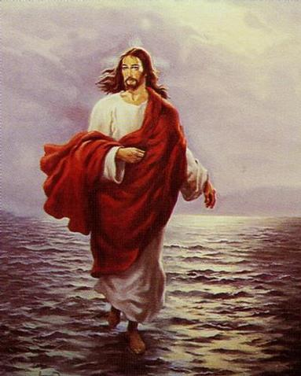
Purpose of the Signs of Jesus
Cause people to have faith in God
Cause people to give glory to God

Slide 24
Signs in John: A Pattern
Miracle/Sign
Response or challenge of people
Follow-up teaching
Response (some have faith and some reject Jesus)

Slide 25
John 1:35-51 Jesus meets Nathanael
Jesus: What do you want?
Come, and you will see
What about the contradictions in the Bible? What about all the hypocrites? What about all the killing in the Bible? I am really busy. I’m Catholic. I don’t believe in God.
Come, and you will see!!!

Slide 26
Who Is Jesus?
John 1:41 the Messiah
John 1:49 Rabbi
Son of God
King of Israel!

Slide 27
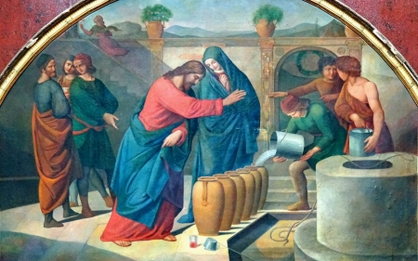
John 2:1-12 Jesus at Cana The First of Seven Signs

Slide 28
On The Third Day A Wedding Took Place

Slide 29
Why Did Jesus Go To a Wedding?
Because he was invited.
Because it would be fun.
But…
My time has not yet come

Slide 30
Why Did Jesus Do the Miracle?
Because his mom asked him to.
Because of the symbolic meaning.
We are invited to a marriage feast. (Isaiah 25:4-6, Revelation 19:6-9)
Empty vessels (Judaism) turned into full containers of wine (Jesus’ blood)

Slide 31
John 2:11
What Jesus did here in Cana of Galilee was the first of the signs through which he revealed his glory and his disciples believed in him.
In John, Jesus’ miracles:
Reveal his glory and
Cause us to believe in Him

Slide 32
III. Jesus Clears the Temple Another “sign”
Jesus clears the temple John 2:12-17
“The Jews” demand a sign to prove his authority to act this way.
John 2:18-19
Note: The Jews assumed that authority as an inspired teacher must be supported by “signs.”
Jesus: No sign will be given you if you demand one.

Slide 33
Jesus Clears the Temple
John 2:18-19. What is the sign of Jesus?—the sign proving my right to be greater than the temple? I will be raised from the dead on the third day.

Slide 34
IV. The Miracles Jesus Did Not Do
A. Jesus did not work miracles as a response to a challenge or to defend his claims about himself. John 2:18-22.
B. He did not do miracles to convince the hard-hearted or to force people’s mind. Matthew 13:55-58
John 13:27 Satan did not hesitate in this area at all. (notice v. 28 Jesus did not resist this)
Implication?

Slide 35
The Miracles Jesus Did Not Do
C. Jesus did not work miracles to take care of his own physical needs John 4:6 tired. John 19:28 Jesus thirsty. Mark 11:12, Luke 4:3-4 hungry
Implications?
D. Jesus did not use his power to judge or destroy his enemies. Luke 9:52-56. Jn 12:47
Implications?

Slide 36
The Miracles Jesus Did Not Do
E. (and this one contains them all) He did not use his power to end the crucifixion.
Mark 15:29-30.
Matthew 26:52-53. Jesus: I could call on my Father and he would put at my disposal more than twelve legions of angels.
Implications?

Slide 37
John 3 & 4 Interviews Nicodemus and Samaritan Woman
Jesus gives an enigmatic metaphor which provokes thought
Confusion
Jesus explains the metaphor
Jesus identifies himself

Slide 38
John 3 Nicodemus John 4 Samaritan Woman
John 3 The insider believes
John 4 The outsider believes
Romans 1:16 First for the Jews, then for the Gentiles
John 3:3 Nicodemus is spiritually blind
3:14 The solution to spiritual blindness: Look to Jesus on the cross

Slide 39
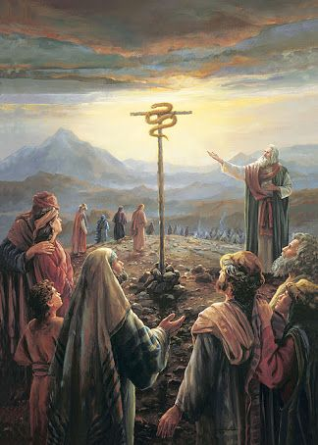
John 3:14
Numbers 21:7-9
Just as Moses lifted up the snake in the wilderness, so the Son of Man must be lifted up.

Slide 40
Jesus Must Be Lifted Up
a. The snake in the desert by Moses.
b. Jesus on the cross.
c. Jesus lifted from the grave.
d. Jesus lifted up (ascended) to heaven.
e. We lift Jesus up as we share our faith in him.
f. So we, too will be lifted up to heaven, as Jesus was lifted up.

Slide 41
John 3:16-21 Stark Contrasts!
v. 16 perish vs have eternal life
v. 18 condemned already vs not condemned
v. 19 darkness vs light
Where is the grey area?

Slide 42
Come Into the Light!
Are there any deeds that you have been keeping in the darkness?
Bring it out into the light!!! Today!!!

Slide 43
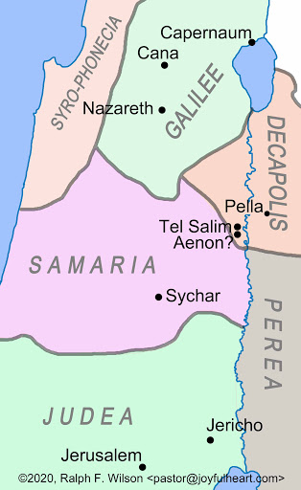
John 4 Jesus and the Samaritan Woman
John 4:1-9
Jesus ministers in Samaria

Slide 44
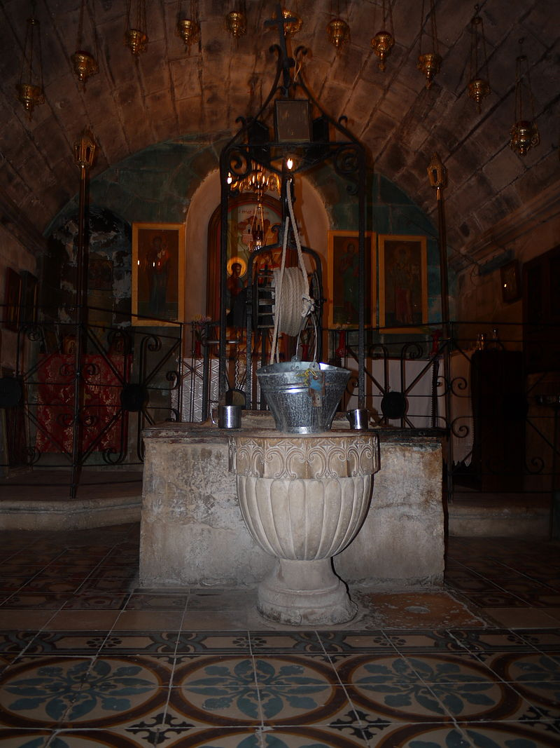
Jacob’s Well
Jesus and Outsiders
A Samaritan
A woman
A “sinful” unmaried Samaritan woman.
Jesus: Will you give me a drink?

Slide 45
John 3 & 4 Interviews Nicodemus and Samaritan Woman
Jesus gives an enigmatic metaphor which provokes thought Jn 4:10
Confusion Jn 4:11-12
Jesus explains the metaphor Jn 4:13
Jesus identifies himself 4:26 I who speak to you am he.

Slide 46
John 4:10-26
v. 10 living water
v. 14 Whoever drinks the water I give them will never thirst. Indeed, the water I give them will become in them a spring of water welling up to eternal life.
Jesus is talking about the Holy Spirit. John 7:37-39.

Slide 47
John 4:39-42
Now, many Samaritans believe.
Faith progresses
1. Thirsty man
2. Jewish man
3. A Rabbi
4. A prophet.
5. Messiah
6. Savior of the world All true!

Slide 48
IV. Sign #2 The Official’s Son
Jesus heals official’s Son 4:43-54 (parallels Matt 8:5-13, Luke 7:1-10)
Healing for Gentiles too.
Healing from a distance.
Result: faith 4:53 Your son will live “he and all his household believed.”
Gentile man believes without seeing. (unlike Thomas, but like us John 20:29)

Slide 49
Theme: Jesus Replacing/Greater than the Jewish Festivals
1. Jesus greater than the Sabbath Jn 5:1-18
2. Jesus greater than Passover Jn 6:1-70
3. Jesus greater than Booths/Tabernacles Jn 7:1-9:41
4. Jesus greater than Festival of Lights (Chanukkah)
Jn 10

Slide 50
John 5 Healing at Bethsaida
Jn 5:1 An unidentified festival (because this is about the Sabbath)
Do you want to get well?
Jesus is Lord of the Sabbath

Slide 51
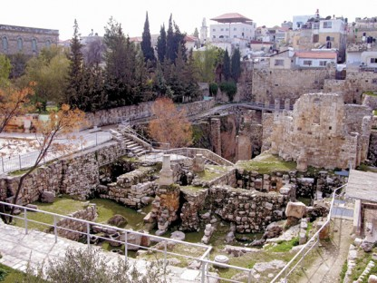
V. Sign #3 Healing at Bethesda
John 5:1-9 Jesus: “Get up your mat and walk”
“My father is always at work to this very day and I, too, am working” (v17)
Jesus is Lord of/greater
than the Sabbath
5:18 Result: The Jews
tried even harder to kill
him. Why? He claims
to be equal to God.

Slide 52
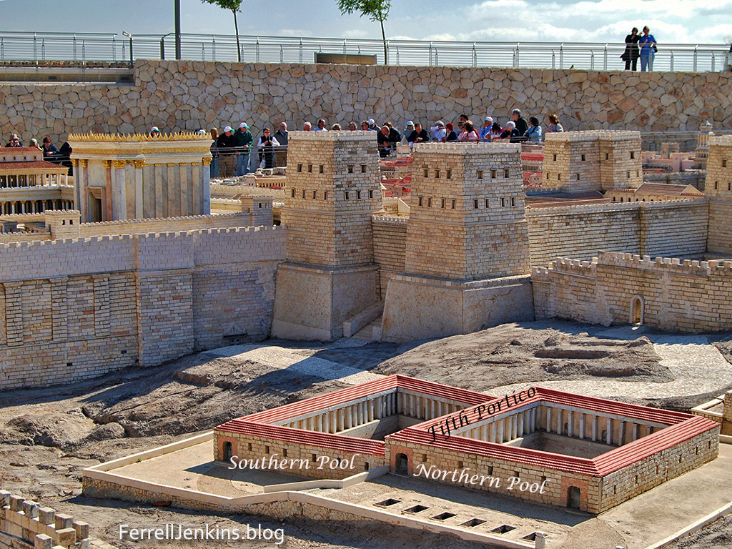
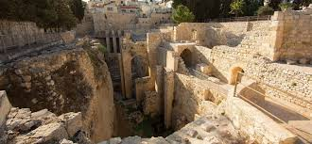
The Pool of
Bethsaida

Slide 53
Testimonies of Jesus John 5:31-40
Jesus: There are three things which testify about me:
a. John the Baptist 5:31-33
b. The miracles 5:36
c. Prophecy/Scripture 5:37-40
John 5:45-47 I am Greater than Moses.

Slide 54
John 5:6 Do You Want to Get Well?
What if Jesus healed you?
What would you have to change?

Slide 55
John 5:7-15 Jesus 3rd Sign
John 5:8 Jesus: “Get up your mat and walk”
To be healed:
Trust Jesus
Take action
The cure was
Sudden and complete
Stop sinning!

Slide 56
John 5:16-30 Jesus the Lord of the Sabbath
v. 17 My Father is always at work.
v. 18 They tried all the more to kill Jesus.
Why? Because he claims to have authority over the Sabbath.
Sabbath for man Mark 2:27
Jesus Lord of the Sabbath Matthew 12:1-8, Luke 6:1-5

Slide 57
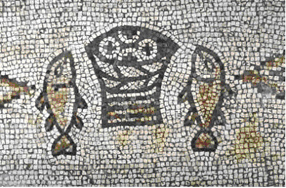
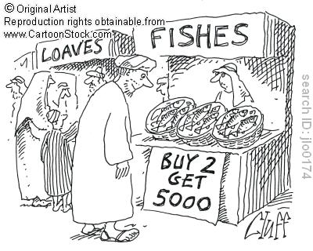
VI. Sign #4 Feeding the 5000
Theme: Jesus will replace Moses and will replace the Passover.
Type: Marriage feast with God
Jesus gives bread (like the manna)
People’s response: 6:14 “Surely this is the prophet” (Deuteronomy 18:17-19)

Slide 58
VII. Sign #5 Walking on Water
Jn 6:16-24 (Matt14:22-33, Mark 6:47-51)
John’s emphasis: A parallel to Moses parting the water. An Exodus/Passover scene.
“It is I” (I AM that I AM ego eimi Exodus 3:14) Do not be afraid. Suddenly they are on the other side (recalling the crossing of the Red Sea)

Slide 59
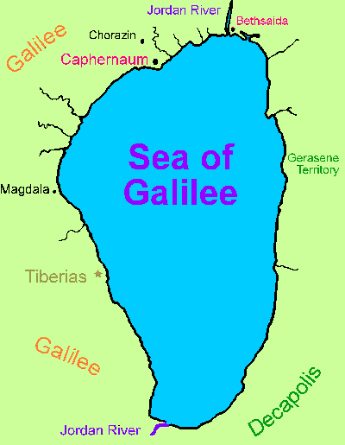

Slide 60
VIII. John 6:25-70 I AM The Bread of Life subtext: I am greater than Moses
v. 25-27 Seek spiritual not physical food
“Work” for spiritual food.
v. 28-29 What is the work of God? Believe in the one he sent. Irony
v. 30 Jews demand a sign again (recall clearing the temple)
Jesus: I gave you bread. I am greater than Moses. Isn’t that testimony enough?
In fact: I AM the bread of life. physically v. 35 and eternally v. 47-51.

Slide 61
A Practical Question
6:35b What is “bread” for you? What do you hunger for?
6:35c What is “water” for you? What do you thirst for?
The people: Please give us this bread!

Slide 62
John 6:53-59 Eat the flesh and the blood
Not a prefigure of the Lord’s Supper.
The Lord’s Supper is a remembrance of this fact.
v. 60-70 The people respond. Offended.
v. 67 Jesus: What about you?
Peter: To whom else shall we go?

Slide 63
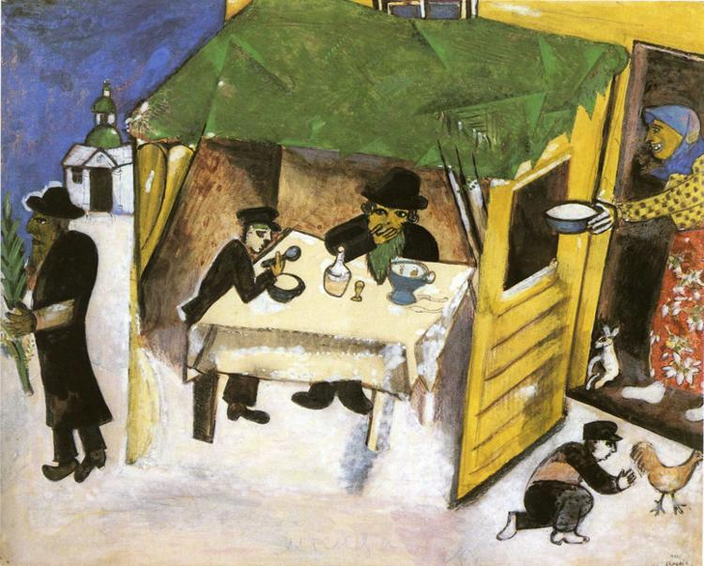
IX. John 7:1-9:41 Tabernacles Discourses
Tabernacles (Sukkot)
Harvest Festival
Remembrance of Wandering in the Wilderness = living by faith in a relationshiip with God
John 1:14

Slide 64
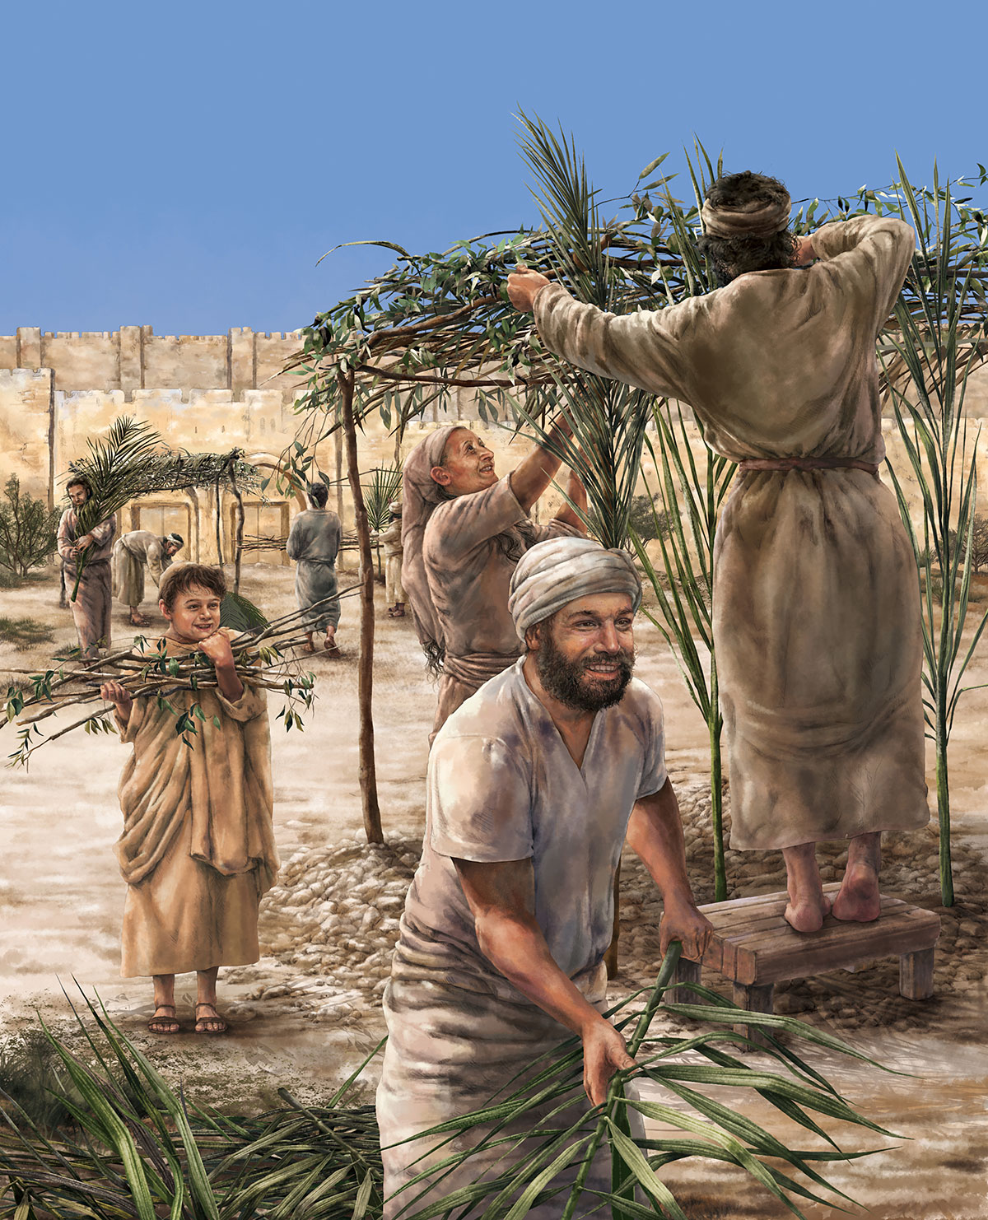
John 7 & 8 Jesus and Tabernacles
Feast of Tabernacles
Feast of Booths
Sukkot
A harvest festival Sept/Oct
Remembering God dwelling with his people

Slide 65
Tabernacles/Booths/Sukkot
A Celebration of Wandering in the Wilderness: Living in Close Fellowship with God (John 1:14 Jesus tabernacled with us)
Water Motif: Water Pouring Ceremony
Light Motif: The Illumination of the Temple

Slide 66
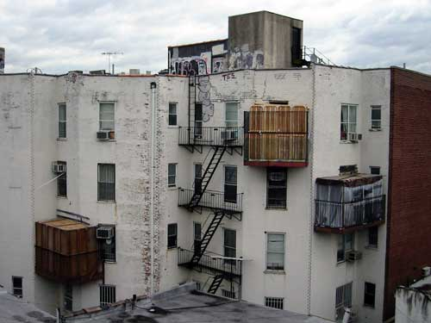
Sukkot in a City

Slide 67
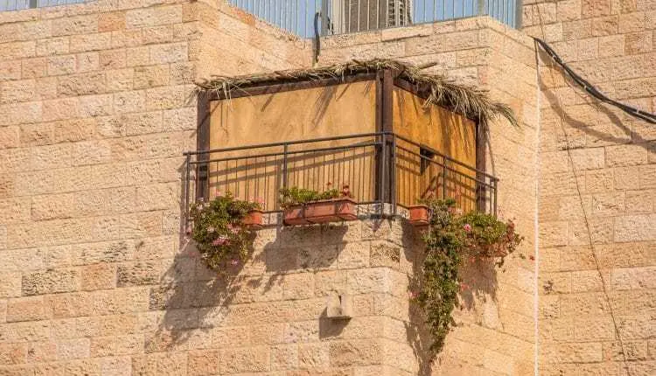
John 7:14-24
Sukkot in a city
John 7:17
If anyone chooses to do God’s will, he will find out whether my teaching comes from God or whether I speak on my own.

Slide 68
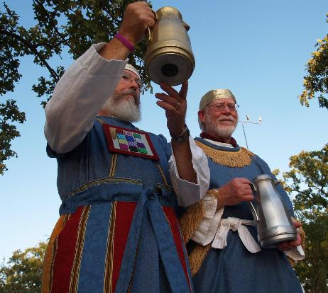
John 7:37-43 Living Water
John 7:37 “Whoever believes in my, as Scripture says, rivers of living water will flow from within them.” By this he meant the Spirit…
Isaiah 12:3 With joy, you will draw water from the well of salvation.
Zechariah 14:6-9, 16-17
Ezekiel 47:1-11
Joel 3:18
The Water Ceremony

Slide 69
The Water-Pouring Ceremony
Every Day of the Feast
Procession from the Temple to the Pool of Siloam
Priest fills a golden pitcher with water from Siloam (“living” water, by the way)
Recite Isaiah 12:3
Back through the Water Gate to the Temple
Pour the water out over the altar of sacrifice
A symbol of the Holy Spirit and of salvation.
Isaiah 12:3, Zechariah 14:8,16, Joel 3:18, Ezekiel 47:1-10
Jesus: The Messianic Age has come.

Slide 70
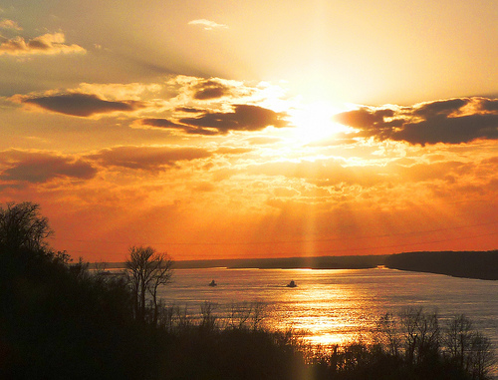
John 8:12 I Am The Light of the World
John 8:12 I AM the light of the world.
John 9:5 While I am in the world, I AM the light of the world.
John 12:46 I have come into the world as a light, so that no one who believes in me should stay in darkness.

Slide 71
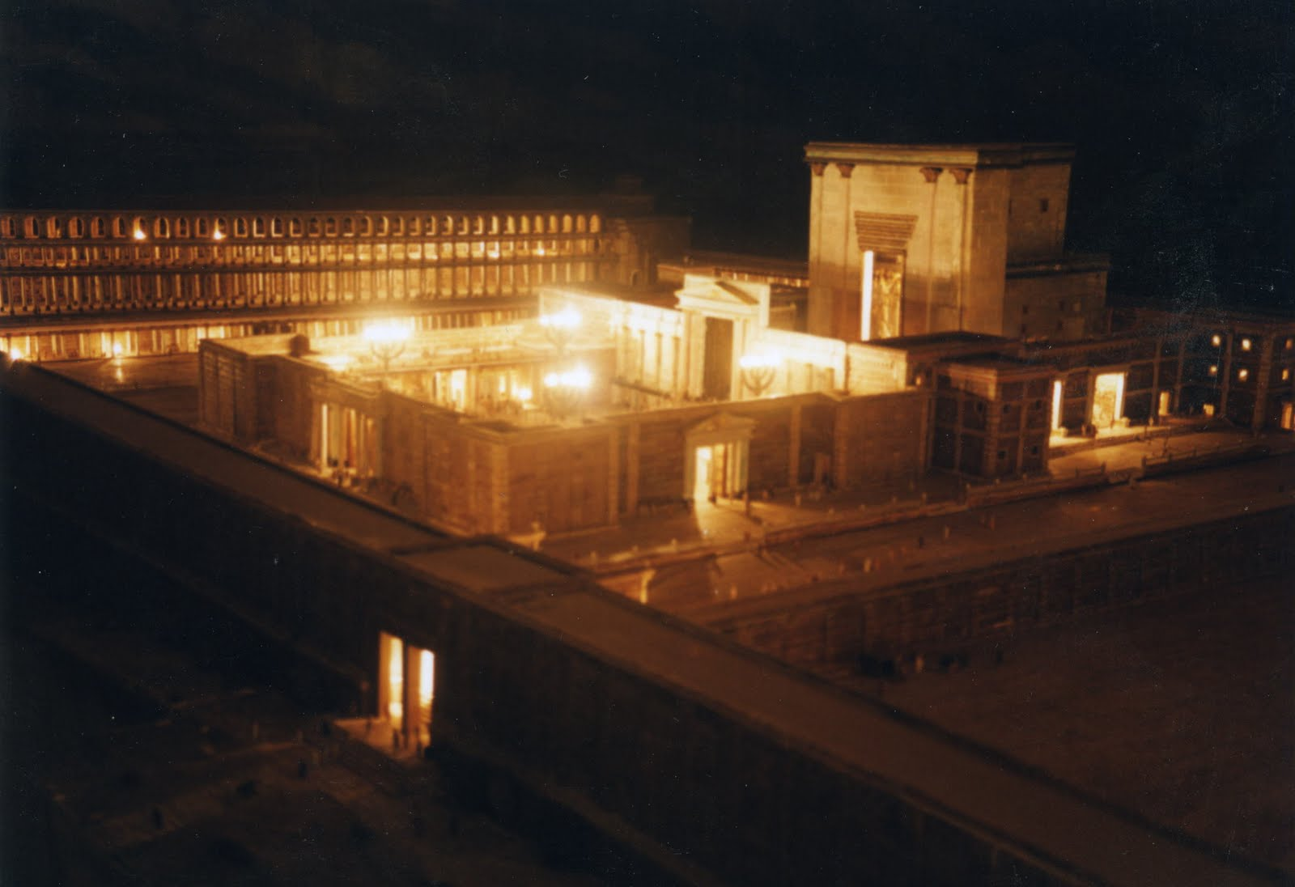
John 8:12-20 I AM the Light of the World
Illumination of the Temple
Purpose: To remember the Shekinah—the Glory of God who dwelt with them in the wilderness

Slide 72
The Illumination of the Temple
Every night during Tabernacles.
Entire Temple lit up with lamps.
Celebration in the Court of Women.
A symbol of the shekinah—God’s glory which was in and above the Tabernacle.
Jesus: I am the shekinah of God.
John 12:36 Through Jesus we can become sons of light, and no longer walk in darkness.
Jesus: I am the fulfillment of Tabernacles.

Slide 73
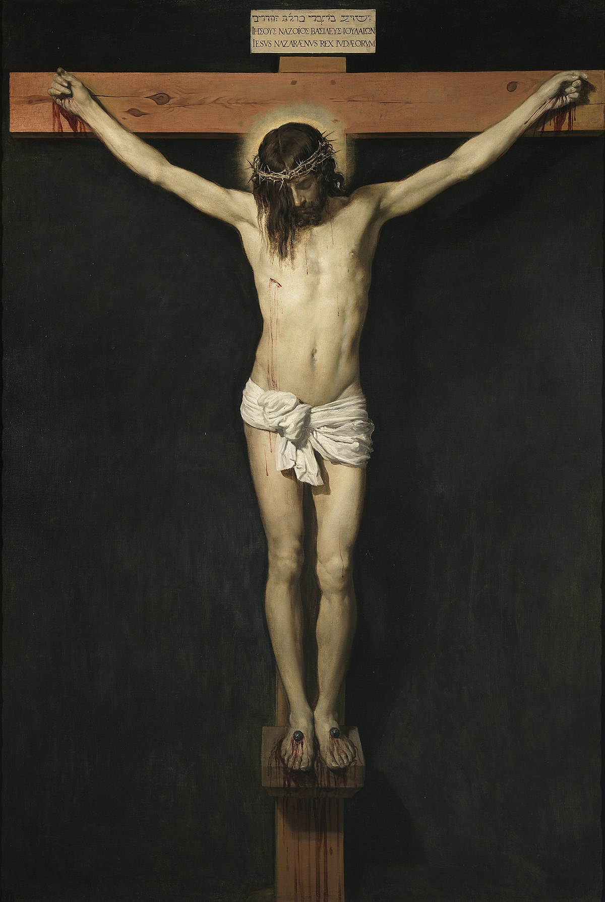
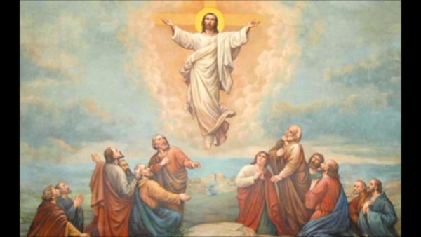
John 8:28 I AM He ego eimi
When you have lifted up the Son of Man, then you will know that I AM He
Have you been lifting Jesus up?

Slide 74
John 8:31-48 True Disciples
John 8:31 “Belief” is not enough.
We need to hold to Jesus’ teachings!
John 8:46 Can any of you prove me guilty of sin?
Jesus was sinless!!!
John 8:48 Response: You are demon-possessed!

Slide 75
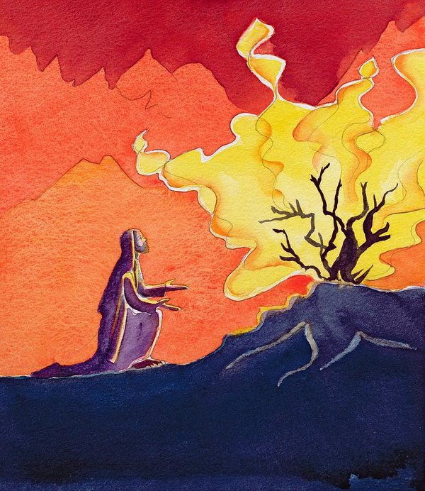
John 8:49-59 I AM
John 8:51 Whoever obeys my word will never see death.
Jesus: I am greater than Abraham.
John 8:58 Before Abraham was born, I AM
They picked up stones…
YHWH I AM

Slide 76
X Sign # 6 Jesus proves he is the light of the world
9:5 I AM the light of the world.
This miracle involves both water and light.
Note: Wash in the Pool of Siloam.
The man grows in his faith.
v. 11 “the man Jesus”
v. 17 “the Prophet”
v. 31 from God
v. 38 Lord, I believe!
The parents and the Pharisees become more blind than they were at the beginning.

Slide 77
John 9 Jesus Heals a Man Born Blind
John 6 Jesus gives bread, then claims “I AM the bread of life.
John 8:12 Jesus says I AM the light of the world, then in John 9 Jesus heals a man born blind.
In John
Miracles: Give glory to God John 9:3
Create faith (as we will see)
Tell us who Jesus is John 9:5

Slide 78
John 9:35-41 The Man Now Sees
v. 11 the man named Jesus
v. 17 a prophet
v. 33 He is from God
v. 38 Lord, I believe! He now sees!!!
Where are you in this progression?

Slide 79
XI. John 10 More claims and testimonies
The Context: The Feast of Dedication (Hannukuh) John 10:22
John 10:7 I AM the gate. (John 14:6)
John 10:11,14 I AM the good shepherd.
The Shepherd Discourse Ezekiel 34:2-10
1st Macabbees: false shepherds
1 Samuel 17:34
Response: Division. You are demon-possessed!
Could a demon give sight to the blind?
John 10:25,32,38 My miracles testify to the things I say

Slide 80
Jesus: I AM God
John 10:30 I and the father are one.
Response: John 10:31 They picked up stones to stone him.
You, a mere man, claim to be God.

Slide 81
XII. Sign #7 The Raising of Lazarus
For John: The greatest of Jesus’ signs.
John 11:4 This sickness will not end in death (irony)
Purpose: To give glory to God (and to his son)
John 11:23-26 I AM the resurrection and the life! He who believes in me will live, even though he dies.
John to the reader: Do you believe this?

Slide 82
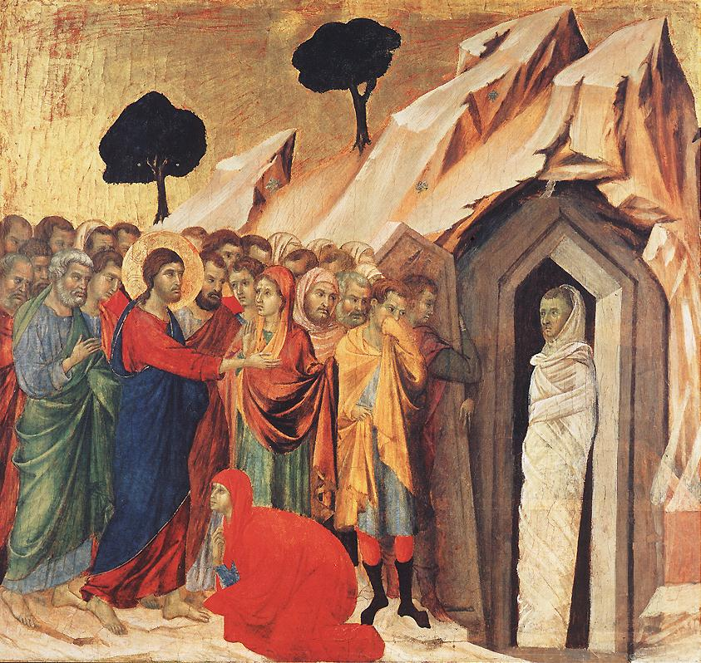
Jesus proves he is the resurrection and the life.
“Lazarus: Come out!”
John 11:45-51 Believe or murder Jesus. A stark choice.
What about you?

Slide 83
John Chapter 12
Theme: The Glorification of the King
A transition… Jesus enters Jerusalem
A transition… Jesus’ public ministry ends
A transition… The Book of Signs ends and the Book of the Passion begins

Slide 84
The Glorification of the Messiah/King
John 12:1-8 Anointing of a king for burial.
John 12:12-16 Triumphal entry of the King.
John 12:28 God: I will glorify your name.
John 12:32 Jesus will be lifted up (glorified)
(talk about irony!)

Slide 85
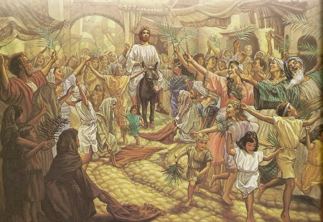
John 12:12 The Passion Story Begins…
I Maccabees 13:21
(Simon Maccabeus)
Hosannah! Ps 118:25-26
Jesus hailed as King and Messiah.
King of Peace (donkey)
Zechariah 9:9

Slide 86
Jesus: The Hour Has Come! Jn 12:23
The hour for a triumphant king? No!!
Unless a kernel of wheat falls to the ground an dies.
Q: Message for us?
John 12:32 (John 3:14, John 8:28) I will draw all men to myself. How??? By dying!
John 12:36 Jesus’ public ministry ends
John 12:37-50 Final summary Do not reject me.

Slide 87
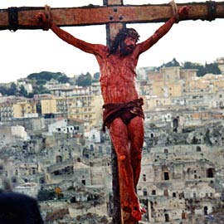
John 13:1-20:29 The Book of the Passion
Jesus’ public ministry is done.
Ch 13-17 Very personal view of Jesus with his apostles.
John Ch 2-12 Jesus’ message to the world. John Ch 13-17 Jesus’ message to the apostles/church

Slide 88
A Little Chronological Problem
When did the Last Supper happen according to John?
John 18:28 The day before the Passover? (Synoptics are definite that the Last Supper was a Passover Seder)
Solution:
1. John is just plain wrong.
2. John 18:28 is a reference to any day in Passover/Feast of Unleavened Bread.
3. The Jews disagreed over the day of Passover (Nisan 14 vs Nisan 15)

Slide 89
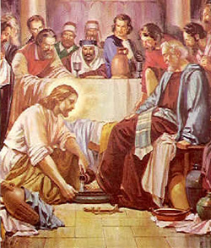
John 13 Jesus’ Love for the Apostles
John 13:1 Jesus loved them “to the end.”
John 13:3-11 Jesus shows them his love.
John 13:12-17 Go and do likewise.
John 13:18-30 Jesus will be betrayed.
John 13:31-38 Love one another as I have loved you.

Slide 90
John Ch. 14
1. Jesus is trying to reassure them that he is with them and that, even when he is gone, He will still be with them in the form of the Holy Spirit. You guys will be OK.
2. He is both setting an example and giving them a command to love.

Slide 91
Jesus: Trust in me
Wedding metaphor
Jewish betrothal: Groom promises to “build a room” for the bride.
Claim to be deity
Trust in God, Trust also in me.
If you have seen me, you have seen the father.
Greater works than these.
Bringing salvation and offering the Holy Spirit

Slide 92
Jesus Comforts the Disciples
Ask anything in my name.
I will send the comforter (Holy Spirit) You will not be alone.
My peace I leave you.

Slide 93
John 15 The Vine and the Branches
The vine: A common metaphor
Psalm 80:8-18, Isaiah 5:1-7, Jeremiah 2:21 Ezekiel 15:1-8 Ezekiel 19:10 and Hoseah 10:1.

Slide 94
I am the Vine. My Father is the gardener
Q: In what sense is Jesus a vine?
Q: In what sense is the Father a gardener?
Q: In what sense are we branches?
John 15:2a, 15:6 Matthew 7:15-20 Can we be cut off the vine? If so, why?

Slide 95
John 15 Abide in Me
The key point in John 15 is abiding in Christ.
Abiding = Bearing fruit. Q: What fruit?
Answer: The things we ask for. 15:7-8
John 15:9-17 The key to abiding is love (and obedience)

Slide 96
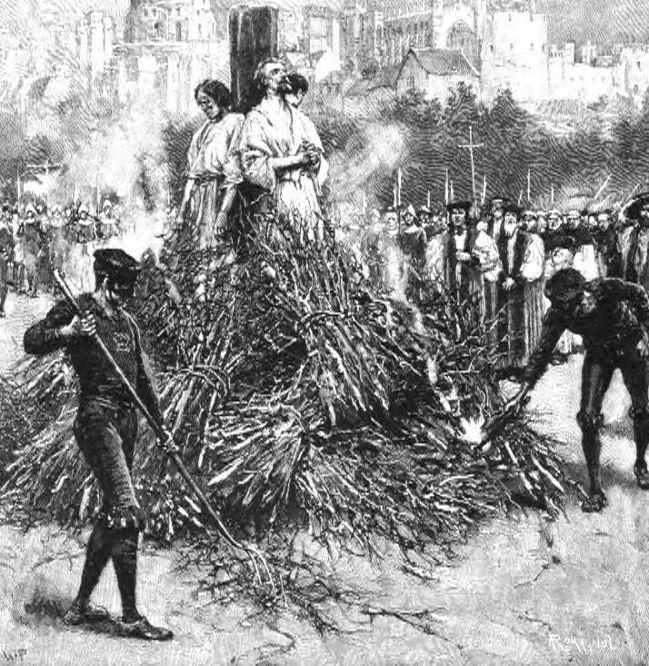
John 15:18-16:4 The reason we need so much comfort: Persecution
Jesus “assures” them with six if… then.. Statements
v. 18, 19, 20 (2x), 22, 24

Slide 97
John 16 Jesus Comforts His Disciples
John 16:6 It is good that I am going away.
I will send the Comforter.
Aside: Does the Holy Spirit “proceed from the Father and the Son” (filioque)? John 15:7
He will convict the world
He will guide you into the truth

Slide 98
Comfort for the Disciples
16:20 Your grief will turn to joy.
16:25 I will speak to you plainly.
16:33 Take heart: I have overcome the world.

Slide 99
John 17 Jesus Prays for the Disciples
Themes:
Jesus’ amazing love and concern for the disciples John 17:11-19
Glory 9 times in John 17 John 17:4-5
Knowing God John 17:3, 25-26
Unity and Relationship John 17:23

Slide 100
John 18-19 The Passion Narrative
Things to notice:
Jesus is totally in control. He is not a victim.
V. 4 “Jesus, knowing all that was going to happen to him”
Jesus fulfilling prophecies (unlike the rest of John) 18:9,32 19:24 19:36,37
Jesus confronts Annas(contrast with Peter), Jesus questions Pilate!
Deity: I Am He v. 5,8

Slide 101
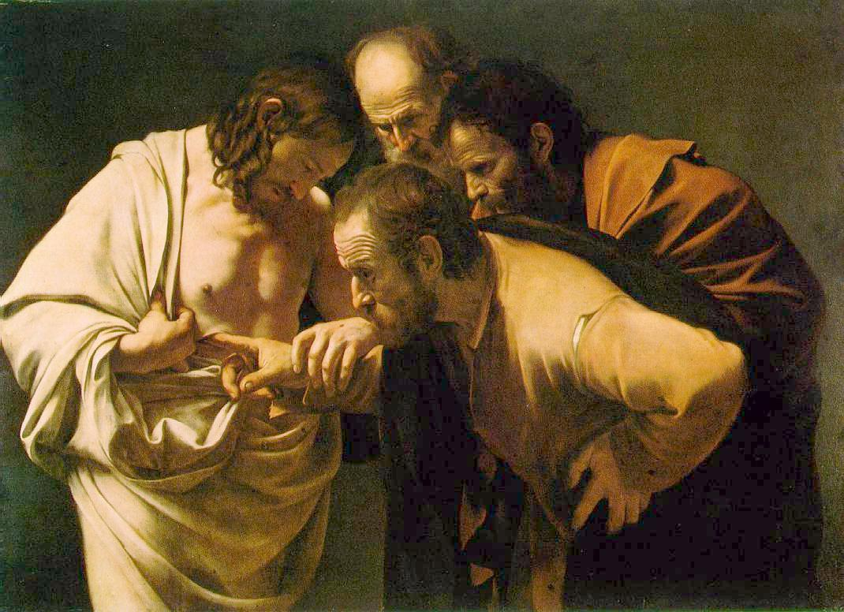
John 20 Resurrection Appearances
Mary Magdalene
Peter and “the other disciple (John)
Mary Magdalene again
The disciples (- Thomas)
The disciples, including Thomas

Slide 102
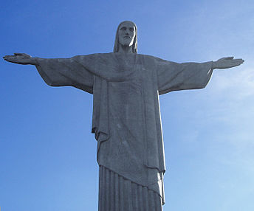
Jesus’ Signs and Claims: Summary
John 20:29-31 Will you believe, even though you have not seen? If you do, you will have life in his name.
What is your response to Jesus?
For God so loved the world that he gave his one and only Son that whoever believes in him will not perish but will have eternal life. John 3:16

Slide 103
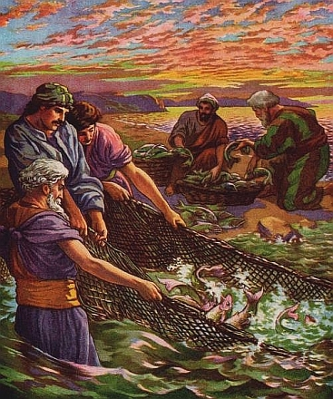
John 21 Epilogue
The eighth sign
Purpose:
To explain restoration of Peter
To correct the false idea that John would live until Jesus comes back.

Slide 104
John 21:24
John: I was there. I saw the whole thing. Jesus did a lot more than this!
“These are written that you may believe that Jesus is the Christ, the Son of God, and that by believing you may have life in his name.”

