Slide 1
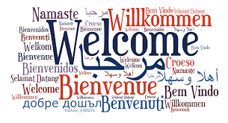
Welcome to the Merced Christian Church!!!

Slide 2
The Spirits Fire
(273)

Slide 3
We need you now, we need your fire within
We need your love, we need you as our friend
We need your light to guide through what’s ahead
We need you now
We need you now

Slide 4
The Spirit’s fire
Almighty flame
Calling us higher
Never the same
Burn in our hearts
Flow through our veins
The Spirit’s fire
The Spirit’s fire

Slide 5
Your power made this universe we see
Your power saved our lives and set us free
Your power’s here among us as we sing
You’re everything
You’re everything

Slide 6
The Spirit’s fire
Almighty flame
Calling us higher
Never the same
Burn in our hearts
Flow through our veins
The Spirit’s fire
The Spirit’s fire

Slide 7
Give us your fire to carry us along
Give us desire to build the kingdom strong
Give us the dream and when the dream is done
We’ll be with you
We’ll be with you

Slide 8
The Spirit’s fire
Almighty flame
Calling us higher
Never the same
Burn in our hearts
Flow through our veins
The Spirit’s fire
The Spirit’s fire
(x2)
[End]

Slide 9
Sanctuary
(440)

Slide 10
Oh Lord prepare me
To be a sanctuary
Pure and holy,
Tried and true.
With thanksgiving,
I’ll be a living
Sanctuary for You.

Slide 11
It was you Lord
Who gave the Savior
Heart and soul Lord
To every man
It is You Lord
Who knows my weakness
You refine me
With thine own hand

Slide 12
Lead me oh Lord
Through temptation
You refine me
From within
Fill our hearts with
Your holy spirit
And take all our
Sins away

Slide 13
Oh Lord prepare me
To be a sanctuary
Pure and holy,
Tried and true.
With thanksgiving,
I’ll be a living
Sanctuary for You.
[End]

Slide 15
REPENT,

Slide 16
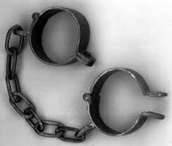
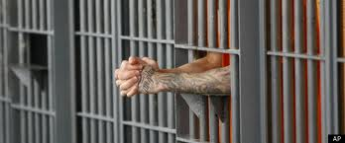
Here was Your Situation:
Lost
Enslaved
Captured
Imprisoned

Slide 17
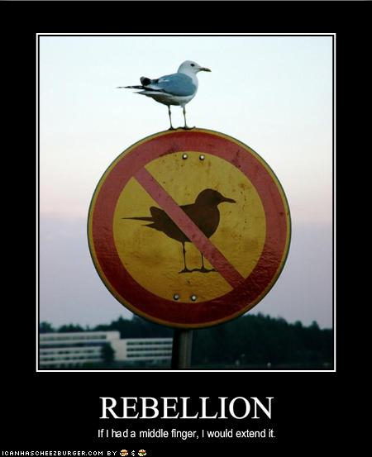
How Did you get there?
You Rebelled.
You went after other gods.
You said that what God
wants for you is not enough.

Slide 18
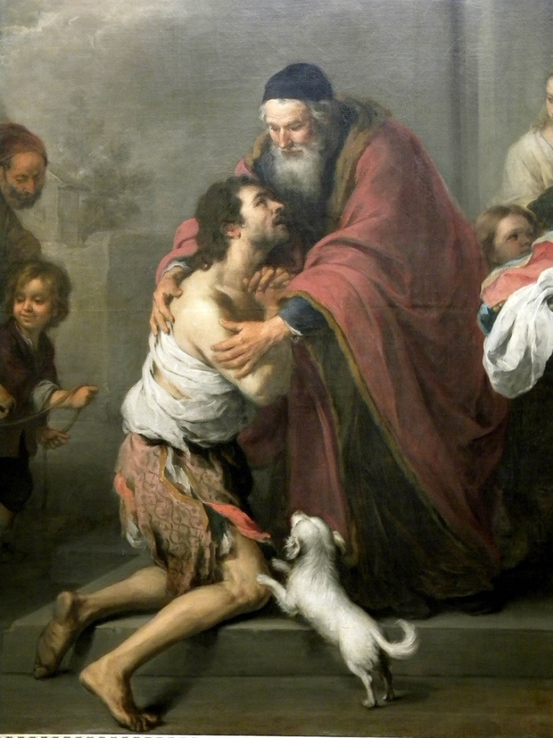
What is the solution?
Repent and Return
So that God can
Restore and Rebuild

Slide 19
Who are you?
You are people loved by God
You are Israel
You are any individual
You are the Church
You are a Church

Slide 20
Post-exile books
Ezra, Nehemiah, and Esther History
Haggai, Zechariah, and Malachi Prophets
Theme of these books: God’s wrath is complete. It is time for his remnant to Repent and Return so that God can Restore and Rebuild them.

Slide 21
Outline
Background: Deuteronomy and Jeremiah
Ezra Part I God uses Cyrus and Darius
Haggai Repent and Rebuild
Zechariah Repent, Return, Restore, Rebuild
Esther
Ezra Part II God uses Artaxerxes
Nehemiah Return and Rebuild
Malachi Repent and Restore

Slide 22
Historical Background
722 BC Northern Kingdom destroyed by Sennacherib
605 BC First siege of Jerusalem by Nebuchadnezzar
597 2nd siege Ezekiel taken as captive to Babylon.
592 Ezekiel receives his commission.
586 Jerusalem Destroyed 70 years of captivity begins
538 Cyrus captures Babylon. Cyrus decrees the temple should be rebuilt. (Ezra 1:1-4)
537-536 First wave of remnant returns under Zerubbabel.

Slide 23
Historical Background
520 Zechariah begins to prophesy
518 Darius: Rebuild the temple! (Ezra 6:1-12) Haggai agrees.
516 Temple is completed (seventy years after Solomon’s temple destroyed)
458 Ezra returns to Jerusalem, second wave of exiles. Artaxerxes: Rebuild the city of Jerusalem. (Ezra 7:11-29)
445-444 Nehemiah returns and the city is built.
430 BC? Malachi

Slide 24
2 Chronicles 36:6, 10, 19-21
Notes:
Nebuchadnezzar conquered Palestine. Happened in three waves (36:6 Jehoiakim, Daniel 605 BC; 36:10 Jehoiachin in 597 BC; and 36:20 Zedekiah in 587 BC). They stayed until Persia overtook Babylon (v. 22).

Slide 26
All this was prophesied
Deuteronomy 28:15-19 If you do not obey the Lord your God… you will be cursed.
Deuteronomy 28:36-37 You and your king will be taken to a foreign land.
Deut 28:49-57 The Lord will bring a nation against you. Terrible suffering. Cannibalism in Jerusalem.
Summary: Deut 29:22-29.

Slide 27
But… Deuteronomy 30:1-6 Repent, Return, Restore, REbuild
When all these blessings and curses I have set before you come on you and you take them to heart (repent) wherever the LORD your God disperses you among the nations, and when you and your children return to the LORD your God and obey him with all your heart and with all your soul according to everything I command you today, then the LORD your God will restore your fortunes[a] and have compassion on you and gather you again from all the nations where he scattered you. Even if you have been banished to the most distant land under the heavens, from there the LORD your God will gather you and bring you back. He will bring you to the land that belonged to your ancestors, and you will take possession of it. He will make you more prosperous and numerous than your ancestors. (rebuild) The LORD your God will circumcise your hearts and the hearts of your descendants, so that you may love him with all your heart and with all your soul, and live.

Slide 28
If God says it will happen It will happen
Jeremiah 2:4-13 What fault did you find with me?
Jeremiah 3:14-18, 22 Repent and Return
Jeremiah 4:1-6 Disaster from the North!
Jeremiah 7:30-34 The Valley of Slaughter.
But… There is good news in Jeremiah!

Slide 29
Good news: A remnant will be saved
Jeremiah 23:1-8 God will gather a remnant
God will restore that remnant
The Righteous Branch (Jesus) will rebuild in their own land.
Jeremiah 30:1-11 This is about us!

Slide 30
Summary
The story of Judah is our story. We, too, began as God’s people. We, too, went after other gods and told God that what he has to give us is not enough. We, too, rebelled. We, like them, were lost, enslaved, and imprisoned.
But… By his mercy and because of his love
We, too, repented and returned to God’s kingdom. Now, God is in the process of restoring and rebuilding us into a people who will give him glory in his kingdom.
This is the message of the post-exilic books.

Slide 31
Historical Introduction: Ezra
Ezra 1:1-4 Cyrus says it is time to repent, to return, to be restored and to rebuild.

Slide 32
Ezra 1:1-3
eeeeEzra 1:1-3 Dead Sea Scrolls
Notes:
Why? Goodwill, collection of tribute, god’s favor. Almost a century later: In 407 BC, letter to Persian governor requesting that a Jewish temple at Elephantine in Egypt be rebuilt after destroyed by Egyptians in 411 BC.

Slide 33
The Cyrus Cyllinder (British Museum)
Notes:
“I returned the statues of the divine patrons of every land…to their own sanctuaries. When I found their sanctuaries in ruins, I rebuilt them. I also repatriated the people of these lands and rebuilt their houses. Finally, with Marduk’s permission, I allowed statues of the dive patrons of Sumer and Akkad to be returned to their own sanctuaries.”

Slide 34
Isaiah 44:26-45:7
Cyrus
Isaiah 44:24-45:4
Notes:
Inhabited, rebuilt, restored! Isaiah prophecies through Hezekiah (1:1) - 4 kings before Jehoiakim! Cyrus as shepherd, anointed. Why? So that all may know. No other Lord. Prosperity and disaster; I do all!

Slide 35
I Need Your Love
(218)

Slide 36
Lord I need your love
In this shadowed place
I can’t get enough
Of your sunlight on your face
When it’s cold and dark
Or I’m far from home
You are in my heart
And I never walk alone

Slide 37
And just like a tree
Planted by a stream
Thirsty for a drink
Of your love
I can’t face a day
Without some time to pray
I sing this song to say
I need your love

Slide 38
I’m a tiny child
But when I’m with You
I will not grow tired
Cause there’s nothing You can’t do
Your love makes me strong
Though I’m small and weak
And the whole day long You’ll speak through me as I speak

Slide 39
And just like a tree
Planted by a stream
Thirsty for a drink
Of your love
I can’t face a day
Without some time to pray
I sing this song to say
I need your love

Slide 40
I’m a tiny child
But when I’m with You
I will not grow tired
Cause there’s nothing You can’t do
Your love makes me strong
Though I’m small and weak
And the whole day long You’ll speak through me as I speak

Slide 41
And just like a tree
Planted by a stream
Thirsty for a drink
Of your love
I can’t face a day
Without some time to pray
I sing this song to say
I need your love

Slide 42
You gave all for me
Though I’d cursed your name
On that bitter tree
Lord you suffered for my shame
How can I thank you?
Your love paid my way
All that I can do is live for you every day

Slide 43
And just like a tree
Planted by a stream
Thirsty for a drink
Of your love
I can’t face a day
Without some time to pray
I sing this song to say
I need your love
[End]

Slide 44
Announcements
Book of John Class M-Th 2:00 Here
Bible Groups: MC, UCM Tu-Th 12:00
Tu 7:30 Bible Group here
Midweek at UCM GLCR 120 Vince Lara
Th 7:00 Lecture: Is the Bible Reliable Granite Pass 135
Fri 4:00 AM Hike to Yosemite
Fri 7:30 PM Movie Night at UC Merced
Sat June 17 10:00-2:00 Family Fun Day at Lake Yosemite Park

Slide 49
Contribution
www.mercedchurch.com click give
Or just give today!

Slide 50
Unto Thee O Lord
(100)

Slide 51
Unto Thee O Lord,
Do I lift up my soul
Unto Thee O Lord
Do I lift up my soul

Slide 52
Oh my God
I trust in Thee
Oh, let me not be ashamed, let not my enemies triumph over me.

Slide 53
Let none that wait
On Thee be ashamed
Let none that wait
On Thee be ashamed

Slide 54
Oh my God
I trust in Thee
Oh, let me not be ashamed, let not my enemies triumph over me.

Slide 55
Remember not
The sins of my youth
Remember not
The sins of my youth

Slide 56
Oh my God
I trust in Thee
Oh, let me not be ashamed, let not my enemies triumph over me.

Slide 57
Teach me Thy paths
Thy ways O Lord
Teach me Thy paths
Thy ways O Lord

Slide 58
Oh my God
I trust in Thee
Oh, let me not be ashamed, let not my enemies triumph over me.
[End]

