Slide 1
REPENT,

Slide 2
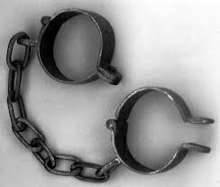
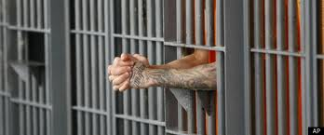
Here was Your Situation:
Lost
Enslaved
Captured
Imprisoned

Slide 3
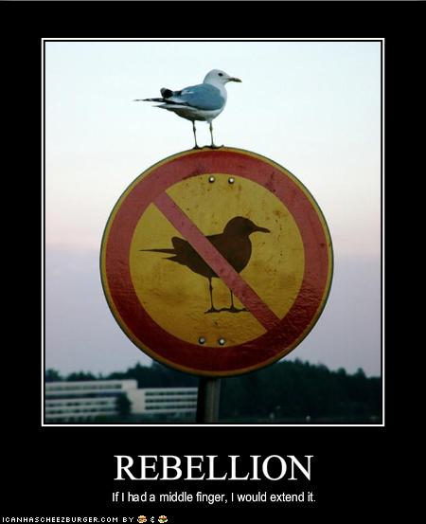
How Did you get there?
You Rebelled.
You went after other gods.
You said that what God
wants for you is not enough.

Slide 4
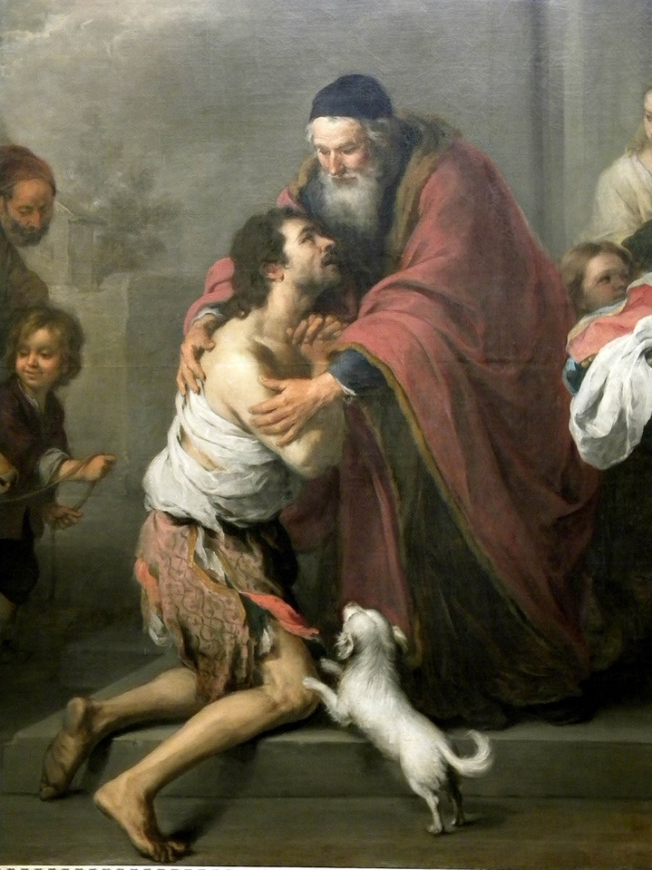
What is the solution?
Repent and Return
So that God can
Restore and Rebuild

Slide 5
Who are you?
You are people loved by God
You are Israel
You are any individual
You are the Church
You are a Church

Slide 6
Outline
Background: Deuteronomy and Jeremiah
Ezra Part I God uses Cyrus and Darius
Haggai Repent and Rebuild
Zechariah Repent, Return, Restore, Rebuild
Esther
Ezra Part II God uses Artaxerxes
Nehemiah Return and Rebuild
Malachi Repent and Restore

Slide 7
But… Deuteronomy 30:1-6 Repent, Return, Restore, REbuild
When all these blessings and curses I have set before you come on you and you take them to heart (repent) wherever the LORD your God disperses you among the nations, and when you and your children return to the LORD your God and obey him with all your heart and with all your soul according to everything I command you today, then the LORD your God will restore your fortunes[a] and have compassion on you and gather you again from all the nations where he scattered you. Even if you have been banished to the most distant land under the heavens, from there the LORD your God will gather you and bring you back. He will bring you to the land that belonged to your ancestors, and you will take possession of it. He will make you more prosperous and numerous than your ancestors. (rebuild) The LORD your God will circumcise your hearts and the hearts of your descendants, so that you may love him with all your heart and with all your soul, and live.

Slide 8
Summary
The story of Judah is our story. We, too, began as God’s people. We, too, went after other gods and told God that what he has to give us is not enough. We, too, rebelled. We, like them, were lost, enslaved, and imprisoned.
But… By his mercy and because of his love
We, too, repented and returned to God’s kingdom. Now, God is in the process of restoring and rebuilding us into a people who will give him glory in his kingdom.
This is the message of the post-exilic books.

Slide 9
Historical Introduction: Ezra
Ezra 1:1-4 Cyrus says it is time to repent, to return, to be restored and to rebuild.

Slide 10
Isaiah 44:26-45:7
Cyrus
Isaiah 44:24-45:4
Cyrus says:
Return,
Rebuild
Restore!
Notes:
Inhabited, rebuilt, restored! Isaiah prophecies through Hezekiah (1:1) - 4 kings before Jehoiakim! Cyrus as shepherd, anointed. Why? So that all may know. No other Lord. Prosperity and disaster; I do all!

Slide 11
Ezra 2 Captives return to Jerusalem

Slide 12
Ezra 3 temple foundation laid

Slide 13
Ezra 4 But… Satan has not taken a nap

Slide 14
Haggai
Message: Build up the house of the Lord, not your own house. (Matt 6:19-21)
Submessage: Discouragement is not sufficient excuse to neglecting the work of the Lord.

Slide 15
Historical Background
586 BC Jerusalem and the temple destroyed.
538 BC Cyrus defeats Belshazzar and Babylon.
537/536 BC First wave of Jews return to Jerusalem, altar built foundation of temple is laid. (Ezra 1:1-3:13). Opposition arises. Project abandoned.
521 BC Darius I takes the throne of Persia. Tells Judah to get back to building the temple.
520 BC Haggai preaches. Build the temple!

Slide 16
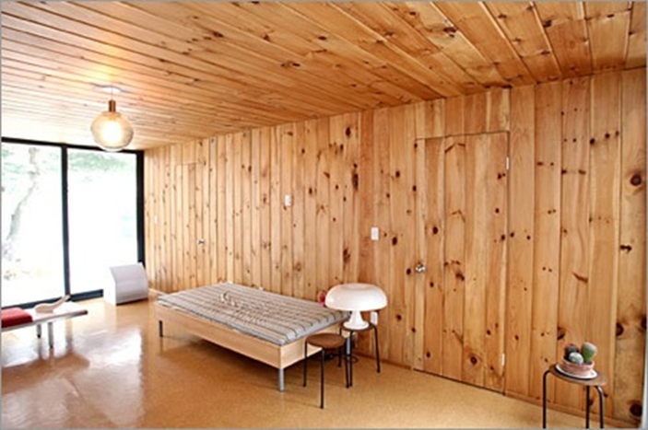
Haggai 1:1-4 The People’s Excuse
Haggai 1:2 We’re too busy to build the temple.
Q: Can you relate?
Haggai 1:3-4 Hmmm…. You seem to have time to build your house.
Haggai 1:5-6 You have
planted much but
harvested little.
Q: Can you relate?

Slide 17
God’s Solution
“Indifference to the things of God produces calamity.”
1. Haggai 1:7 Give careful thought to your ways.
2. Haggai 1:8 Bring down timber to build God’s temple.
Haggai 1:12-15 The people obeyed, the leaders led, the people’s spirits were inspired and the work got started.

Slide 18
Conclusion
God wants us to repent, return, so that he can restore and rebuild.
God is already working behind the scenes and is working miracles.
But Satan is not napping.
It is time to repent and start rebuilding!

Slide 19
Rebuild
Haggai 1:12-15 The people repented and the temple got rebuilt.
Result: God: I am with you (Matthew 28:20)
Haggai 2:1-9 The work is hard and we humans can get discouraged, but God encourages us.
God really gets carried away with excitement when he sees his people repenting and returning so that he can restore and rebuild.

Slide 20
Two Great Memory Verses
Haggai 2:6
“In a little while I will once more shake the heavens and the earth, the sea and the dry land.”
Haggai 2:8
“'The silver is mine and the gold is mine,’ declares the Lord Almighty.”

Slide 21
Haggai 2:10-18 “parable of defiled flesh
Does coming into contact with clean meat make you clean? No!
Does coming into contact with defiled meat make you unclean? Yes!
Defilement is a thing. Holiness is a lack of a thing.
Sin is contagious. Holiness is not necessarily contagious. We need to deal with the plague of materialism.

Slide 22
Haggai 2:19-23
If we repent, God will bless us.
“I will shake the heavens and the earth. I will overturn royal thrones and shatter the power of the foreign kingdoms. I will overthrow chariots and their drivers; horses and their riders will fall, each by the sword of his brother.”

