Slide 2
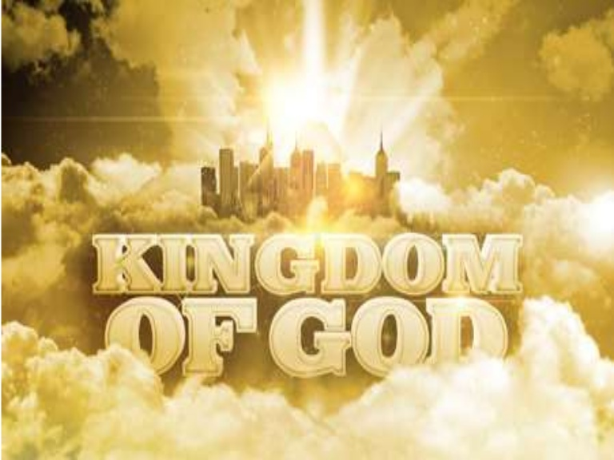
Zechariah III On That Day
Zechariah Theme: The Messiah is coming: Get your house in order.
Message: It is time to build the temple: Repent, Return, Restore, Rebuild.

Slide 3
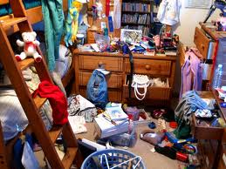
The Messiah is Coming: Is Your Spiritual House in Order?
Is your (spiritual) house ready for guests right now?

Slide 4
Outline of Zechariah
1:1-6 Prologue: Repent, Return, Restore and Rebuild
1:7-6:8 Eight visions.
6:9-15 Coronation of Joshua/Jesus
7:1-8:23 Two sermons.
9:1-14:21 Two Oracles concerning Jerusalem.

Slide 5
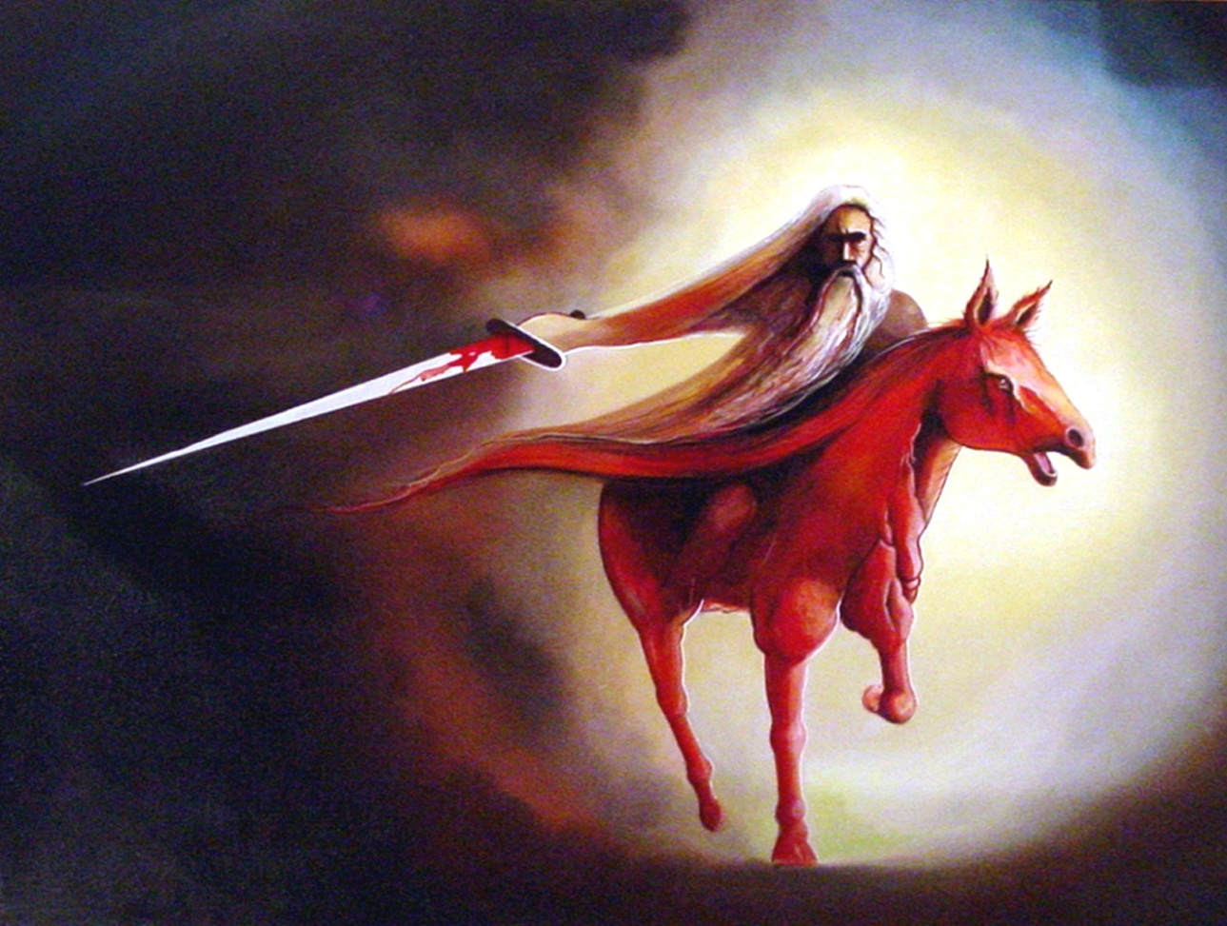
Vision #1 Zechariah 1:7-17 A Messenger on a red horse
v. 14 God is jealous!
Zech 1:16 I will return to Jerusalem and rebuild my house!
Are you on board?

Slide 6
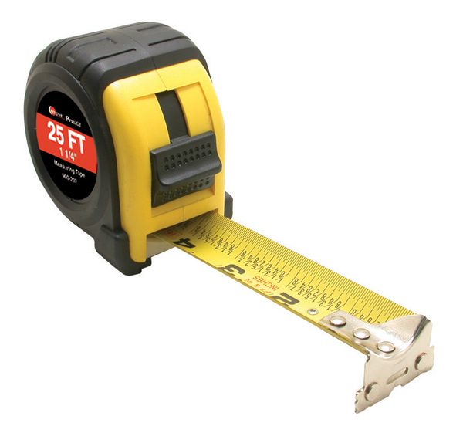
Vision #3 Zech 2:1-13 A man with a measuring line
God: I will make my kingdom into a city without walls.
Message: Do not rely on protection the world provides. Rely on God for your safety.

Slide 7
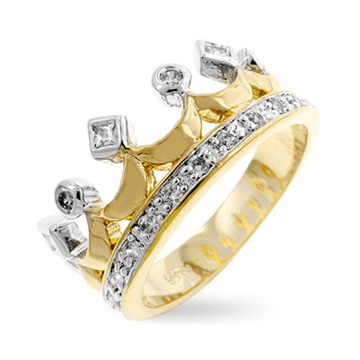
Zechariah 6:9-15 The coronation scene
v. 11 Does a priest wear a crown?
v. 12 Branch = nazer = Nazarene = Jesus Matt 2:23
Jesus is King
Jesus is the perfect high priest.

Slide 8
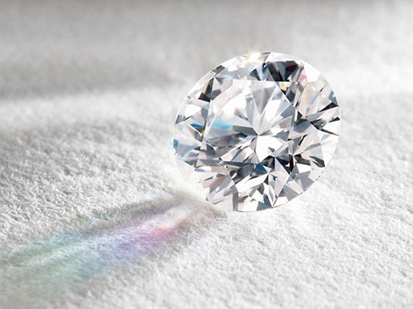
Zech 9:10-17 A Kingdom of Peace
Zech 9:11 God took you out of a waterless pit.
Zech 9:16 You will sparkle.

Slide 9
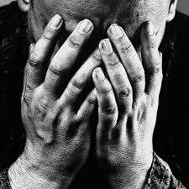
Zechariah III On That Day Zech 7:1-2 Should I mourn and fast?
Fasts:
5th month: Destruction of the temple
7th month: Assassination of Gedaliah
10th month: Capture of Jersualem

Slide 10
Should I Mourn and Fast?
God’s response: Zechariah 7:4-10
Give me your heart, not your religion.
Act like God.
Zech 7:9-10 Administer true justice; show mercy and compassion to one another. Do not oppress the widow or the fatherless, the foreigner or the poor. Do not plot evil against each other.

Slide 11
Should I Mourn and Fast?
Zech 7:13 When I called, they would not answer, so when they called, I would not listen.

Slide 12
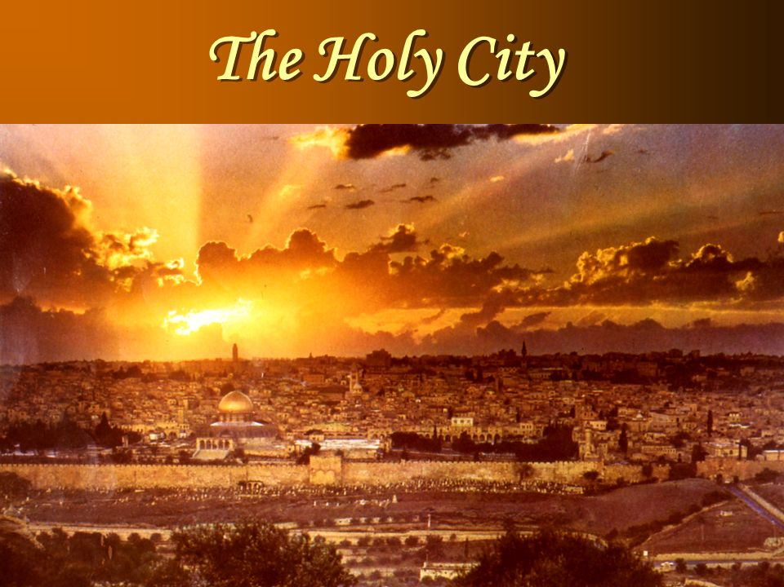
Zechariah 8:1-9 The Messiah Will Come to Jerusalem
v. 3 I will return to Zion and dwell in Jerusalem
You will be called the Faithful City.
v. 9 Let your hands be strong so that the temple may be built.

Slide 13
Zechariah 8:18-23 God Answers the Question
v. 19 Stop fasting! The Messiah has come to Jerusalem.
God is blessing us.
v. 23 10 visitors for each member!

Slide 14
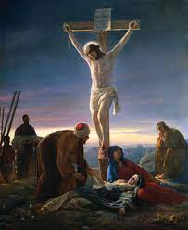
Zech 12:10-14 Bonus Material
12:10 They will look on me, the one they have pierced.
Weeping and mourning as at Hadad Rimon (when Josiah, the most righteous king, was killed)
But…

Slide 15
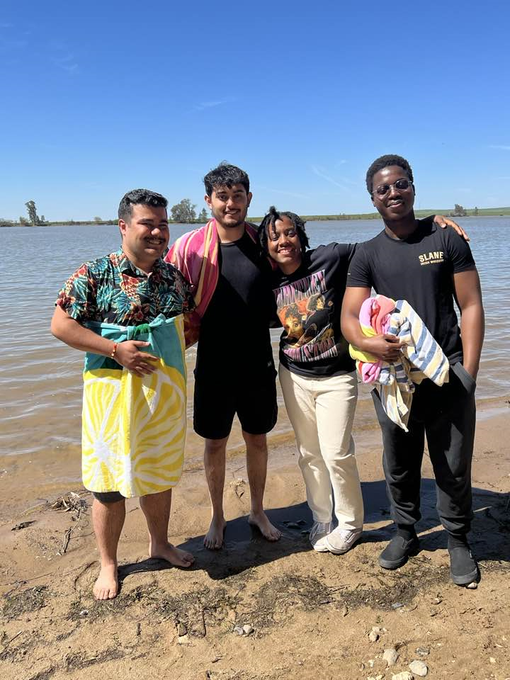
Zech 13:1-6 On That Day
On That Day a fountain will be opened.
Hebrews 1:2 But in these last days he has spoken to us by his Son

Slide 16
Zechariah 14 On That Day
Zech 14:1 The Day of the Lord
Zech 14:1-7 Destruction of Jersualem in AD 70
Zech 14:8-11 God will build his kingdom—the Church
Zech 14:12-21 God will come and judge the nations
Heaven will be an eternal Feast of Tabernacles
We will be “Holy to the Lord.”

Slide 17
Should I mourn and fast?
Actually, you should celebrate because a fountain has been opened.
But, when God calls, listen!
Let your hands be strong and start building
On that Day we will have an eternal Feast of Tabernacles with God
So let us repent and return, so God can restore and rebuild.

