Slide 1
REPENT,

Slide 2
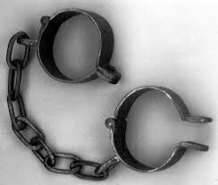
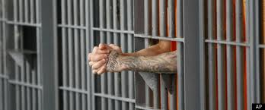
Here was Your Situation:
Lost
Enslaved
Captured
Imprisoned

Slide 3
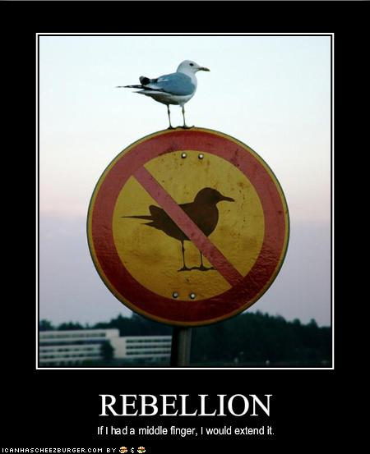
How Did you get there?
You Rebelled.
You went after other gods.
You said that what God
wants for you is not enough.

Slide 4
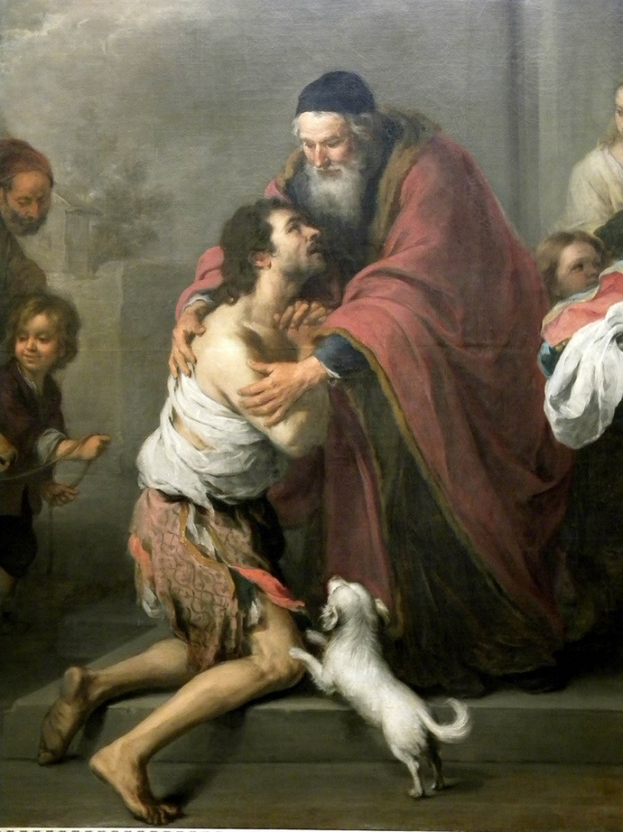
What is the solution?
Repent and Return
So that God can
Restore and Rebuild

Slide 5
Who are you?
You are people loved by God
You are Israel
You are any individual
You are the Church
You are a Church

Slide 6
Outline
Background: Deuteronomy and Jeremiah
Ezra Part I God uses Cyrus and Darius
Haggai Repent and Rebuild
Zechariah Repent, Return, Restore, Rebuild
Esther
Ezra Part II God uses Artaxerxes
Nehemiah Return and Rebuild
Malachi Repent and Restore

Slide 7
Zechariah: Things to bear in mind
Dated prophecies: Nov. 520 BC – Dec 518 BC
• Contemporary of Haggai
• The book is apocalyptic
• The book has many Messianic prophecies
• The book has many Kingdom prophecies

Slide 8
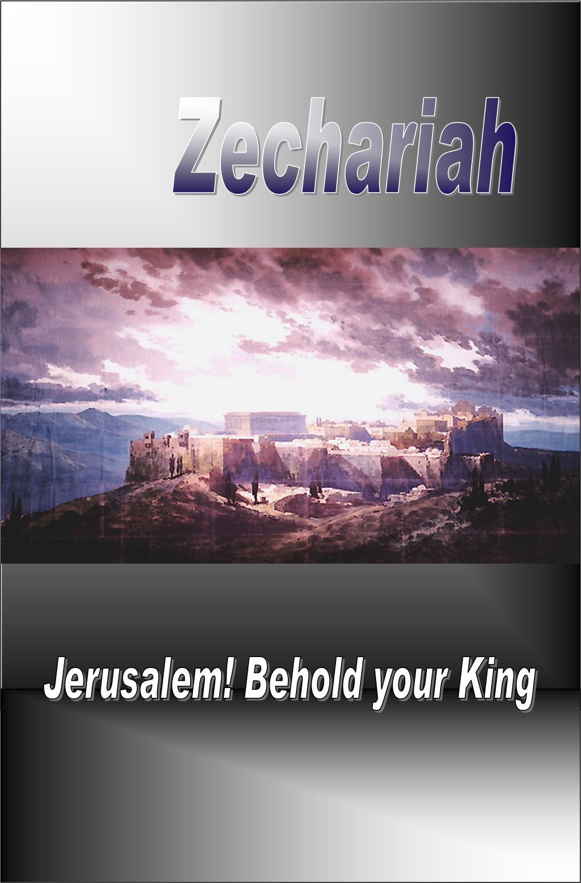
Zechariah I The Messiah Is Coming: Get Your House In Order
Theme: The Messiah is coming: Get your house in order.
Message: It is time to build the temple: Repent, Return, Restore, Rebuild.

Slide 9
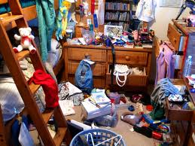
The Messiah is Coming: Is Your Spiritual House in Order?
Is your (spiritual) house ready for guests right now?
(Or would you be scrambling around, trying to straighten up all the mess)

Slide 10
Outline of Zechariah
1:1-6 Prologue: Repent, Return, Restore and Rebuild
1:7-6:8 Eight visions.
6:9-15 Coronation of Joshua/Jesus
7:1-8:23 Two sermons.
9:1-14:21 Two Oracles concerning Jerusalem.
Warning: We will not be following this exact order. We will be more thematic.

Slide 11
Zech 1:1-6 Prologue
God: Repent and Return so I can Restore and Rebuild
v. 2 Why was God so angry with their forefathers?
v. 3 The solution: Repent and Return
v. 4-6 Those faithless Jews are no longer around, but my Words are still in place.
v. 6 Good news. They repented and the temple got rebuilt.
We are seeing the end of the story right at the beginning.

Slide 12
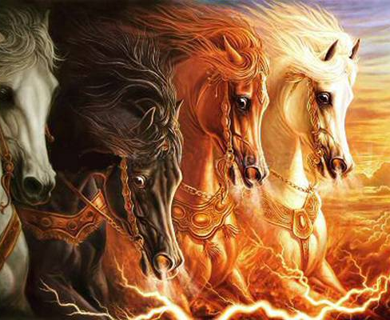
Vision #1 Zech 1:7-17 A man on a red horse
v. 11 All is quiet and at peace, is that good? No! Because God’s people are still in captivity.
Isn’t God the prince of peace? Matthew 10:34-36
Does God want people to feel secure? Amos 6:1-7
That depends….

Slide 13
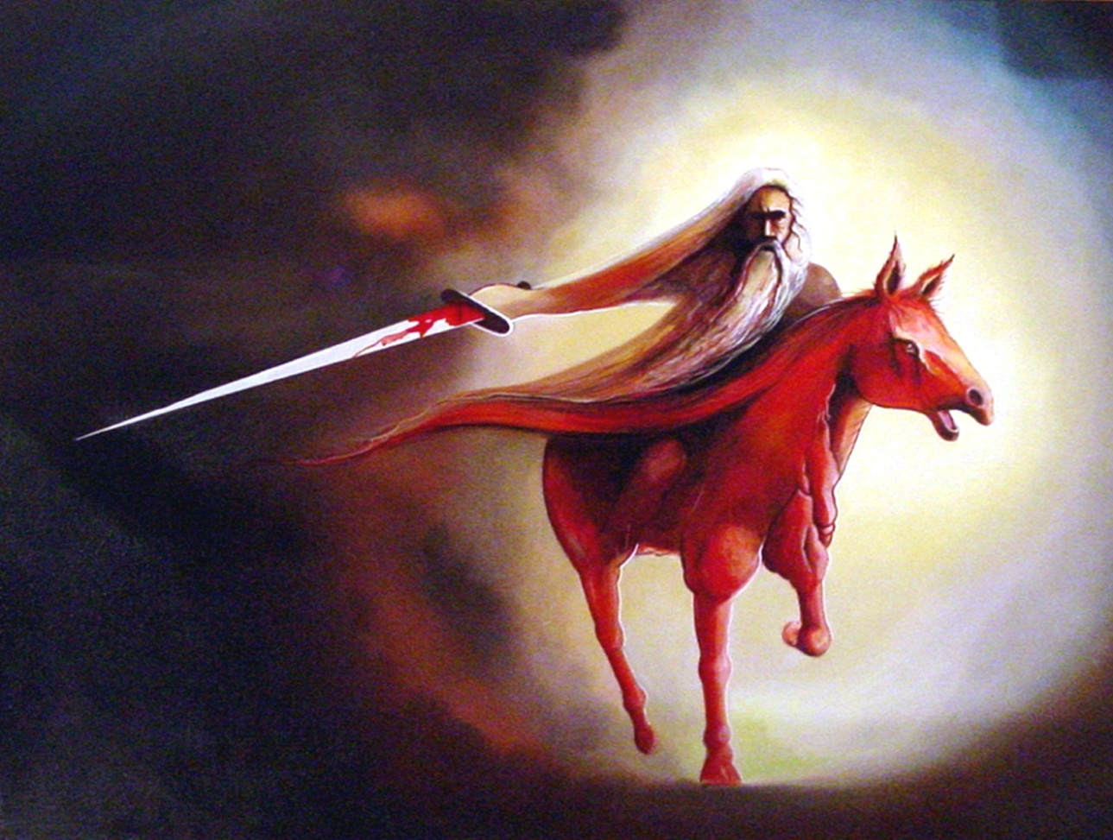
Vision #1 Zechariah 1:7-17 A Messenger on a red horse
v. 14 God is jealous!
Zech 1:16 I will return to Jerusalem and rebuild my house!
Are you on board?

Slide 14
Vision #1 cont.
Zech 1:16-17
This, in essence, is the theme of Zechariah: The Messiah is coming: Get your house in order!
God’s reply: I will return to Jerusalem and rebuild my house! Do not look at outward appearances.
Application: If your situation or church seems stagnant, do not look at the outward appearance. God can and will work in your life.

Slide 15
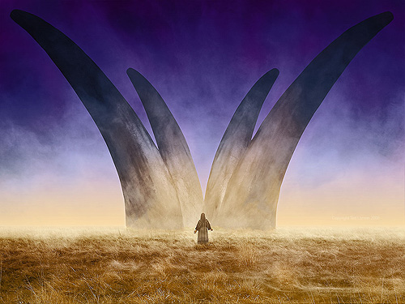
Vision #2 Zech 1:18-21 The vision of four horns and four craftsmen
The four horns are four nations which scattered God’s people as a judgment for their sins.
Assyria, Egypt, Babylon, Persia
Message: God will judge your enemies. Trust God

Slide 16
Vision #4 Zech 3:1-10 Joshua accused and exonerated
Zech 3:1-2 Who is Joshua symbolic of here?
Judah? Yes!
You, me and the Church? Yes!
Jesus/Messiah? Yes! (v. 8-9, Jeremiah 23:5)
Satan is an accuser (Rev 12:10)
Satan is a deceiver (John 8:44)
How does Satan accuse you?

Slide 17
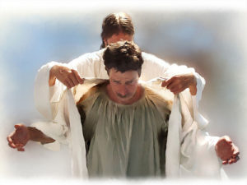
God to Satan: The Lord Rebuke You!!!
Zech 3:3-5 Good news!
“I have taken away your sin and I will put fine garments on you.”
Zech 3:6-7 The Messiah is coming. Get your house in order.
Zech 3:10 Have you invited your neighbor to sit under your vine?

Slide 18
Vision #5 Zech 4:1-16 The Golden Lampstand and the Two Olive Trees
The oil in the menorah is the Holy Spirit.
Two Trees: endless supply.
Zechariah 4:6 Not by might nor by power, but by my Spirit

Slide 19
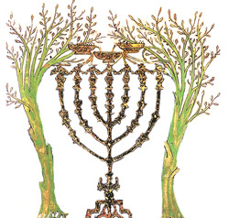
Vision #5 The Golden Lampstand and the Two Olive Trees
John 7:37-39 Streams of living water.
“As Scripture says” Zech 4, Ezekiel 37
Zech 4:10 Therefore do not worry about small beginnings

Slide 20
Summary
The Messiah is coming: Get your house in order.
God wants to rebuild his temple.
The key? Repent and Return so God can Restore and Rebuild.
Then God will give you clean clothes and empower you with the Holy Spirit. God will do the heavy lifting to rebuild the kingdom in your life.

