Slide 1
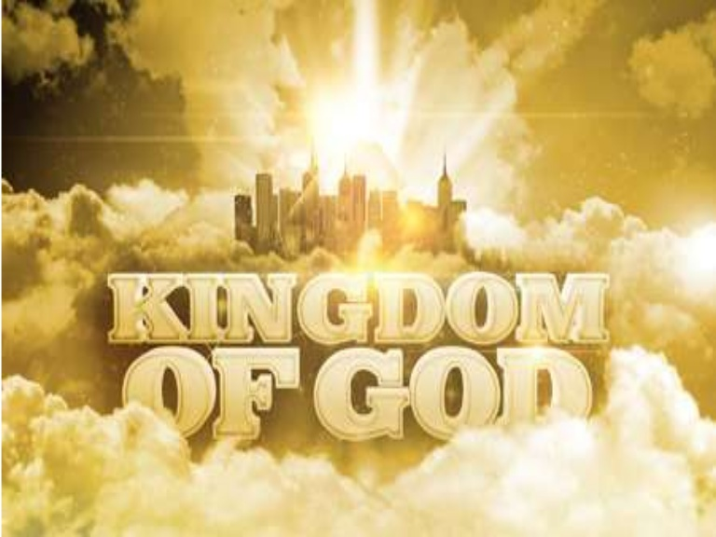
Repent, Return, Restore, Reuild V Zechariah II Your Kingdom Come
Theme: The Messiah is coming: Get your house in order.
Message: It is time to build the temple: Repent, Return, Restore, Rebuild.

Slide 2
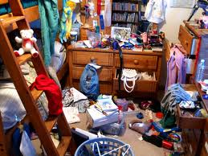
The Messiah is Coming: Is Your Spiritual House in Order?
Is your (spiritual) house ready for guests right now?
(Or would you be scrambling around, trying to straighten up all the mess)

Slide 3
Outline of Zechariah
1:1-6 Prologue: Repent, Return, Restore and Rebuild
1:7-6:8 Eight visions.
6:9-15 Coronation of Joshua/Jesus
7:1-8:23 Two sermons.
9:1-14:21 Two Oracles concerning Jerusalem.
Warning: We will not be following this exact order. We will be more thematic.

Slide 4
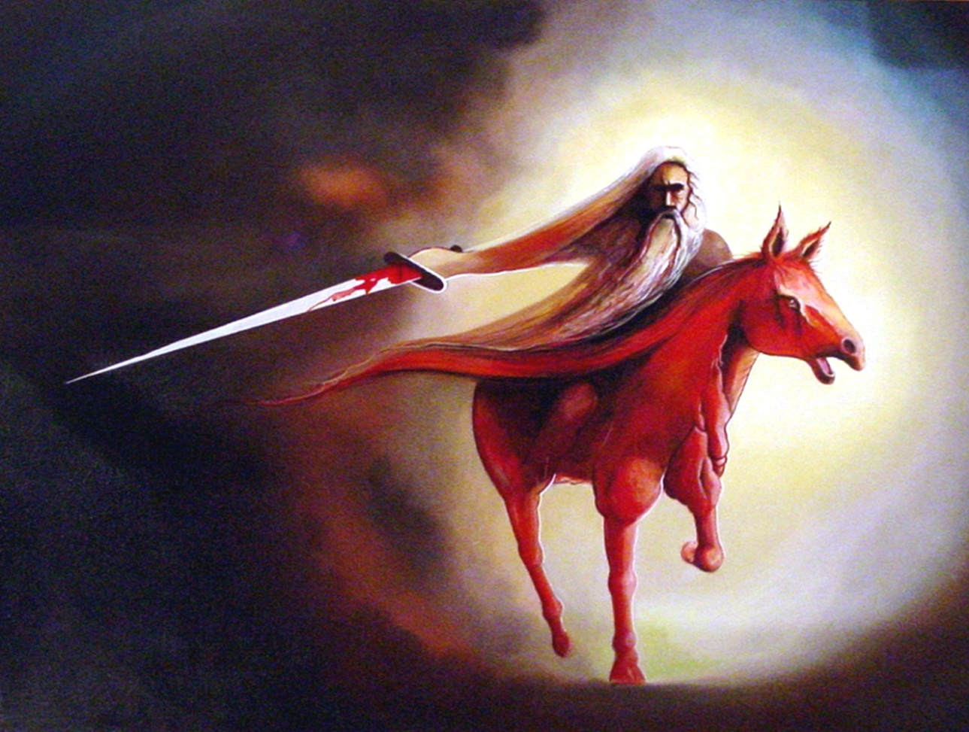
Vision #1 Zechariah 1:7-17 A Messenger on a red horse
v. 14 God is jealous!
Zech 1:16 I will return to Jerusalem and rebuild my house!
Are you on board?

Slide 5
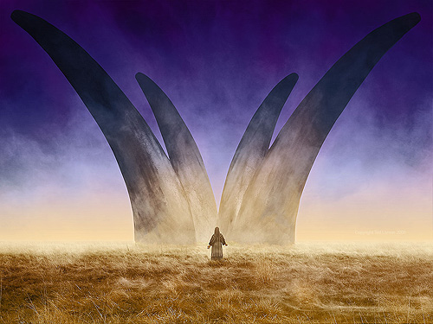
Vision #2 Zech 1:18-21 The vision of four horns
The four horns are four nations which scattered God’s people as a judgment for their sins.
Assyria, Egypt, Babylon, Persia?
Message: God will judge your enemies

Slide 6
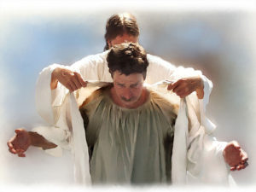
Vision #4 Joshua Accused and Exonerated
God to Satan: The Lord Rebuke You!!!
Good news!
“I have taken away your sin and I will put fine garments on you.”

Slide 7
Vision #5 Zech 4:1-16 The Golden Lampstand and the Two Olive Trees
The oil in the menorah is the Holy Spirit.
Two Trees: endless supply.
Zechariah 4:6 Not by might nor by power, but by my Spirit

Slide 8
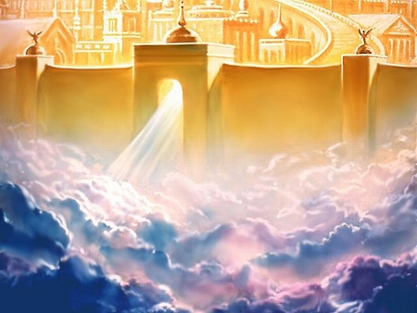
Zechariah II Your Kingdom Come Kingdom prophecies in Zechariah
Zechariah 2:1-13
Zechariah 6:9-15
Zechariah 8:1-7
Zechariah 9:10-17
Zechariah 12:7-8
Zechariah 13:1-3
Zechariah 14:1-21
And more….

Slide 9
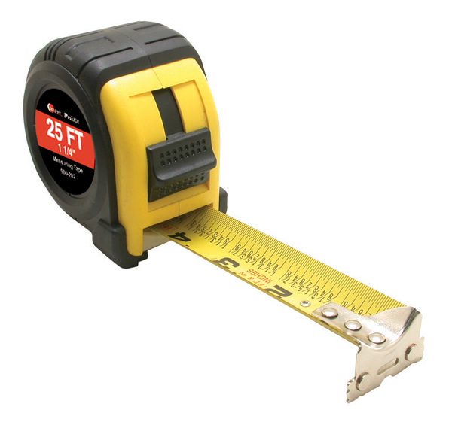
Vision #3 Zech 2:1-13 A man with a measuring line
God: I will make my kingdom into a city without walls.
Zech 2:1-2 Measuring = Protecting Rev 11:1-6, Ezekiel 38:7-16
Message: Do not rely on protection the world provides. Rely on God for your safety.

Slide 10
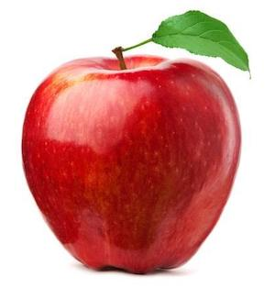
Vision #3 (cont.)
What are your worldly “walls”?
2:8 God: You are the apple of my eye.
2:10-13 I will live among you.
Many nations will be joined with the Lord on that day and will become my people.

Slide 11
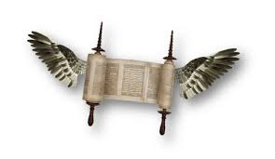
Vision #6 The flying scroll
Judgment on sinners and on all the enemies of God’s people.

Slide 12
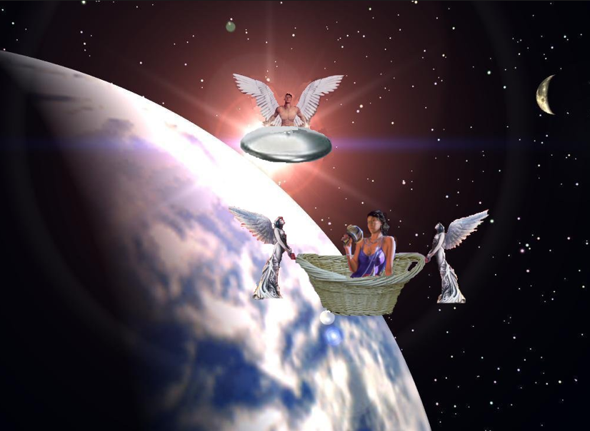
Vision #7 A woman in a basket
Message:
Judgment on sinners
Measuring basket:
Judgment
v. 7 Woman = sin = Babylon
v. 10-11 Those who sin will be sent to captivity in Babylon

Slide 13
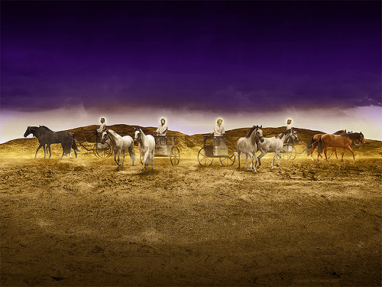
Vision #8 Four Chariots
Message: Judgment is coming!
Parallel passage: Revelation 6:2-7

Slide 14
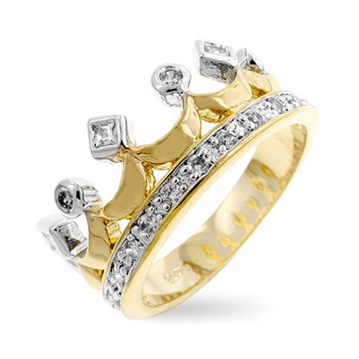
Zechariah 6:9-15 The coronation scene
v. 11 Does a priest wear a crown?
v. 12 Branch = nazer = Nazarene = Jesus Matt 2:23
Jesus is King
Jesus is the perfect high priest. Heb 4:15-16

Slide 15
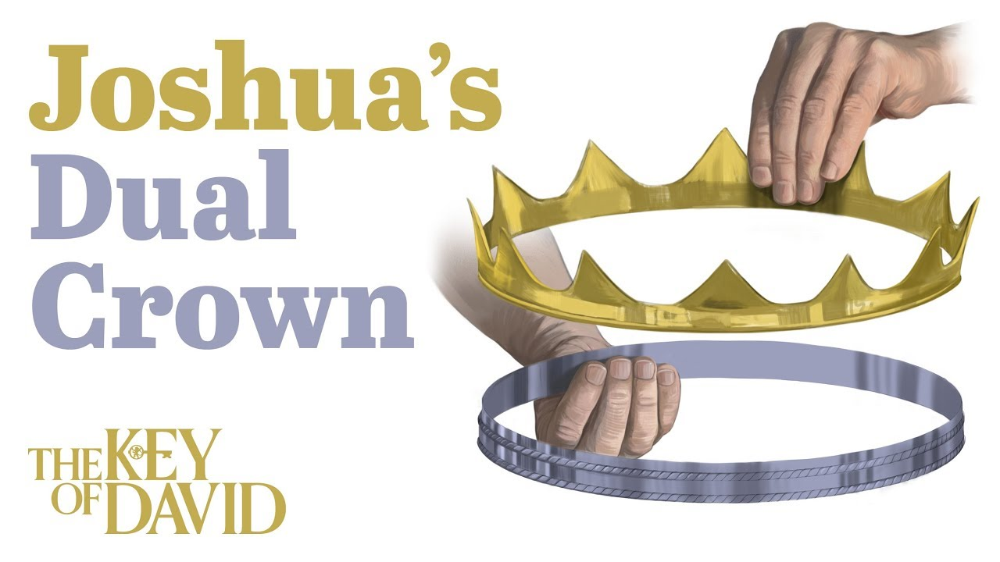
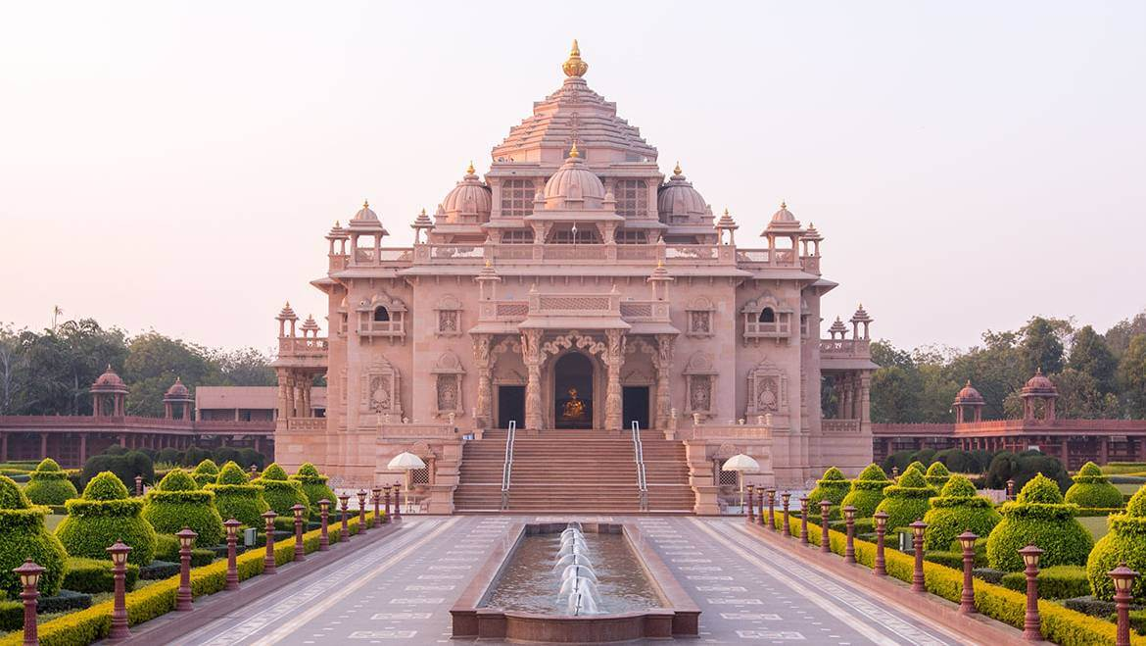
Zechariah 6:9-15 The coronation scene
v. 13 He will build the temple. Eph 2:11-22
v. 15 Those who are far away will come.
v. 15b God will use our hands to build the temple

Slide 16
Zech 9:10-17 A Kingdom of Peace
v. 10 No more chariots, war horses, bows.
Yet…
His kingdom will extend from sea to sea.
How? By Jesus’ blood.
v. 11 What kind of waterless pit did God pull you out of?
v. 13 God will “bend Judah” He will use you!

Slide 17
Zechariah 9:16 We Will Sparkle
They will sparkle in his land like jewels in a crown.

Slide 18
Zechariah 14 Your Kingdom Come
Zech 14:1 The Day of the Lord
Zech 14:1-7 Destruction of Jersualem in AD 70
Zech 14:8-11 God will build his kingdom—the Church
Zech 14:12-21 God will come and judge the nations
Heaven will be an eternal Feast of Tabernacles
We will be “Holy to the Lord.”

Slide 19
Summary: Your Kingdom Come
A city without walls
A place where God lives among his people
A place where a perfect priest rules as king
A temple built by God, using human hands
A place where those the far are brought near
A place of peace
A place without waterless pits
A place where we will sparkle
A place where we dwell with God

