Slide 1
Welcome to Alpha Omega Midweek!

Slide 2
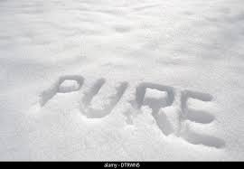
Purity
Our Theme Passage: 1 Timothy 4:11-16 Set an example for the believers in speech, in conduct, in love, in faith and in purity.

Slide 3
What Is Purity?
Greek: katharos
Pure = unmixed, unadulterated

Slide 4
What is Purity?
Example: Leviticus 19 Do not wear clothes of more than one materia. Do not sow more than one crop in the same field.
2 Corinthians 6:16-18 (quoting Isaiah 52:11) Come out from them and be separate from them.

Slide 5
The Importance of Purity
Revelation 21:27 No impure things in heaven.
Titus 1:15 To the pure, all things are pure.
The motivation to purity: The impure are “unfit for doing anything good.”

Slide 6
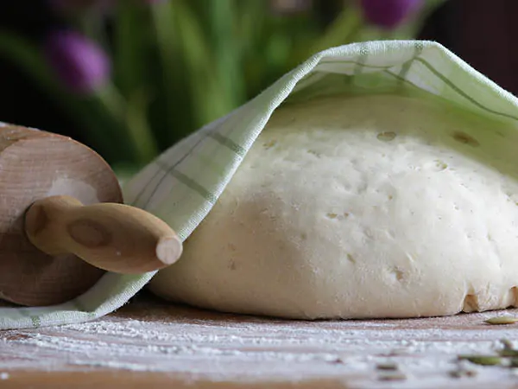
The Importance of Purity
1 Corinthians 5:6-8 Leaven in the Old Testament is a metaphor for sin and impurity.
Q: Why is God so big on getting ALL the leaven out of the house?
v. 8 The unleavened bread of sincerity and truth

Slide 7
Examples of Purity
Ephesians 4:29-5:3
Purity of words
Purity of action
Sexual purity Not even a hint…
1 Timothy 5:2 Absolute purity

Slide 8
Examples of Purity
Matthew 5:2 Pure at heart.
Q: What does it mean to have a pure heart?
1 Tim 1:5

Slide 9
Discussion Questions
1. Are there any areas in your life in which impure words are an issue?
2. Are there any areas in your life in which impure actions or sexual impurity are an issue?
3. Have you had an impure heart toward God? Have you had mixed motives in your service to God?

