Slide 1
Esther: God saves his people
Esther: Only book in Bible that does not mention God
Only book in Old Testament not found in the DSS
Included in the Old Testament because of Purim?

Slide 2
Esther: God Saves His People Theme #1 God is in control. He is working behind the scenes to save his people. Theme #2 God uses a righteous woman to save Israel. Strong messianic implications Esther is a prefigure of the Messiah!

Slide 3
Esther 1:1-3
Esther: Queen of Xerxes (485-465 BC)
3rd year of Xerxes 483 BC
Jerusalem is destroyed. Where is God?
Notes:
From India to Cush - largest empire of that time! 127 provinces (20 Satrapies - Judah was a province of the 5th, Syria). Specific!
Where’s God? His people aren’t ruling; emphasis on Persia, not Judah.

Slide 4
Esther 1:4-22 Vashti refuses Xerxes

Slide 5
Esther 2:1-7 Esther and Mordecai
Notes:
Two main heroes: Esther (Hadassah), Mordecai (great-grandson). Orphan / Cousin. Tragedy! Where’s God? Gave her a cousin, beauty and character (submission). She’s taken to evaluation by king (what a risk). $, school, share faith, confront someone.

Slide 6
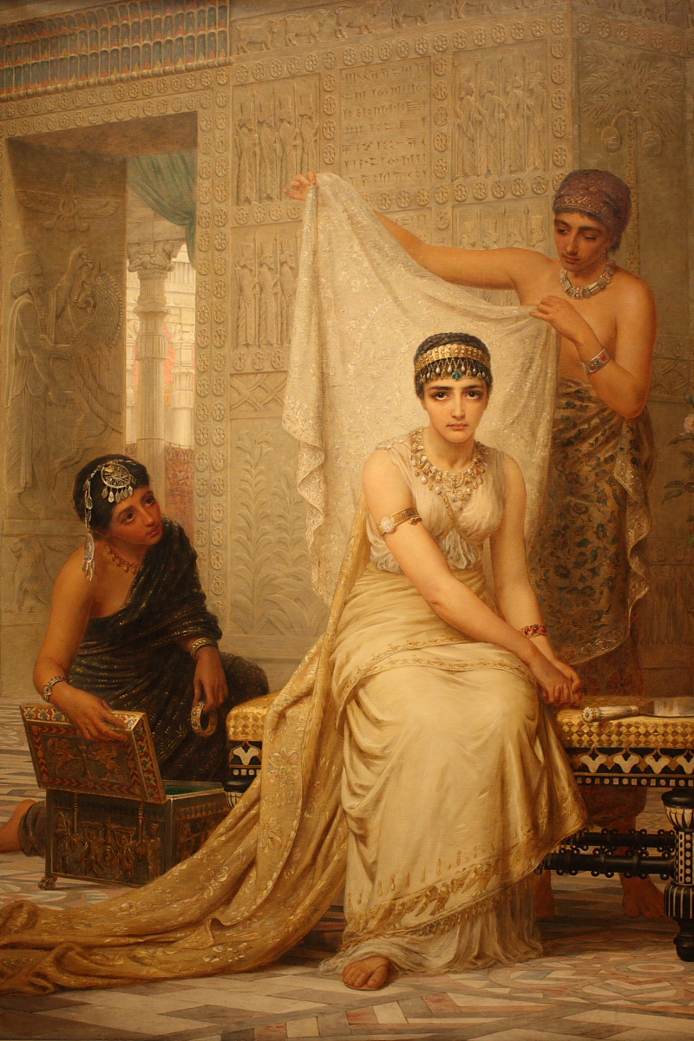
Esther 2:8-23 Esther is humble Esther meets Xerxes: God is in control!
Notes:
Not reveal identity. Interesting - he commands her, but emphasizes own nationality (3:4), reason for edict. Possibilities: 1) afraid of not being chosen if from exiles, foreigners looked down on; 2) from family of King Saul, so better to be of low birth so not be chosen. Not known motives.

Slide 7
Esther 3:1-15
Prideful Haman
Notes:
Mordecai is honest man, helping the king. Deserves a reward, but overlooked. Good guys have down times (Joseph, David, Jeremiah).

Slide 8
Esther 4:1-11
Disaster!
Mordecai
1. Prays
2. Takes action
Notes:
M tells of the plot / asks her talk to king. She’s afraid, he expresses faith that if not her, rescue from somewhere else. Discipleship (calling higher)! How? No explanations - Faith! No mention of God, but does she believe? Fasts. To whom? God! What is her resolve? Even if die!

Slide 9
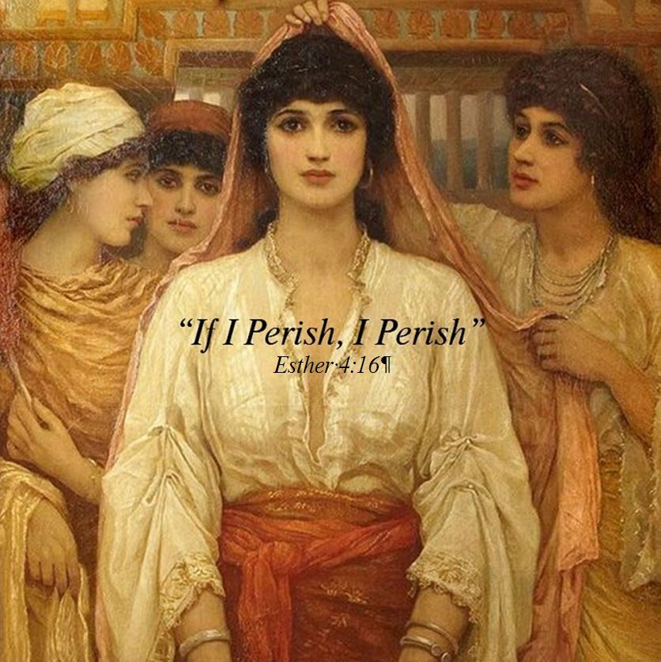
Esther 4:12-17
“For such a time as this.”
If I perish, I perish.
Esther a prefigure of the Messiah. She offers her life to save Israel.

Slide 10
Where’s God? Hebrews 11:1
Notes:
What situation..in right now that requires faith? What situation happened..causes you to question: Where’s God? Broken relationship / illness / loss of loved one / Financial pressures / Unreasonable children or parents… God is invisible, but always there! Faith.

Slide 11
Esther 5:1-8
On the third day…
1 Cor 15:4-5
God sends a ram.
Notes:
After 3 days of fasting, waits outside, the king extends scepter & asks. Now! Requests banquet (preparing during fast). He asks. Come on! Another banquet. No rush (we get in too much of a hurry). We ask for opportunities, God works (our patience, circumstances, others).

Slide 12
Esther 5:9-14
Haman/Satan is so confident!
Will God save Esther and will he save his people? Stay tuned…
Notes:
Before the next banquet 2 things happen: Haman decides to erect poles to impale Mordecai-eventually Romans add nails. (rage is getting out of hand) Slap our kids, yell at our spouse, hit a wall, swear at a car! Get it together! Esther’s waiting on Lord, Haman’s fuming inside!

Slide 13
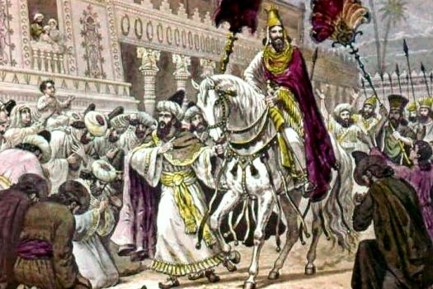
Esther 6:1-14 God is in Control!
Xerxes just happens to read the account of Mordecai saving his life.
Haman: Put a robe on him!

Slide 14
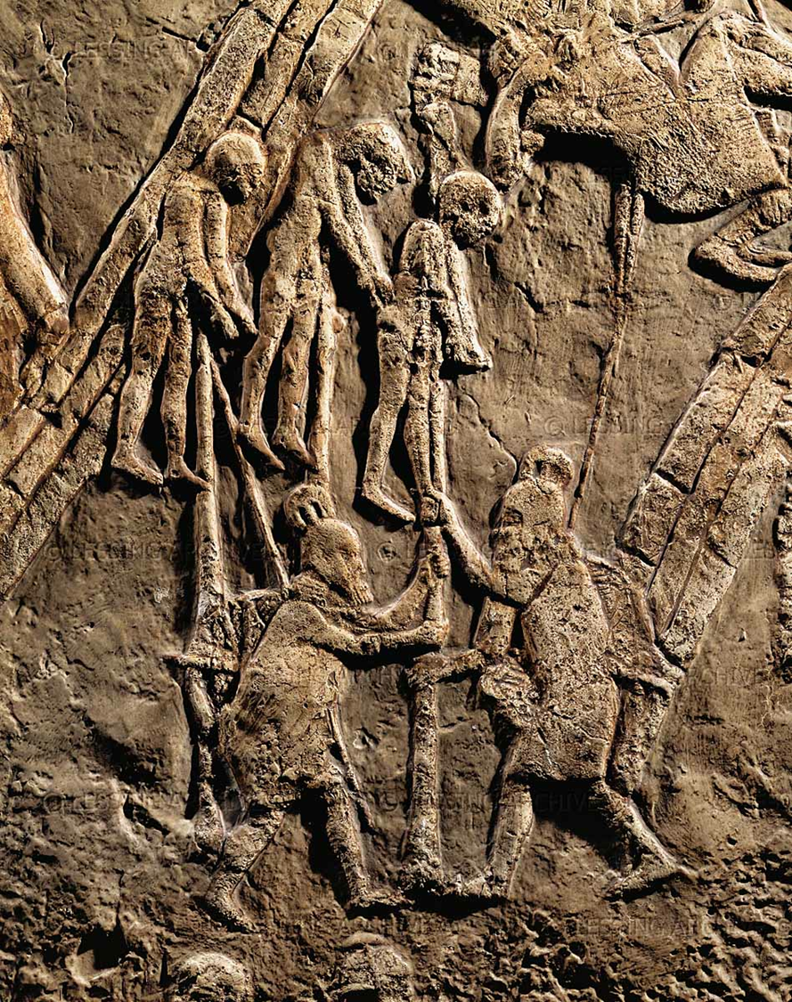
Esther 7:1-10 Again: God is in Control

Slide 15
Esther and Purim
Celebrated in March
2-day celebration
Dress up in constumes
Give gifts to the needy
Read Esther

Slide 16
Let’s Celebrate!
Passover to celebrate God saving Israel in Egypt.
Pentecost to celebrate the Spring harvest
Rosh Hoshannah/Trumpets to prepare for God’s coming
Yom Kippur/Day of Atonement to celebrate our atonement
Tabernacles to celebrate God living among his people
Hanukkuh to celebrate God saving Israel from Antiochus Epiphanes
Purim to celebrate God using Esther to save Israel from Haman and Xerxes

Slide 17
Lessons from Esther
God is in control. God is always working behind the scenes to support those faithful to him.
God blesses both faithfulness and humility.
God’s Messiah will save His remnant and Esther is a picture of his salvation.

