Slide 1
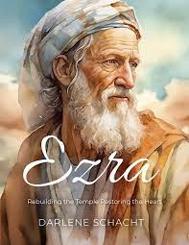
RRRR VIII Ezra Part II
Ezra: God uses a teacher to Restore and Rebuild the Kingdom

Slide 2
REPENT,

Slide 3
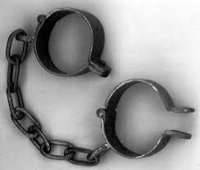
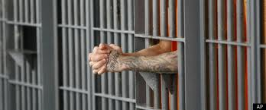
Here was Your Situation:
Lost
Enslaved
Captured
Imprisoned

Slide 4
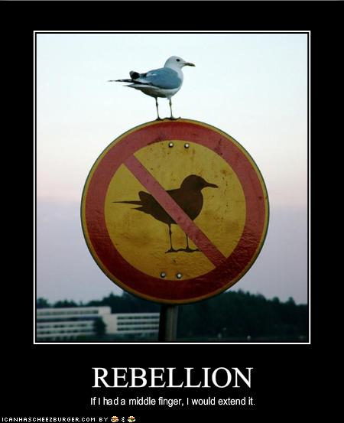
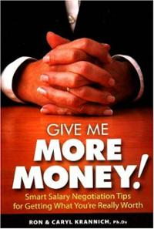
How Did you get there?
You Rebelled.
You went after other gods.
You said that what God
wants for you is not enough.

Slide 5
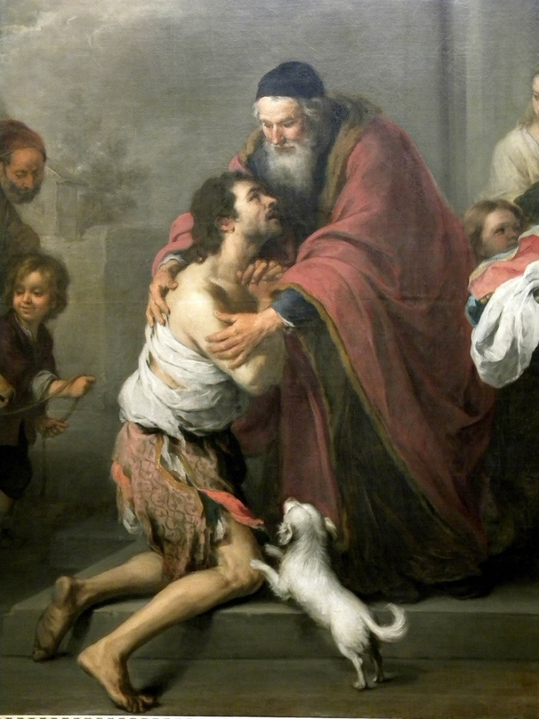
What is the solution?
Repent and Return
So that God can
Restore and Rebuild

Slide 6
Who are you?
You are people loved by God
You are Israel
You are any individual
You are the Church
You are a Church

Slide 7
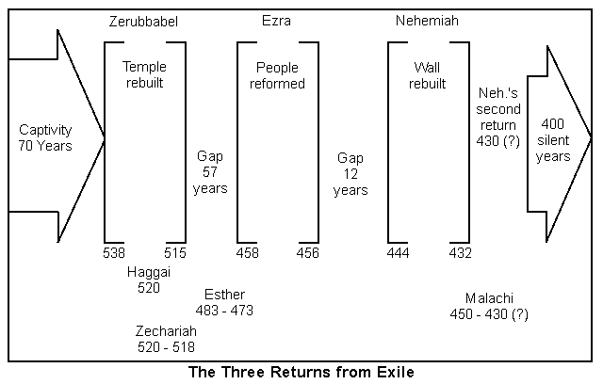
Notes:
Ezra 1-6 Cyrus allowed return (538 BCE) and began temple, completion under Darius (23 years later). Esther during Xerxes. Ezra comes under Artaxerxes.

Slide 8
Post-exile books
Ezra, Nehemiah, and Esther History
Haggai, Zechariah, and Malachi Prophets
Theme of these books: God’s wrath is complete. It is time for his remnant to Repent and Return so that God can Restore and Rebuild them.

Slide 9
Ezra / Nehemiah
Repent, Return, Restore, Rebuild
Notes:
The temple was rebuilt, the wall was finished, but repentance had to continue. That’s why we need Jesus; he covers all our sins and exemplifies the right path. Return to the Lord (repent), Restore convictions and obedience to the Word, Rebuild his holy nation!

Slide 10
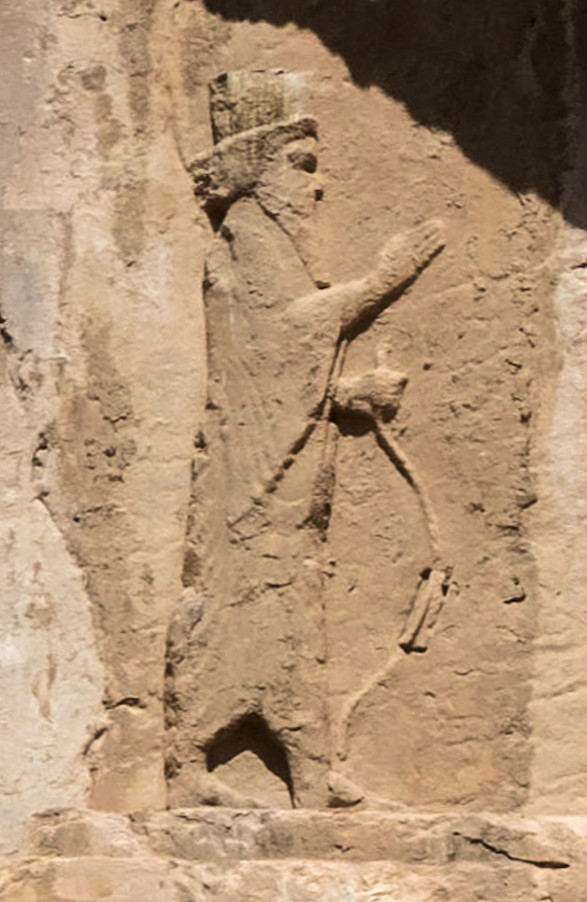
Ezra 4:11-23 Opposition to Rebuilding
Artaxerxes I of Persia

Slide 11
Ezra 7:1-10 Ezra the Teacher
Notes:
He is a priest (direct descendant of Aaron, v. 1-5) and scribe. Devoted to studying, obeying and teaching!

Slide 12
Nehemiah 8: Ezra
1. Ezra 7:6 Ezra was well-versed in Scripture
Neh 8:1-3 Ezra taught and preached for 6 hours!
2. Neh 8:7-9 Ezra read from the Law and made the meaning clear.
Neh 8:18 Ezra taught from the Law every day!
3. Ezra 7:10 Devoted to the study and observance of Scripture.

Slide 13
Ezra 7:13-26 Artaxerxes: Go back and rebuild Jerusalem!
Ezra 7:8 The seventh year of Artaxerxes. 458 BC
Daniel 9:24-25 Seventy sevens from the decree to restore and rebuild Jerusalem.
70 x 7 = 490 years
458 – 490 = -32 = 33 AD God is in control!

Slide 14
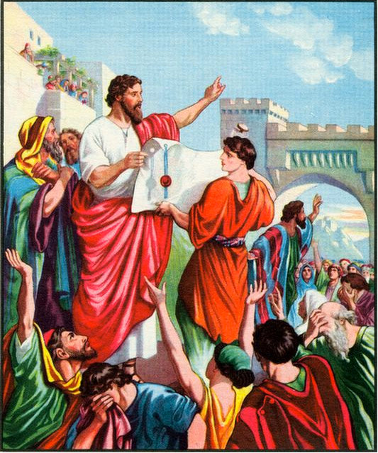
Ezra 7:27-28 God moves the heart of Artaxerxes
Notes:
God moved his heart (Pv 21:1). God did it! Because of his relationship with God, he gathered men to go with him.

Slide 15
Ezra 8:1-23 Ezra the humble teacher. Ezra 8:25 Scarcity vs abundance mentality
Notes:
v. 1-14 lists 2 priests and a descendant of David, then 12 clans (to recall the Exodus and the return in ch. 2, same clans).
Humble before God. Ask God for safe trip (Nehemiah didn’t mind asking the king). God used both. He answered!

Slide 16
Ezra 9 Sin in the camp
Ezra 9:1-4
v. 3 Ezra pulls his hair out.
v. They trembled about their sin
v. 4 Ezra appalled at the sin

Slide 17
Ezra 10 ezra takes action!
Ezra 10:1-6 Ezra praying, confessing, weeping, throwing himself down, fasting.
10:2 But there is still hope. We can repent and return to God.
Ezra 10:16-17 Ezra investigates who among them have married outside the “church.”
111/42,000 0.26% But look at Ezra!

Slide 18
Nehemiah 1:5-11 Nehemiah the builder is like Ezra the teacher.
Notes:
Once again a prayer for God to have the king extend favor. Did Nehemiah have control? No, but God did and he was God’s servant!

Slide 19
summary
1. God’s enemies will try to intimidate us into stopping the work or restoring and rebuilding.
2. In addition to evangelists and shepherds, God will use teachers to encourage the people and to keep the work of repenting, restoring and rebuilding going.
3. We need to continue to deal with sin in order for God to do the work of restoring and rebuilding.
4. The leaders must be zealous and humble.

