Slide 1
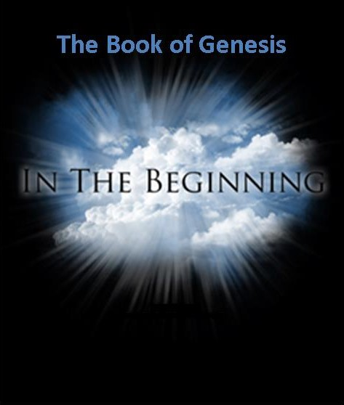

Slide 2
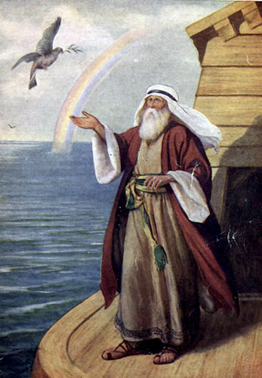
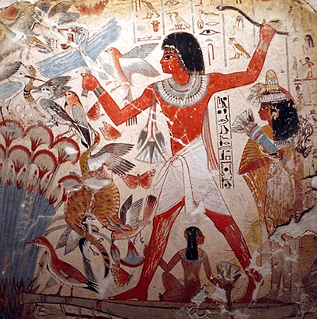
Genesis
Creation, Fall and Judgment
God chooses a man through whom to send the Messiah

Slide 3
An Outline of the Bible:
Genesis 1: Who is God?
Genesis 2: Who is man?
Genesis 3 & 4 The problem of sin.
Genesis 5-Revelation 20 God is solving the problem
Genesis 21-22 The problem is solved.

Slide 4
Another Outline of the Bible
I. Genesis 1 God created the universe and the earth. It was very good.
II. Genesis 2 God created man so that we could have an intimate relationship with him.
III. Genesis 3 and 4 We messed up very badly—destroying that relationship.
IV. Genesis 5-Rev 20 God is repairing the damage done by sin.
V. Rev 21-22 God has fixed the problem and we are back in a relationship with him.

Slide 5
Themes in Genesis
God: a loving Creator.
The Fall: Sin and separation from God.
Judgment
The Solution: God chooses a man of faith through whom to send the Messiah.

Slide 6
Genesis as an Introduction
Genesis: An Introduction to God.
Genesis: An Introduction to the Bible

Slide 7
A Very Brief Outline of Genesis
Ch 1-11 Primeval History Sets the background for the main focus of the book
Ch 12-50 The Patriarchs God launches his plan to save humanity from the consequences of sin.
The focus of Genesis: 1. God 2. Abraham

Slide 8
A Slightly More Detailed Outline
Ch 1-2 The original state of the world and the state to which we will return in the end.
Ch 3-11 Why mankind needs to be saved.
Ch 12-50 God initiates his plan to save mankind.

Slide 9
Outline of Genesis
Ch 1 Creation God, the creator
Ch 2,3 Adam and Eve The fall of man, God’s plan begun.
Ch 4 Cain and Abel Temptation, sin, judgment and death.
Ch. 5 Genealogy God’s plan to send the Messiah
Ch 6-9 The Flood Judgment against sin and salvation by faith
Ch 10 More Genealogy God’s plan to send the Messiah
Ch 11 The tower of Babel God vs. idols
Ch 12-23 Abraham; The Father of Faith God chooses a person through whom to send the Messiah.

Slide 10
Outline of Genesis (cont.)
Ch 24-26 Isaac The Son of Promise
Ch 27-35 Jacob The Father of the Nation
Ch 37-47 Joseph Favorite son and savior of Israel
Genesis 49 The Twelve Tribes Prophecies about God’s People.
Genesis 50 The Death of Jacob Epilogue to Genesis Prologue to Exodus

Slide 11
Author of Genesis
Not named
We do not know.
Tradition: Moses. Not likely.
An author(s) who is familiar with/lived in Mesopotamia.
Biblical Criticism: J, P, E,… multiple authors
speculative and unlikely.

Slide 12
Genesis Chapter 1: Creation
Genesis Ch 1-3 is primarily theology.
Genesis 1:1
In the beginning…
In the beginning, God…
In the beginning, God created… (Heb 11:3 Rom 1:21-25)
In the beginning God created the heavens and the earth

Slide 13
Genesis 1: A Polemic
A polemic against Enumah Elish. The Babylonian creation myth.
Wenham: “Gen 1-11 is a commentary, often highly critical, on ideas current in the ancient world about the natural and supernatural world.”
In Enumah Elish creation of mankind was an afterthought. In the Genesis mankind are the apex and purpose of creation.

Slide 14
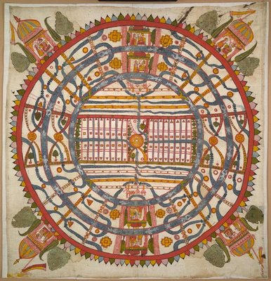
World View
One's world view is the perspective one uses to process and interpret information received about the world.
James W. Sire, The Universe Next Door (InterVarsity Press, 1997)
A Jain World View

Slide 15
Competing World Views
Naturalism/Atheism
Postmodernism: No World View
Deism
Pantheism
Animism/Polytheism
Dualism
Biblical Theism

Slide 16
The Christian World View According to Genesis 1-4:
1. The physical world is: a. real b. created out of nothing (ex nihilo) and c. essentially good.
2. There exists an unseen spiritual reality which is not limited to or defined by the physical reality. Human beings have a spiritual aspect to their nature.
3. The creator of both the physical and spiritual realm is the God who reveals himself in the Bible.
4. Human beings have both a physical and a spiritual nature.
5. God is characterized by certain qualities. God is a person. God is love, God is just, God is holy, God is omniscient, omnipotent and omnipresent.

Slide 17
The Christian World View (cont.)
6. Although all God’s creation is good, evil does exist. Evil is the result of freedom of will given to created beings and their decision to use that freedom to rebel--to “sin”
7. Because of God’s justice and his holiness, those who choose to rebel against him will ultimately be judged and separated from God for eternity.
8. The solution to evil, to sin and its eternal consequences is provided by God through the atoning substitutionary sacrifice of Jesus Christ.
All of this is found in Genesis 1-4

Slide 18
A Good World View
True. It is consistent with reality.
Successfully answers the important questions.
Purpose of life
Why is there evil
What is my value?
What is the right thing to do?
3. Makes those who accept it better than they otherwise would have been.

Slide 19
The Hard Questions
Evil: What is Evil and Why is There Evil
Why is There Suffering?
The Problem of Justice
The Problem of Sin.
The Problem of Death.

Slide 20
Christianity: A Good World View
It is true (the universe was created from nothing)
It answers the hard questions (why is there evil,
what is my purpose, what is my value, etc.)
It makes us better that polytheism, animism, dualism, atheism, panteism…

Slide 21
Genesis Chapter 1: Creation
Genesis 1:2-10 God creates order and distinctions out of disorder and formlessness
Light vs dark
Sky, water, land
Living vs non-living 1:11
Male vs female 1:27
Good vs evil Gen Ch 3

Slide 22
What Does God Do in Genesis 1?
He creates out of nothing.
He creates order out of chaos.
He creates distinctions/ separation
separation = holiness
He names things
naming = having power over

Slide 23
Two things to notice in Gen 1:2
v. 2 The Spirit of God was hovering…
The Holy Spirit in Genesis?
v. 2 etc. Evening and morning… the first day.
We would say morning and evening.
The Jewish day begins at sunset.

Slide 24
Genesis 1:11-25 God Creates Life
A lot of order from a lot of chaos.
Gen 1:14 The greater and lesser lights.
Again, a polemic against Mesopotamian worship of heavenly objects.

Slide 25
In God’s image and likeness
Genesis 1:26-30 God creates mankind in his image, to rule the earth.
Q: In what sense are we created in God’s image?
Q: What are the implications that God put us in charge of the earth?

Slide 26
Blessings
1:26 Let us make mankind in our image.
- The royal we?
- The heavenly court?
- The trinity?
1:28 God blessed humankind. This was his plan all along.

Slide 27
God: Mankind Will Rule the Earth
v. 28-30 Subdue and rule
Hebrews 2:8 “in putting everything under them…”
Q: What are the implications that we are in charge of the earth?
Does this mean we can do what we like? 1 Cor 4:2

Slide 28
It’s All Good
Genesis 1:31 Summary: It was all very good.
Q: Do you agree with God’s analysis here?

Slide 29
Genesis 2:1-3 The Seventh Day
Genesis 2:2 God rests from creating (but he is not completely resting).
This is theological justification for the Jewish Sabbath.
Heb 4:8-11 We do not rest. Our Sabbath-rest is in heaven.

Slide 30
Genesis Chapter One: Creation
Young Earth Theory
Earth is young and science supports this conclusion.
Earth is young because God created it “with an appearance of age.”
Day/Age Theory
Gap Theory
Framework Theory
It’s all just a myth
Each view has its problems

Slide 31
Framework Theory
Habitats Creatures
Day 1 Light Day 4 Luminaries
Day 2 Sky Day 5 Birds and fish
Day 3 Land Day 6 Land animals, man

Slide 32
A Quick Summary of Genesis One:
a. God pre-existed the universe
b. God created the universe: “Let there be light”
c. God created the earth
d. God created life
e. Last of all, God created mankind

Slide 33
A More Detailed Summary of Genesis One From the Viewpoint of an Observer on the Earth:
a. The earth created and is spinning: night and day. Day 1
b. Water covers earth, Very thick atmosphere forms. Day 2
c. The earth cools, land appears out of the water. Day 3
d. Life appears on the earth. Day 3
e. (Photosynthetic life dramatically changes the chemistry of the atmosphere from reducing to oxidizing.)
f. Finally, the heavenly objects appeared in the sky Day 4
g. More advanced life forms; first in the water, later on the land Day 5
h. Even more advanced life forms. Last of all human beings Day 6

Slide 34
Is Genesis 1:1 a Myth?
Yes! It is a true myth.
A myth is a simplified story, given to explain the gods (or God) to common people.
“Genesis 1 is a mixture of historical facts and religious truth based on these facts”

Slide 35
Creation Myths
Babylonian Creation Myth
Primeval swamp. Marduk kills Tiamat. Blood + mud = humans
Egyptian Creation Myth
Primeval ocean “Nun” from which arrises a Primeval hill.
Greek Creation Myth
Prometheus and Epimetheus form clay molds. Earth supported by Atlas.
Iroquois Creation Myth
Enigorio and Enigohahetgea: Good and evil brothers battle
Genesis One is an obvious exception to this pattern

Slide 36
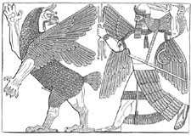
Babylonian Creation Myth: Marduk kills Tiamat

Slide 37
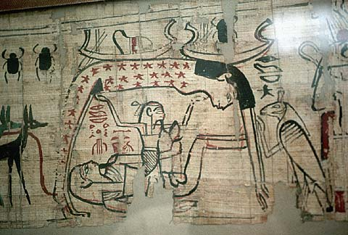
Egyptian Creation Myth

Slide 38
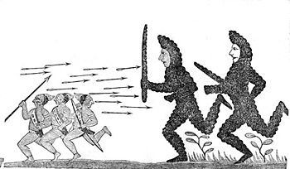
Iroquois Creation Myth:
Enigorio and Enigohahetgea Battling the Ronnongwetowanca (Stone Giants)

Slide 39
Is the Metaphorical Day a Reasonable Interpretation? Pre-Science Theologians Who Said Yes.
Philo 1st century
Origen early 3rd century
Augustine early 5th century
Thomas Aquinas 13th century

Slide 40
Translations of yom in the Old Testament (NIV)
1181 times as “day” (but with several different connotations of the word, some not being literal)
Isaiah 4:2 In that day the Branch of the Lord will be beautiful…
67 times as “time”
30 times as “today”
18 times as “forever”
10 times as “continuously”
6 times as “age”
4 times as “life”
2 times as “perpetually”

Slide 41
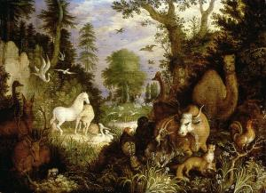
Genesis 2:4-25 Who is man?
Created in God’s image 1:27
Given authority over the earth 1:26 2:19-20
Created to know God and to be known by him.
Created for relationships Genesis 2:18. 23-25
God walked in the garden 3:8
Given everything, including “free will.” Genesis 2:9, 15-17
Adam and Eve are us!

Slide 42
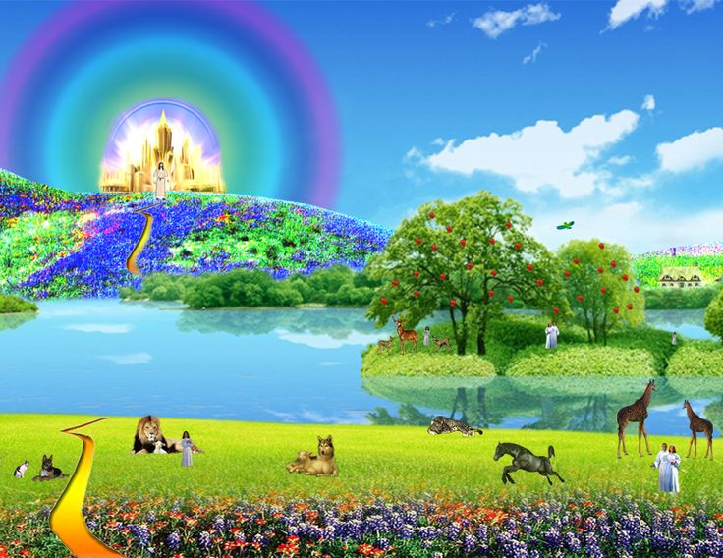
Genesis 2:4-25 How it was supposed to be
Eden is a picture of heaven.
Heaven imagery comes from Eden
Ezekiel 47:1-12, Revelation 22:1-5

Slide 43
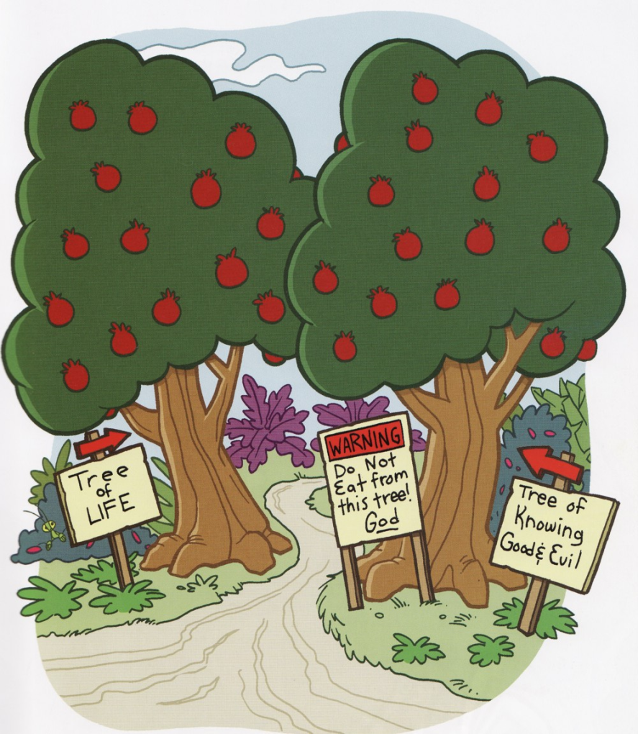
Genesis 2:9 Two Trees
The tree of life. A tree which imparts life (Rev 22:2)
Q: Were Adam and Eve supposed to be immortal?
The tree of knowledge of good and evil.
Q: What is this knowledge?

Slide 44
Knowledge of Good and Evil
Gen 3:5 It made them (more) like God.
It was knowledge that we could not handle without becoming prideful.
Genesis 11:4 They wanted to make a name for themselves.
Gen 2:17 If we eat of this tree, we will die.

Slide 45
Genesis 2:17 What is this death?
Romans 5:12 Sin came into the world and death through sin.
Is it physical death?
Is it spiritual death?
Could it be both?

Slide 46
Genesis 2:20-25 God creates a helper
Adam is not satisfied with naming the animals.
v. 22 Eve formed from Adam’s rib = equal to Adam
v. 23 Adam is really fired up!
v. 25 Naked and unashamed.

Slide 47
II. Genesis 3-11 The Need For a Savior
Genesis 2 The Fall of Adam and Eve
Genesis 3 Cain Kills Abel
Genesis 6-9 The Flood
Genesis 11 The Tower of Babel

Slide 48
Genesis 3 The Fall of Man
God: There is just one thing you cannot have.
v. 3 Eve exaggerates the restriction.
v. 4 Satan: “You will not surely die” tells a half-truth
Satan’s goal is to get us to question God’s love for us.

Slide 49
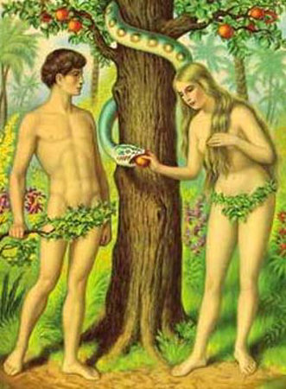
Genesis 3 The Fall of Man
Genesis 3:6 The fruit was desirable.
Their sin? Pride. Wanted to be “like” God.
The result: lost innocence death and separation from God.
Adam and Eve are us in this sense as well.
Genesis 3:15 God will provide a solution: Jesus.

Slide 50
Genesis 3 The Pattern of Sin
Selfish desire
Lack of trusting God’s providence
Sin
Consequences
James 1:14-15
In Genesis, God teaches theology through story

Slide 51
Genesis 3 The Consequences of Sin
Shame
Loss of Innocence
v. 8 “Where are you?” God is trying to get Eve to realize the seriousness of what she has done.
v. 12-13 Attempts to blame-shift

Slide 52
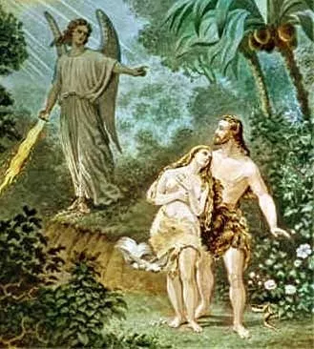
Consequences (cont.)
v. 16 pain, suffering
v. 17-19 harder labor
v. 22 death
v. 23-24 separation from God
But… God provides
Pattern: temptation, sin,
consequences, provision for
healing.

Slide 53
Adam: A Type of Jesus
Romans 5:12-19 The sin of Adam set a pattern and produced a terrible result.
The sinless life of Jesus set a pattern and produced a wonderful result.
1 Cor 15:45-49 Like Adam in our physical nature. Like the second Adam in our spiritual nature.

Slide 54
The “Fall” A Hard Question
Q: What is the nature of the “fall” of mankind?
Lost innocence
Gained unhealthy knowledge
Calvinists: “In Adam’s fall, we sinned all.”
Did we acquire a sinful nature?

Slide 55
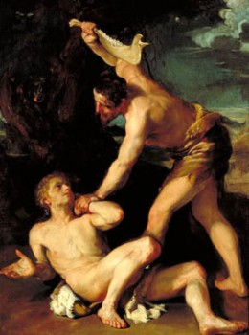
Genesis 4 Cain and Abel Things go from bad to worse
Genesis 4:3-5 God did not look with favor on Cain’s sacrifice.
not meat?
did not give his best.
Did not follow instructions?
Not given in faith (Heb 11:4)
v. 5 Very angry. Why? God favored the younger brother: Abel, Seth, Isaac, Jacob, Joseph, David

Slide 56
Cain’s Sin: A Pattern
4:6 For us, “sin is crouching at your door; it desires to have you, but you must master it.”
Genesis 3,4,6,11
Temptation
Sin
Avoiding Responsibility
Consequences
God Provides Healing and Hope

Slide 57
Genesis 4 Consequences
Gen 4:9,10 God: Where is your brother? What have you done?
Q: Is Cain Abel’s keeper?
Cain is exaggerating what God required to give himself an excuse.
Genesis 4:13-14 Has Cain repented?

Slide 58
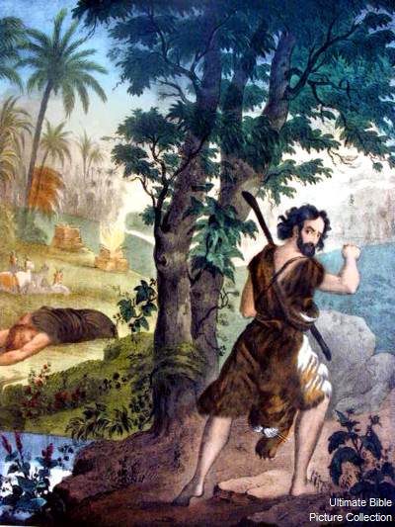
Gen 4 God Makes Provision for Cain
4:15 God marks Cain to protect him from harm.
4:16 Cain flees to Nod (wandering)
The result of sin: alienation and loneliness

Slide 59
Genesis 4:17-5:32 Genealogy
4:17-24 Who did Cain marry? Gen 5:4
The descendants of Cain, generally, are more worldly.
Lamech, for example. 2 wives, revenge 77 times.
4:25-5:32 The descendants of Seth are more spiritual.

Slide 60
Genesis 5 Descendants of Seth
Enosh “men began to call on God”
Enoch “walked with God and was no more”
Heb 11:5 2 Kings 2:3-10
Could this be what God had in mind for Adam and Eve?

Slide 61
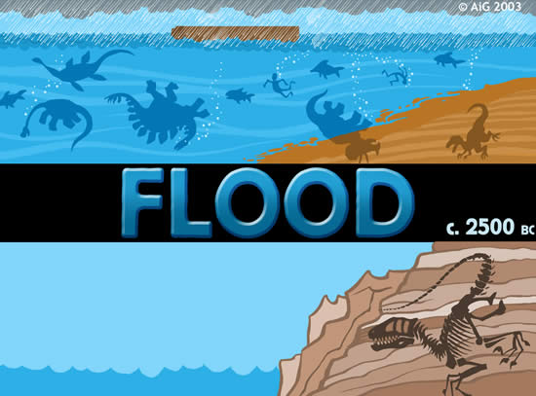
The Flood: Genesis 6-9

Slide 62
Genesis 6-9 The Flood.
The pattern is repeated here.
1. Mankind becomes totally corrupt.
2. God punishes mankind.
3. God provides for healing and restoration.

Slide 63
Genesis 6:1-8 Things Go From Bad to Worse to Worser ☺
Q: Who are these “sons of God”?
Q: Who are these “daughters of men”?
“sons of God” = angels?
1 Enoch 6:2, 2 Peter 2:4-5, Jude 6
“sons of God” = arrogant, ungodly men
“married” = took (laqach)

Slide 64
Genesis 6 Things get even worse
Gen 6:3, 5-8 God’s holiness, justice trump his love in this case.
v. 3 Contend is not the best translation. Remain would be better.
v. 6 “The Lord was grieved that he had made man on the earth, and his heart was filled with pain.”
God regretted (not repented) making mankind.

Slide 65
Noah
Rest
Hope

Slide 66
Salvation is by faith
Genesis 6:8 Great news!!
“But Noah found favor in God’s eyes.”
v. 9 Why? Noah was righteous, blameless and faithful.
Noah was relatively righteous and blameless.
Noah was righteous and blameless because of his faith Genesis 15:6, Romans 4:3
Hebrews 11:7 righteousness in keeping with his faith.

Slide 67
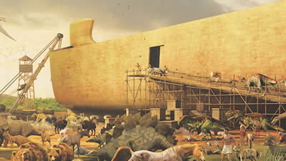
Noah: A Man of Faith
Genesis 6:11-22
Build a massive boat.
I will send the animals.
6:22 An amazing statement. “Noah did everything just as God commanded him.”
Heb 3:18-19 disobedience = unbelief

Slide 68
Historical Foreshadows
The world was judged (2 Peter 3:5-9)
But Noah and his family were saved. (1 Peter 3:20-22)
Noah is a second Adam. Adam 2.0
As Noah was raised, Jesus was raised
Jesus is Adam 3.0

Slide 69
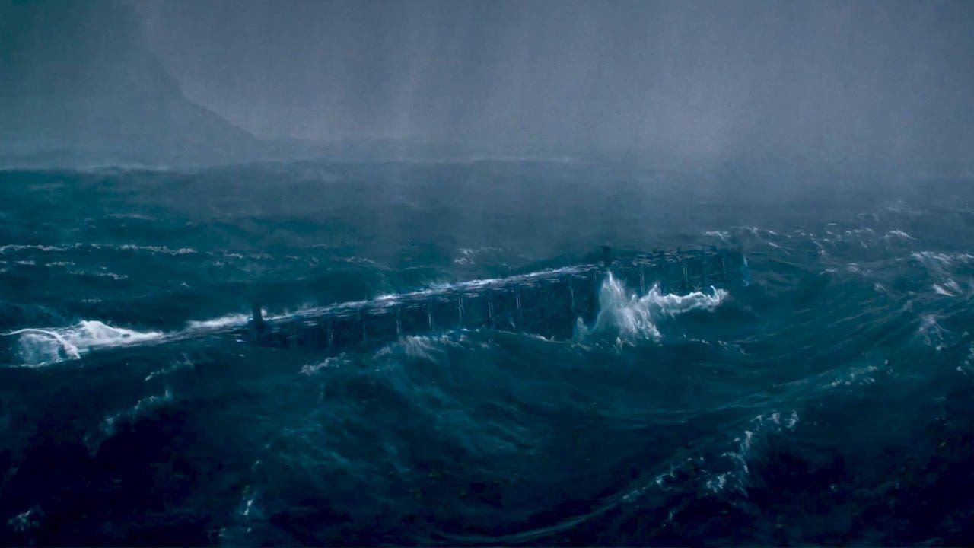
The Flood: Another True Myth
Wenham: “In the flood, the bounds established at creation were overstepped, and chaos and death ensued.”

Slide 70
Ancient Cultures With Flood Stories
Hindus
Burma (Myanmar)
New Guinea
Aborigines of Australia
New Zealand
Iroqoi
Incas
Aztecs
Greeks
Babylonians
Sumerians
Celts
Hottentots (Southern Africa)

Slide 71
Common Elements in Flood Myths
1. The flood a judgment.
2. Massive or world wide in effect.
3. Some humans saved from this flood and repopulate the earth.

Slide 72
Common Elements with Gilgamesh
1. A decision to destroy mankind
2. God or god warns a hero about the impending flood
3. Flood hero (Utnapishtim, Noah) told to build an boat
4. Hero obeys
5. Hero enters ark and the door is closed
6. Flood comes
7. Live destroyed
8. Water subsides
9. Boat grounded in mountians
10. Birds sent out.
11. Exit and sacrifice

Slide 73
Differences from Gilgamesh
The gods not unanimous.
Utnapishtim saved because he worships a god who does not favor bringing on the flood.
Utnapishtim closes the boat himself
The gods lose control of the flood. They “cowered like dogs.”
After the flood, the gods crowd “like flies” around the sacrifice because mankind was created to feed the gods.
The gods are capricious, are not omnipotent and are not just or loving.

Slide 74
Explanations of the Flood
Just an unfounded myth.
Worldwide flood.
With a “scientific” explanation
A unique and miraculous event
Local flood
Earth (erets) and all/every (kol) allow for a local meaning. Ex. Gen 41:57

Slide 75
The Bible and the Flood
New Testament writers clearly believe this was a historical event. Matthew 24:38-39
It happened as judgment for sin 2 Peter 3:6-7
It is a prefigure of final judgment
It is a miracle, not a “natural” event—like the fire which will destroy the world
Belief in the flood based chiefly on faith in the Bible, certainly not on science.

Slide 76
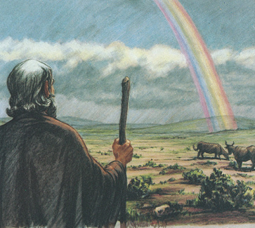
Genesis 9:8-17 God Makes a Covenant With Noah
God: I will take care of you and your family
I will never judge the world by flood again.
The rainbow will be a reminder of my covenant.
5 Covenants:
Noah
Abraham
Moses
David
Jesus

Slide 77
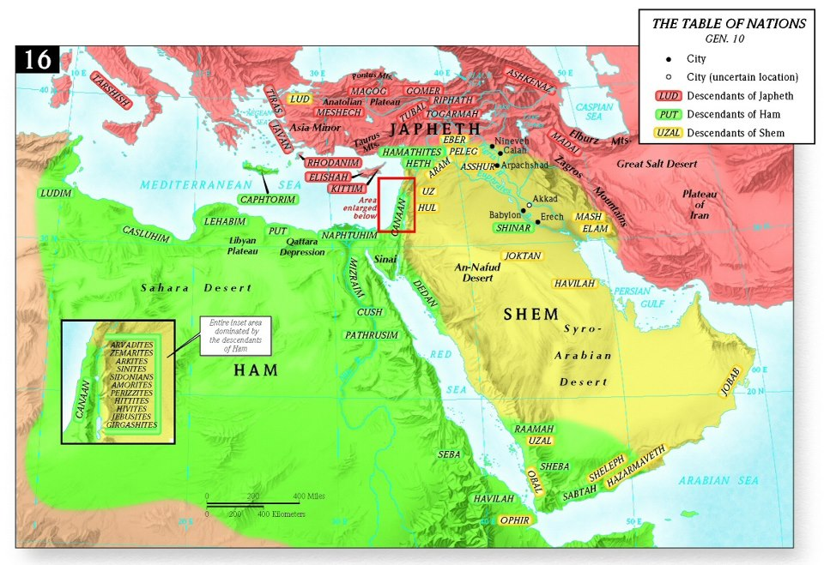
Genesis 10 Genealogy #2
Japheth goes north and west
Ham goes south
Shem goes east.

Slide 78
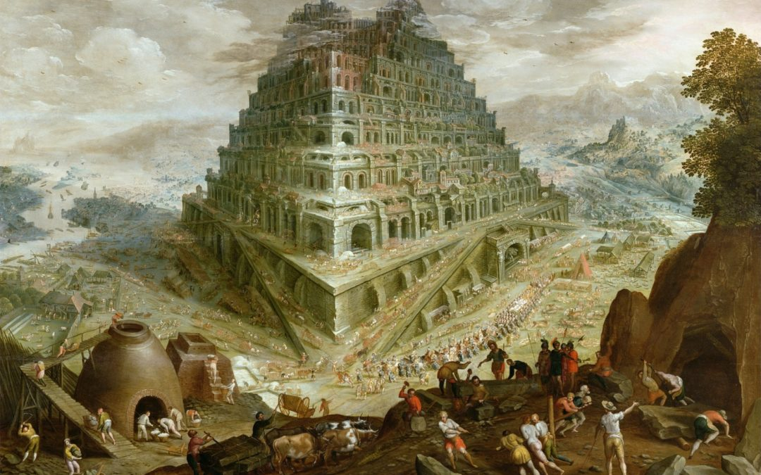
Genesis 11 The Tower of Babel
Genesis 11:1-4 Hubris. Man seeks to make himself great. “Let us make a name for ourselves.”
Like Daniel 4:30
Like us?
1 Corinthians 4:7

Slide 79
God’s Response to Babel
The Lord came down to see the city.
We look tiny to God.
Great accomplishment on our part may not be in our best interest.
Q: Are you trying to make yourself great?
Prov 16:3 Commit your work to the Lord and your plans will be established.

Slide 80
God Judges Babel
Babel: The folly of humanistic effort at greatness.
God’s response: To confuse their language.
Babel = gate of God Balel = confuse
This may have been to protect them from themselves, rather than to punish them.

Slide 81
Genesis 11:10-26 God’s Plan to Save His People
10 toledoths (generations)
1. The heavens and the earth (2:4a)
2. Adam and his descendants (5:1)
3. Noah (6:9)
4. Ham, Shem, and Japheth (10:1)
5. Shem (11:10)
6. Terah/Abraham (11:27)
7. Ishmael (25:12)
8. Isaac (25:19)
9. Esau (36:1 and 9)
10. Jacob (37:2)

Slide 82
Gen 11:27-32 A Slow Start
Gen 11:32 They set out for Canaan
But they “settled” for Harran
Q: Have you settled for less that Canaan?

Slide 83
III. Genesis 12-50 God’s Plan to Save Mankind
Genesis 12-23 God chooses a man of faith through whom to bring the Messiah.
Genesis 24-50 God prepares a people through whom to send the Messiah.

Slide 84
Genesis 12-25 Abraham
Abraham the chief (human) figure in Genesis
Abraham is a “type” and we are the “antitype”.
Romans 4:11-12, 16-17 Faith is why Abraham was made the father of us all and the father of many nations.
Gal 3:7-10 Scripture foresaw…
Abraham: Salvation is by faith from first to last.

Slide 85
Gen 12:1-3 God Calls Abraham
Leave your country.
Leave your people (culture)
Leave your household (family)
zz
A foreshadow of Israel leaving Egypt
Luke 14:33, Luke 9:62 We, like Abraham, have left Harran.
Q: What is your citizenship? Phil 3:20

Slide 86
Genesis 12, 13, 15, 17 A covenant with Abraham
Genesis 12:2 13:16 I will make you into a great nation.
Genesis 12:3 All nations will be blessed through you.
Gen 12:7 13:15 15:18 I will give you this land.
Genesis 15:4-5 I will give you a son, and your offspring will be like the stars in the sky.
Genesis 17:6 Kings will come from you.

Slide 87
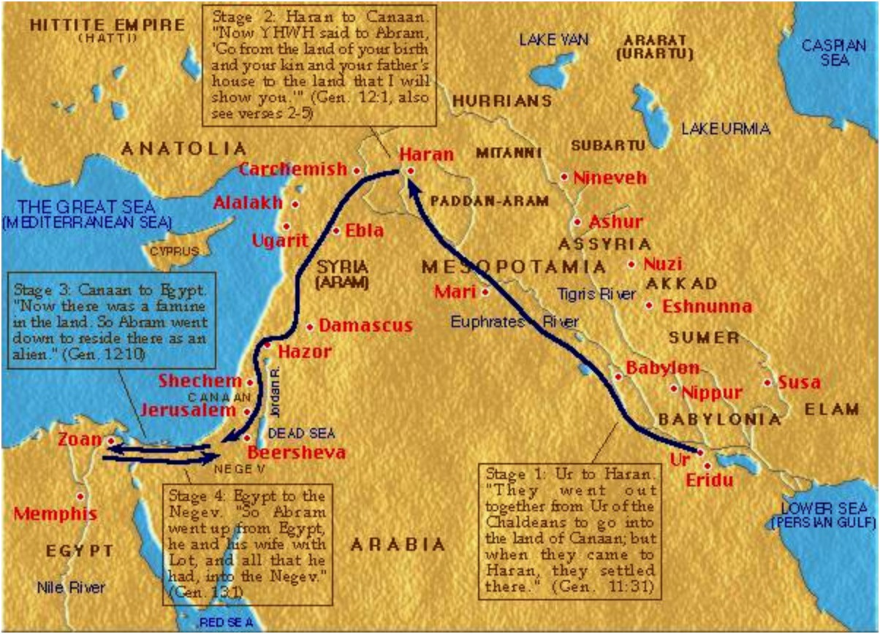
Travels of Abraham and Sarah

Slide 88
Gen 12:10-20 Abram and Sarai in Egypt
Abram tells a half-truth
God judges Egypt and blesses Abram
Pharaoh has more faith than Abram?

Slide 89
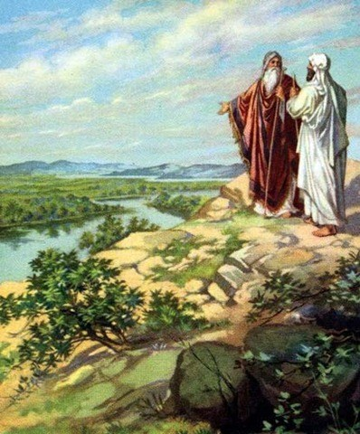
Genesis 13:1-14:24 Abraham and Lot
Gen 13:8-13 Abraham’s faith is increasing.
Lot saw…
Gen 13:17 God: All the land you see I will give you as an inheritance.
Q: What do you see God giving you, by faith?
Gen 14 Abraham saves Lot

Slide 90
Genesis 14 Abraham Saves Lot
Contrast Abraham and Lot
Genesis 13:12 Lot lives NEAR Sodom
Genesis 14:12 Lot living IN Sodom
Gen 14:22-24 Abraham: I will accept nothing belonging to you. Abraham avoids entanglement in the world.

Slide 91
Melchizedek: Prefigure of Christ
Melchizedek means King of Righteousness.
King of Salem means King (prince?) of Peace.
The King of physical Jerusalem.
Without beginning or end of days.
Without descendants.
High Priest because of his character, not by descent.
Greater than Abraham (Heb 7:4, John 8:53-58).
Blessed Abraham Gen 14:19

Slide 92
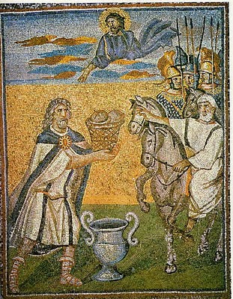
Melchizedek: Prefigure of Christ
Blessed Abraham Gen 14:19
Gave Abraham bread and wine (prefigures Lord’s Supper)
Not a Levite (not even a Jew!)
A priest for everyone; not just for the Jews.
A priest and a king.
A priest forever (Heb 7:3, Ps 110:4

Slide 93
Genesis 15 God Makes a Covenant With Abraham
Gen 15:2-3 Abraham is struggling here
1. You will have a son (15:4)
2. Like the stars in the sky, “So shall your offspring be.” (15:5)
3. I will give you this land (15:18-19)
“Abraham believed God and it was credited to him as righteousness” (15:6) Romans 4:3

Slide 94
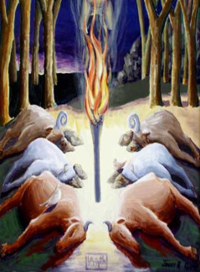
God Confirms His Covenant
Symbolism: Whoever walks between the halves invokes on themselves the same fate if they do not live up to their end of the bargain.
God humbles himself to assure Abraham.
But… 400 years

Slide 95
Genesis 16-18, 21 Hagar, Sarah, Ishmael and Isaac
Gen 16:1-4 Sarai offers Hagar to Abraham.
Ishmael is definitely not the child of promise/faith!
Gen 16:7-16 Sarai persecutes Hagar. Hagar flees. God intervenes.
Gen 16:12 Ishmael’s descendants (the Arabs) will be in perpetual hostility to his brothers (the Jews)

Slide 96
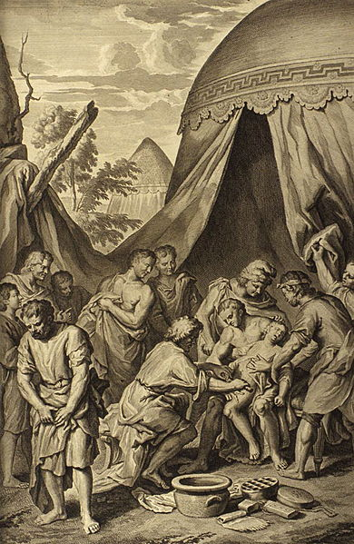
Genesis 17 & 18 The Covenant of Circumcision
Gen 17:12 Every male child 8 days old….
Gen 17:15-16 Sarah will bear a child. Abraham laughs. Isaac (yitschaq) = he laughs
Gen 18:12-14 Sarah laughs. Is anything to hard for the Lord?

Slide 97
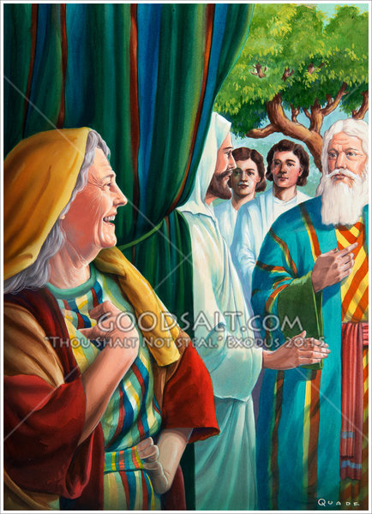
Sarah Laughs Twice
Gen 18:12 Sarah laughs. “After I am worn out and my lord is old will I now have this pleasure?
18:14 Is anything too hard for the Lord?
Gen 21:1-7 Isaac is born and Sarah laughs again.

Slide 98
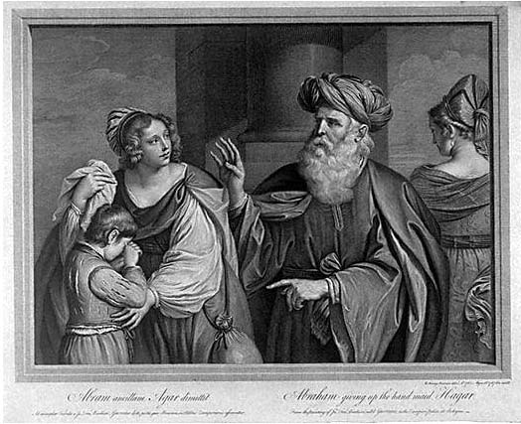
Genesis 16-18, 21 Hagar, Sarah, Ishmael and Isaac
Hagar, Ishmael represent slavery and they represent physical Israel.
Ishmael… born “the usual way”
Sarah and Isaac represent freedom, promise. They represent spiritual Israel—us?
Isaac the child of promise
Galatians 4:21-31

Slide 99
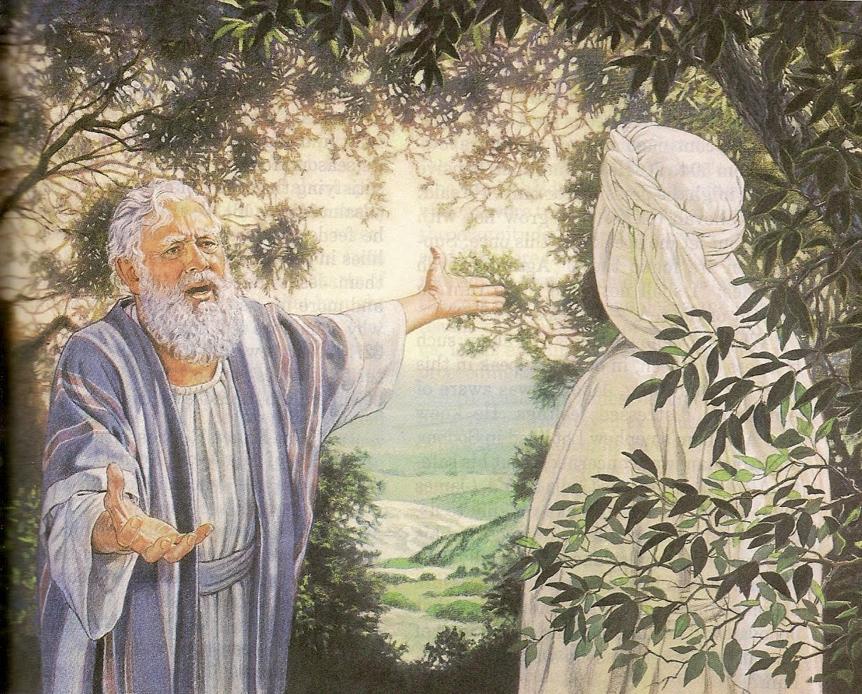
Gen 18:17-23 Abraham Intercedes for Sodom
Gen 18:19 I have chosen (yada known) Abraham.
Abraham, like a prophet, pleads for Sodom.

Slide 100
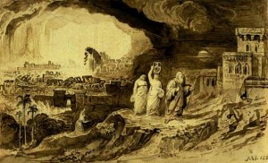
Genesis 19: Sodom and Gomorrah
Sodom and Gomorrah is about Judgment!
Sodom and Gomorrah is about Salvation.
We need to be like the two angels.

Slide 101
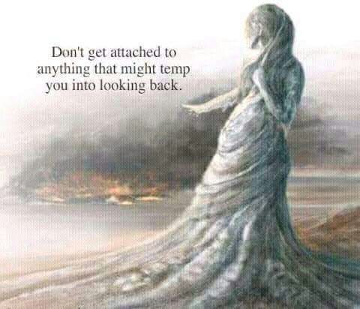
Who is Lot? Who is Lot’s Wife?
2 Peter 2:6 Lot, a righteous man.
Luke 17:32 Remember Lot’s wife.
We need to remember Lot’s wife.
Gen 19:29 God remembered Abraham and saved Lot.

Slide 102
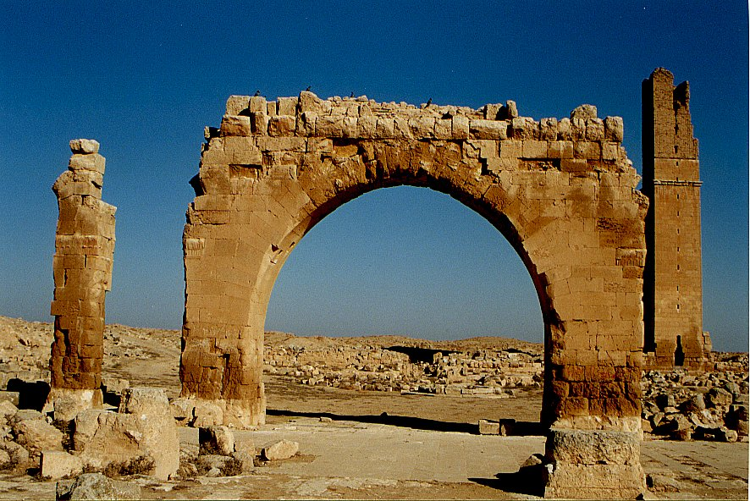
An Aside: Archaeology and Genesis
Haran Ruins In Mesopotamian Plane Near Sanli Urfa, Turkey

Slide 103
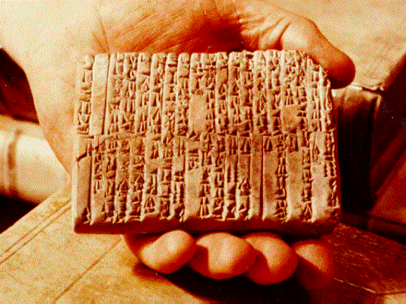
One of the Ebla Tablets about 2100 BC
Nahor, Terug, Abram, Sarai

Slide 104
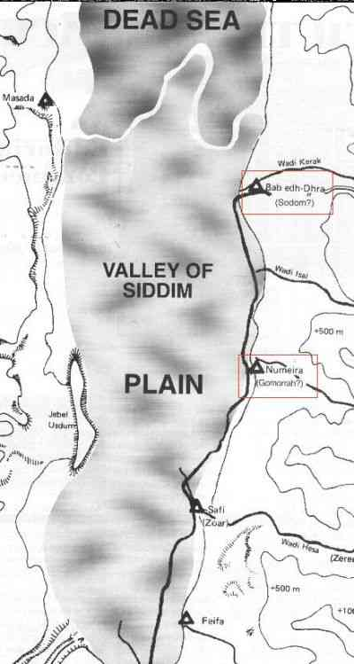
The Five City League, including Sodom and Gomorrah
Genesis 14:2

Slide 105
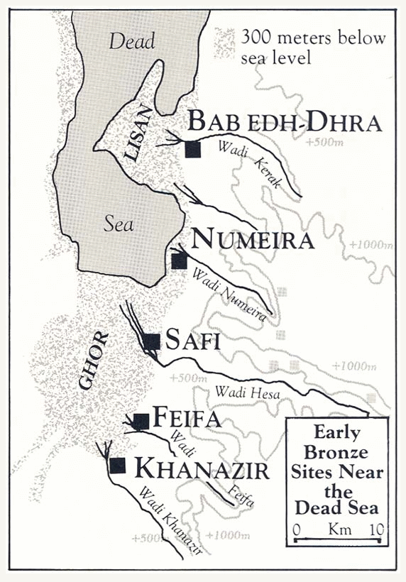

Slide 106
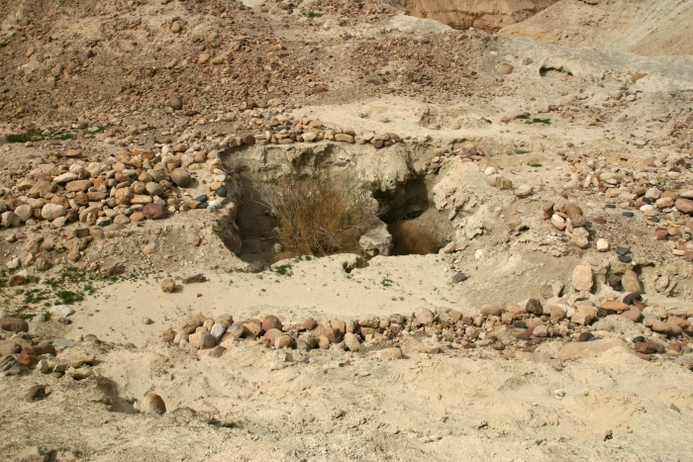
Ruins at Bab ed-Dhra (Sodom)

Slide 107
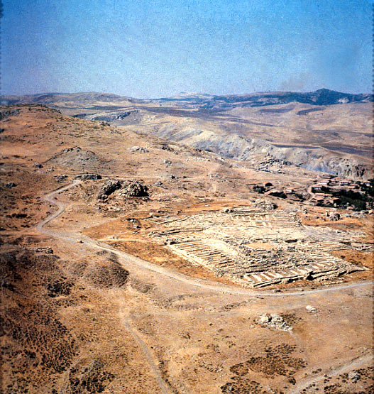
Ruins of Hattusha, capital of the Hittites

Slide 108
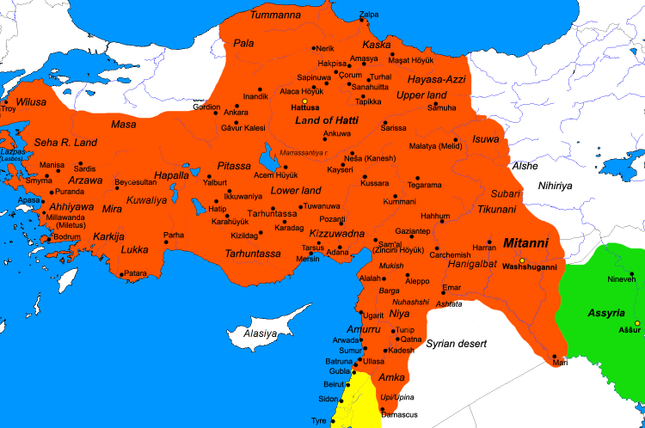
The Hittite Empire ca. 1300 BC

Slide 109
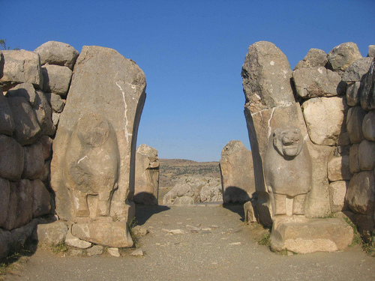
The Lion Gate in Hattusha

Slide 110
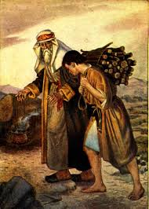
Abraham and Isaac
Genesis 22:2-14
Take your son… your only son Isaac…
1 Cor 15:3-4 On the 3rd day.
Heb 11:19 Figuratively, Abraham received is son on the 3rd day.

Slide 111
Abraham Walked by Faith
We need to follow the footsteps of Abraham:
Out of Ur/Haran.
To Mt. Moriah.
Gen 22:14 On the Mountain of the Lord, it will be provided.

Slide 112
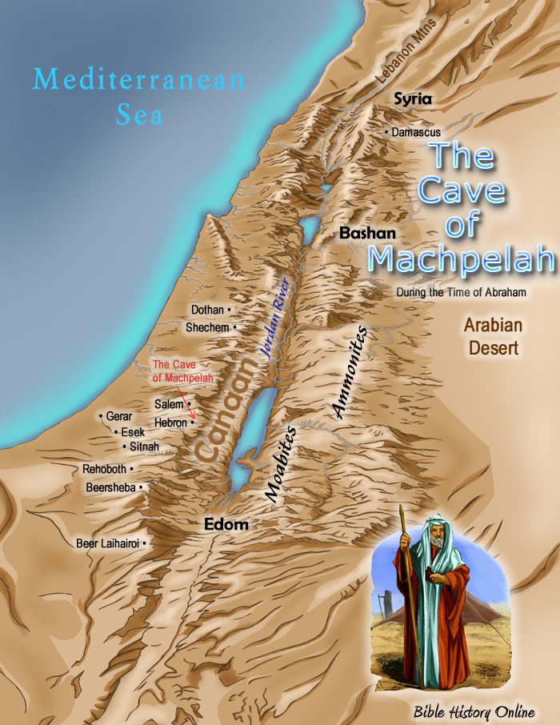
Genesis 23 Abraham Buys a Field
Abraham buys a cave and field in Machpelah.
Heb 11:13 Abraham only saw the fulfillment of the promise from afar.

Slide 113
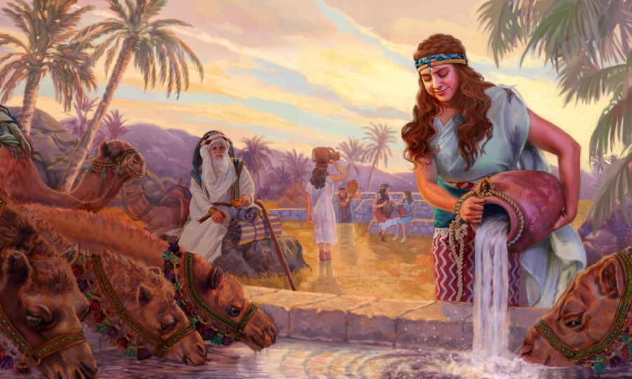
Genesis 24 Isaac and Rebekah
Abraham trusts God.
Abraham’s servant prays specifically and is answered

Slide 114
Genesis 25-36 Jacob and Esau God’s Unmerited Favor
Esau: Physical Israel and the Old Covenant.
The natural first-born.
Jacob: Spiritual Israel and the New Covenant.
The chosen “first-born.” Romans 9:10-13
Q: Was Jacob more righteous than Esau?
Q: Did God really hate Esau?

Slide 115
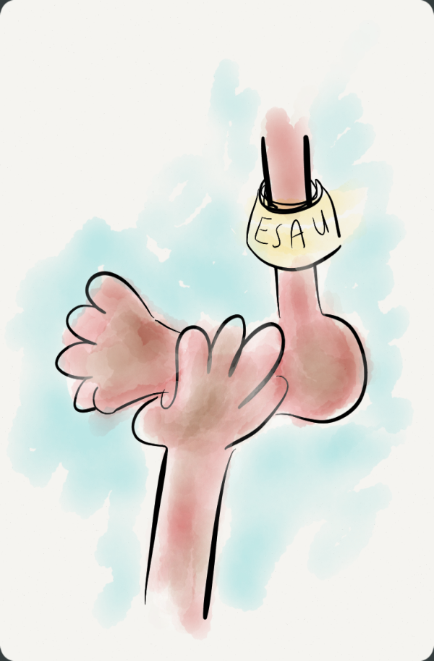
Genesis 25:21-34 God chooses Jacob
Gen 25:23 Two nations are in your womb. (Israel and Edom)
Esau = hairy
Edom = red-head
Jacob = grasp the heel

Slide 116
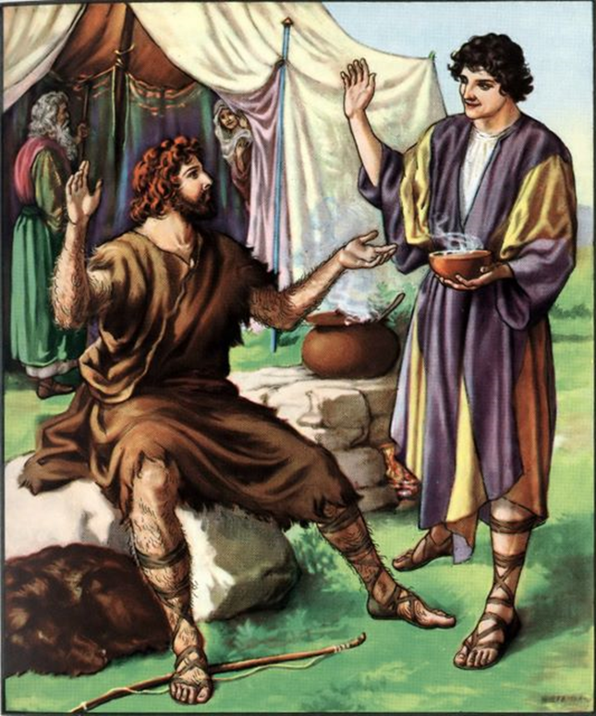
Gen 25 Esau Sells His Birthright
Gen 25:27-34 Jacob takes the birthright by cunning.
25:34 Esau despised his birthright
Luke 9:25.
Q: How could we be like Esau?

Slide 117
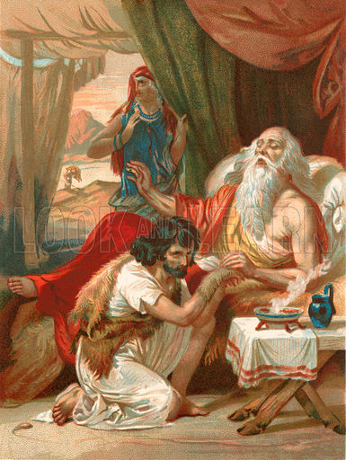
Genesis 27:1-40 Jacob Steals Esau’s Blessing
None of the characters in this story come off well.
Isaac does not invite Jacob to the blessing.
Esau agrees to the plot.
Rebekah a manipulative schemer.
Jacob a selfish, cunning schemer.

Slide 118
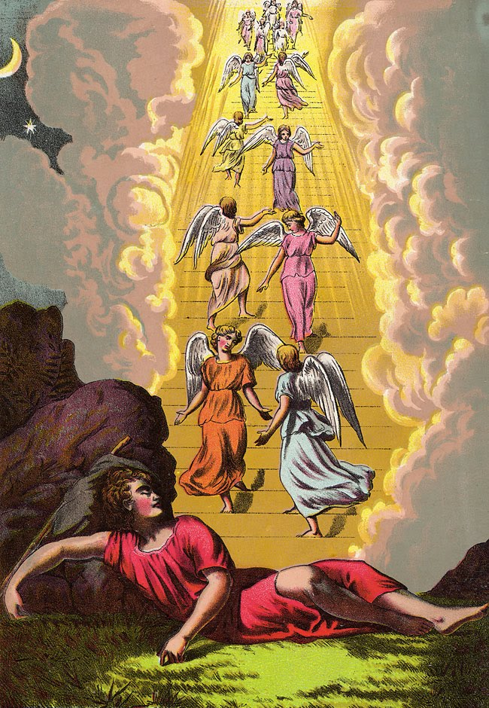
Genesis 28:10-22 God Reassures Jacob
I will be with you.
I will bring you back.
Bethel (house of God)

Slide 119
Gen 29-31 Jacob, Laban, Rachel and Leah The Deceiver is Deceived
Leah’s Children:
Reuben re’ubhen The Lord has looked on my affliction.
Simeon shim’on Because the Lord has heard me.
Levi lewi Now my husband will be joined to me.
Judah yehudhah I will praise the Lord.
Issachar sekhartikha God has given me my hire.
Zebulun zebedh God has given me a good dowry.

Slide 120
12 Sons of Jacob
Bilhah (maid of Rachel)
Dan dananni God has judged me.
Naphtali naphtalti I have wrestled my sister and prevailed.
Zilpah (maid of Leah)
Gad baghadh Good fortune.
Asher be’asheri For the women will call me happy.
Rachel
Joseph ‘asaph God has taken away my reproach.
Benjamin Son of my right hand.

Slide 121
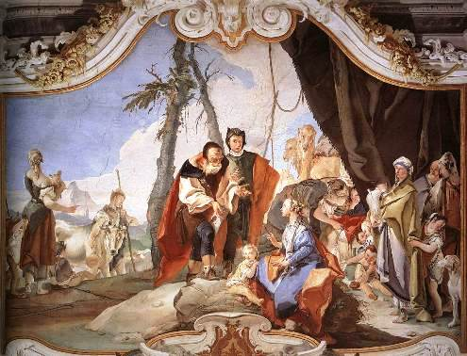
Genesis 31 Jacob Flees From Laban
Laban more interested in the idols/teraphim than in his daughters.
Nuzi Tablets: He who holds the teraphim gets the inheritance.

Slide 122
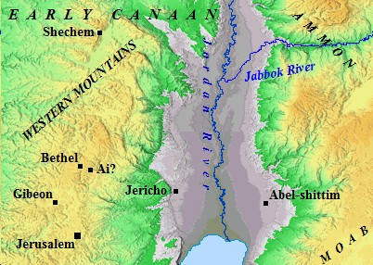
Genesis 32 Jacob’s Worst Fear: Esau
Jacob has really changed.
Gen 32:4 Speak to my Lord Esau
Esau brings 400 men
A faithful prayer.
Jacob: I will pacify him with these gifts.

Slide 123
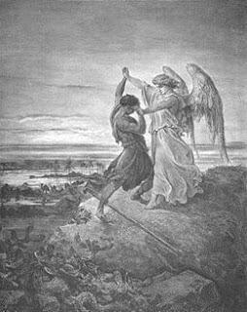
Jacob Fights with an Angel and Wins
Genesis 32:25-31
Jacob is winning!
The angel touches his hip.
v. 27 “I will not let you go until you bless me.”
Jacob renamed Israel. He struggled with God.

Slide 124
Briefly…
Genesis 34 Dinah and the Shechemites. Simeon and Levi lose their birthright.
Genesis 35 Death of Isaac and Rachel, Birth of Benjamin. Reuben commits adultery with Bilhah and loses his birthright.
Genesis 36 Esau’s descendants. Esau leaves Canaan and loses his place with God.

Slide 125
Genesis 37, 39-45 Joseph: A prefigure of the Messiah.
Prince … Slave in Egypt…. Prince
Favorite son.
A shepherd.
A dream: King of the Jews.
Brothers decided to kill him.
Instead, they betrayed him for 20 pieces of silver.
Became a slave in Egypt. (Hosea 11:1)

Slide 126
Genesis 37, 39-45 Joseph: A prefigure of the Messiah.
Raised up to Pharaoh’s right hand.
Saved Israel. Literally.
Saved Gentile nations as well.
Gave bread to the whole world (Gen 41:57)
Jacob, his father, received him back from the dead (Genesis 45:28)

Slide 127
Genesis 38 Judah and Tamar
This seems like a distraction from the main story, but it is not.
Through his sinful action, Jacob has twin sons.
Perez is the ancestor of Boaz, who marries Ruth.
Boaz is the ancestor of Jesse and therefore of David. The messiah comes through Judah.

Slide 128
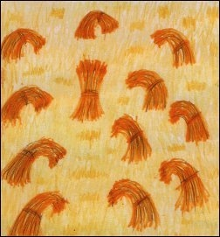
Genesis 37 Jacob’s Dreams. God’s plan is picking up steam.
Jacob, foolishly, shows favoritism to Joseph.
Eleven sheaves of wheat bow.
Eleven stars, as well as the sun (Jacob) and the moon (Rachel) bow to Joseph.
The irony: His brother’s attempts to stop him causes the dream to come true. God is in control!

Slide 129
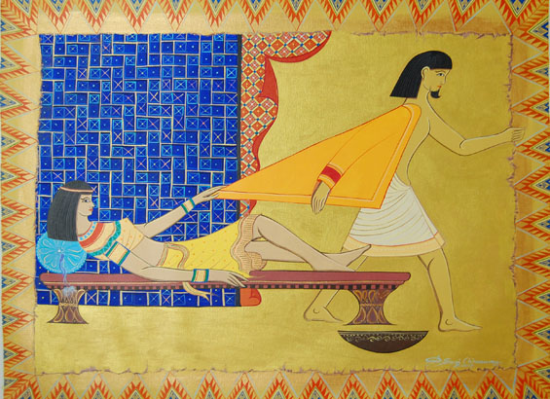
Genesis 39 In Potiphar’s House
Gen 39:2 The Lord was with Joseph and he prospered.
Joseph’s righteousness gets him thrown in prison.
But think about it: If he had not been thrown in prison, he would not have met he cupbearer and he would not have saved Israel.

Slide 130
Genesis 40 Joseph in Prison
Genesis 39:2 “But the Lord was with Joseph and was loyal (chesed) to him.
Joseph the Prophet. In three days you will be restored to Pharaoh.
Please remember me!

Slide 131
Genesis 41 Joseph in Pharaoh’s Palace
Like Joseph, the cup-bearer and the baker, Pharaoh has two dreams.
Seven years of prosperity, followed by seven years of drought.
Gen 41:57 The whole world came to Egypt, to Joseph to buy grain. The promise to Abraham is fulfilled in Joseph. All nations will be blessed..

Slide 132
Genesis 42-47 Joseph Saves Israel
Joseph Prophet, Priest and Prince.
Gen 42 Famine in Canaan. Ten sons come. This does not complete the second dream.
Gen 43-44 Eleven sons bow to Joseph.
Gen 43:8-9, Gen 44:32-34 Judah offers his life as a ransom for Benjamin.

Slide 133
Genesis 42-47 Joseph Saves Israel
Gen 45:1-4 Joseph reveals himself as savior.
Gen 45:5 “And now, do not be distressed and do not be angry with yourselves for selling me here, because it has was to save lives that God sent me ahead of you…. to save your lives by a great deliverance.”
Gen 50:20 “You intended to harm me, but God intended it for good to accomplish what is now being done, the saving of many lives.”

Slide 134
Gen 42-47 Joseph Saves Israel
Gen 46:3 “Do not be afraid to go down to Egypt, for I will make you into a great nation there.”
Gen 46:30 Now I am ready to die, since I have seen for myself that you are still alive.
Resurrection of Jesus foreshadowed.

Slide 135
Genesis 49 Final Prophecies God is sending the Messiah
Judah receives the birthright—the Messiah will come through Judah.
Genesis 49:8-11
Your father’s sons will bow to you.
You are a lion.
You will possess the staff and the scepter.
Nations will obey you—Shiloh.
A donkey and a colt.
Wine, “blood of grapes”

Slide 136
Gen 50 A Segue to Exodus
Gen 49:29-50:14 Israel buried in the cave at Machpelah.
Gen 50:24-25 (Heb 11:22) God will rescue Israel, and when he does, you must carry my bones to Canaan. (fulfilled in Exodus 13:19)
Joseph’s hope: God will fulfill the promises he made to Abraham, Isaac and Jacob. Rulers will come and all nations will be blessed. The Messiah will come to Israel.

