Slide 1
REPENT,

Slide 2
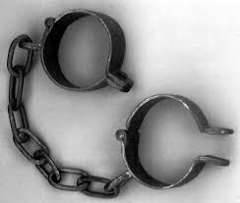
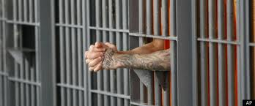
Here was Your Situation:
Lost
Enslaved
Captured
Imprisoned

Slide 3
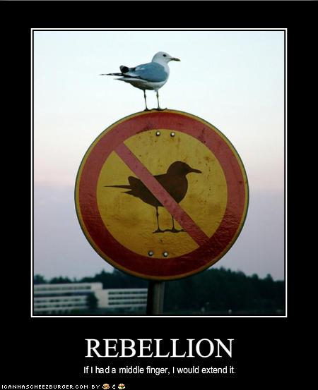
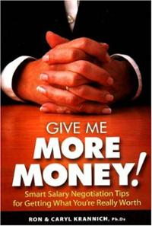
How Did you get there?
You Rebelled.
You went after other gods.
You said that what God
wants for you is not enough.

Slide 4
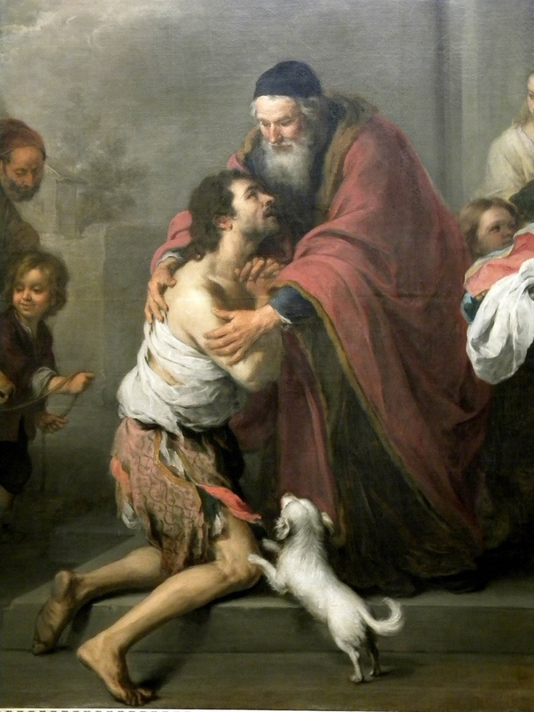
What is the solution?
Repent and Return
So that God can
Restore and Rebuild

Slide 5
Who are you?
You are people loved by God
You are Israel
You are any individual
You are the Church
You are a Church

Slide 6
Historical Background
722 BC Northern Kingdom destroyed by Sennacherib
605 BC First siege of Jerusalem by Nebuchadnezzar
597 2nd siege Ezekiel taken as captive to Babylon.
592 Ezekiel receives his commission.
586 Jerusalem Destroyed 70 years of captivity begins
538 Cyrus captures Babylon. Cyrus decrees the temple should be rebuilt. (Ezra 1:1-4)
537-536 First wave of remnant returns under Zerubbabel.

Slide 7
Historical Background
520 Zechariah begins to prophesy
518 Darius: Rebuild the temple! (Ezra 6:1-12) Haggai agrees.
516 Temple is completed (seventy years after Solomon’s temple destroyed)
458 Ezra returns to Jerusalem, second wave of exiles. Artaxerxes: Rebuild the city of Jerusalem. (Ezra 7:11-29)
445-444 Nehemiah returns and the city is built.
430 BC? Malachi

Slide 8
2 Chronicles 36:6, 10, 19-21
Notes:
Nebuchadnezzar conquered Palestine. Happened in three waves (36:6 Jehoiakim, Daniel 605 BC; 36:10 Jehoiachin in 597 BC; and 36:20 Zedekiah in 587 BC). They stayed until Persia overtook Babylon (v. 22).

Slide 10
Post-exile books
Ezra, Nehemiah, and Esther History
Haggai, Zechariah, and Malachi Prophets
Theme of these books: God’s wrath is complete. It is time for his remnant to Repent and Return so that God can Restore and Rebuild them.

Slide 11
All this was prophesied
Deuteronomy 28:15-19 If you do not obey the Lord your God… you will be cursed.
Deuteronomy 28:36-37 You and your king will be taken to a foreign land.
Deut 28:49-57 The Lord will bring a nation against you. Terrible suffering. Cannibalism in Jerusalem.
Summary: Deut 29:22-29.

Slide 12
Deuteronomy 30:1-6 Repent, Return, Restore, REbuild
When all these blessings and curses I have set before you come on you and you take them to heart (repent) wherever the LORD your God disperses you among the nations, and when you and your children return to the LORD your God and obey him with all your heart and with all your soul according to everything I command you today, then the LORD your God will restore your fortunes[a] and have compassion on you and gather you again from all the nations where he scattered you. Even if you have been banished to the most distant land under the heavens, from there the LORD your God will gather you and bring you back. He will bring you to the land that belonged to your ancestors, and you will take possession of it. He will make you more prosperous and numerous than your ancestors. (rebuild) The LORD your God will circumcise your hearts and the hearts of your descendants, so that you may love him with all your heart and with all your soul, and live.

Slide 13
If God says it will happen It will happen
Jeremiah 4:5-6 6:1-2 Disaster from the North!
Jeremiah 7:30-34 The Valley of Slaughter.
But… Jeremiah 27:16-22
But…. Ezek 36:24-32

Slide 14
Summary
The story of Judah is our story. We, too, began as God’s people. We, too, went after other gods and told God that what he has to give us is not enough. We, too, rebelled. We, like them, were lost, enslaved, and imprisoned.
But… By his mercy and because of his love
We, too, repented and returned to God’s kingdom. Now, God is in the process of restoring and rebuilding us into a people who will give him glory in his kingdom.

Slide 15
RRRR II Historical Introduction: Ezra
Ezra 1:1-4 Cyrus says it is time to repent, to return, to be restored and to rebuild.

Slide 16
Ezra 1:1-3
eeeeEzra 1:1-3 Dead Sea Scrolls
Notes:
Why? Goodwill, collection of tribute, god’s favor. Almost a century later: In 407 BC, letter to Persian governor requesting that a Jewish temple at Elephantine in Egypt be rebuilt after destroyed by Egyptians in 411 BC.

Slide 17
The Cyrus Cyllinder (British Museum)
Notes:
“I returned the statues of the divine patrons of every land…to their own sanctuaries. When I found their sanctuaries in ruins, I rebuilt them. I also repatriated the people of these lands and rebuilt their houses. Finally, with Marduk’s permission, I allowed statues of the dive patrons of Sumer and Akkad to be returned to their own sanctuaries.”

Slide 18
Isaiah 44:26-45:7
Cyrus
Isaiah 44:24-45:4
Cyrus says:
Return,
Rebuild
Restore!
Notes:
Inhabited, rebuilt, restored! Isaiah prophecies through Hezekiah (1:1) - 4 kings before Jehoiakim! Cyrus as shepherd, anointed. Why? So that all may know. No other Lord. Prosperity and disaster; I do all!

Slide 19
Ezra 2 Captives return to Jerusalem

Slide 20
Ezra 3 temple foundation laid

Slide 21
Ezra 4 But… Satan has not taken a nap

Slide 22
RRRR III Haggai
Message: Build up the house of the Lord, not your own house. (Matt 6:19-21)
Submessage: Discouragement is not sufficient excuse to neglecting the work of the Lord.

Slide 23
Historical Background
586 BC Jerusalem and the temple destroyed.
538 BC Cyrus defeats Belshazzar and Babylon.
537/536 BC First wave of Jews return to Jerusalem, altar built foundation of temple is laid. (Ezra 1:1-3:13). Opposition arises. Project abandoned.
521 BC Darius I takes the throne of Persia. Tells Judah to get back to building the temple.
520 BC Haggai preaches. Build the temple!

Slide 24
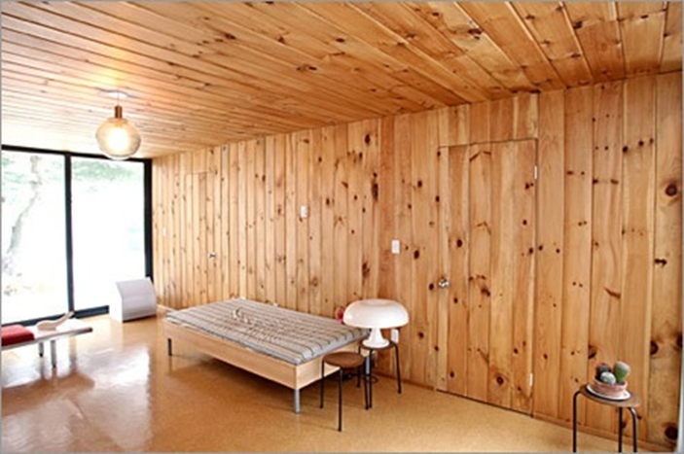
Haggai 1:1-4 The People’s Excuse
Haggai 1:2 We’re too busy to build the temple.
Q: Can you relate?
Haggai 1:3-4 Hmmm…. You seem to have time to build your house.
Haggai 1:5-6 You have
planted much but
harvested little.
Q: Can you relate?

Slide 25
God’s Solution
“Indifference to the things of God produces calamity.”
1. Haggai 1:7 Give careful thought to your ways.
2. Haggai 1:8 Bring down timber to build God’s temple.
Haggai 1:12-15 The people obeyed, the leaders led, the people’s spirits were inspired and the work got started.

Slide 26
Conclusion
God wants us to repent, return, so that he can restore and rebuild.
God is already working behind the scenes and is working miracles.
But Satan is not napping.
It is time to repent and start rebuilding!

Slide 27
Rebuild
Haggai 1:12-15 The people repented and the temple got rebuilt.
Result: God: I am with you (Matthew 28:20)
Haggai 2:1-9 The work is hard and we humans can get discouraged, but God encourages us.
God really gets carried away with excitement when he sees his people repenting and returning so that he can restore and rebuild.

Slide 28
Two Great Memory Verses
Haggai 2:6
“In a little while I will once more shake the heavens and the earth, the sea and the dry land.”
Haggai 2:8
“'The silver is mine and the gold is mine,’ declares the Lord Almighty.”

Slide 29
Haggai 2:10-18 “parable of defiled flesh
Does coming into contact with clean meat make you clean? No!
Does coming into contact with defiled meat make you unclean? Yes!
Defilement is a thing. Holiness is a lack of a thing.
Sin is contagious. Holiness is not necessarily contagious. We need to deal with the plague of materialism.

Slide 30
Haggai 2:19-23
If we repent, God will bless us.
“I will shake the heavens and the earth. I will overturn royal thrones and shatter the power of the foreign kingdoms. I will overthrow chariots and their drivers; horses and their riders will fall, each by the sword of his brother.”

Slide 31
Zechariah: Things to bear in mind
Dated prophecies: Nov. 520 BC – Dec 518 BC
• Contemporary of Haggai
• The book is apocalyptic
• The book has many Messianic prophecies
• The book has many Kingdom prophecies

Slide 32
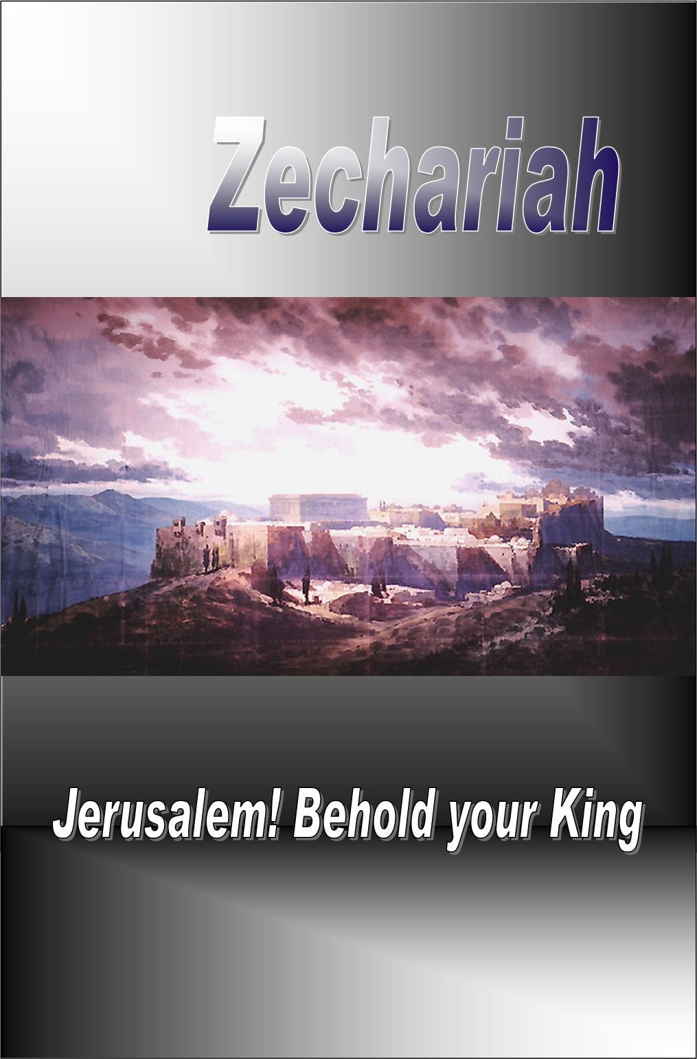
RRRR IV Zechariah I The Messiah Is Coming: Get Your House In Order
Theme: The Messiah is coming: Get your house in order.
Message: It is time to build the temple: Repent, Return, Restore, Rebuild.

Slide 33
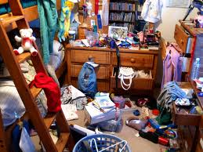
The Messiah is Coming: Is Your Spiritual House in Order?
Is your (spiritual) house ready for guests right now?
(Or would you be scrambling around, trying to straighten up all the mess)

Slide 34
Outline of Zechariah
1:1-6 Prologue: Repent, Return, Restore and Rebuild
1:7-6:8 Eight visions.
6:9-15 Coronation of Joshua/Jesus
7:1-8:23 Two sermons.
9:1-14:21 Two Oracles concerning Jerusalem.
Warning: We will not be following this exact order. We will be more thematic.

Slide 35
Zech 1:1-6 Prologue
God: Repent and Return so I can Restore and Rebuild
v. 2 Why was God so angry with their forefathers?
v. 3 The solution: Repent and Return
v. 4-6 Those faithless Jews are no longer around, but my Words are still in place.
v. 6 Good news. They repented and the temple got rebuilt.
We are seeing the end of the story right at the beginning.

Slide 36
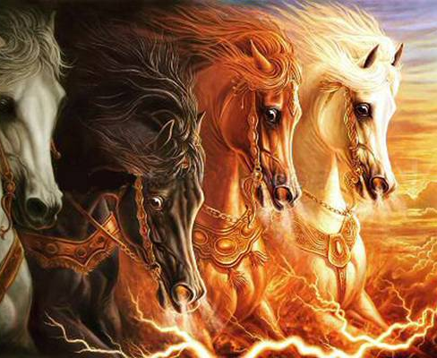
Vision #1 Zech 1:7-17 A man on a red horse
v. 11 All is quiet and at peace, is that good? No! Because God’s people are still in captivity.
Isn’t God the prince of peace? Matthew 10:34-36
Does God want people to feel secure? Amos 6:1-7
That depends….

Slide 37
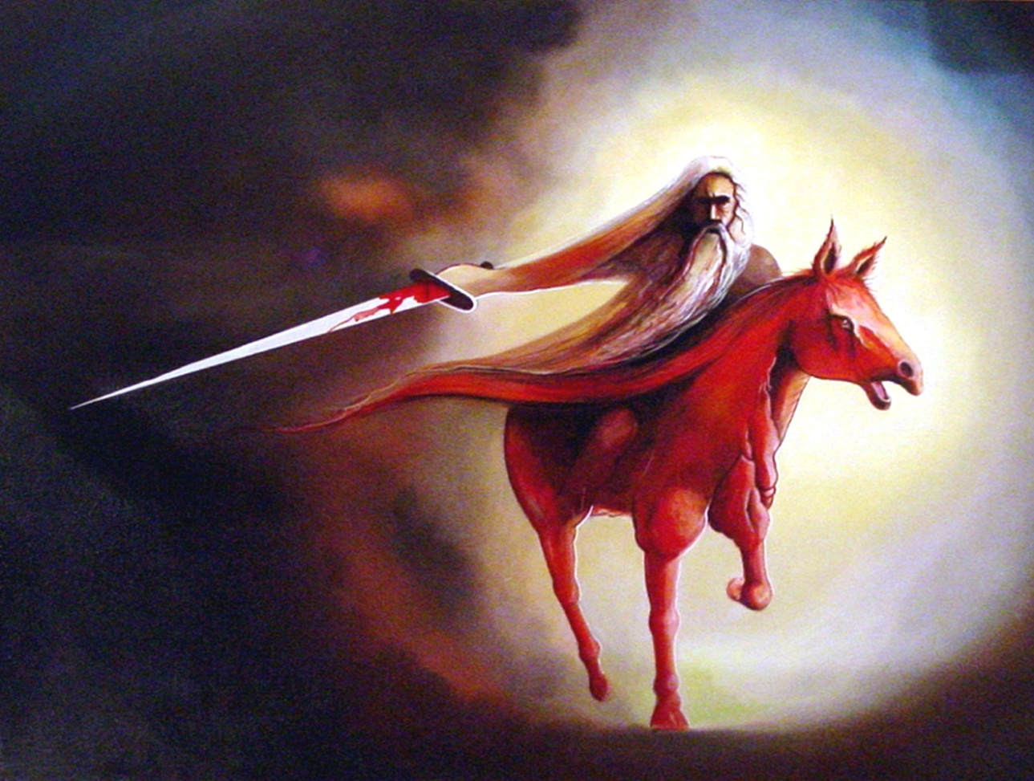
Vision #1 Zechariah 1:7-17 A Messenger on a red horse
v. 14 God is jealous!
Zech 1:16 I will return to Jerusalem and rebuild my house!
Are you on board?

Slide 38
Vision #1 cont.
Zech 1:16-17
This, in essence, is the theme of Zechariah: The Messiah is coming: Get your house in order!
God’s reply: I will return to Jerusalem and rebuild my house! Do not look at outward appearances.
Application: If your situation or church seems stagnant, do not look at the outward appearance. God can and will work in your life.

Slide 39
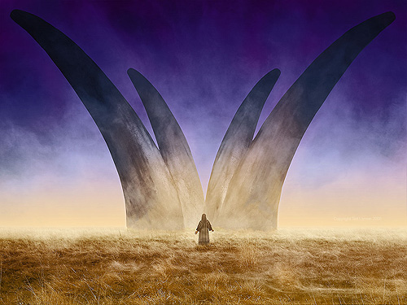
Vision #2 Zech 1:18-21 The vision of four horns and four craftsmen
The four horns are four nations which scattered God’s people as a judgment for their sins.
Assyria, Egypt, Babylon, Persia
Message: God will judge your enemies. Trust God

Slide 40
Vision #4 Zech 3:1-10 Joshua accused and exonerated
Zech 3:1-2 Who is Joshua symbolic of here?
Judah? Yes!
You, me and the Church? Yes!
Jesus/Messiah? Yes! (v. 8-9, Jeremiah 23:5)
Satan is an accuser (Rev 12:10)
Satan is a deceiver (John 8:44)
How does Satan accuse you?

Slide 41
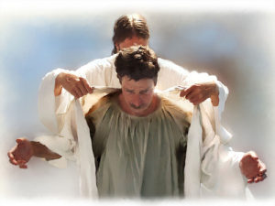
God to Satan: The Lord Rebuke You!!!
Zech 3:3-5 Good news!
“I have taken away your sin and I will put fine garments on you.”
Zech 3:6-7 The Messiah is coming. Get your house in order.
Zech 3:10 Have you invited your neighbor to sit under your vine?

Slide 42
Vision #5 Zech 4:1-16 The Golden Lampstand and the Two Olive Trees
The oil in the menorah is the Holy Spirit.
Two Trees: endless supply.
Zechariah 4:6 Not by might nor by power, but by my Spirit

Slide 43
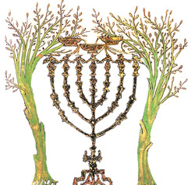
Vision #5 The Golden Lampstand and the Two Olive Trees
John 7:37-39 Streams of living water.
“As Scripture says” Zech 4, Ezekiel 37
Zech 4:10 Therefore do not worry about small beginnings

Slide 44
Summary
The Messiah is coming: Get your house in order.
God wants to rebuild his temple.
The key? Repent and Return so God can Restore and Rebuild.
Then God will give you clean clothes and empower you with the Holy Spirit. God will do the heavy lifting to rebuild the kingdom in your life.

Slide 45
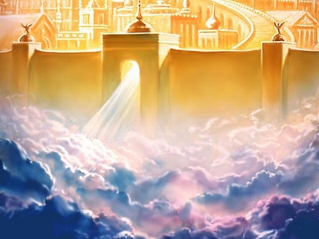
RRRR V Zechariah II Your Kingdom Come Kingdom prophecies in Zechariah
Zechariah 2:1-13
Zechariah 6:9-15
Zechariah 8:1-7
Zechariah 9:10-17
Zechariah 12:7-8
Zechariah 13:1-3
Zechariah 14:1-21
And more….

Slide 46
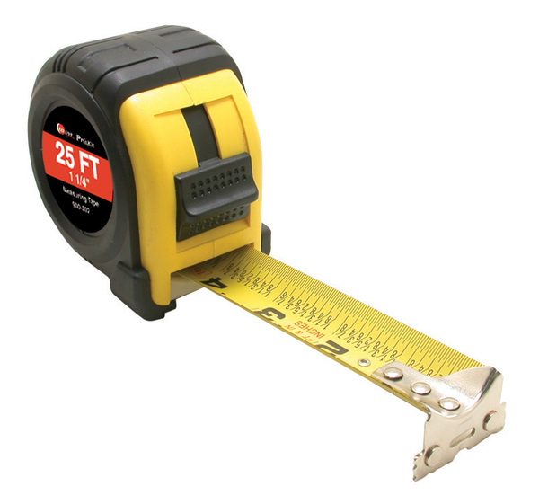
Vision #3 Zech 2:1-13 A man with a measuring line
God: I will make my kingdom into a city without walls.
Zech 2:1-2 Measuring = Protecting Rev 11:1-6, Ezekiel 38:7-16
Message: Do not rely on protection the world provides. Rely on God for your safety.

Slide 47
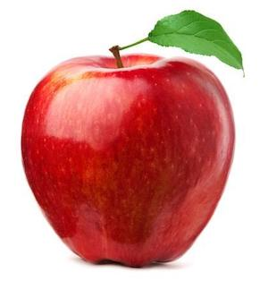
Vision #3 (cont.)
What are your worldly “walls”?
2:8 God: You are the apple of my eye.
2:10-13 I will live among you.
Many nations will be joined with the Lord on that day and will become my people.

Slide 48
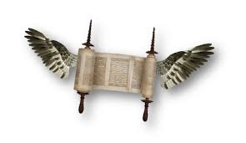
Vision #6 The flying scroll
Judgment on sinners and on all the enemies of God’s people.

Slide 49
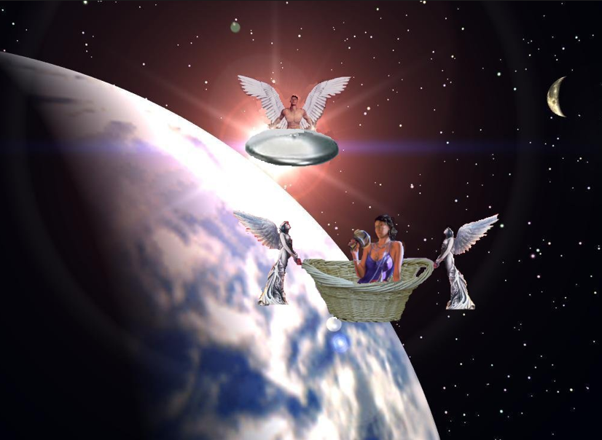
Vision #7 A woman in a basket
Message:
Judgment on sinners
Measuring basket:
Judgment
v. 7 Woman = sin = Babylon
v. 10-11 Those who sin will be sent to captivity in Babylon

Slide 50
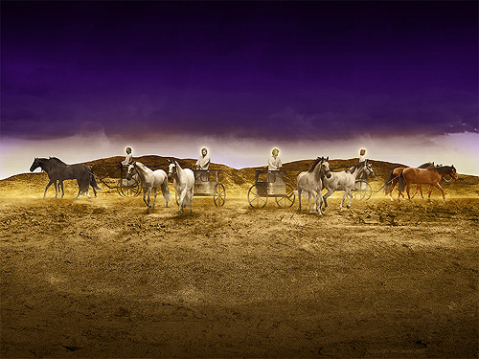
Vision #8 Four Chariots
Message: Judgment is coming!
Parallel passage: Revelation 6:2-7

Slide 51
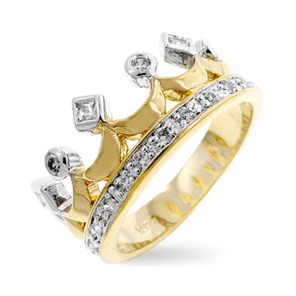
Zechariah 6:9-15 The coronation scene
v. 11 Does a priest wear a crown?
v. 12 Branch = nazer = Nazarene = Jesus Matt 2:23
Jesus is King
Jesus is the perfect high priest. Heb 4:15-16

Slide 52
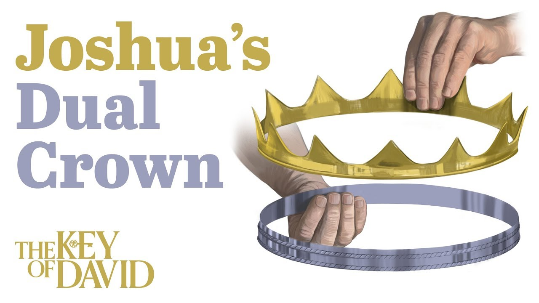
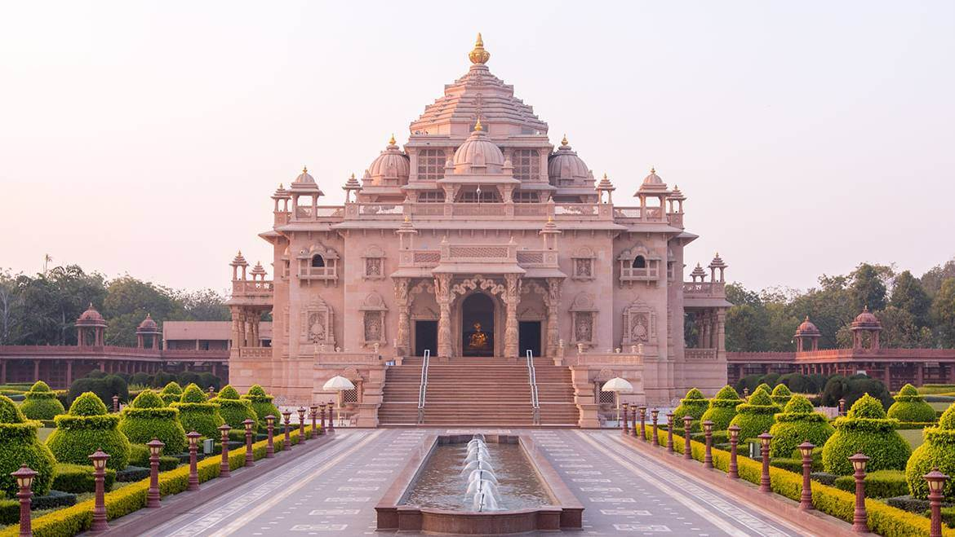
Zechariah 6:9-15 The coronation scene
v. 13 He will build the temple. Eph 2:11-22
v. 15 Those who are far away will come.
v. 15b God will use our hands to build the temple

Slide 53
Zech 9:10-17 A Kingdom of Peace
v. 10 No more chariots, war horses, bows.
Yet…
His kingdom will extend from sea to sea.
How? By Jesus’ blood.
v. 11 What kind of waterless pit did God pull you out of?
v. 13 God will “bend Judah” He will use you!

Slide 54
Zechariah 9:16 We Will Sparkle
They will sparkle in his land like jewels in a crown.

Slide 55
Zechariah 14 Your Kingdom Come
Zech 14:1 The Day of the Lord
Zech 14:1-7 Destruction of Jersualem in AD 70
Zech 14:8-11 God will build his kingdom—the Church
Zech 14:12-21 God will come and judge the nations
Heaven will be an eternal Feast of Tabernacles
We will be “Holy to the Lord.”

Slide 56
Summary: Your Kingdom Come
A city without walls
A place where God lives among his people
A place where a perfect priest rules as king
A temple built by God, using human hands
A place where those the far are brought near
A place of peace
A place without waterless pits
A place where we will sparkle
A place where we dwell with God

Slide 57
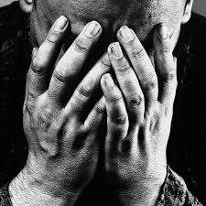
RRRR VI Zechariah III On That Day Zech 7:1-2 Should I mourn and fast?
Fasts:
5th month: Destruction of the temple
7th month: Assassination of Gedaliah
10th month: Capture of Jersualem

Slide 58
Should I Mourn and Fast?
God’s response: Zechariah 7:4-10
Give me your heart, not your religion.
Act like God.
Zech 7:9-10 Administer true justice; show mercy and compassion to one another. Do not oppress the widow or the fatherless, the foreigner or the poor. Do not plot evil against each other.

Slide 59
Should I Mourn and Fast?
Zech 7:13 When I called, they would not answer, so when they called, I would not listen.

Slide 60
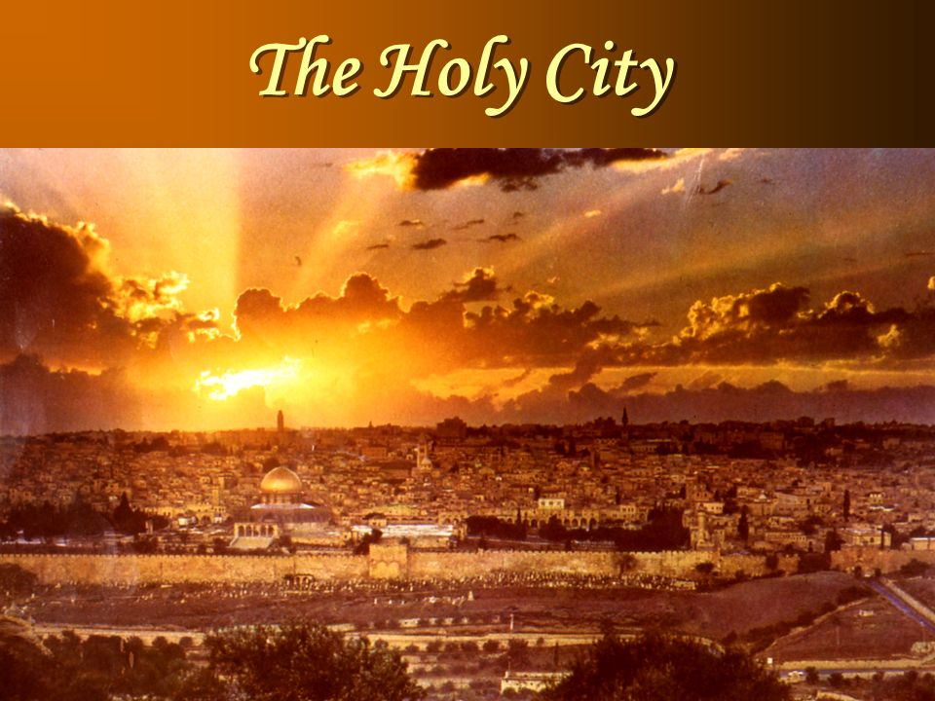
Zechariah 8:1-9 The Messiah Will Come to Jerusalem
v. 3 I will return to Zion and dwell in Jerusalem
You will be called the Faithful City.
v. 9 Let your hands be strong so that the temple may be built.

Slide 61
Zechariah 8:18-23 God Answers the Question
v. 19 Stop fasting! The Messiah has come to Jerusalem.
God is blessing us.
v. 23 10 visitors for each member!

Slide 62
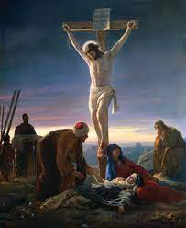
Zech 12:10-14 Bonus Material
12:10 They will look on me, the one they have pierced.
Weeping and mourning as at Hadad Rimon (when Josiah, the most righteous king, was killed)
But…

Slide 63
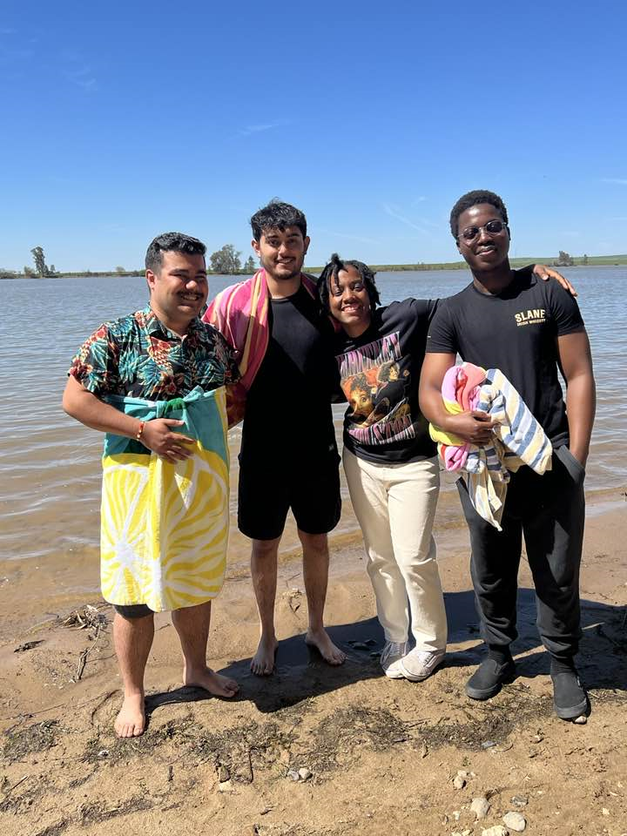
Zech 13:1-6 On That Day
On That Day a fountain will be opened.
Hebrews 1:2 But in these last days he has spoken to us by his Son

Slide 64
Zechariah 14 On That Day
Zech 14:1 The Day of the Lord
Zech 14:1-7 Destruction of Jersualem in AD 70
Zech 14:8-11 God will build his kingdom—the Church
Zech 14:12-21 God will come and judge the nations
Heaven will be an eternal Feast of Tabernacles
We will be “Holy to the Lord.”

Slide 65
Should I mourn and fast?
Actually, you should celebrate because a fountain has been opened.
But, when God calls, listen!
Let your hands be strong and start building
On that Day we will have an eternal Feast of Tabernacles with God
So let us repent and return, so God can restore and rebuild.

