Slide 1
RRRR VII Esther: God saves his people
Esther: Only book in Bible that does not mention God
Only book in Old Testament not found in the DSS
Included in the Old Testament because of Purim?

Slide 2
Esther: God Saves His People Theme #1 God is in control. He is working behind the scenes to save his people. Theme #2 God uses a righteous woman to save Israel. Strong messianic implications Esther is a prefigure of the Messiah!

Slide 3
Esther 1:1-3
Esther: Queen of Xerxes (485-465 BC)
3rd year of Xerxes 483 BC
Jerusalem is destroyed. Where is God?
Notes:
From India to Cush - largest empire of that time! 127 provinces (20 Satrapies - Judah was a province of the 5th, Syria). Specific!
Where’s God? His people aren’t ruling; emphasis on Persia, not Judah.

Slide 4
Esther 1:4-22 Vashti refuses Xerxes

Slide 5
Esther 2:1-7 Esther and Mordecai
Notes:
Two main heroes: Esther (Hadassah), Mordecai (great-grandson). Orphan / Cousin. Tragedy! Where’s God? Gave her a cousin, beauty and character (submission). She’s taken to evaluation by king (what a risk). $, school, share faith, confront someone.

Slide 6
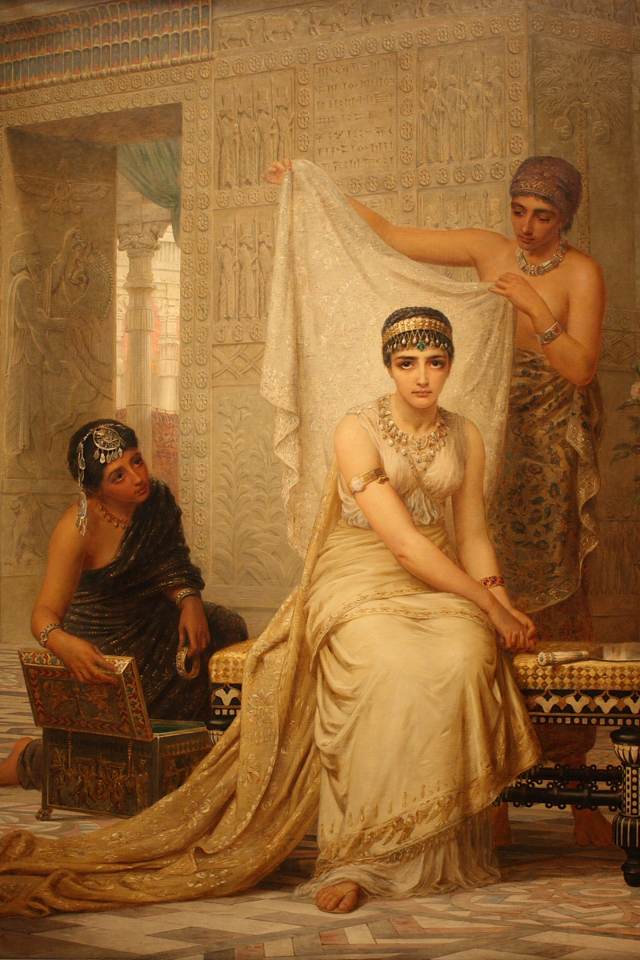
Esther 2:8-23 Esther is humble Esther meets Xerxes: God is in control!
Notes:
Not reveal identity. Interesting - he commands her, but emphasizes own nationality (3:4), reason for edict. Possibilities: 1) afraid of not being chosen if from exiles, foreigners looked down on; 2) from family of King Saul, so better to be of low birth so not be chosen. Not known motives.

Slide 7
Esther 3:1-15
Prideful Haman
Notes:
Mordecai is honest man, helping the king. Deserves a reward, but overlooked. Good guys have down times (Joseph, David, Jeremiah).

Slide 8
Esther 4:1-11
Disaster!
Mordecai
1. Prays
2. Takes action
Notes:
M tells of the plot / asks her talk to king. She’s afraid, he expresses faith that if not her, rescue from somewhere else. Discipleship (calling higher)! How? No explanations - Faith! No mention of God, but does she believe? Fasts. To whom? God! What is her resolve? Even if die!

Slide 9
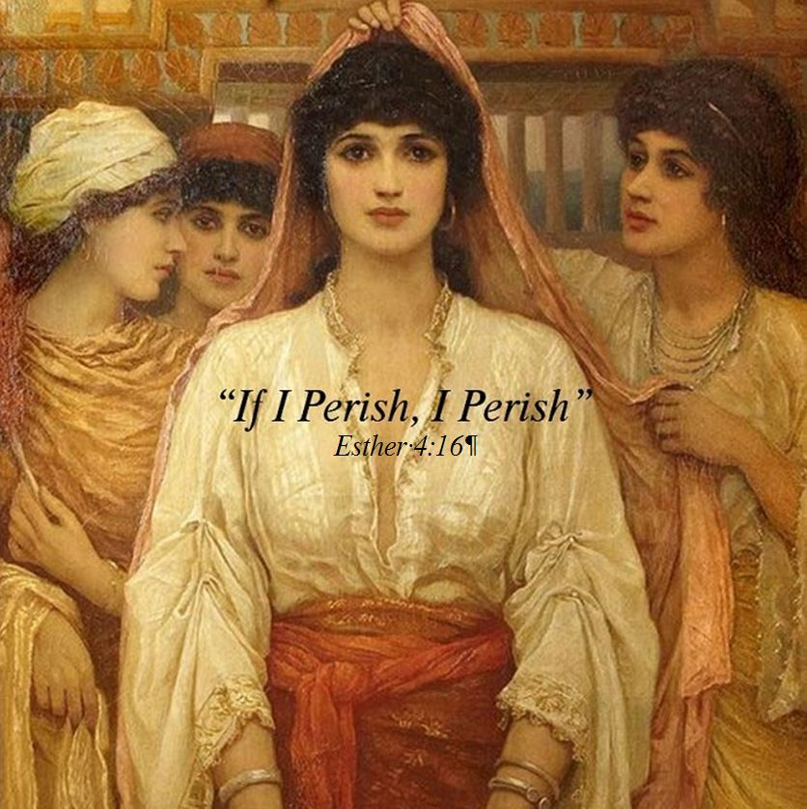
Esther 4:12-17
“For such a time as this.”
If I perish, I perish.
Esther a prefigure of the Messiah. She offers her life to save Israel.

Slide 10
Where’s God? Hebrews 11:1
Notes:
What situation..in right now that requires faith? What situation happened..causes you to question: Where’s God? Broken relationship / illness / loss of loved one / Financial pressures / Unreasonable children or parents… God is invisible, but always there! Faith.

Slide 11
Esther 5:1-8
On the third day…
1 Cor 15:4-5
God sends a ram.
Notes:
After 3 days of fasting, waits outside, the king extends scepter & asks. Now! Requests banquet (preparing during fast). He asks. Come on! Another banquet. No rush (we get in too much of a hurry). We ask for opportunities, God works (our patience, circumstances, others).

Slide 12
Esther 5:9-14
Haman/Satan is so confident!
Will God save Esther and will he save his people? Stay tuned…
Notes:
Before the next banquet 2 things happen: Haman decides to erect poles to impale Mordecai-eventually Romans add nails. (rage is getting out of hand) Slap our kids, yell at our spouse, hit a wall, swear at a car! Get it together! Esther’s waiting on Lord, Haman’s fuming inside!

Slide 13
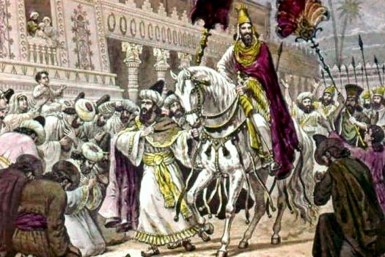
Esther 6:1-14 God is in Control!
Xerxes just happens to read the account of Mordecai saving his life.
Haman: Put a robe on him!

Slide 14
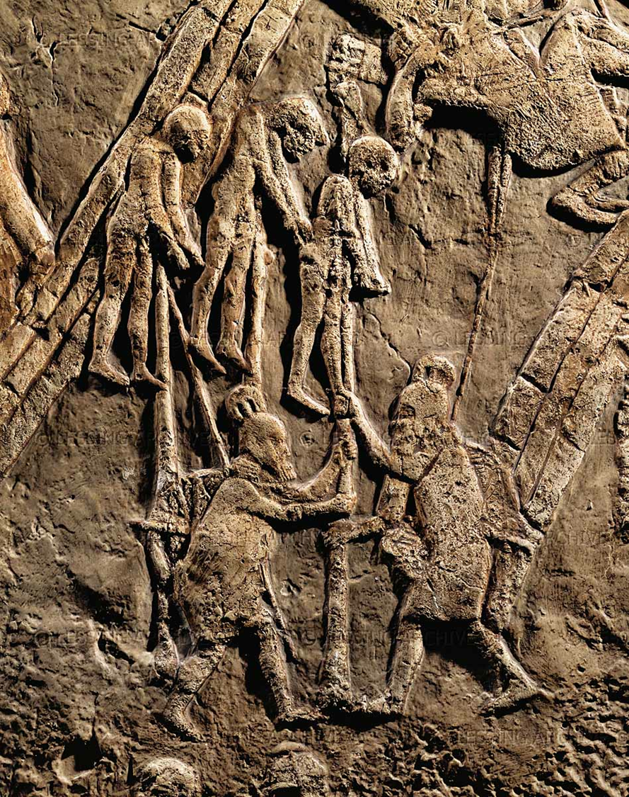
Esther 7:1-10 Again: God is in Control

Slide 15
Esther and Purim
Celebrated in March
2-day celebration
Dress up in constumes
Give gifts to the needy
Read Esther

Slide 16
Let’s Celebrate!
Passover to celebrate God saving Israel in Egypt.
Pentecost to celebrate the Spring harvest
Rosh Hoshannah/Trumpets to prepare for God’s coming
Yom Kippur/Day of Atonement to celebrate our atonement
Tabernacles to celebrate God living among his people
Hanukkuh to celebrate God saving Israel from Antiochus Epiphanes
Purim to celebrate God using Esther to save Israel from Haman and Xerxes

Slide 17
Lessons from Esther
God is in control. God is always working behind the scenes to support those faithful to him.
God blesses both faithfulness and humility.
God’s Messiah will save His remnant and Esther is a picture of his salvation.

Slide 18
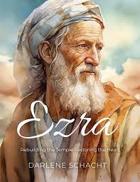
RRRR VIII Ezra Part II
Ezra: God uses a teacher to Restore and Rebuild the Kingdom

Slide 19
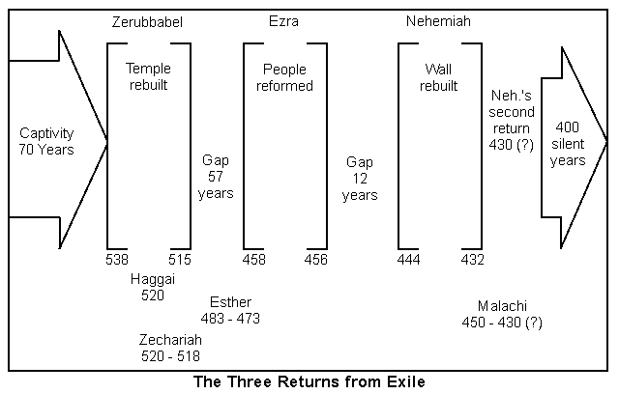
Notes:
Ezra 1-6 Cyrus allowed return (538 BCE) and began temple, completion under Darius (23 years later). Esther during Xerxes. Ezra comes under Artaxerxes.

Slide 20
Post-exile books
Ezra, Nehemiah, and Esther History
Haggai, Zechariah, and Malachi Prophets
Theme of these books: God’s wrath is complete. It is time for his remnant to Repent and Return so that God can Restore and Rebuild them.

Slide 21
Ezra / Nehemiah
Repent, Return, Restore, Rebuild
Notes:
The temple was rebuilt, the wall was finished, but repentance had to continue. That’s why we need Jesus; he covers all our sins and exemplifies the right path. Return to the Lord (repent), Restore convictions and obedience to the Word, Rebuild his holy nation!

Slide 22
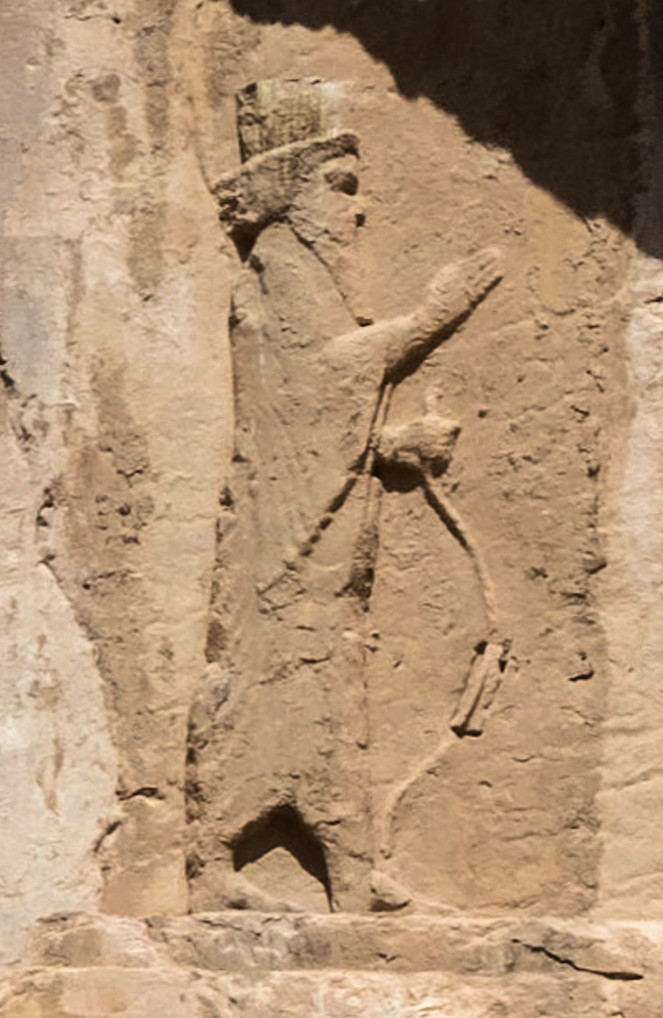
Ezra 4:11-23 Opposition to Rebuilding
Artaxerxes I of Persia

Slide 23
Ezra 7:1-10 Ezra the Teacher
Notes:
He is a priest (direct descendant of Aaron, v. 1-5) and scribe. Devoted to studying, obeying and teaching!

Slide 24
Nehemiah 8: Ezra
1. Ezra 7:6 Ezra was well-versed in Scripture
Neh 8:1-3 Ezra taught and preached for 6 hours!
2. Neh 8:7-9 Ezra read from the Law and made the meaning clear.
Neh 8:18 Ezra taught from the Law every day!
3. Ezra 7:10 Devoted to the study and observance of Scripture.

Slide 25
Ezra 7:13-26 Artaxerxes: Go back and rebuild Jerusalem!
Ezra 7:8 The seventh year of Artaxerxes. 458 BC
Daniel 9:24-25 Seventy sevens from the decree to restore and rebuild Jerusalem.
70 x 7 = 490 years
458 – 490 = -32 = 33 AD God is in control!

Slide 26
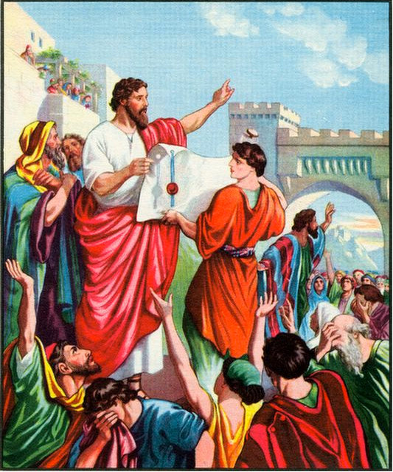
Ezra 7:27-28 God moves the heart of Artaxerxes
Notes:
God moved his heart (Pv 21:1). God did it! Because of his relationship with God, he gathered men to go with him.

Slide 27
Ezra 8:1-23 Ezra the humble teacher. Ezra 8:25 Scarcity vs abundance mentality
Notes:
v. 1-14 lists 2 priests and a descendant of David, then 12 clans (to recall the Exodus and the return in ch. 2, same clans).
Humble before God. Ask God for safe trip (Nehemiah didn’t mind asking the king). God used both. He answered!

Slide 28
Ezra 9 Sin in the camp
Ezra 9:1-4
v. 3 Ezra pulls his hair out.
v. They trembled about their sin
v. 4 Ezra appalled at the sin

Slide 29
Ezra 10 ezra takes action!
Ezra 10:1-6 Ezra praying, confessing, weeping, throwing himself down, fasting.
10:2 But there is still hope. We can repent and return to God.
Ezra 10:16-17 Ezra investigates who among them have married outside the “church.”
111/42,000 0.26% But look at Ezra!

Slide 30
Nehemiah 1:5-11 Nehemiah the builder is like Ezra the teacher.
Notes:
Once again a prayer for God to have the king extend favor. Did Nehemiah have control? No, but God did and he was God’s servant!

Slide 31
summary
1. God’s enemies will try to intimidate us into stopping the work or restoring and rebuilding.
2. In addition to evangelists and shepherds, God will use teachers to encourage the people and to keep the work of repenting, restoring and rebuilding going.
3. We need to continue to deal with sin in order for God to do the work of restoring and rebuilding.
4. The leaders must be zealous and humble.

Slide 32
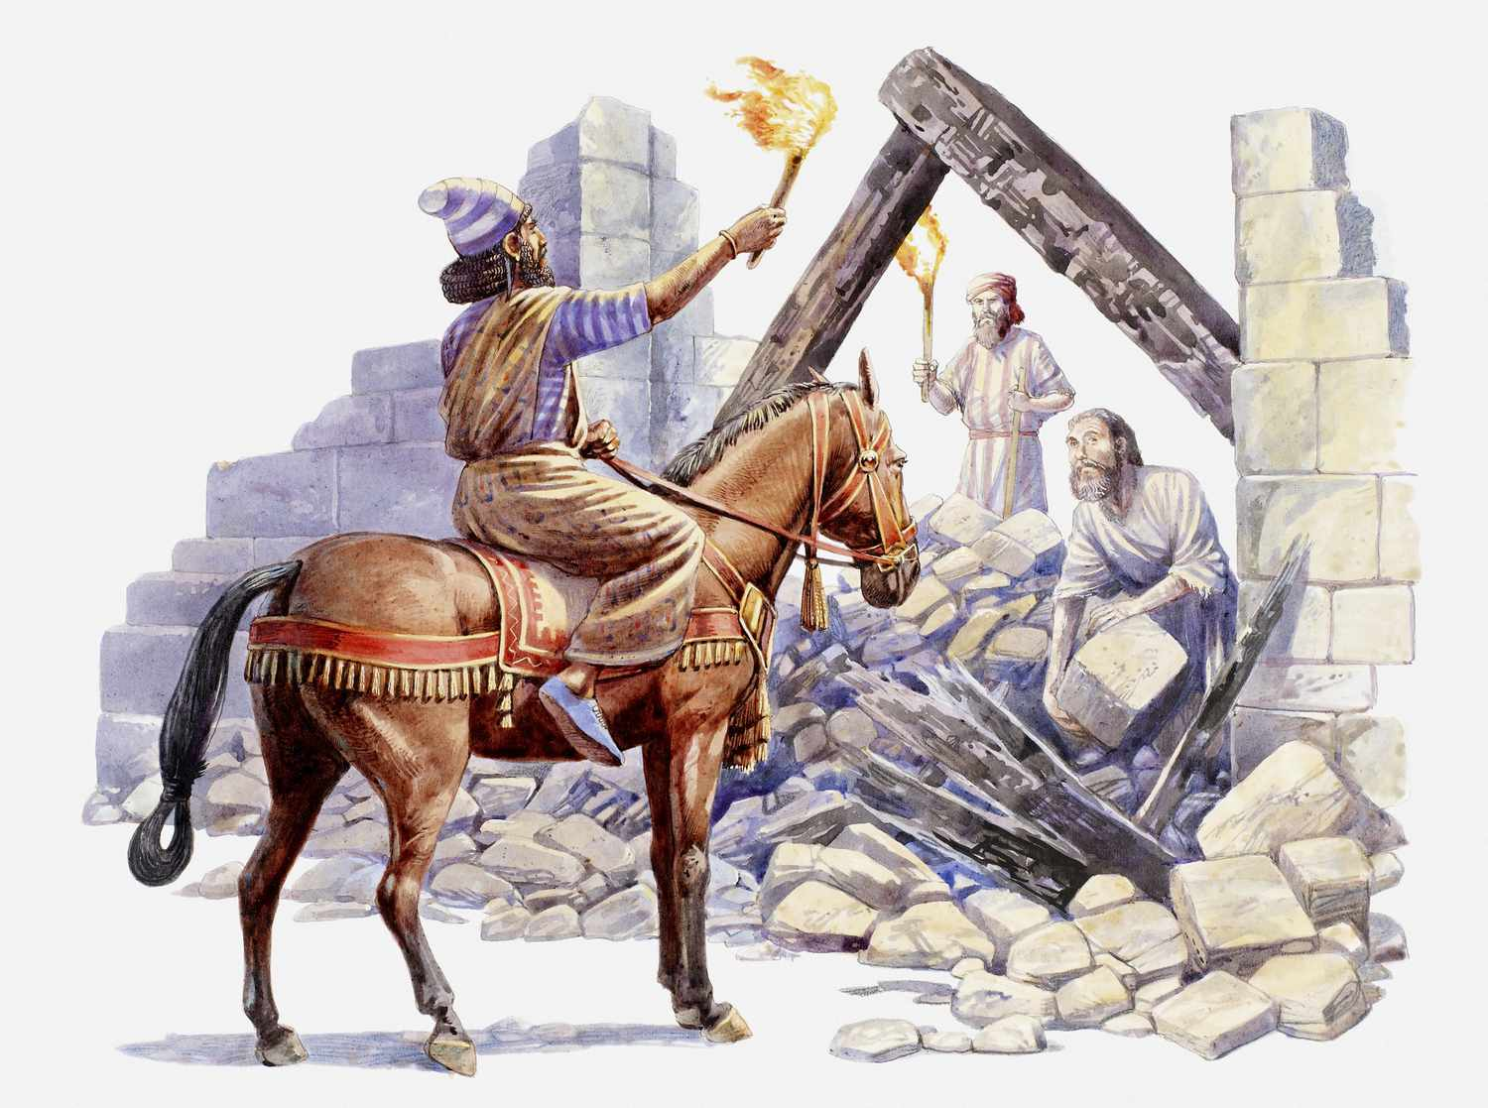
RRRR IX Nehemiah
Nehemiah: God uses a leader to Restore and Rebuild the Kingdom

Slide 33
Notes:
Ezra 1-6 Cyrus allowed return (538 BCE) and began temple, completion under Darius (23 years later). Esther during Xerxes. Ezra comes under Artaxerxes.

Slide 34
Nehemiah: God Uses a Leader to Restore and Rebuild His Kingdom
Ezra: God uses a teacher.
Nehemiah: God uses a leader.
What are some traits of a godly leader?

Slide 35
Nehemiah 1:5-11 Nehemiah the builder is like Ezra the teacher.
Notes:
Once again a prayer for God to have the king extend favor. Did Nehemiah have control? No, but God did and he was God’s servant!

Slide 36
Repent, Return, Restore, Rebuild
Ch 1 Nehemiah repents
Ch 2 Nehemiah returns
Ch 3-6 Nehemiah restores and rebuilds

Slide 37
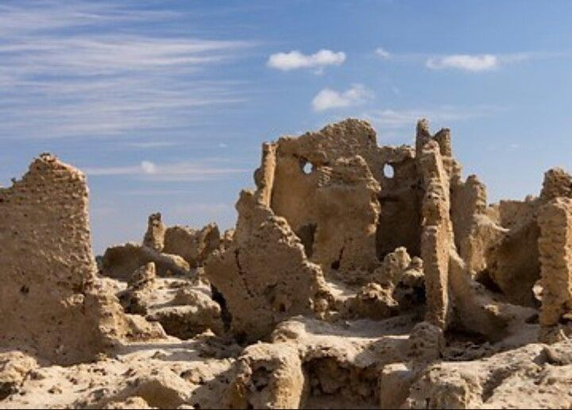
Nehemiah 1:1-10 The Walls Are Broken Down
Nehemiah’s response:
Mourned
Prayed
Confessed
“We” sinned
Boldness
Took action

Slide 38
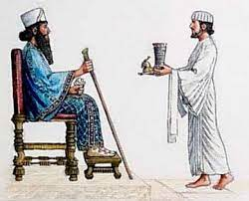
Nehemiah 1:11-2:10
Nehemiah: cupbearer
God is working behind the scenes.
Like Esther, Nehemiah takes a big risk for God.
Nehemiah says a quick prayer.
Nehemiah expects great things

Slide 39
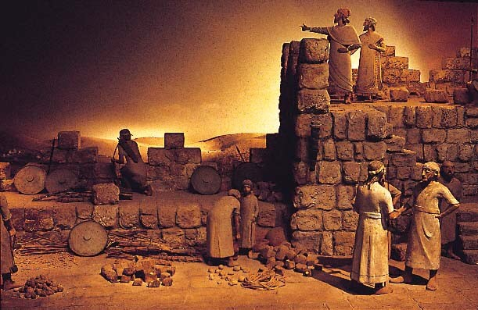
Nehemiah 2:11-18 Nehemiah forms a plan
Nehemiah evaluates the situation.
Nehemiah forms a plan.
Nehemiah creates a vision.
Nehemiah reminds people God is in control.
Nehemiah calls people to rise up and build!!!

Slide 40
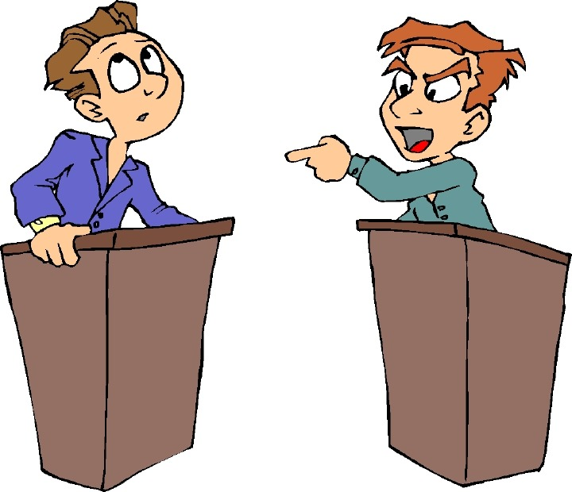
Nehemiah 2:19-20 Opposition!
Tobiahs and Sanballats will always oppose the work of God
Nehemiah: “The God of heaven will give us success.” We will not stop building!!!

Slide 41
Nehemiah 3:1-5 The Builders Get Building!
Neh 3:20 Baruch built zealously. Are you zealously building the wall?
Notes:
Learn from lists: Spiritual leaders are involved (3:1). It begins with dedication to God (3:1). Some give even though no direct benefit: Jericho (2), Tekoa (5), Gibeon (7), Mizpah (7, 15, 19), Zanoah (13), Beth Hakkerem (14), Beth Zur (16) and Keilah (17, 18). Not perfect (3:5).

Slide 42
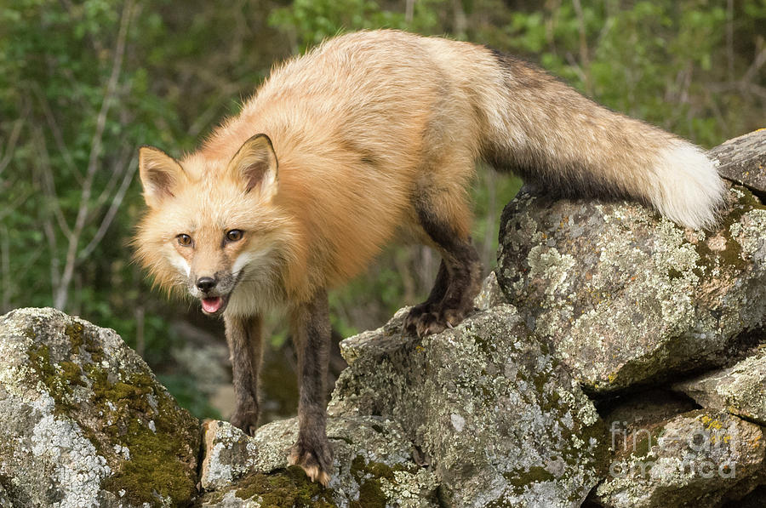
Nehemiah 4:1-9 More Opposition
When we get busy building the kingdom, opposition will come!
Tobiah: Even a fox…
You cannot build a church of 200 or a campus ministry of 100. Impossible!!!

Slide 43
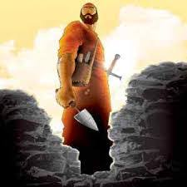
Nehemiah 4:10-20 Valid Concerns
- There is so much rubble.
Our strengthe is running out.
Danger: We will be attacked.
It’s HOOOOOTTTTTT
Let’s stop building!!!
Nehemiah:
Came up with a practical plan.
We will NOT STOP BUILDING!

Slide 44
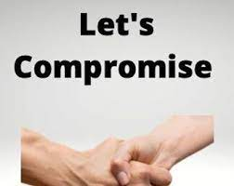
Nehemiah 6:1-2
Sanballat and Tobiah: Let’s compromise.
Nehemiah says Oh No! to going to the Valley of Ono

Slide 45
Nehemiah 5
Stop sinning!
Make restitution.
Nehemiah takes care of the poor

Slide 46
Nehemiah 6:1-2
Sanballat and Tobiah: Let’s compromise.
Nehemiah says Oh no to Ono

Slide 47
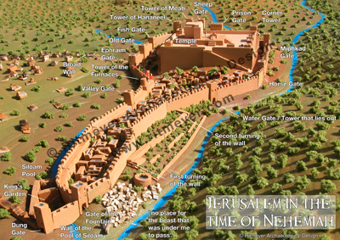
Nehemiah 6:15-16 The Wall is Completed
Notes:
They finally finish the wall! Really fast. Only because of God’s mercy and the people working hard. Amazing what can be accomplished. Pray and roll up sleeves when given direction from leaders.

Slide 48
Nehemiah 12:27 Time to party
Notes:
It was a special occasion and they brought in all the Levites to celebrate! Two choirs in procession on or near the wall in opposite directions and met at the temple. * We may have a fight in the car on the way…but God’s mercy is greater!

Slide 49
Nehemiah: God Uses a Leader to Build the Kingdom
Nehemiah loves God and his kingdom.
Nehemiah prays boldly and humbly.
Nehemiah takes action.
Nehemiah is real with the people about the problem.
Nehemiah, nevertheless, creates a powerful vision.
Nehemiah calls the people to rise up and build.
Nehemiah refuses to stop building, despite opposition.
Jerusalem was restored and rebuilt.

Slide 50
RRRR X Malachi
Malachi: Faith in God or Faithful to God?
hesed

Slide 51
Theme: Covenant

Slide 52
Malachi: God’s Messenger
Message: Faithful to God vs. Faith in God
Malachi = my messenger
Date of writing about 440 BC The end of the Old Testament.
Malachi is God’s last word to the Jews. It is a capstone to the message of the Old Testament and a final preparation for the ministry of John the Baptist and of Jesus. The next word from God will be “Repent for the kingdom of heaven is near” (John the Baptist)

Slide 53
Background to Malachi
The earlier generation had repented, returned been restored and rebuilt. The new generation are becoming cynical and questioning that God has fulfilled his promise to restore and rebuild. They need personal repentance and restoration. Will they have faith in God or will they be faithful to God?
Style: A diatribe—a staged debate.
God: You have robbed me.
People: How have we robbed you?
God: In tithes and offerings.

Slide 54
Outline of Malachi
Introduction: God still loves Israel. God has been faithful to Israel. 1:1-5
I The Priests have been unfaithful 1:6-2:9
II The People have been unfaithful 2:10-3:15
III The Day of the Lord is coming Malachi 3:16-4:6

Slide 55
Introduction: Malachi 1:1-5
God: I still love you. I have kept my covenant with you. I have been faithful to you.
People: How have you loved us? Cynical. They do not feel that God has been faithful. God has not loved them the way they expected to be loved.
Jacob have I loved, Esau I have hated….
This sets the tone for the book. I have been faithful to you, will you be faithful to me (or will you merely have faith in me)?

Slide 56
I. The Priests have been unfaithful
It is you, O priests, who show contempt for my name.
Priests: Who,… Us?
How have we shown contempt?
Remember: We are the priests!
1 Pet 2:5,9 a royal priesthood
Exodus 19:6 A kingdom of priests.

Slide 57
Unfaithful priests
People: How have we shown contempt?
God: You place defiled food on my altar.
People: Who, us?
God: Yes, you. You have not show me the respect I deserve.
People: Who us? How?
God: You gave me your second best.
People: Oh……
God: Try offering that to your boss.

Slide 58
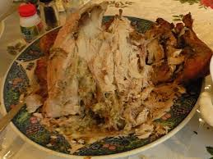
Unfaithful priests
Message: We can be religious, yet show complete contempt for God by giving Him our second best.
Faith: Giving something to God.
Faithful: Giving your very best to God.
Q: Do you give God your
left-overs?

Slide 59
Does God get your leftovers?
Malachi 1:9 Let’s reason together. Do you really feel that God should accept the second best?

Slide 60
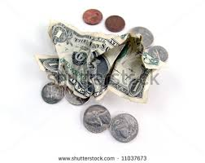
Unfaithful priests
Q: Is it better to give $5 or $0?
Malachi 1:10-11 God: Do me a favor. Leave your leftovers at home. Giving nothing at all is better than publicly disrespecting me.
My name will be great!!!!!

Slide 61
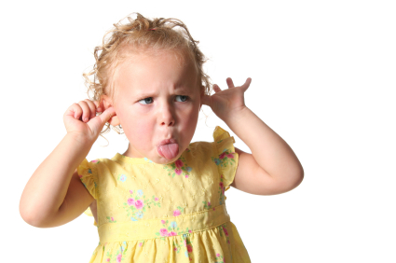
Unfaithful priests
Malachi 1:12-14 The key point:
Malachi 1:12 Have you “sniffed contemptuously” to God? People: How?
Malachi 1:13a “What
a burden.”
Zech 7:2-3

Slide 62
Unfaithful priests
Malachi 1:14 If you give your second best, God calls you a “cheat.”
God: I am a king and I expect to be treated as one.

Slide 63
II. Malachi 2:10-3:18 The people have been unfaithful
Malachi 2:16-17 The people have stopped trusting in God’s love.
Malachi uses the analogy of a divorce.
God: I hate divorce. It breaks hesed.
The people are accusing God of not living up to his side of the covenant. Being righteous has done us no good. We might as well sin… They do not trust God’s justice.

Slide 64
Malachi 3:6-15 The People have been unfaithful
Malachi 3:6-7 God: Return to me and I will return to you.
People: Who, me? I never left!!
Q: Can you leave God while still attending church?

Slide 65
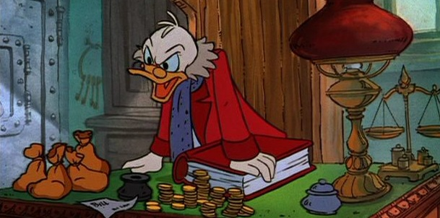
Malachi 3:6-15 The People have been unfaithful
Malachi 3:8 God: You have robbed me!
People: Who… Me?
v. 9 God: Yes, you. In tithes and offerings.
v. 10 Trust me in this….
It is not about money, it is about trusting God. It is about covenant
You are Stingy toward God

Slide 66
The key question
Here is the key question of Malachi:
Do you really, in your heart of hearts, believe that if you put all your trust in God, that he will take care of you.
Do you feel that what God has for you is enough?
If so, then you will be faithful to God.

Slide 67
Malachi 3:6-15 The people have been unfaithful
Malachi 3:13 God: You have said harsh things against me.
People: We have????
God: Yes!!! When you said “it is futile to serve God.”
You asked yourself: What am I getting out of this?
You have said that you do not believe that God will take care of you.
1 Timothy 6:17-19

Slide 68
Malachi 3:1-5 The Day of the Lord Part I
Malachi 3:1 I will send my messenger (Malachi).
John the Baptist (Matthew 11:3, 10, 14)
The Lord you are seeking will come to his temple.
The messenger of the covenant whom you desire = The Messiah.
Malachi 3:2-5 Are you sure you want God to come?
The people will get what they are asking for (God to come) but not what they want (a free ride without judgment).

Slide 69
Malachi 4:4-6 Day of the Lord Part II God’s final word to his people
1. Remember my law—remember Moses (v 4)
2. Be ready. I will send Elijah before that day. John the Baptist.
Matthew 17:11 “To be sure, Elijah comes and will restore all things.” Then the disciples understood that he was talking to them about John the Baptist.
All this is fulfilled in Jesus of Nazareth.

