Slide 2
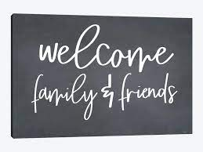

Slide 3
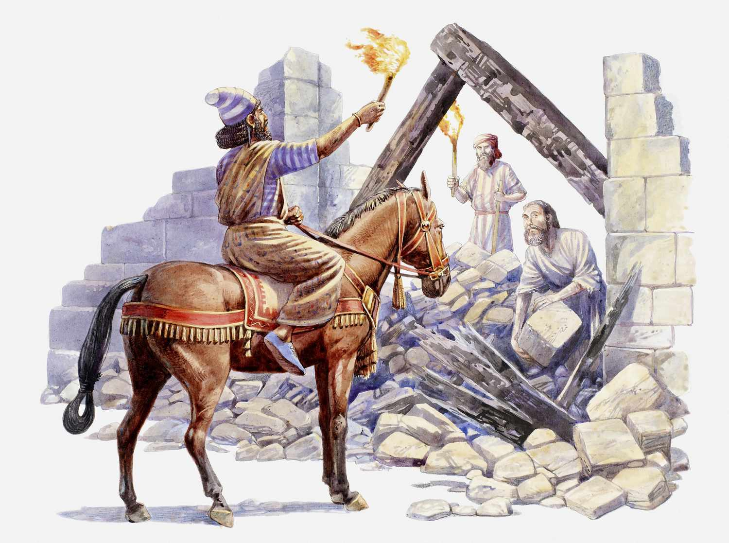
RRRR IX Ezra Part II
Nehemiah: God uses a leader to Restore and Rebuild the Kingdom

Slide 4
REPENT,

Slide 5
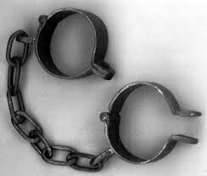
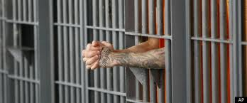
Here was Your Situation:
Lost
Enslaved
Captured
Imprisoned

Slide 6
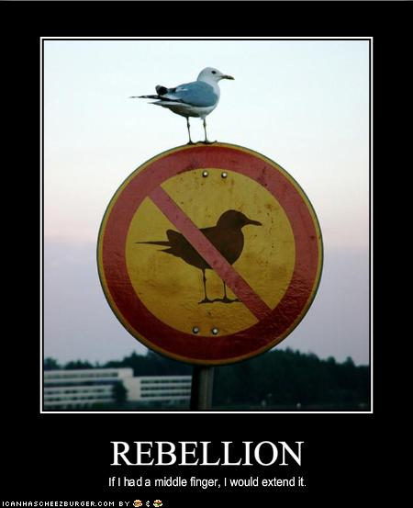
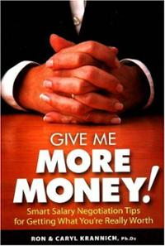
How Did you get there?
You Rebelled.
You went after other gods.
You said that what God
wants for you is not enough.

Slide 7
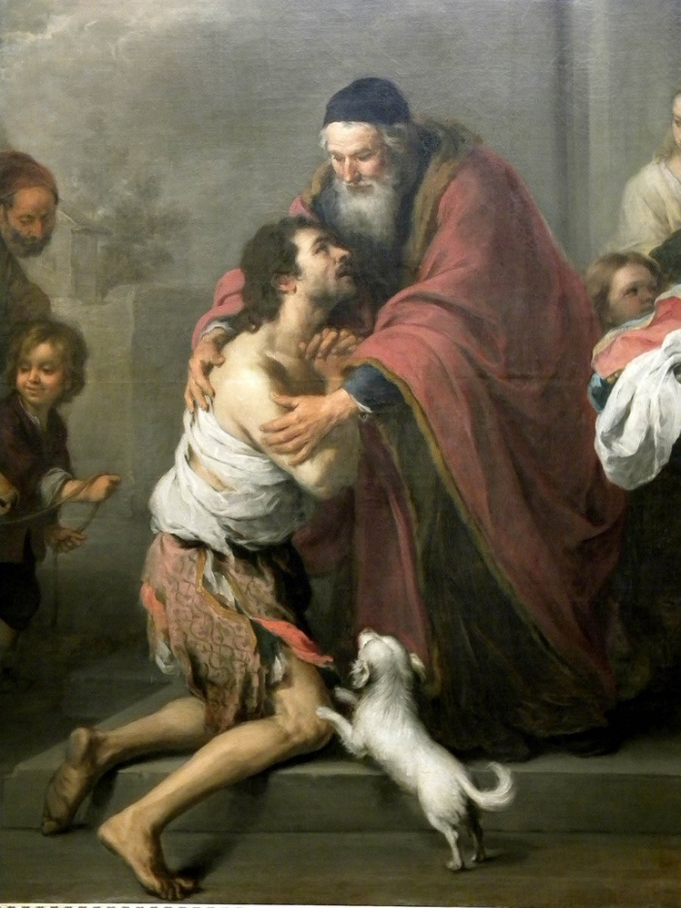
What is the solution?
Repent and Return
So that God can
Restore and Rebuild

Slide 8
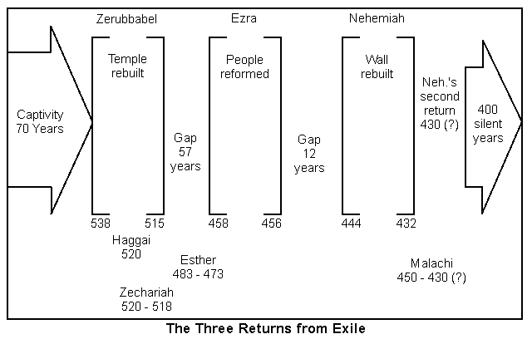
Notes:
Ezra 1-6 Cyrus allowed return (538 BCE) and began temple, completion under Darius (23 years later). Esther during Xerxes. Ezra comes under Artaxerxes.

Slide 9
Nehemiah: God Uses a Leader to Restore and Rebuild His Kingdom
Ezra: God uses a teacher.
Nehemiah: God uses a leader.
What are some traits of a godly leader?

Slide 10
Nehemiah 1:5-11 Nehemiah the builder is like Ezra the teacher.
Notes:
Once again a prayer for God to have the king extend favor. Did Nehemiah have control? No, but God did and he was God’s servant!

Slide 11
Repent, Return, Restore, Rebuild
Ch 1 Nehemiah repents
Ch 2 Nehemiah returns
Ch 3-6 Nehemiah restores and rebuilds

Slide 12
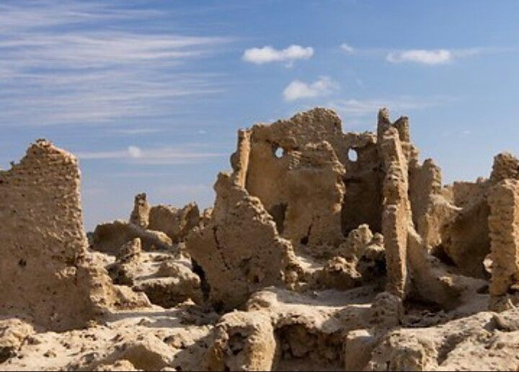
Nehemiah 1:1-10 The Walls Are Broken Down
Nehemiah’s response:
Mourned
Prayed
Confessed
“We” sinned
Boldness
Took action

Slide 13
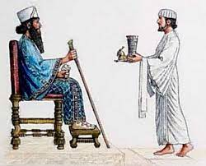
Nehemiah 1:11-2:10
Nehemiah: cupbearer
God is working behind the scenes.
Like Esther, Nehemiah takes a big risk for God.
Nehemiah says a quick prayer.
Nehemiah expects great things

Slide 14
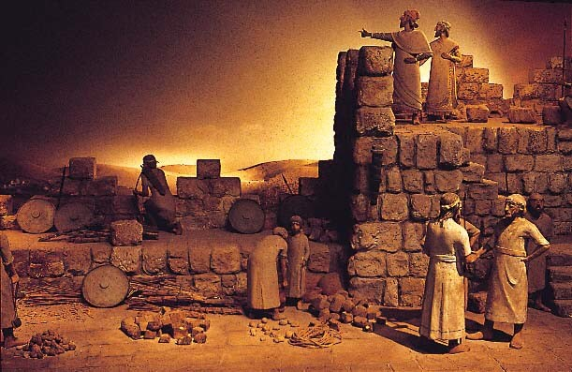
Nehemiah 2:11-18 Nehemiah forms a plan
Nehemiah evaluates the situation.
Nehemiah forms a plan.
Nehemiah creates a vision.
Nehemiah reminds people God is in control.
Nehemiah calls people to rise up and build!!!

Slide 15
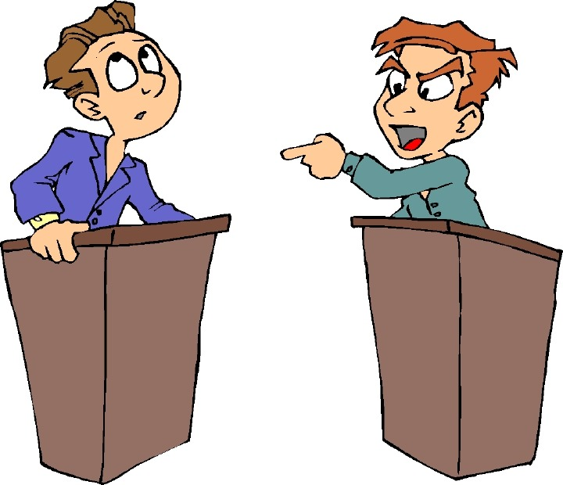
Nehemiah 2:19-20 Opposition!
Tobiahs and Sanballats will always oppose the work of God
Nehemiah: “The God of heaven will give us success.” We will not stop building!!!

Slide 16
Nehemiah 3:1-5 The Builders Get Building!
Neh 3:20 Baruch built zealously. Are you zealously building the wall?
Notes:
Learn from lists: Spiritual leaders are involved (3:1). It begins with dedication to God (3:1). Some give even though no direct benefit: Jericho (2), Tekoa (5), Gibeon (7), Mizpah (7, 15, 19), Zanoah (13), Beth Hakkerem (14), Beth Zur (16) and Keilah (17, 18). Not perfect (3:5).

Slide 17
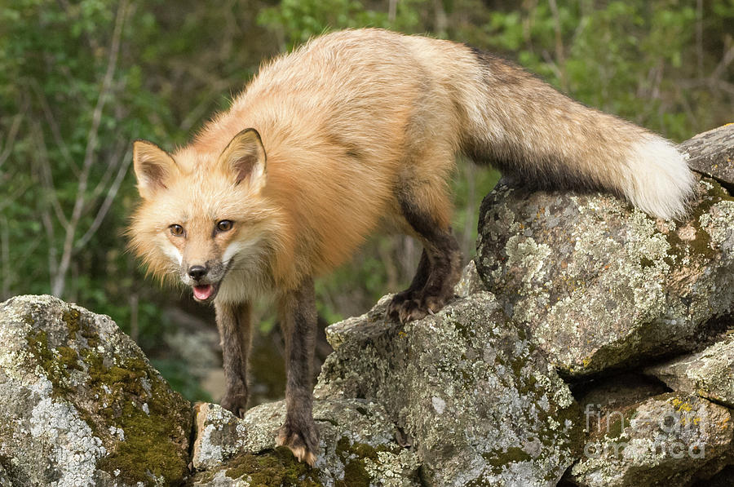
Nehemiah 4:1-9 More Opposition
When we get busy building the kingdom, opposition will come!
Tobiah: Even a fox…
You cannot build a church of 200 or a campus ministry of 100. Impossible!!!

Slide 18
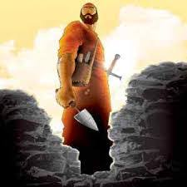
Nehemiah 4:10-20 Valid Concerns
- There is so much rubble.
Our strengthe is running out.
Danger: We will be attacked.
It’s HOOOOOTTTTTT
Let’s stop building!!!
Nehemiah:
Came up with a practical plan.
We will NOT STOP BUILDING!

Slide 19
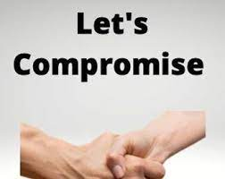
Nehemiah 6:1-2
Sanballat and Tobiah: Let’s compromise.
Nehemiah says Oh No! to going to the Valley of Ono

Slide 20
Nehemiah 5
Stop sinning!
Make restitution.
Nehemiah takes care of the poor

Slide 21
Nehemiah 6:1-2
Sanballat and Tobiah: Let’s compromise.
Nehemiah says Oh no to Ono

Slide 22
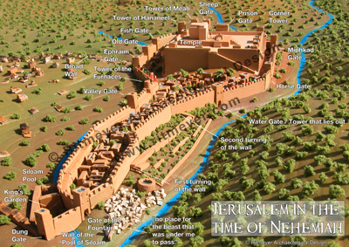
Nehemiah 6:15-16 The Wall is Completed
Notes:
They finally finish the wall! Really fast. Only because of God’s mercy and the people working hard. Amazing what can be accomplished. Pray and roll up sleeves when given direction from leaders.

Slide 23
Nehemiah 12:27 Time to party
Notes:
It was a special occasion and they brought in all the Levites to celebrate! Two choirs in procession on or near the wall in opposite directions and met at the temple. * We may have a fight in the car on the way…but God’s mercy is greater!

Slide 24
Nehemiah: God Uses a Leader to Build the Kingdom
Nehemiah loves God and his kingdom.
Nehemiah prays boldly and humbly.
Nehemiah takes action.
Nehemiah is real with the people about the problem.
Nehemiah, nevertheless, creates a powerful vision.
Nehemiah calls the people to rise up and build.
Nehemiah refuses to stop building, despite opposition.
Jerusalem was restored and rebuilt.

Slide 25
Announcements
Rush Week Take Brochures
Sharing UCMerced Monday
Bible Talk UCMerced Tuesday 1:00
Bible Talk Merced College Wednesday 12:00
Midweek Wed 7:30 UC Merced GLCR 120 Vision Night
Friday 7:00 Scavenger Hunt. Downtown @ theatre. We will need help Th 7:00 to create the event.

Slide 26
Announcements
Sat 10:00 Picnic and games at Lake Yosemite Park
Sun 9/3 11:00 First service at First Baptist Church
Inaugural Service 10/1
West Coast Singles Conference Oct 12-15 in San Diego
Campus Fall Retreat Oct 20-22.

Slide 27
Contribution
www.mercedchurch.com click give
Or just give today!

