Slide 1
RRRR X Malachi
Malachi: Faith in God or Faithful to God?
hesed

Slide 2
REPENT,

Slide 3
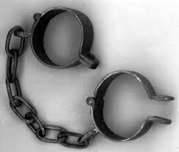
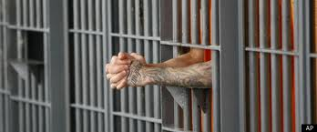
Here was Your Situation:
Lost
Enslaved
Captured
Imprisoned

Slide 4
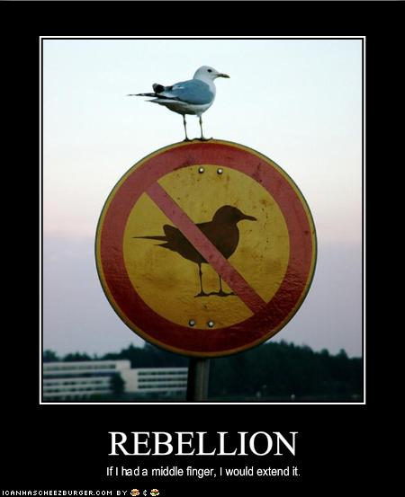
How Did you get there?
You Rebelled.
You went after other gods.
You said that what God
wants for you is not enough.

Slide 5
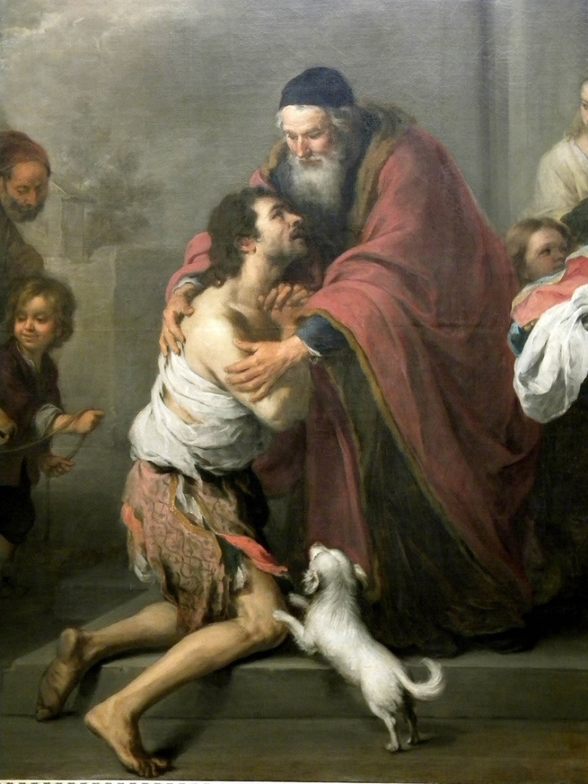
What is the solution?
Repent and Return
So that God can
Restore and Rebuild

Slide 6
Theme: Covenant

Slide 7
Malachi: God’s Messenger
Message: Faithful to God vs. Faith in God
Malachi = my messenger
Date of writing about 440 BC The end of the Old Testament.
Malachi is God’s last word to the Jews. It is a capstone to the message of the Old Testament and a final preparation for the ministry of John the Baptist and of Jesus. The next word from God will be “Repent for the kingdom of heaven is near” (John the Baptist)

Slide 8
Background to Malachi
The earlier generation had repented, returned been restored and rebuilt. The new generation are becoming cynical and questioning that God has fulfilled his promise to restore and rebuild. They need personal repentance and restoration. Will they have faith in God or will they be faithful to God?
Style: A diatribe—a staged debate.
God: You have robbed me.
People: How have we robbed you?
God: In tithes and offerings.

Slide 9
Outline of Malachi
Introduction: God still loves Israel. God has been faithful to Israel. 1:1-5
I The Priests have been unfaithful 1:6-2:9
II The People have been unfaithful 2:10-3:15
III The Day of the Lord is coming Malachi 3:16-4:6

Slide 10
Introduction: Malachi 1:1-5
God: I still love you. I have kept my covenant with you. I have been faithful to you.
People: How have you loved us? Cynical. They do not feel that God has been faithful. God has not loved them the way they expected to be loved.
Jacob have I loved, Esau I have hated….
This sets the tone for the book. I have been faithful to you, will you be faithful to me (or will you merely have faith in me)?

Slide 11
I. The Priests have been unfaithful
It is you, O priests, who show contempt for my name.
Priests: Who,… Us?
How have we shown contempt?
Remember: We are the priests!
1 Pet 2:5,9 a royal priesthood
Exodus 19:6 A kingdom of priests.

Slide 12
Unfaithful priests
People: How have we shown contempt?
God: You place defiled food on my altar.
People: Who, us?
God: Yes, you. You have not show me the respect I deserve.
People: Who us? How?
God: You gave me your second best.
People: Oh……
God: Try offering that to your boss.

Slide 13
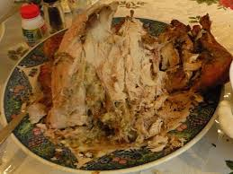
Unfaithful priests
Message: We can be religious, yet show complete contempt for God by giving Him our second best.
Faith: Giving something to God.
Faithful: Giving your very best to God.
Q: Do you give God your
left-overs?

Slide 14
Does God get your leftovers?
Malachi 1:9 Let’s reason together. Do you really feel that God should accept the second best?

Slide 15
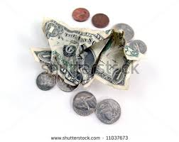
Unfaithful priests
Q: Is it better to give $5 or $0?
Malachi 1:10-11 God: Do me a favor. Leave your leftovers at home. Giving nothing at all is better than publicly disrespecting me.
My name will be great!!!!!

Slide 16
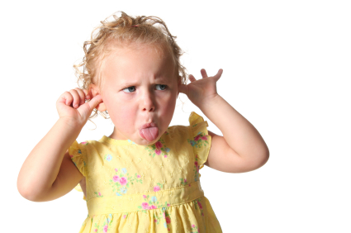
Unfaithful priests
Malachi 1:12-14 The key point:
Malachi 1:12 Have you “sniffed contemptuously” to God? People: How?
Malachi 1:13a “What
a burden.”
Zech 7:2-3

Slide 17
Unfaithful priests
Malachi 1:14 If you give your second best, God calls you a “cheat.”
God: I am a king and I expect to be treated as one.

Slide 18
II. Malachi 2:10-3:18 The people have been unfaithful
Malachi 2:16-17 The people have stopped trusting in God’s love.
Malachi uses the analogy of a divorce.
God: I hate divorce. It breaks hesed.
The people are accusing God of not living up to his side of the covenant. Being righteous has done us no good. We might as well sin… They do not trust God’s justice.

Slide 19
Malachi 3:6-15 The People have been unfaithful
Malachi 3:6-7 God: Return to me and I will return to you.
People: Who, me? I never left!!
Q: Can you leave God while still attending church?

Slide 20
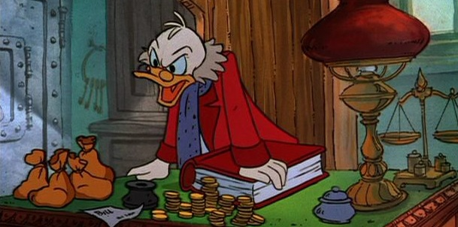
Malachi 3:6-15 The People have been unfaithful
Malachi 3:8 God: You have robbed me!
People: Who… Me?
v. 9 God: Yes, you. In tithes and offerings.
v. 10 Trust me in this….
It is not about money, it is about trusting God. It is about covenant
You are Stingy toward God

Slide 21
The key question
Here is the key question of Malachi:
Do you really, in your heart of hearts, believe that if you put all your trust in God, that he will take care of you.
Do you feel that what God has for you is enough?
If so, then you will be faithful to God.

Slide 22
Malachi 3:6-15 The people have been unfaithful
Malachi 3:13 God: You have said harsh things against me.
People: We have????
God: Yes!!! When you said “it is futile to serve God.”
You asked yourself: What am I getting out of this?
You have said that you do not believe that God will take care of you.
1 Timothy 6:17-19

Slide 23
Malachi 3:1-5 The Day of the Lord Part I
Malachi 3:1 I will send my messenger (Malachi).
John the Baptist (Matthew 11:3, 10, 14)
The Lord you are seeking will come to his temple.
The messenger of the covenant whom you desire = The Messiah.
Malachi 3:2-5 Are you sure you want God to come?
The people will get what they are asking for (God to come) but not what they want (a free ride without judgment).

Slide 24
Malachi 4:4-6 Day of the Lord Part II God’s final word to his people
1. Remember my law—remember Moses (v 4)
2. Be ready. I will send Elijah before that day. John the Baptist.
Matthew 17:11 “To be sure, Elijah comes and will restore all things.” Then the disciples understood that he was talking to them about John the Baptist.
All this is fulfilled in Jesus of Nazareth.

