Slide 1
Deuteronomy 8
Advice to Disciples

Slide 2
In the wilderness: The life of a disciple
OLD TESTAMENT TYPE
NEW TESTAMENT ANTITYPE
SLAVERY IN EGYPT
LOST, SLAVE TO SIN
WANDERING IN THE WILDERNESS
LIVING THE LIFE OF A DISCIPLE
ENTERING THE PROMISED LAND
ENTERING HEAVEN

Slide 3
Deuteronomy 8:1
God’s purpose for us:

Slide 4
Deuteronomy 8:1
God’s purpose for us:
To prosper in this life
To make it to heaven
Remember Hebrews 3:16-19 Their bodies were scattered across the desert.

Slide 5
Deuteronomy 8:2
How will God bless us and get us into heaven?

Slide 6
Deuteronomy 8:2
How will God bless us and get us into heaven?
By humbling us and by testing us.
Why?
So that we will keep his commandments. Deut 8:2b

Slide 7
Deuteronomy 8:3
How will God humble us?

Slide 8
Deuteronomy 8:3
How will God humble us?
By causing us to be hungry… and then feeding us
How has God caused you to hunger?

Slide 9
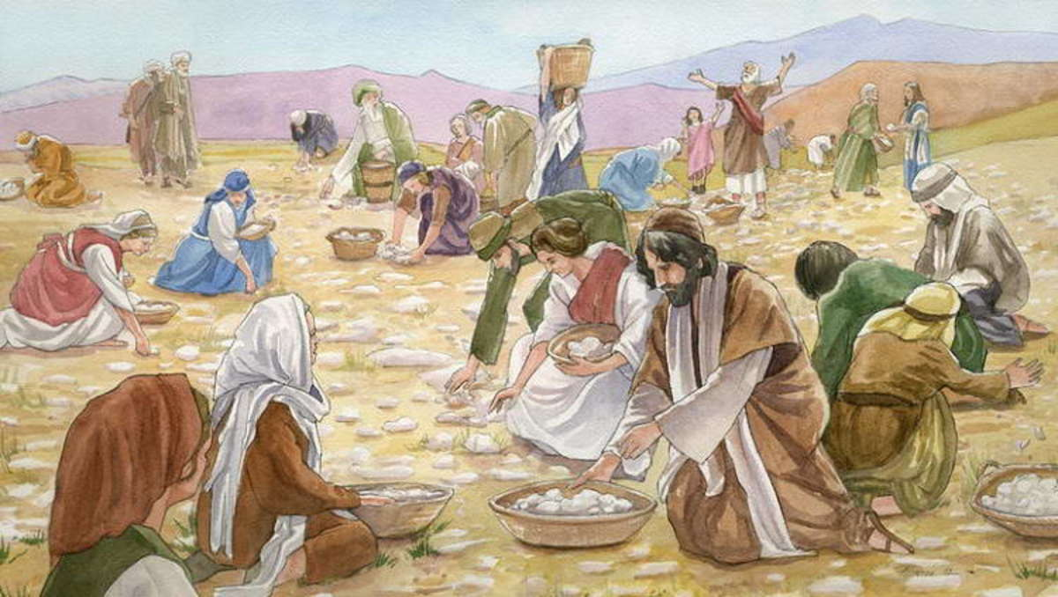
Deuteronomy 8:3
He caused you to hunger, then he fed you with manna.
God meets our needs, but not the way we would have chosen.
Ex: Numbers 21:4-9
Numbers 11:4-6

Slide 10
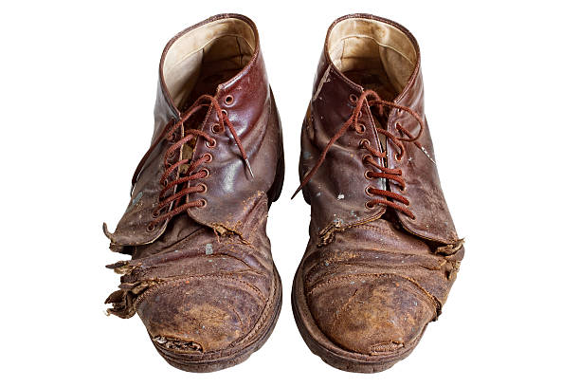
Deuteronomy 8:4
Your clothes did not wear out and your feet did not swell during these forty years.
We need to recognize and appreciate God’s “little miracles” every day.

Slide 11
Deuteronomy 8:5
What is God’s plan for blessing us?

Slide 12
Deuteronomy 8:5
What is God’s plan for blessing you?
…the Lord your God disciplines you…

Slide 13
Deuteronomy 8:6-9
Why does God discipline us?

Slide 14
Deuteronomy 8:6-9
Why does God discipline us?
So that he can bless us.
So that we will rely on Him.
Two ways God humbles us:
1. By giving us a lot of blessings.
2. By taking those blessings away from us.

Slide 15
Deuteronomy 8:10-14 A Solemn Warning
When God blesses you, you better praise God!
Don’t become comfortable….
Q: Are we Americans tempted to become comfortable?
v. 14 Then your heart will become proud.

Slide 16
Deuteronomy 8:15-18
He humbled you…
He blessed you…
He humbled you…
He blessed you…
Suggestion: Do not become prideful!
1 Corinthians 4:17

Slide 17
Conclusion: Deuteronomy 8:19
Do not EVER forget the Lord your God
Or you will be destroyed.

Slide 18
Conclusion
God wants to bless us and to help us to make it to heaven.
His method toward that end is to humble us and to cause us to rely on him.
When he blesses you REMEMBER the little blessings and the big blessings and acknowledge Him.
Or you will lose all.

Slide 19
Bonus Material
Deuteronomy 30:11-20
It is not too hard… What?
Love God with ALL your heart and fully obey all he commands you.
That’s not too hard????
The solution: Choose life.

