Slide 1
Integrity

Slide 2
Integrity: The quality of being honest and having strong moral principles which you refuse to change. Having high standards and refusing to lower them.
Integral/integrated: Strong connectedness, despite significant differences. Necessary to make a whole complete.

Slide 4
Integrity: Having a strong moral compass

Slide 7
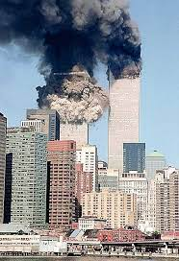
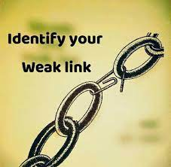
Matthew 22:16 Jesus was a man of integrity
Do you have any weak links?

Slide 8
Proverbs and Integrity
Prov 10:9 Whoever walks with integrity
Prov 11:3 The integrity of the upright…

Slide 9
Areas to Maintain Integrity
Our work ethic
Our honesty
Our moral character
Our consistency

Slide 10
Biblical Examples of Integrity
Job 2:3,9 He still maintained his integrity.
Nehemiah 7:3 Integrity ↔ Fear of God
Daniel 6:1-5
Not at all corrupt
Not at all negligent

Slide 11
Biblical Examples of Integrity
Proverbs 31:10-31 The person of noble character
v. 11 full confidence
v. 15, 18, 27 Up early in the AM and late in the PM
v. 17 She works vigorously
v. 20 She opens her arms to the poor
v. 25 She makes short, medium and long term plans and sticks to them
v. 30 She fears the Lord, not man

Slide 12
Discussion Questions
1. What does integrity mean for you as a student or as a worker at your job?
2. What does integrity mean to you as a disciple of Jesus Christ?
3. What area or areas of integrity do you want to shore up in your own life?

