Slide 1
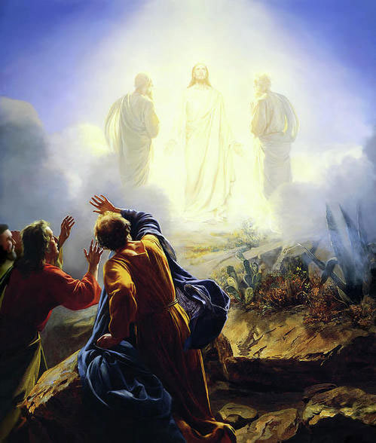
Last Week
Take up your cross daily.
This is my Son whom I love. Listen to Him!

Slide 2
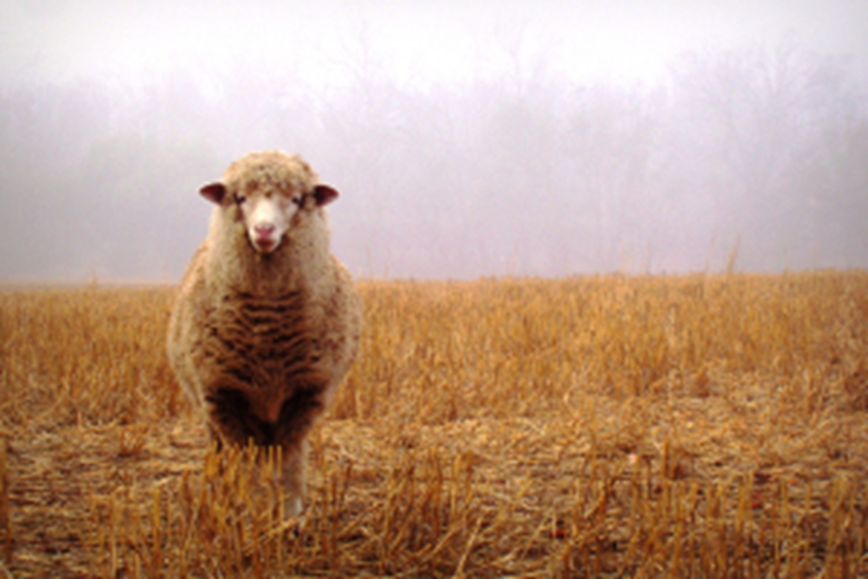
Relationships in the Kingdom
1. The greatest in the Kingdom is the least of all.
2. Bring back the lost sheep.
3. Make every effort to restore those who have sinned.

Slide 3
Matthew 18:10-14 Bring in the wandering sheep.
Jesus: Leave the 99, go look for the stray, find it and bring it back into the flock.
Q: Have you been doing this?
Your Friend

Slide 4
Parable of the Unmerciful Servant
Peter: How forgiving should I be?
A: As forgiving as God is.
Peter: How many times should I forgive?
A: How many times did God forgive you?
Seventy times seven = an unlimited number of times.

Slide 5
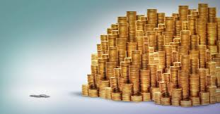
How Much Has God Forgiven You?
10,000 talents
1 talent = 75 lbs. gold.
$2000/oz x 160z/lb x 75lb x 10,000 =
$20,000,000,000
20 billion dollars

Slide 6
God’s Forgiveness
1. More than we could ever pay.
2. God entrusted a lot with us. 1 Cor 4:2
More than we would have the nerve to ask
Appeared unconditional. No strings attached.
But… Conditional on our forgiveness of others.

Slide 7
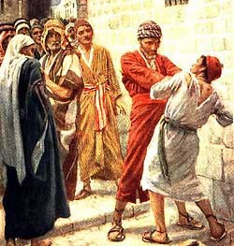
Has Someone Sinned Against You?
What is the worst sin someone has committed against you?
How does it compare to your sin against God?
20,000,000:1

Slide 8
Is God’s Forgiveness Conditional?
Matthew 18:35 This is how my heavenly Father will treat each of you unless you forgive your brother or sister from your heart.
Colossians 3:12-13 Bear with one another and forgive one another if any of you has a grievance against someone. Forgive as the Lord has forgiven you.
Matthew 6:14-15 But if you do not forgive others their sins, your Father will not forgive your sins.

Slide 9
What is the hardest thing for you to forgive?
Who do you still need to forgive?
What if they do not apologize to you?

Slide 10
Summary
1. We have an almost infinite debt of sin.
2. God is willing and prepared to remove the entire debt without condition.
3. Except with one condition. We MUST forgive those who sin against us.

Slide 11
Announcements
Bible Talk UCMerced Tuesday 12:00 MC Wed 12:00
Bible Talk at the Oakes Tues 7:30
Midweek Wed 7:30 UC Merced GLCR 120 Practical Christianity Part IV Knowledge and Self-Control
Friday 7:00 Study night at UC Merced GLCR 120
Sunday 11:00 Worship at 1st Baptist 500 Buena Vista Dr.

Slide 12
Coming Up
Sat 12/9 Catholic Charities
Sat 12/9 Pinnacles National Park
Tues 12/12 White Elephant Christmas Party

Slide 13
Contribution
www.mercedchurch.com click give
Or use the basked
in the back

