Slide 1
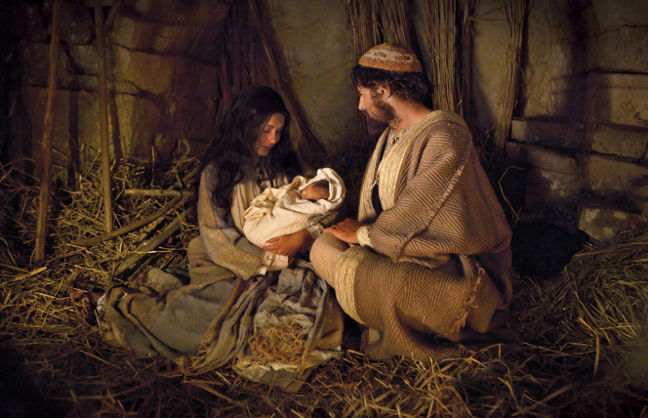
O Come, O Come
Immanuel

Slide 2
The meaning of Christmas
Christ = Messiah, Anointed one, Savior
mas = mass = maese = missa = sent
Christmas = A Savior/King is sent

Slide 3
O Come, O Come Immanuel
O come, O come, Immanuel,
And ransom captive Israel,
That mourns in lonely exile here,
Until the Son of God appear.
Rejoice! Rejoice!
Immanuel Shall come to thee, O Israel.

Slide 4
O Come, O Come Immanuel
O come, Thou Dayspring, from on high,
And cheer us by Thy drawing nigh;
Disperse the gloomy clouds of night,
And death's dark shadows put to flight.
Rejoice! Rejoice!
Emmanuel Shall come to thee, O Israel.

Slide 5
O Come, O Come Immanuel
O come, Thou Key of David, come,
And open wide our heav'nly home;
Make safe the way that leads on high,
And close the path to misery.
Rejoice! Rejoice!
Emmanuel Shall come to thee, O Israel.

Slide 6
Matthew 1:18-23 O Come! O Come, Immanuel! Isaiah 7:14
Im = toward or among
Manu = us
El = God
Jesus is God who came toward/among us

Slide 7
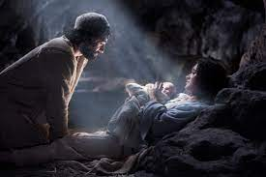
Matthew 1:18-23
Isaiah 7:14 Therefore the Lord himself will give you a sign: The virgin will conceive and give birth to a son and will call him Immanuel.
Im = among manu = us
El = God
God among us

Slide 8
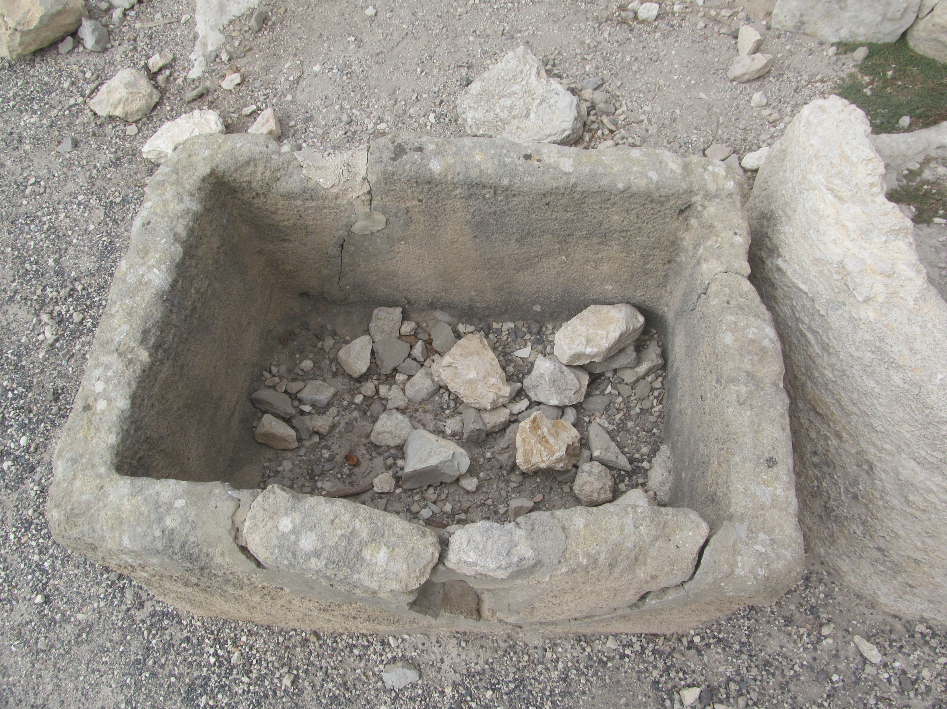
John 1:1-3,14,18 The Word became flesh and took up residence among us. God among us
A manger in Megeddo

Slide 9
Immanuel ransomed captive Israel
We mourned in exile here
We were Joseph—sold as a slave
We were Israel—sold as slaves in Egypt
We were Judah—in captivity in Babylon
Psalm 137:1-5
Isaiah 59:2 Separated from our God.

Slide 10
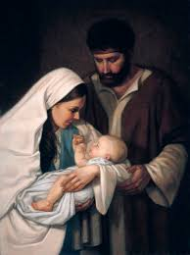
Isaiah 9:1-7 No more gloom
We were walking in darkness
A yoke burdened us
But… To us a child is born
To us a Son is given.
He will reign on David’s throne.

Slide 11
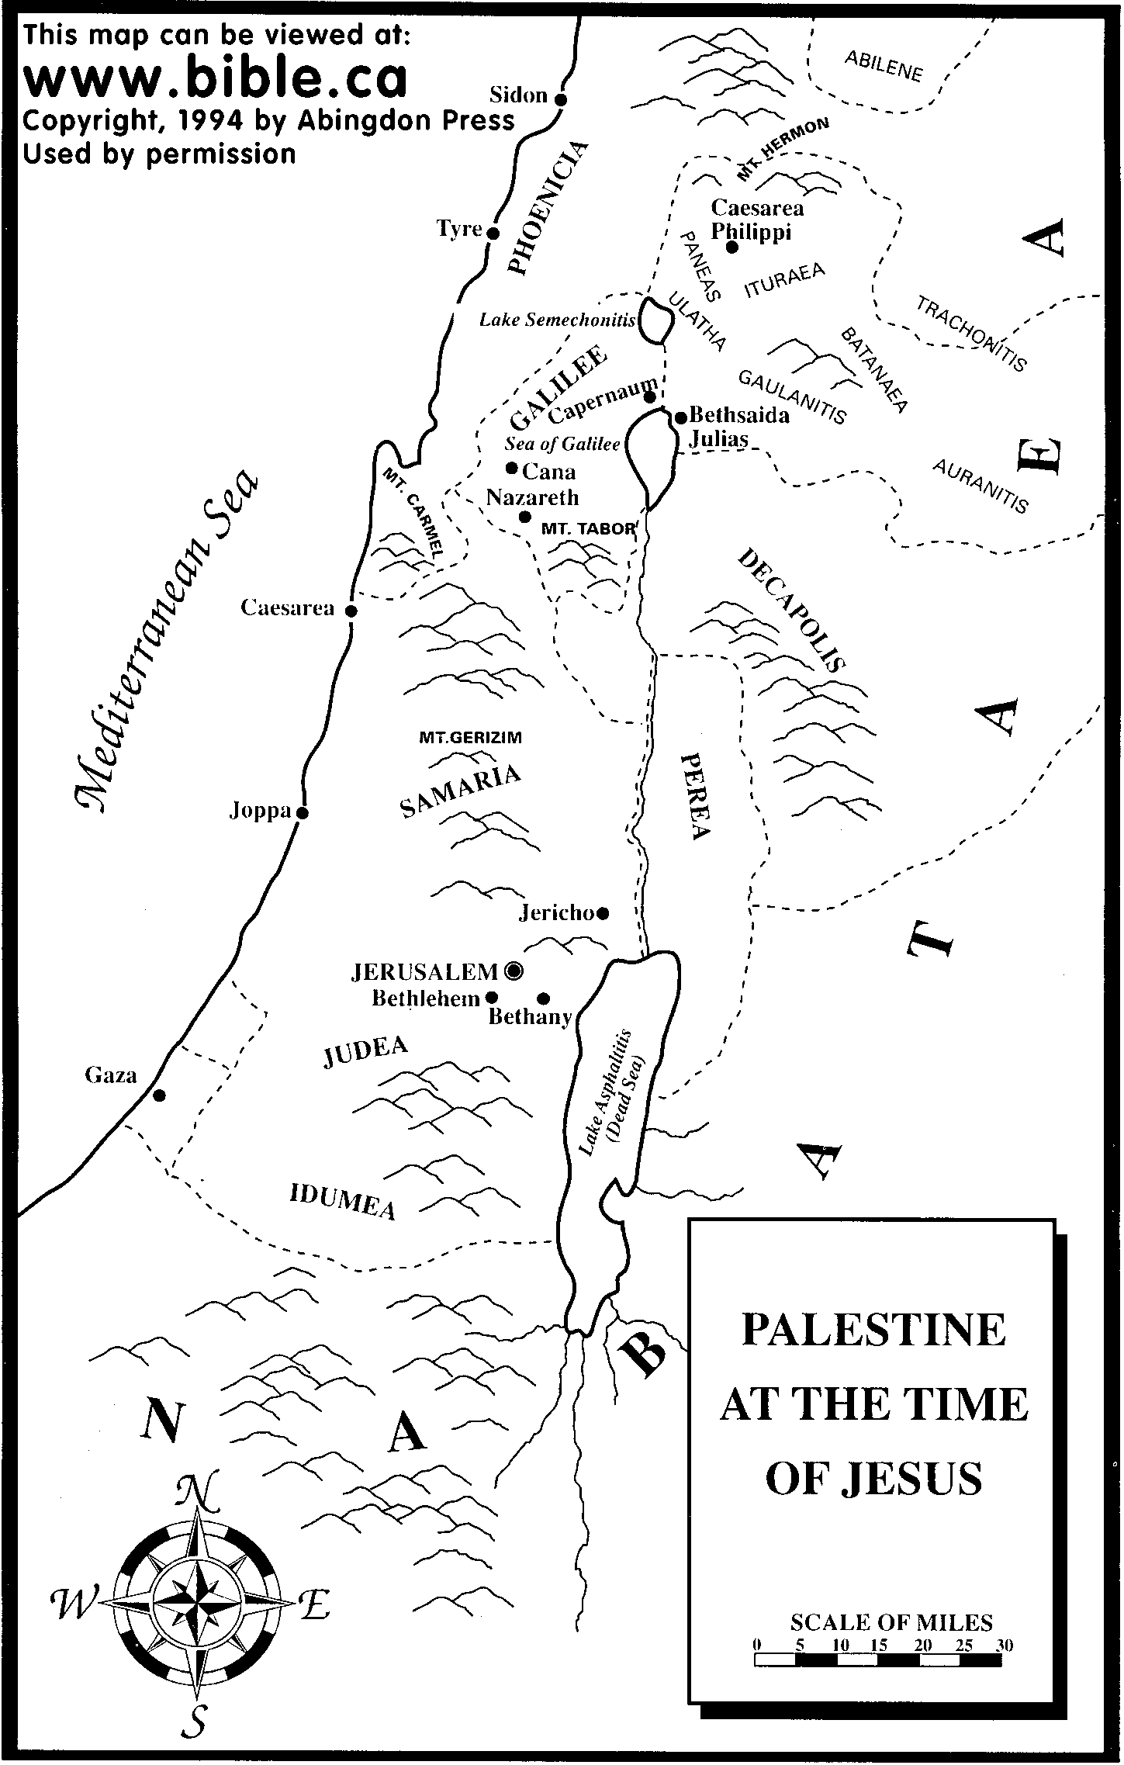
Zebulun
Naphtali
and
Nazareth

Slide 12
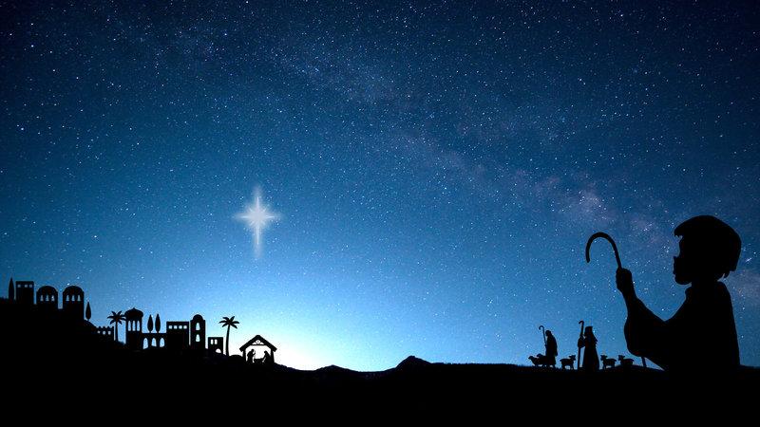
Micah 5:2 But you, Bethlehem, Ephrathah, though you are small among the clans of Judah, out of you will come for me one who will be ruler of Israel, whose origins are from old, from ancient times.
Rejoice, Rejoice, Immanuel, has come to the, O Israel!!!

Slide 13
Luke 2:8-12
Behold! I bring you news of great joy that will be for all the people. Today, a Savior who is Messiah the Lord was born for you in the city of David.

Slide 14
Joy to the world! The Lord is come
Let earth receive her King!
Let every heart prepare Him room
And heaven and nature sing
And heaven and nature sing
And heaven, and heaven and nature sing

Slide 15
Joy to the world! The Savior reigns
Let men their songs employ
While fields and floods Rocks, hills and plains
Repeat the sounding joy Repeat the sounding joy
Repeat, repeat the sounding joy

Slide 16
He rules the world with truth and grace
And makes the nations prove
The glories of His righteousness
And wonders of His love And wonders of His love
And wonders, wonders of His love

Slide 17
O Come, O Come, Immanuel
Joy to the world!

