Slide 1
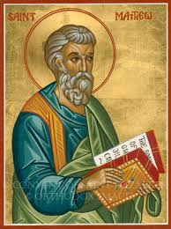
Matthew XVI
Matthew Ch. 24
Getting Ready to Meet God

Slide 2
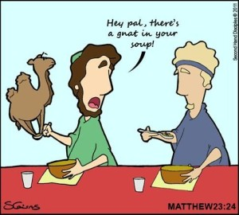
Weightier Matters: Gnats vs. Camels
Camels:
Justice
Mercy
Faithfulness
Gnats:
Outer things, rules

Slide 3
Matthew 23:37-39 Jesus Loves the Pharisees
How I longed to gather you in as a hen gathers in her chicks, but you were not willing.
Will you accept the invitation to the banquet? Are you clothed with Christ?
Are you willing to be gathered in?

Slide 4
Matthew Ch. 24
Getting Ready to Meet God
Are you ready?

Slide 5
Matthew 23:39-4:3 Jesus Abandons the Temple and Climbs the Mount of Olives
Jesus fulfills Ezekiel 11:13-14
The temple and the city are doomed
“Not one stone will be left on another.
The Mount of Olives

Slide 6
Jesus: Not one stone will be left on another. Every one will be thrown down

Slide 7
This Is About Three Things
1. The destruction of Jerusalem in AD 70, and the end of the Jewish age.
2. The end of time and the return of Christ.
3. The fact that we need to be prepared to see Jesus at any time.

Slide 8
Matthew 24:4-14
v. 4-12 Don’t get distracted.
v. 13 Stand firm to the end.
v. 14 The gospel will be preached to all nations (Acts 1:8 Acts 17:6)

Slide 9
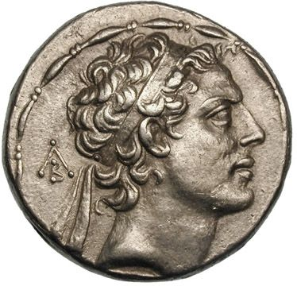
Matthew 24:15-25
The Abomination of Desolation.
As spoken by Daniel
167 BC Daniel 11:31, 1 Maccabees 1:57
AD 70 Daniel 9:27
Flee to the mountains!
Antiochus Epiphanes

Slide 10
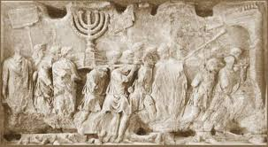
Matt 24:15-25 What’s the Point for Us?
The Jewish age is over.
The kingdom of God has come.
Jesus is in the heavenly tabernacle
Don’t lose focus
Arch of Titus, Rome

Slide 11
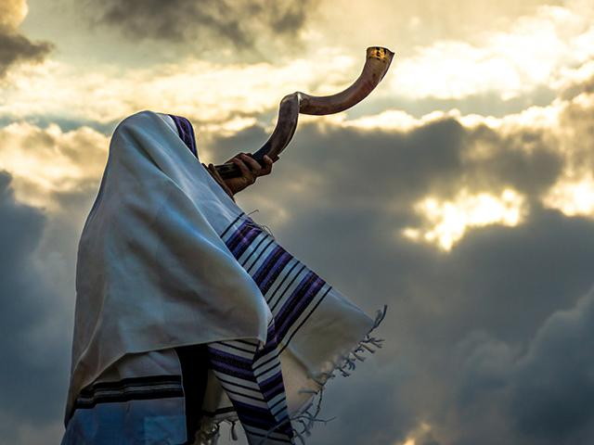
Matthew 24:26-35 The Second Coming of Christ
They will see the Son of Man coming on the clouds of heaven, with power and great glory. And he will send his angels with a loud trumpet call and the elect will be gathered from the four winds…

Slide 12
Matthew 24:36-51
No one knows the day or the hour, not even Jesus
So be ready!

Slide 13
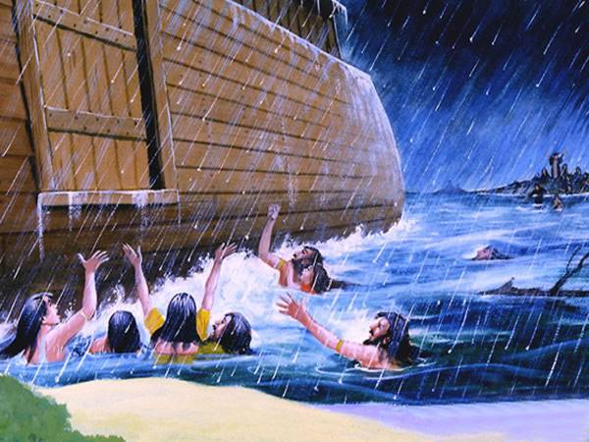
As in the days of Noah…
One will be taken, one will be left.

Slide 14
Matthew 25:42 Keep Watch!
How?
v. 43 Live every day like it might be THE DAY.
v. 44 Be ready!
v. 46 Be doing good when he comes.
v. 48 Stop doing evil. Repent today.

Slide 15
Matthew 25:1-13 The Parable of the Wise and Foolish Virgins
Matt 24:36-51 Be ready for him to come back today.
Matt 25:1-13 Keep oil in the lamp. Be ready even if he does not come back immediately.
Q: How do we keep our lamp full?

Slide 16
Summary
Keep Watch! Be ready! You do not know when Jesus will come (or you will die).
Live every day like Jesus will come back today.
Be ready for him to come back after a long, productive Christian life.

