Slide 1
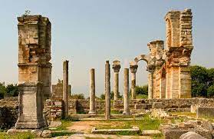
Dr. John Oakes
January, 2024
Philippians 1

Slide 2
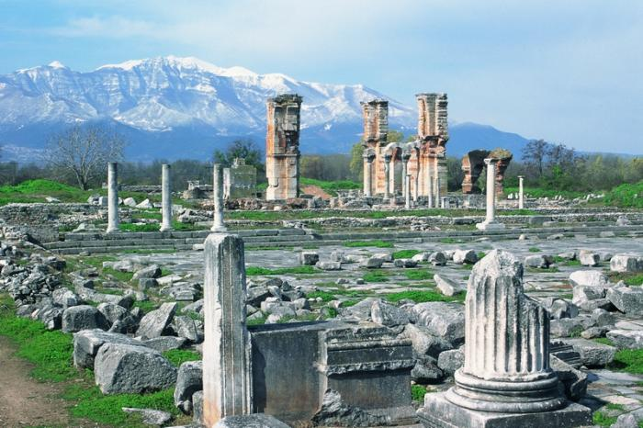
Philippians: To Live is Christ
Theme:
Life in Christ
Theme verse:
Phil 1:21
For me, to live is Chist and to die is gain.

Slide 3
Background: Acts 16:6-15 Paul Hemmed in by the Holy Spirit

Slide 4
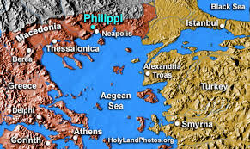
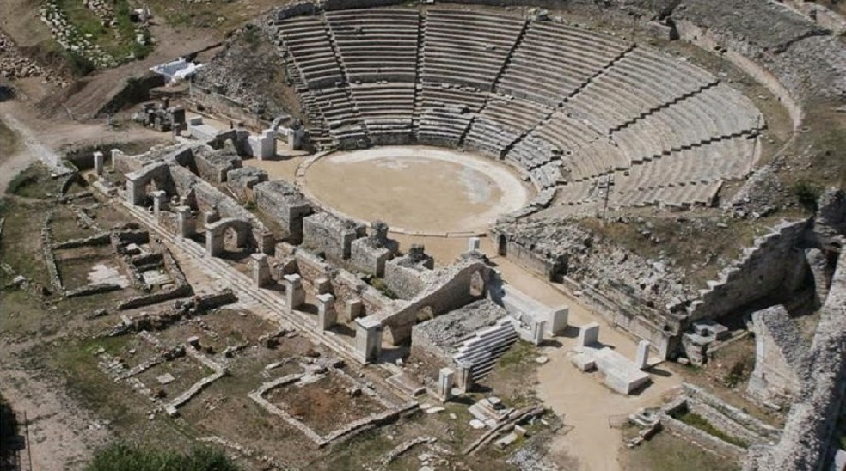
Paul’s First Mission in Europe
A Roman colony
No synagogue
A completely new ministry for Paul

Slide 5
Fond Memories….
Lydia
Partnership with Silas
Philippian Jailer
Q: What do you do in your darkest moments?
Q: Would you be willing to be publicly flogged and thrown into the darkest prison to help others to be saved?

Slide 6
Philippians 1:1-2
Phil 1:1 To all the saints in Christ Jesus
Saints haggios
called-out, separate, different, a holy person.
Throughout the book, Paul describes us as we are in Christ.
Who are we? We are Holy in Christ Jesus

Slide 7
Philippians 1:3-8 Assurance in Christ
1:6 God began a good work in us.
1:5 …from the first day (has already done) until now. He is still working in us… (is now doing)
1:6 God will carry his work in us on to completion. (will do)
1:6 God sees in us that which will be fully realized in heaven. In Christ the outcome is guaranteed.

Slide 8
Paul and the Philippians
1. Phil 1:5 Partners in the gospel.
2. Phil 1:7 I have you on my heart.
3. Phil 1:8 I yearn for you. Epipotheo deep longing,
homesickness

Slide 9
Phil 1:9-11 Paul’s Prayer
Q: What is Paul’s deep desire for the Philippians?

Slide 10
Phil 1:9-11
Knowledge and Discernment
Knowledge of what is right.
Discernment about how to best carry it out.
Discernment: The ability which makes us able to make a wise, moral decision.
To decide between good, better and best.

Slide 11
Philippians 1:12-26
Q: What is on Paul’s heart (despite the fact that he is in chains for Christ)?

Slide 12
Paul’s Testimony:
v. 12-13 What has happened has advanced the gospel.
v. 14-18 What is happening now is advancing the gospel.
v. 19-26 What will happen in the future will advance the gospel.
Paul believes Philippians 1:6 applies to him.

Slide 13
Philippians 1:14-18
What is now happening to Paul
v. 14 Fruitful suffering.
v. 15-18 Paul refuses to let people with insincere motives rob his joy at the advancement of the gospel.
v. 18 “What does it matter?” Could you say this if people were undermining you and your ministry?

Slide 14
Philippians 1:19-26
Paul is confident that the future situation will work to advance the gospel as well.
Note: Paul is certain of the outcome, but uncertain about the path by which he will reach that outcome.

Slide 15
Phil 1:19-20 Paul’s Confidence
v. 19 Paul: I KNOW Through your prayers and through the encouragement of the Holy Spirit… that I will be delivered/saved.
I EXPECT I will have sufficient courage.
God will be exalted….
Whether by my life or by my death. (uncertain about the path)
Q: What is your attitude about your life?
What is your attitude about your death?

Slide 16
Philippians 1:21
Theme verse of Philippians
For me to live is Christ, to die is gain.
Q: Is this how you feel about your life?
For me to live is ______________________

Slide 17
Discussion Groups
God will complete the work he began in you.
Q: What work do you see God doing in you this semester?
Q: For me to live is _____________________
Notes:
2-24

