Slide 1
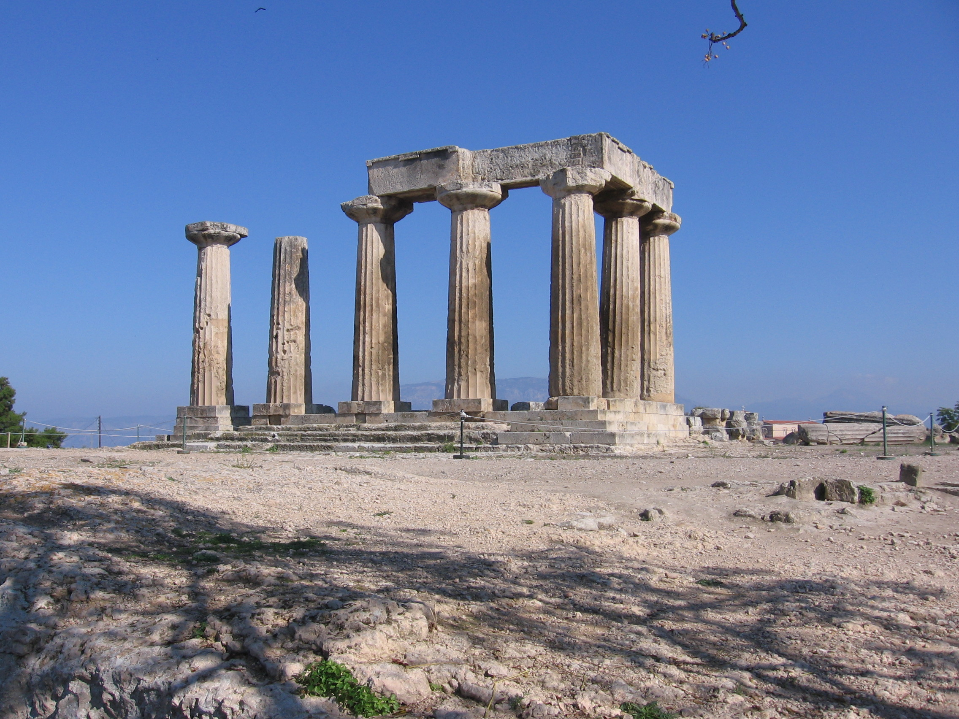
2nd Corinthians
Uc merced
Winter, 2024

Slide 4
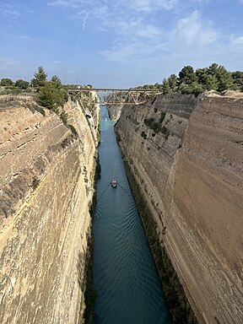
Corinth Canal

Slide 5
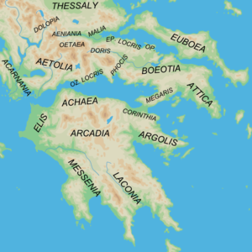
Isthmus of Corinth

Slide 6
Background in Corinth
Roman city
Very prosperous and wealthy
Very worldly Much pagan worship

Slide 7
Background in the church in Corinth
1 Corinthians:
Divisiveness
Sexual immorality
Pagan worship tolerated
Lawsuits among believers
Chaos in worship, abuse of Lord’s Supper
Doubts about the resurrection!

Slide 8
Context of 2 Corinthians
“Painful visit” of AD 56
“Severe Letter of AD 57
Some repentance (2 Cor 7)
Paul’s last visit in AD 57/58
Presence of Judaizing “super-apostles

Slide 9
Purpose of 2 Corinthians
I. To defend Paul’s apostolic authority
II. To oppose the influence of the Judaizing “super-apostles”
III. To explain and defend Paul’s New Covenant ministry

Slide 10
Outline of 2 Corinthians
Outline of 2 Corinthians:
I. 1:1-2:13 Introduction and defense of Paul’s apostolic ministry
II. 2:14-7:4 Paul explains his ministry of the New Covenant.
III. 7:5-9:15 Titus brings news from Corinth. Paul’s response. Collection for the Jerusalem Church.
IV. 10:1-13:14 Paul defends his ministry and prepares the Corinthians for his 3rd visit.

Slide 11
2 Cor 1:1-7 Comfort
Suffering ↔ Comfort
Comfort 9 times!
Where does your comfort come from?

Slide 12
2 Corinthians 1:8-11
Paul: I despaired of life! But…
But now I am happy… I have learned to rely on God.
Q: Do you want to learn to rely on God? Are you sure?

Slide 13
2 Corinthians 1:12-2:4
Paul explains his plans
I am not being fickle!
I had my reasons—I did not want to hurt you.
My yes is yes!

Slide 14
2 Corinthians 2:5-11 Restore the Brother
Church discipline/disfellowship
Purpose: to protect the purity of the church and to restore the offender to faith
Paul: v. 7 Forgive and comfort him.
v. 8 Reaffirm your love for him.
Do not give Satan a foothold. We know his schemes

Slide 15
2 Corinthians 2:14-17 The Aroma of Christ
Christians are part of a triumphal procession
We spread the aroma of Christ.
Death to some.
Life to others.

Slide 16
Triumphal Procession

Slide 19
Discussion Questions
How has God comforted you?
How will you learn to rely on God? (trials?)
How have/will you spread the aroma of Christ?

Slide 20
2 Cor 2:14-17 (cont.)
Q: What do you smell like? What aroma are you putting out?
v. 16 A rhetorical question: Who is adequate?
v. 17 The super-apostles think that they are adequate to the task. That is the problem!

Slide 21
2 Cor 3:1-6
The super-apostles: Paul, where are your letters of reference?
Paul: You Corinthians ARE my letter of recommendation!
Written on the tablets of hearts, not on stone (Law, Moses)

Slide 22
Confidence!
2 Cor 2:16 Paul: Who is competent/equal to the task?
2 Cor 3:4 Paul: We are confident!
I am confused!
Q: Are you confident?
Q: Where does your confidence/competence come from?

Slide 23
Confidence!
2 Cor 3:5 Our competence comes from God.
The theme of 2 Cor 2:14-7:4
“He has made us competent as ministers of the New Covenant… by the Holy Spirit.

Slide 24
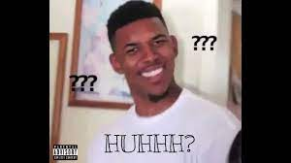
2 Corinthians 3:7-11
…the ministry that brought death. Huhhh????
What is this ministry?

Slide 25
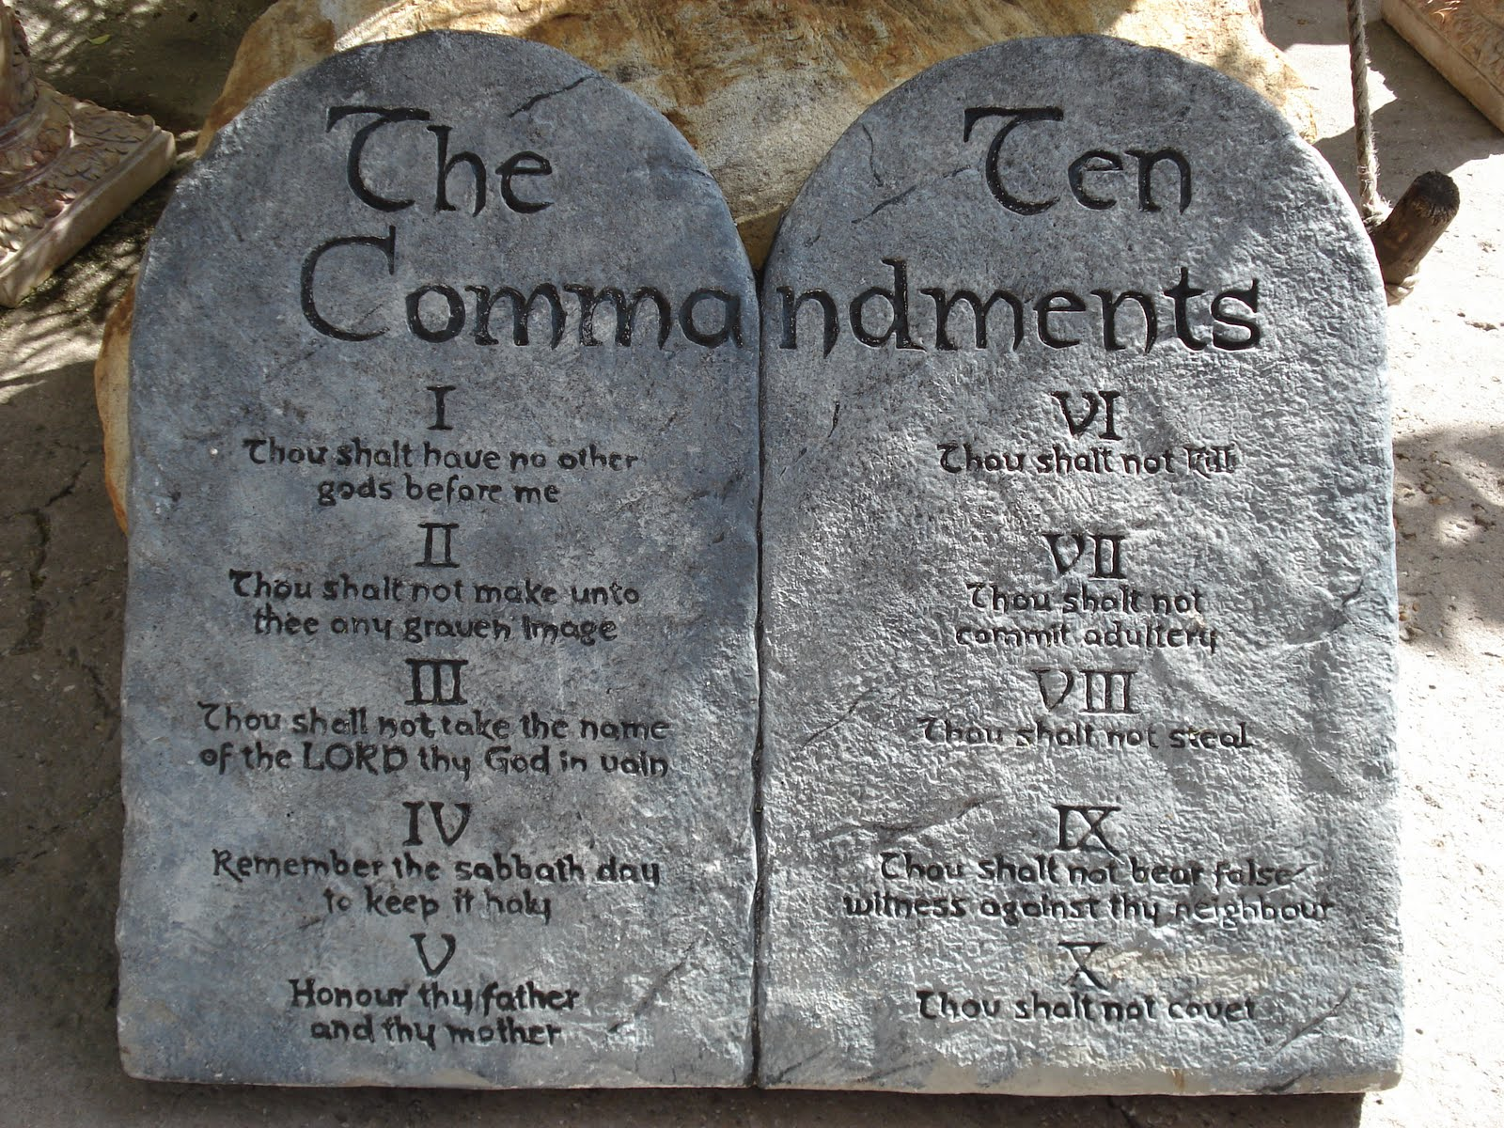
The Ministry That Brought Death
v. 9 that brought condemnation.
Romans 7:13, Romans 5:20.
v. 7 “engraved in letters of stone..,”

Slide 26
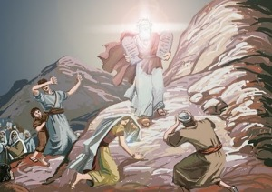
The Ministry That Came With Glory
2 Cor 3:7, 11 transitory glory
fading glory
glory = doxa

Slide 27
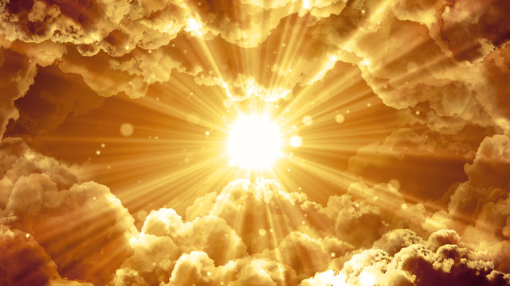
Surpassing Glory
v. 8 The ministry of the Holy Spirit will be even more glorious.
Why glorious?
v. 9 It brings righteousness
v. It lasts… It is not transitory.

Slide 28
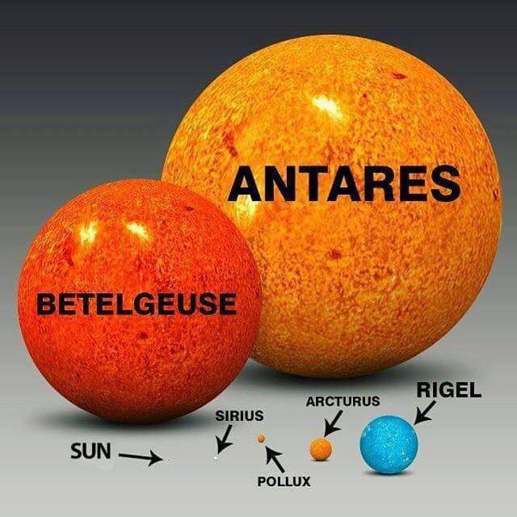
Much Brighter

Slide 29
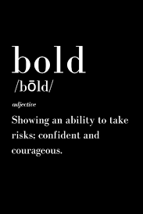
2 Corinthians 3:12-18
Because we have this hope…
The hope of glory!!!
We are very bold.
Q: Are you very bold??

Slide 30
v. 16 TheVeil is Removed!!!
Only in Christ…. Is the veil removed.
How? The Holy Spirit!!!

Slide 31
2 Corinthians 3:16-17
Veil-removal is not the goal!
The goal is glorification!

Slide 32
2 Corinthians 3:18
The goal: Transformation.
Contemplate → Reflect →
Contemplate → Reflect →
Contemplate → Reflect

Slide 33
Discussion Questions
1. Are you confident that God will use you to do great things?
2. Where does this confidence (or lack thereof) come from?
3. What will you do to more confidently contemplate and reflect the glory of God?

Slide 34
2 Corinthians 4 & 5 The Power of Knowing!

Slide 35
2 Cor 4:1-6 We do not lose heart!
Why? Because we have this ministry.
What ministry? Of contemplating and reflecting the glory of Christ.
How?
a. Plainly
b. Commend to everyone’s conscience.

Slide 36
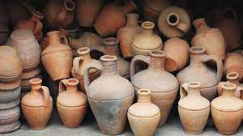
2 Cor 4:7-12 Jars of Clay
Our humanness proves that the power comes from God, not us!
Is the death of Christ working in you? How?

Slide 37
2 Cor 4:13-18 We Speak
v. 13 We speak.
v. 14 Why? Because we KNOW
v. 16 Therefore… (because we know) we do not lose heart.

Slide 38
2 Cor 5:1-10 Confidence!!!
2 Cor 4:14 we know
5:1 we know
5:5 guarantee
5:6 confident
5:6 we know
5:7 we live by faith
5:8 we are confident

Slide 39
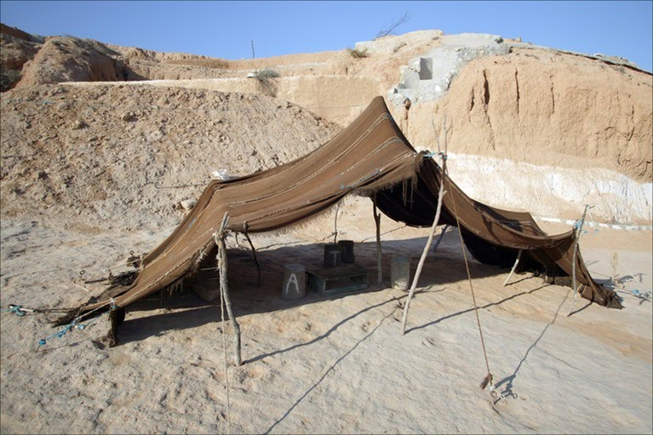
2 Cor 5:1-10 Wait a minute!
2 Cor 4:7 jars of clay
2 Cor 5:1, 4 earthly tent
That sounds weak!
That’s the point!
We have and eternal home in heaven!

Slide 40
Faith in invisible things!
Question: Do you live by faith, not sight?
(Hebrews 11:1)
Therefore… I make it my goal to please him.

Slide 41
2 Cor 5:10-15 Fear
2 Cor 5:10 We will face the judgment seat of Christ.
v. 11 Because we know what it means to fear God… We persuade people.
Wait a minute! I thought we were confident!
Our fear is for the souls of others, not ourselves.
That is why we persuade people!!!

Slide 42
2 Cor 5:13 Paul: You are out of your mind!
Why?
Because Paul was convinced…
Christ’s love compelled him

Slide 43
Discussion Questions
1. Is the death of Christ at work in you? How?
2. Are you confident? Do you know?
3. Do you believe: Have you been speaking?
4. Would anyone accuse you of being just a bit crazy for Christ?

