Slide 1
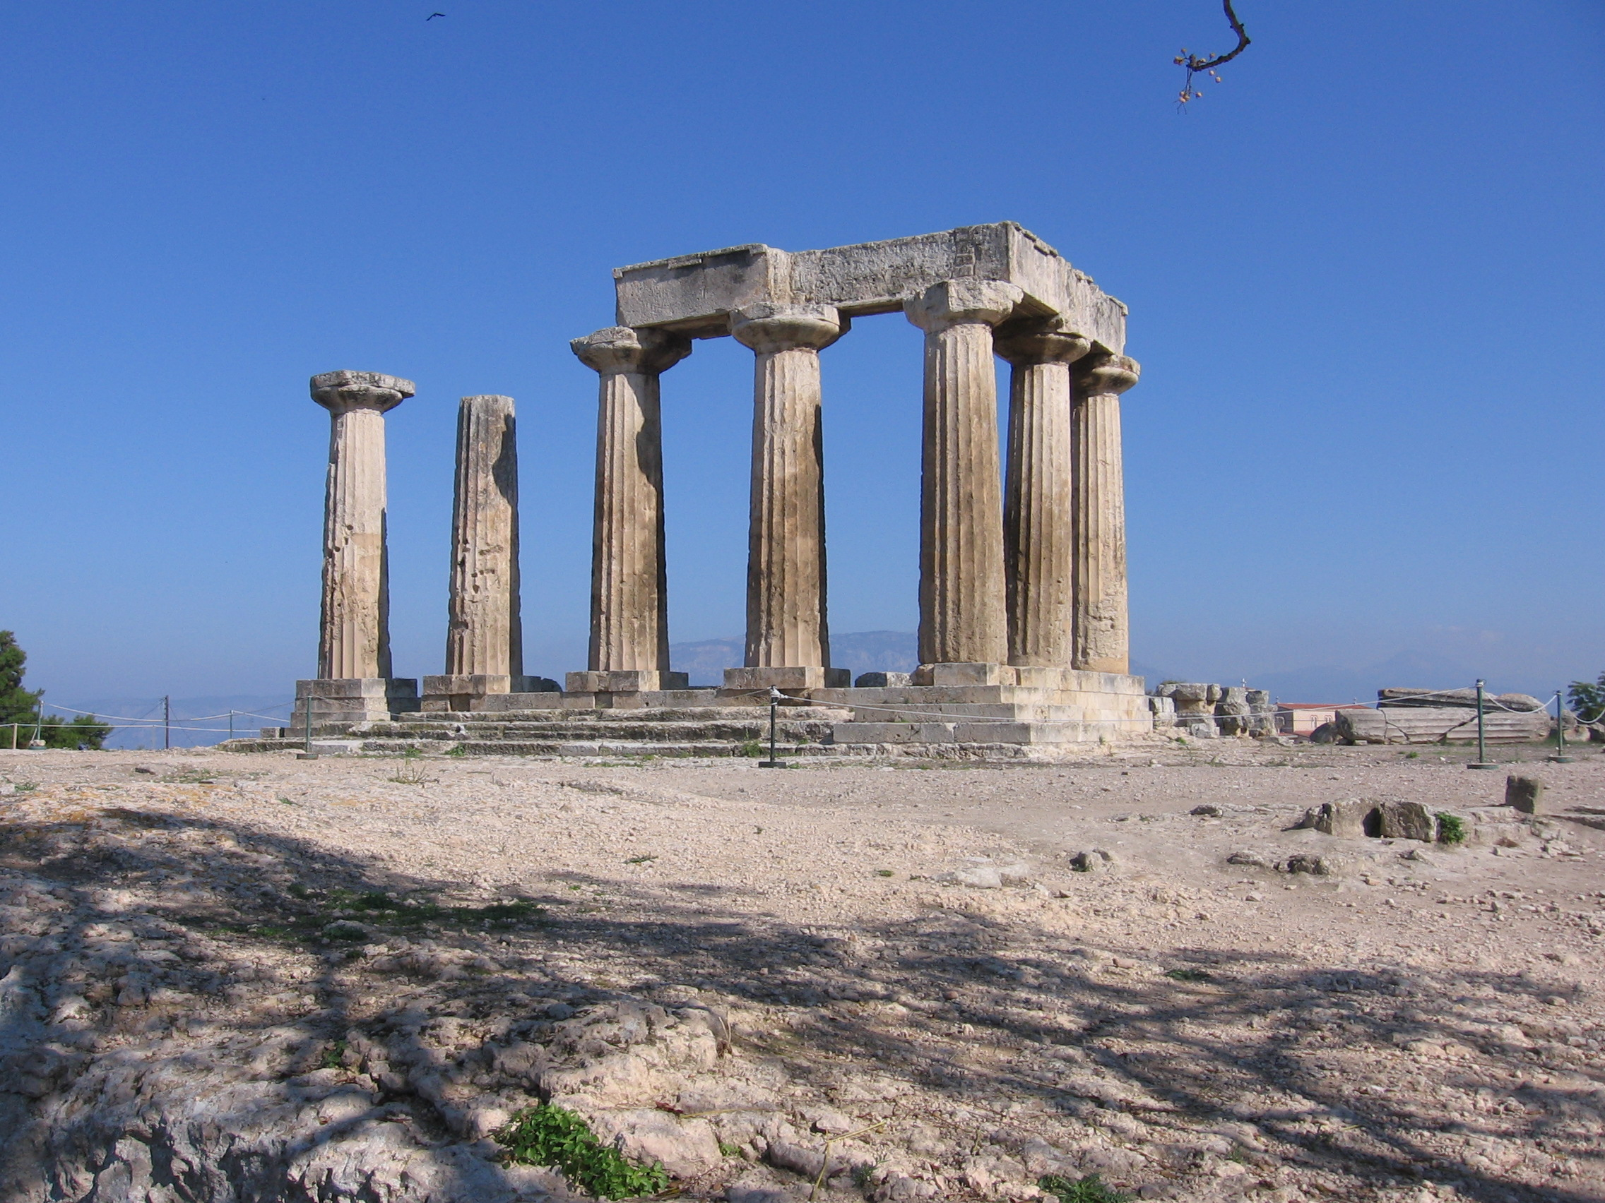
2nd Corinthians
Uc merced
Winter, 2024

Slide 4
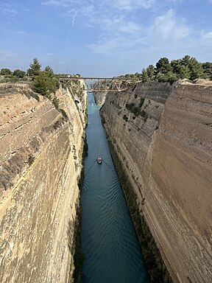
Corinth Canal

Slide 5
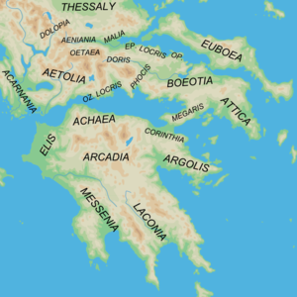
Isthmus of Corinth

Slide 6
Background in Corinth
Roman city
Very prosperous and wealthy
Very worldly Much pagan worship

Slide 7
Background in the church in Corinth
1 Corinthians:
Divisiveness
Sexual immorality
Pagan worship tolerated
Lawsuits among believers
Chaos in worship, abuse of Lord’s Supper
Doubts about the resurrection!

Slide 8
Context of 2 Corinthians
“Painful visit” of AD 56
“Severe Letter of AD 57
Some repentance (2 Cor 7)
Paul’s last visit in AD 57/58
Presence of Judaizing “super-apostles”

Slide 9
Purpose of 2 Corinthians
I. To defend Paul’s apostolic authority
II. To oppose the influence of the Judaizing “super-apostles”
III. To explain and defend Paul’s New Covenant ministry

Slide 10
Outline of 2 Corinthians
Outline of 2 Corinthians:
I. 1:1-2:13 Introduction and defense of Paul’s apostolic ministry
II. 2:14-7:4 Paul explains his ministry of the New Covenant.
III. 7:5-9:15 Titus brings news from Corinth. Paul’s response. Collection for the Jerusalem Church.
IV. 10:1-13:14 Paul defends his ministry and prepares the Corinthians for his 3rd visit.

Slide 11
2 Cor 1:1-7 Comfort
Suffering ↔ Comfort
Comfort 9 times!
Where does your comfort come from?

Slide 12
2 Corinthians 1:8-11
Paul: I despaired of life! But…
But now I am happy… I have learned to rely on God.
Q: Do you want to learn to rely on God? Are you sure?

Slide 13
2 Corinthians 1:12-2:4
Paul explains his plans
I am not being fickle!
I had my reasons—I did not want to hurt you.
My yes is yes!

Slide 14
2 Corinthians 2:5-11 Restore the Brother
Church discipline/disfellowship
Purpose: to protect the purity of the church and to restore the offender to faith
Paul: v. 7 Forgive and comfort him.
v. 8 Reaffirm your love for him.
Do not give Satan a foothold. We know his schemes

Slide 15
2 Corinthians 2:14-17 The Aroma of Christ
Christians are part of a triumphal procession
We spread the aroma of Christ.
Death to some.
Life to others.

Slide 16
Triumphal Procession

Slide 19
Discussion Questions
How has God comforted you?
How will you learn to rely on God? (trials?)
How have/will you spread the aroma of Christ?

Slide 20
2 Cor 2:14-17 (cont.)
Q: What do you smell like? What aroma are you putting out?
v. 16 A rhetorical question: Who is adequate?
v. 17 The super-apostles think that they are adequate to the task. That is the problem!

Slide 21
2 Cor 3:1-6
The super-apostles: Paul, where are your letters of reference?
Paul: You Corinthians ARE my letter of recommendation!
Written on the tablets of hearts, not on stone (Law, Moses)

Slide 22
Confidence!
2 Cor 2:16 Paul: Who is competent/equal to the task?
2 Cor 3:4 Paul: We are confident!
I am confused!
Q: Are you confident?
Q: Where does your confidence/competence come from?

Slide 23
Confidence!
2 Cor 3:5 Our competence comes from God.
The theme of 2 Cor 2:14-7:4
“He has made us competent as ministers of the New Covenant… by the Holy Spirit.

Slide 24
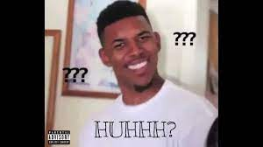
2 Corinthians 3:7-11
…the ministry that brought death. Huhhh????
What is this ministry?

Slide 25
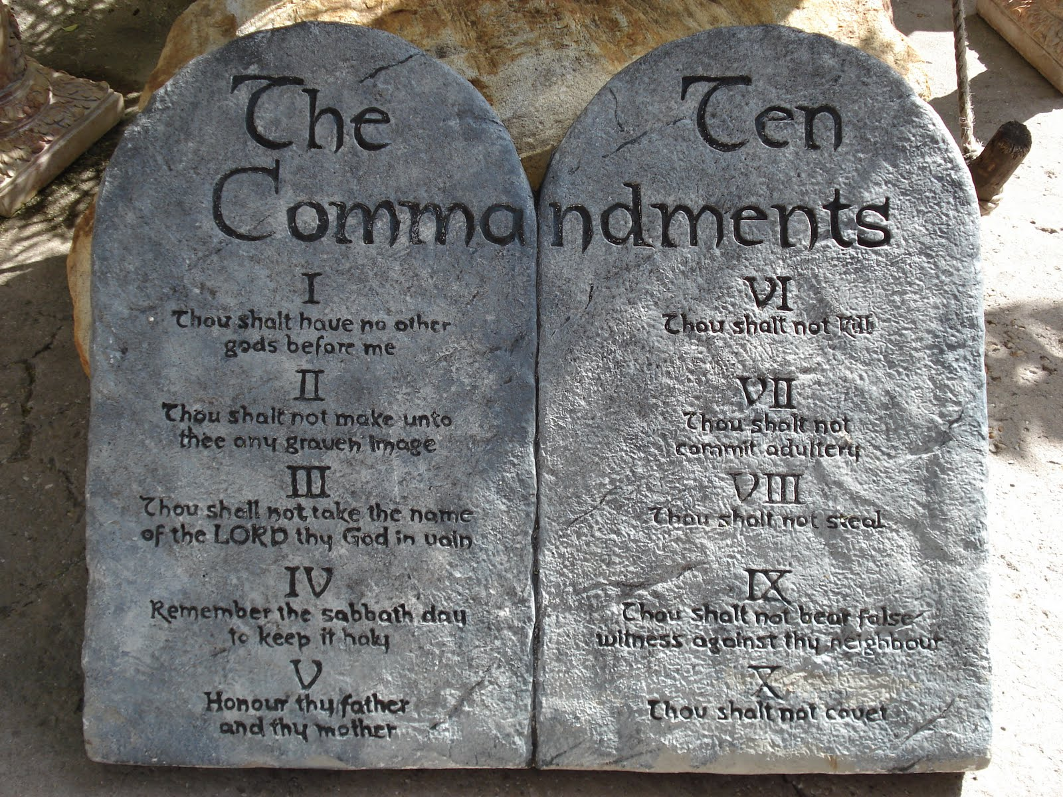
The Ministry That Brought Death
v. 9 that brought condemnation.
Romans 7:13, Romans 5:20.
v. 7 “engraved in letters of stone..,”

Slide 26
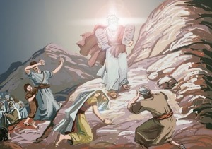
The Ministry That Came With Glory
2 Cor 3:7, 11 transitory glory
fading glory
glory = doxa

Slide 27
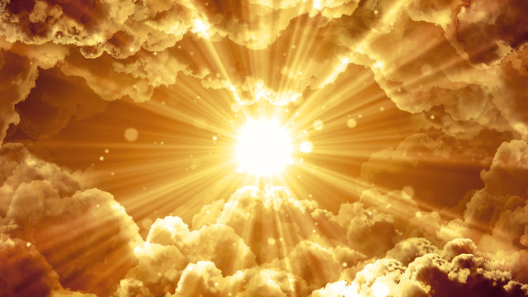
Surpassing Glory
v. 8 The ministry of the Holy Spirit will be even more glorious.
Why glorious?
v. 9 It brings righteousness
v. It lasts… It is not transitory.

Slide 28
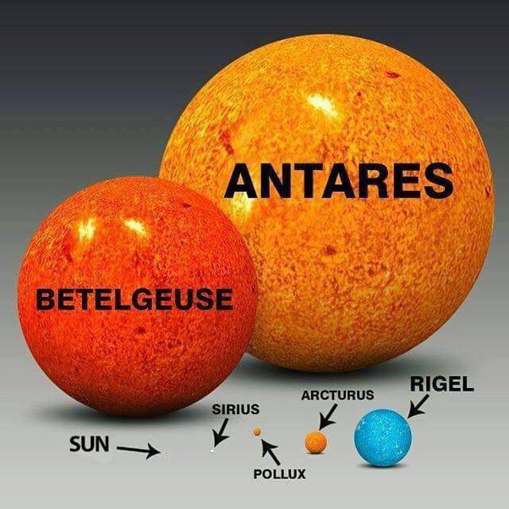
Much Brighter

Slide 29
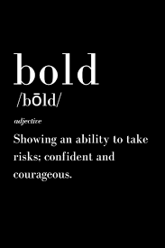
2 Corinthians 3:12-18
Because we have this hope…
The hope of glory!!!
We are very bold.
Q: Are you very bold??

Slide 30
v. 16 TheVeil is Removed!!!
Only in Christ…. Is the veil removed.
How? The Holy Spirit!!!

Slide 31
2 Corinthians 3:16-17
Veil-removal is not the goal!
The goal is glorification!

Slide 32
2 Corinthians 3:18
The goal: Transformation.
Contemplate → Reflect →
Contemplate → Reflect →
Contemplate → Reflect

Slide 33
Discussion Questions
1. Are you confident that God will use you to do great things?
2. Where does this confidence (or lack thereof) come from?
3. What will you do to more confidently contemplate and reflect the glory of God?

Slide 34
2 Corinthians 4 & 5 The Power of Knowing!

Slide 35
2 Cor 4:1-6 We do not lose heart!
Why? Because we have this ministry.
What ministry? Of contemplating and reflecting the glory of Christ.
How?
a. Plainly
b. Commend to everyone’s conscience.

Slide 36
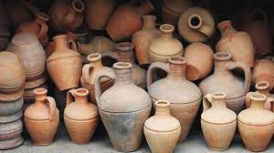
2 Cor 4:7-12 Jars of Clay
Our humanness proves that the power comes from God, not us!
Is the death of Christ working in you? How?

Slide 37
2 Cor 4:13-18 We Speak
v. 13 We speak.
v. 14 Why? Because we KNOW
v. 16 Therefore… (because we know) we do not lose heart.

Slide 38
2 Cor 5:1-10 Confidence!!!
2 Cor 4:14 we know
5:1 we know
5:5 guarantee
5:6 confident
5:6 we know
5:7 we live by faith
5:8 we are confident

Slide 39
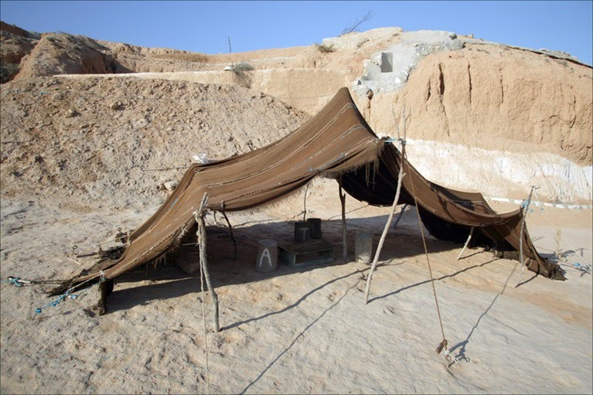
2 Cor 5:1-10 Wait a minute!
2 Cor 4:7 jars of clay
2 Cor 5:1, 4 earthly tent
That sounds weak!
That’s the point!
We have and eternal home in heaven!

Slide 40
Faith in invisible things!
Question: Do you live by faith, not sight?
(Hebrews 11:1)
Therefore… I make it my goal to please him.

Slide 41
Discussion Questions
1. Is the death of Christ at work in you? How?
2. Are you confident? Do you know?
3. Do you believe: Have you been speaking?

Slide 42
2 Cor 5:10-15 Fear
2 Cor 5:10 We will face the judgment seat of Christ.
v. 11 Because we know what it means to fear God… We persuade people.
Wait a minute! I thought we were confident!
Our fear is for the souls of others, not ourselves.
That is why we persuade people!!!

Slide 44
2 Cor 5:13 Paul: You are out of your mind!
Why did they say that? Because Paul persuaded people.
Why was he “out of his mind?”
2 Cor 5:14 Christ’s love compelled him
Paul was convinced…

Slide 45
Compelled!
1. To persuade people. (2 Cor 5:11)
2. To commend himself to everyone’s conscience. (2 Cor 4:2)
3. To speak. (2 Cor 4:13)

Slide 46
2 Corinthians 5:16-21 Ministers of Reconciliation.
In Christ….
1. A new creation.
2. A minister of reconciliation
Minister = give aid or service to

Slide 47
In Christ, you are a minister!
…so what is my ministry?
Reconciliation.
Bringing people estranged from God into a saved relationship with him.

Slide 48
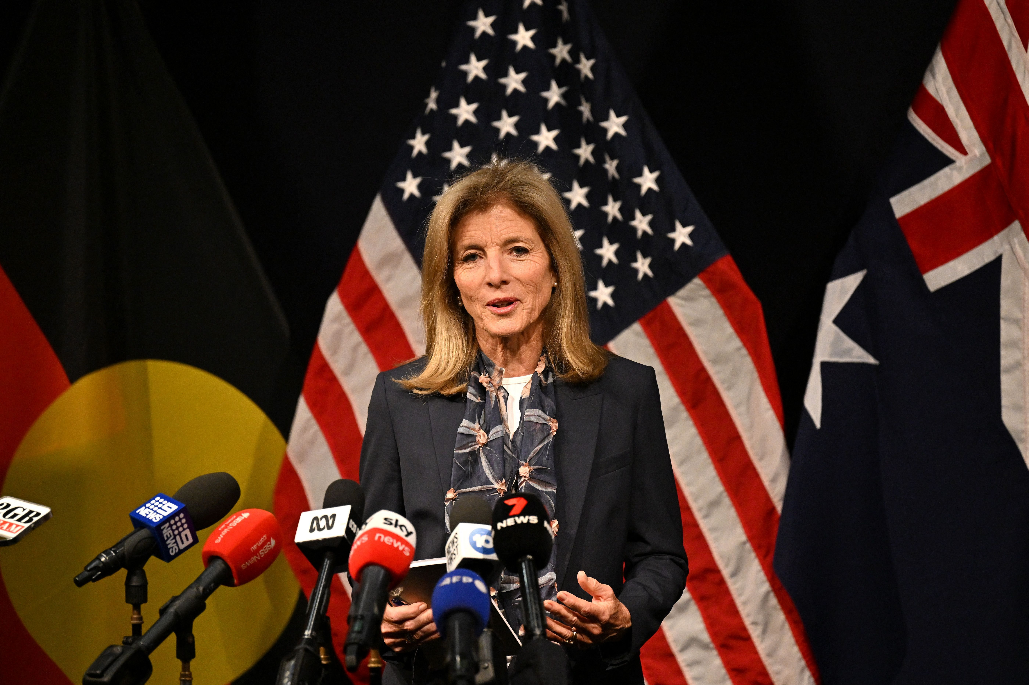
Ambassadors!
What does an ambassador do?
God is making his appeal through us!!!!!!!!!!!!!
A Priviledge
A Responsibility

Slide 49
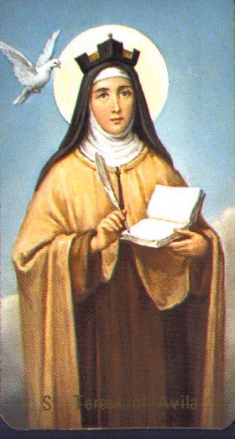
Theresa of Avila
Christ has no body but yours.
No hands, no feet on earth but yours.
Yours are the eyes with which he looks with compassion on the world.
Yours are the feet with which he walks to do good.
Yours are the hands with which he blesses the world.
Yours are the hands, yours are the feet, yours are the eyes, you are his body.

Slide 50
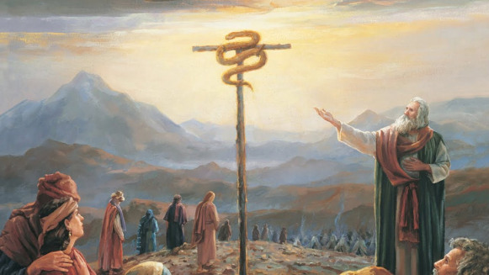
2 Cor 5:21 Jesus became sin for us
Because Jesus “knew” no sin.
He is able to become sin for us.
The result: Righteousness!!!

Slide 51
2 Cor 6:1-2 NOW!!!!!
Now is the best time to be reconciled to God.
Now is the time to make Jesus Lord, to repent and to be bapized into Christ.

Slide 52
Discussion Questions
1. Would anyone accuse you of being just a bit crazy for Christ?
2. Have you been persuading people for Christ?
3. How is your “ministry” of reconciliation going? How can you be a better ambassador?

Slide 53
2 Corinthians Class #5 Godly Sorrow Leads to Repetance
Review: Because we have this ministry, we are being transformed, we are confident…
We are very bold, we appeal to everyone’s conscience…
Because “God made him who knew no sin to be sin for us…
Now is the day of salvation.

Slide 54
2 Cor 6:3-13 Paul’s Resume
Endurance, hardships, beatings, imprisonments, hard work, sleepless nights, beaten, sorrowful, poor
Purity, patience, kindness, sincere love, honest speech
Dishonor, bad report, labeled an imposter, regarded as unknown.

Slide 55
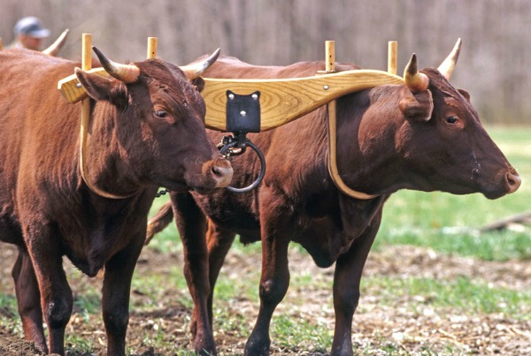
2 Cor 6:14-7:1 Come Out From Them!
Do not be yoked with unbelievers: a principle
Meaning? Do not be too closely joined with those who will draw you away from your devotion to God.
Application: Business partnerships, employment, dating, marriage

Slide 56
2 Cor 7:8-13 Godly Sorrow Brings Repentance
Is Paul sorry?
Are you a conflict-avoider?
Two kinds of repentance:
Repentance which leads to salvation.
Repentance in the daily lives of believers.

Slide 57
Wordly Sorrow Leads to Death
Guilt feelings
Shallow remorse
Shame
Lack of conviction
Lack of observable action
Trying to avoid the consequences
Sad you got caught

Slide 58
Godly Sorrow
earnestness (diligence, seriousness)
eagerness to clear yourself (come into the light
indignation (anger)
Alarm (fear)

Slide 59
Godly Sorrow
longing (deep desire to be restored)
concern (zeal)
readiness to see justice done (embracing consequences)

Slide 60
Repentance: The Result:
Acts 3:19 Repent, then, and turn to God, so that your sins will be wiped out and times of refreshing will come from the Lord!

Slide 61
Discussion Questions:
1. What has been in your life recently for which repentance is needed?
2. What have you done/will you do about this? Earnest? Come into the light? Angry about your sin? Fearful of long-term consequences? Wanting to be right with God? Zeal? Embracing consequences?

Slide 62
2 Corinthians Class #6 Generosity
2 Cor 8:1-7
Context: Paul is raising money for the church in Jerusalem.
They gave them selves, first to the Lord, then to us. What does that mean?
Do you “excel in the grace of giving?”

Slide 63
2 Cor 8:8-9
Jesus “made himself poor” for our sake
Ex: Phil 2:6
What are some other areas of generosity, other than the giving of money (which Jesus did not do!)

Slide 64
2 Cor 8:10-15
The key word here is equality.
2 Cor 8:16-24 What are some areas in which we need to do what is right to the world that God does not care all that much about?
Why is this important?

Slide 65
2 Cor 9:1-5
Two principles:
1. More generosity results in more blessings.
2. God does not want us to give reluctantly but cheerfully.

Slide 66
2 Cor 9:10-15
You will be “enriched in every way” if you are generous toward God.
What are some of these ways?

Slide 67
2 Cor 10:4-6
Weapons of the world:
Intimidation, witholding affection, threats, outbursts of anger, emotional intimidation, use of power
Our weapons:
Truth, sincerity, open admonishment, rational argument, being right
How to “take captive every thought?”

Slide 68
Discussion Questions
1. Share an example of generosity that you have seen—not necessarily related to money.
2. In what area of being generous would you like to grow (It can be in the area of money!)

Slide 69
Welcome!

Slide 71
Announcements
Josh Brummett baptized!

Slide 72
Announcements
Campus Spring Retreat: The Light of the World
Posey, CA March 22-24. Deadline to register: tonight!
www.aocampus.com

Slide 76
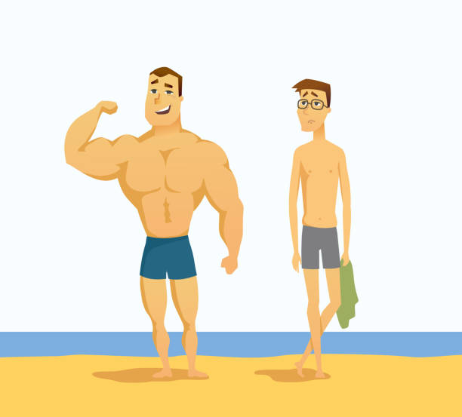
Class #7 2 Cor 10-12 When I Am Weak, Then I Am Strong
2 Cor 10:3-6
Our weapons are not the weapons of the world.

Slide 77
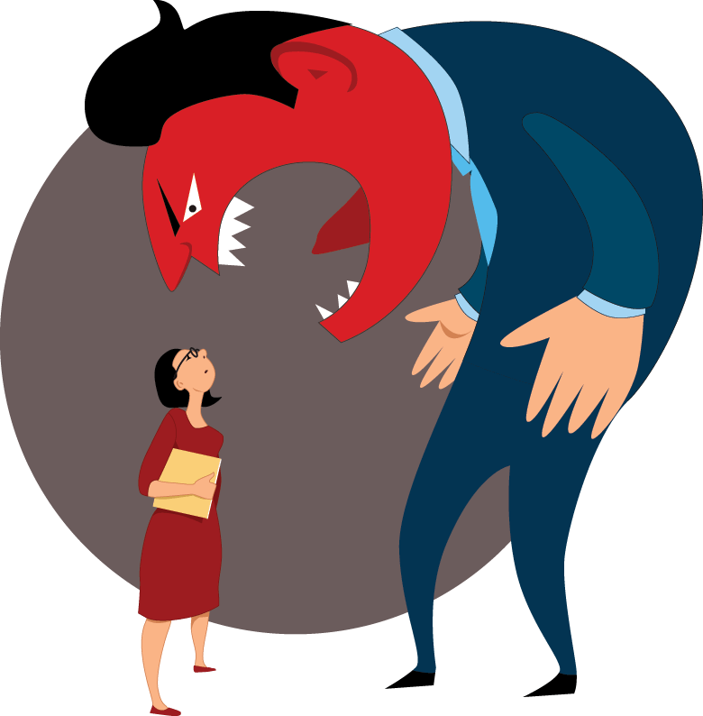
Worldly Weapons
Intimidation
Witholding affection
Threats
Outbursts of anger
Emotional manipulation
Stronger vs Weaker
Politics

Slide 78
Christian “Weapons”
Truth
Sincerity
Open rebuke
Rational argument
Honesty
Being right
Humility

Slide 79
We take captive every thought
Exposing misleading arguments
Encouraging sound reasoning
Asking good questions
Applying Scripture
2 Cor 10:17 “Let him who boasts, boast in the Lord.”

Slide 80
2 Cor 11:21-29
Paul is “boasting” in order to defend his apostolic authority.
2 Cor 12:11 I am not the least inferior to those “super apostles.”
2 Cor 11:30-32 Paul is boasting about his weaknesses, not his strengths (which are many, by the way!)

Slide 81
2 Cor 12:1-7
Who is this man he is talking about?
The “third heaven.”
Heaven #1 = the sky
Heaven #2 = the universe outside the earth
Heaven #3 = heaven: where God is.

Slide 82
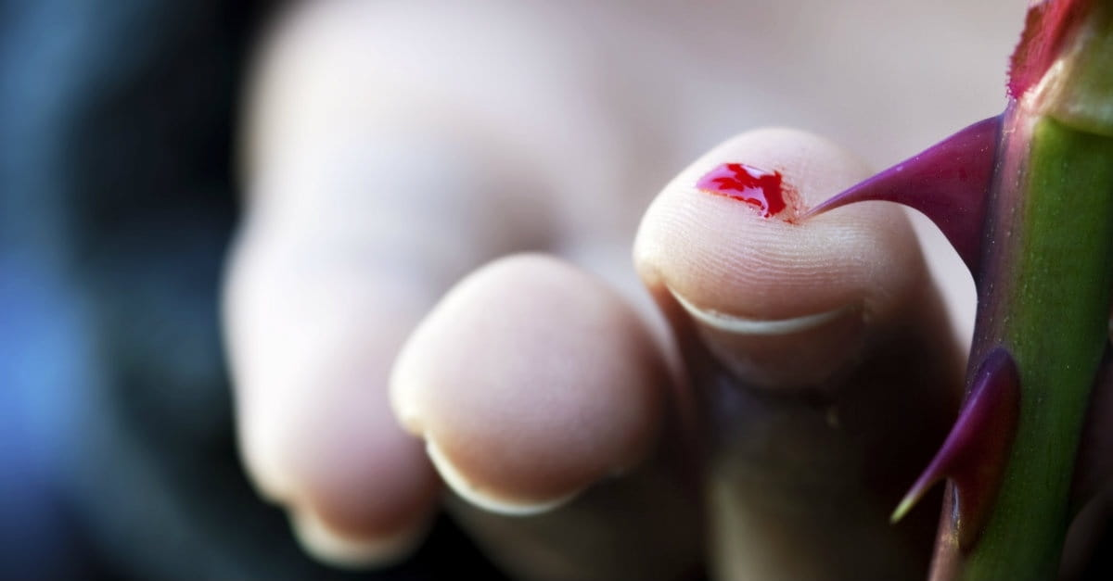
2 Cor 12:7-8 A thorn in the flesh
Paul to God: Please take away this limitation to my ministry.
God to Paul: No! I prefer you to be weak.

Slide 83
2 Cor 12:9-10
My power is made perfect (complete, mature) in weakness.
Paul “boasts” in his weakness.
Q: What are your strengths?
Q: What are your weaknesses?

Slide 84
2 Cor 12:10
When I am weak, then I am strong.
Paul: I delight in weaknesses and hardships.
Me: You are crazy, Paul!
Are you here to glorify God or to glorify yourself?

Slide 85
Discussion Questions
1. What are your strengths?
2. What are your weaknesses?
3. How can God use you through/despite your weaknesses?

Slide 86
Epilogue: 2 Cor 13:5
Examine yourselves to see if you are in the faith.
1. Romans 1:5 Faith implies obedience.
2. 1 Thess 1:3, James 2:26 Faith implies works.
3. Gal 5:6 Faith implies love.
The ultimate test of faith is this kind of love.

